Slide 2
Main Menu
01
About Alibaba Group and Alibaba.com
02
E-com Opportunities in the World and in Pakistan
03
Making the 1st Step with Alibaba.com
04
Alpharex International Awards And Achievements

Slide 3
About Alibaba Group and Alibaba.com
First Session
Notes:
The Alibaba Group was founded in 1999 by 18 people, led by Jack Ma, a former English teacher from Hangzhou, China. Our founders started our company to champion small businesses. They believed that the internet would level the playing field by enabling small enterprises to leverage innovation and technology to grow and compete more effectively in domestic and global economies.
Alibaba.com was founded in 1999, it is Alibaba Group's first business sector which has become the world's leading cross-border trade B2B e-commerce platform.

Slide 4
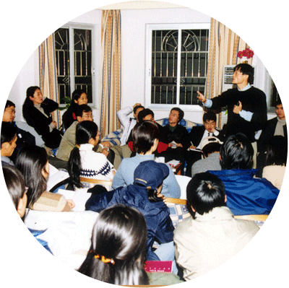
Alibaba Group: One of the world’s largest online and mobile retail commerce company in the world
One of the largest online and mobile commerce company in the world
Started in
Nearly 960 million consumers shop on our platforms
1999
18
Founders based in Jack Ma’s apartment
With more than ten million small businesses and
US$ 1trillion
180,000+
Our mission
To make it easy to do business anywhere
GMV*
brands currently active on Alibaba platforms
* GMV – Gross Merchandise Volume

Slide 5
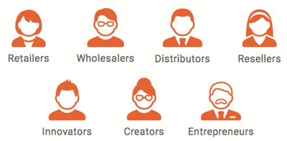
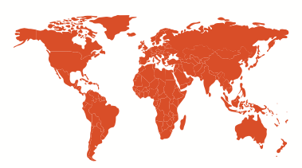
Alibaba.com: A world-leading B2B e-Commerce marketplace
Over 20 million
active buyers
More than 150,000
global suppliers
More than 190
countries and regions
Over 340,000
daily inquiries
Notes:
(1) In the 12 months ended March 31, 2020, over 20 million buyers from approximately 190 countries had sourced business opportunities or completed transactions on Alibaba.com
Notes:
插入视频

Slide 6
TOP 10 Active Buyer Distribution in Alibaba.com
An enormous pool of qualified global buyers
United States
India
UK
Australia
Canada
Russia
Mexico
Brazil
Germany
France
Top 10 countries
Source: According to the number of active buyers sending inquiries on Alibaba.com

Slide 7
E-com Opportunities in the World and in Pakistan
Second Session

Slide 8
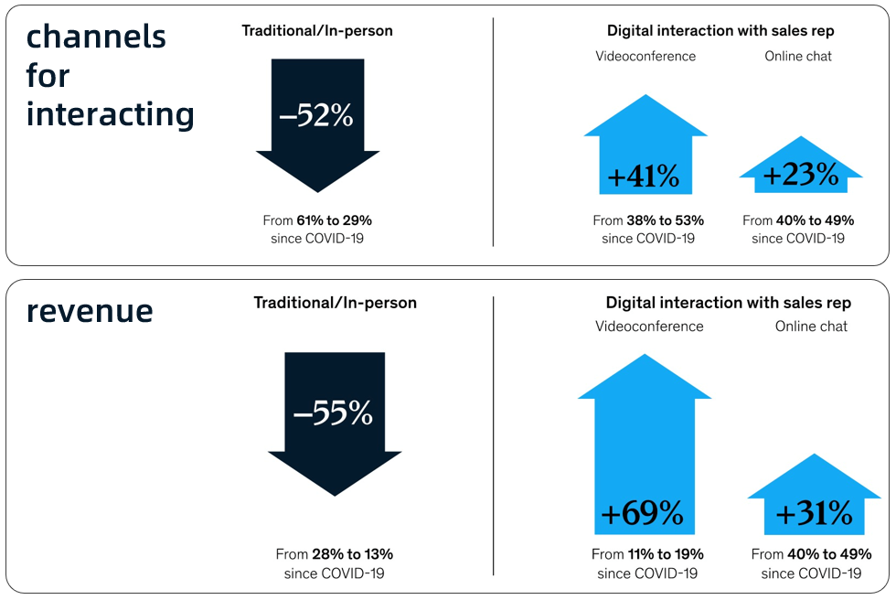
Global trends: The world is going more digital after COVID-19
Global Selling/Buying
Go-to-market sales model during COVID-19
Behavior
39%
Remote sales
Live streaming
Online tradeshow
Real-time live chat
Company video
Product video
of manufacturers already have an e-Commerce site
29%
of small businesses sell online
>90%
of B2B buyers make orders using their mobile phones
Data source: McKinsey

Slide 9
Alibaba.com: Global Business Growth in the past three years
160%
50%
65%
160%
active buyers
paying buyers
GMV
65%
50%
March 2018
March 2019
March 2020
March 2018
March 2019
March 2020
March 2018
March 2019
March 2020

Slide 10
Comparison of Export Ecommerce Marketplace in Pakistan
Alibaba.com
Indianmart
Tradekey
Visitor Traffic
14000
Currently Alibaba.com has more than 142M visits per month
Compare to 0.4M in Tradekey, and 69M in Indiamart
13000
12000
11000
4.6
Visiting Time-length
9000
4.5
7000
4.4
Staying time for Alibaba.com in average is 268s per visit;
Compare to 197s in Tradekey, 252s in Indiamart
5000
4.3
3000
4.2
1000
4.1
Depth of Visiting
0
The Visit depth of Alibaba.com in average is 4.3 pages per visit;
Compare to 4.15 pages in Tradekey, and 4.25 pages in Indiamart
Visitor Traffic
Depth of Visiting
Visitor Traffic
Depth of Visiting
Visitor Traffic
Depth of Visiting
Visiting Time Length
Visiting Time Length
Visiting Time Length

Slide 11
Popular Products from Pakistan
Apparel
Surgical instruments
Sports Goods
Pink Himalayan salt
Agricultural Products
Leather Products

Slide 12
Third Session
Making the 1st Step with Alibaba.com

Slide 13
Gold Supplier-Alibaba.com Premium Membership to expand your global biz
What is a Gold Supplier?
A Gold Supplier is Alibaba.com's highest and most premium membership.
It helps maximize a company's exposure and business opportunities.
As a Gold Supplier, suppliers are able yield more inquiries than a free member
Gold Supplier membership also benefits businesses by providing easy-to-use online tools, exclusive training, and customer
support, making it an opportunity to meet millions of buyers worldwide.

Slide 14
Gold Supplier Benefit
1. Onboarding service
Customized mini-site
Business Verification (BV)
2. More business opportunities
Unlimited product listings
Product Showcase
3. Business negotiation
Inquiries
Request for Quotations (RFQs)
4. Effective business tools
Sub-accounts
Real-time performance analysis

Slide 15
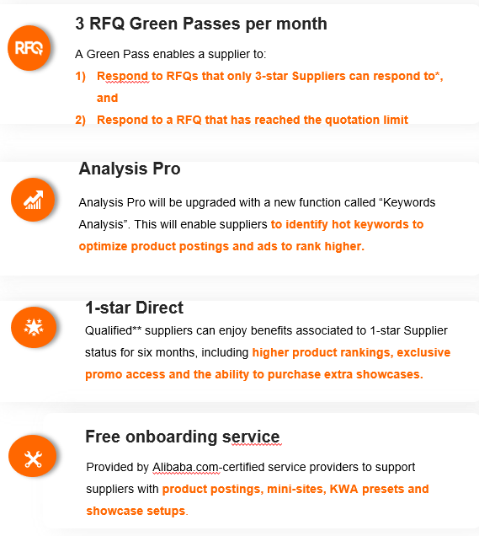
New GGS Package and Price Offer-Pakistan
Additional benefits for GGS Plus members
FY22 Membership | Basic | Basic Plus | Basic Pro | Standard | Premium
Price | $1,399 /Year | $1,999 /Year | $2,499 /Year | $3,499 /Year | $4,999 /Year
Showcase Products | 5 | 20 | 20 | 20 | 20
Request to Quotation | 20 | 60 +3 Green Pass | 60 +3 Green Pass | 60 +6 Green Pass | 60 + 9 Green Pass
KWA ad spend | x | X | USD 500 | USD 1500+150 | USD3000+500
Key words Trend | x | √ | √ | √ | √
1-star direct | x | * | * | * | *
VAS Pro* | x | √ | √ | √ | √
Free onboarding service
Provided by Alibaba.com-certified service providers to support suppliers with product postings, mini-sites, KWA presets and showcase setups.

Slide 16
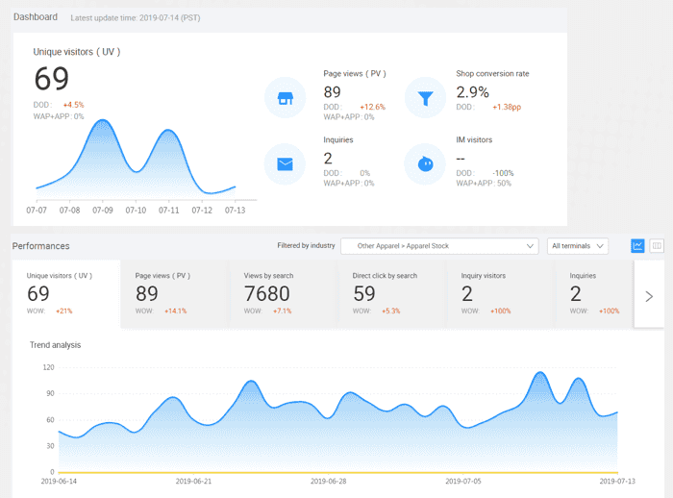
Real-time performance analysis
My Alibaba analytics is a powerful statistical analysis tool because
It shows buyer behavior patterns
It provides business strategy insights
It gives valuable feedback on business performance and operations
It maximizes online exposure and return on investment (ROI)

Slide 17
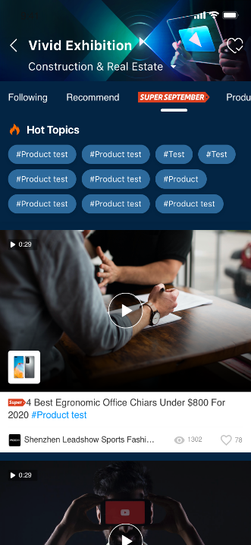
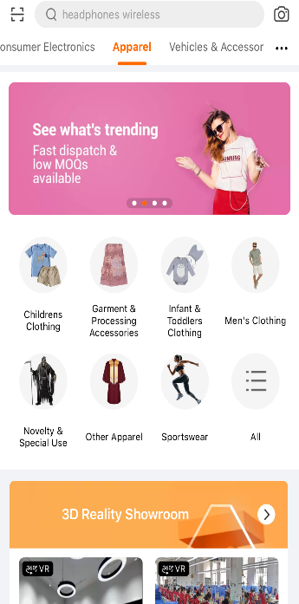
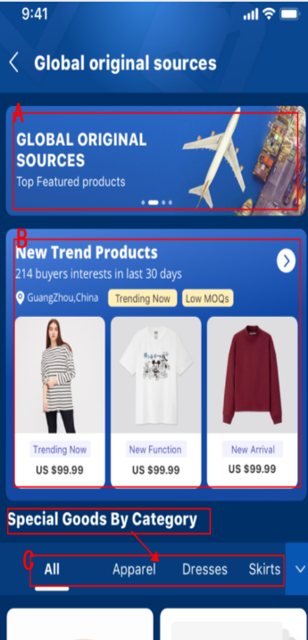
Centralized Scenario Traffic
SUPER SEPTEMBER
MARCH EXPO
Online
Trade Show
True View
Short Video
Category Events
Category
Front Page
Global Industry Hub
Origin of the wall
During SUPER SEPTEMBER of year 2020
128% growth of GMV 133% growth of Transaction Orders 83% growth of Paid Buyers
17

Slide 18
Country Pavilion and global original source for Pakistan
The purpose for this program is help the buyer to find the country origin advantage products and suppliers to help the buyers get the competitive business advantage globally and with the different contents guidance to help them accurate drainage to match the needs of buyers and sellers.
Country Pavilion source and global original source is one of the centralized scenarios and help the buyer and sellers concentrate on the country origin advantage suppliers and products
Entrance of the country pavilion
Entrance of the country pavilion

Slide 19
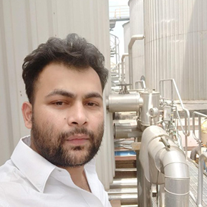
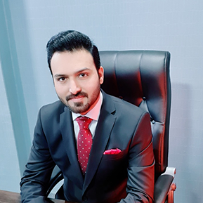
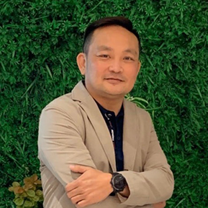
Learn from successful first-year sellers
Alibaba.com is very open to our wholesale business world experience. This allows us to meet with foreign customers from all over the world and help us to have the opportunity to do business together.
We mostly take part in training sessions and have acquired a lot of knowledge. We received our first inquiry within four days and our first order within 15 days afterjoining Alibaba.com.
Thailand
Sahachol Food Supplies
India
Fazlur Rehman Khan
Food & Beverage
Service Equipment
Within 23days got a potential first order of FCL 20ft container, obtained 57 plus valid inquires within 90days, my company is getting 60-70% revenue growth on sales from Alibaba.com.
We joined Alibaba.com in March 2021, and secured our first order in the second month worth USD 15,000 from a buyer in Hong Kong. We also received quality inquiries from Middle East, Indonesia, Singapore and China.
Pakistan
Haider Ali
Malaysia
Mountain Cat Frozen Durian
Gifts & Crafts
Food & Beverage

Slide 20
Alpharex International Achievements
Fourth Session

Slide 21
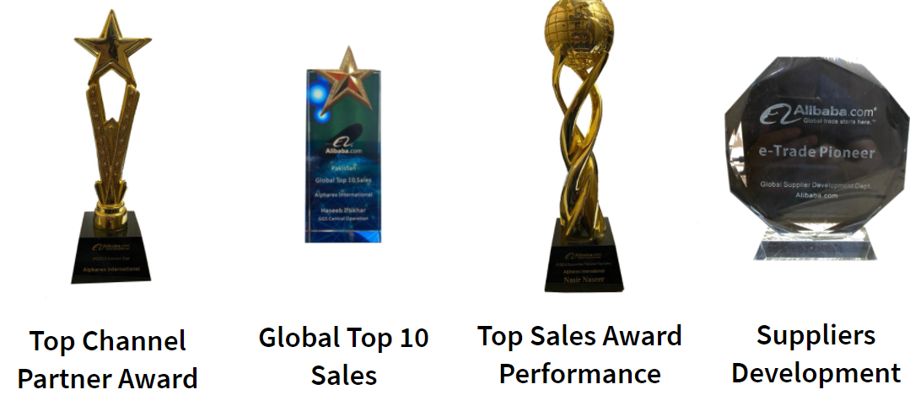
Alpharex International Achievements

Slide 22
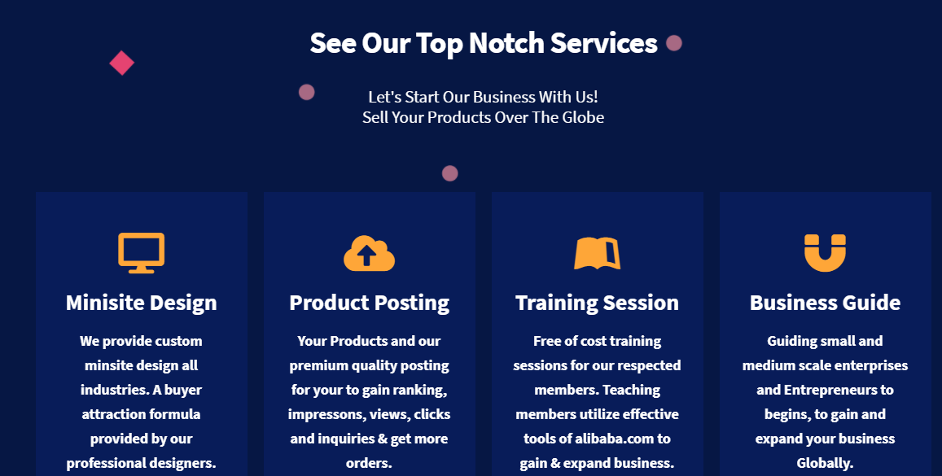

Slide 23
FAQ Time

