Slide 1
Ease of Doing Business

Slide 2
BACKGROUND
Objectives
Facilitate the business community
Improve Doing Business rankings for Pakistan
April 2016 Research/discussions Initiated (with LCCI)
Nov 2016 Endorsed under World Bank’s EoDB Program
January 2018 Launched in Lahore
February 2019 Launched in Karachi
August 2019 – April 2020 Roll out in Punjab

Slide 3
DOING BUSINESS
Out of 11 indicators - Indicators under Provincial domain;
Registering Property
Enforcing Contracts
Dealing with Construction Permits
Starting a Business (partially)
Getting Electricity (partially)
Paying Taxes (partially)

Slide 4
PAKISTAN’S PERFORMANCE (2020)
Indicators | DB 2020 Rank | Distance to Frontier (DTF) 2020 | DB 2019 Rank | Distance to Frontier (DTF) 2019
Overall | 108↑ | 61.0↑ | 136 | 55.31
Starting a Business | 72↑ | 89.3↑ | 130 | 81.89
Dealing with Construction Permits | 112 | 66.5 | 166 ↓ | 53.59 ↓
Getting Electricity | 123 | 64.0 | 167 | 44.75
Registering Property | 151 | 48.6 | 161 ↑ | 45.63 ↑
Getting Credit | 119 | 45.00 | 112 | 45.00
Protecting Minority Investors | 28 | 72.0 | 26 | 71.67
Paying Taxes | 161↑ | 52.9↑ | 173 | 47.05
Trading across Borders | 111 | 68.8 | 142 | 60.12
Enforcing Contracts | 156 | 43.5 | 156 | 43.49
Resolving Insolvency | 58 | 59.0 | 53 | 59.86

Slide 5
STARTING A BUSINESS

Slide 6
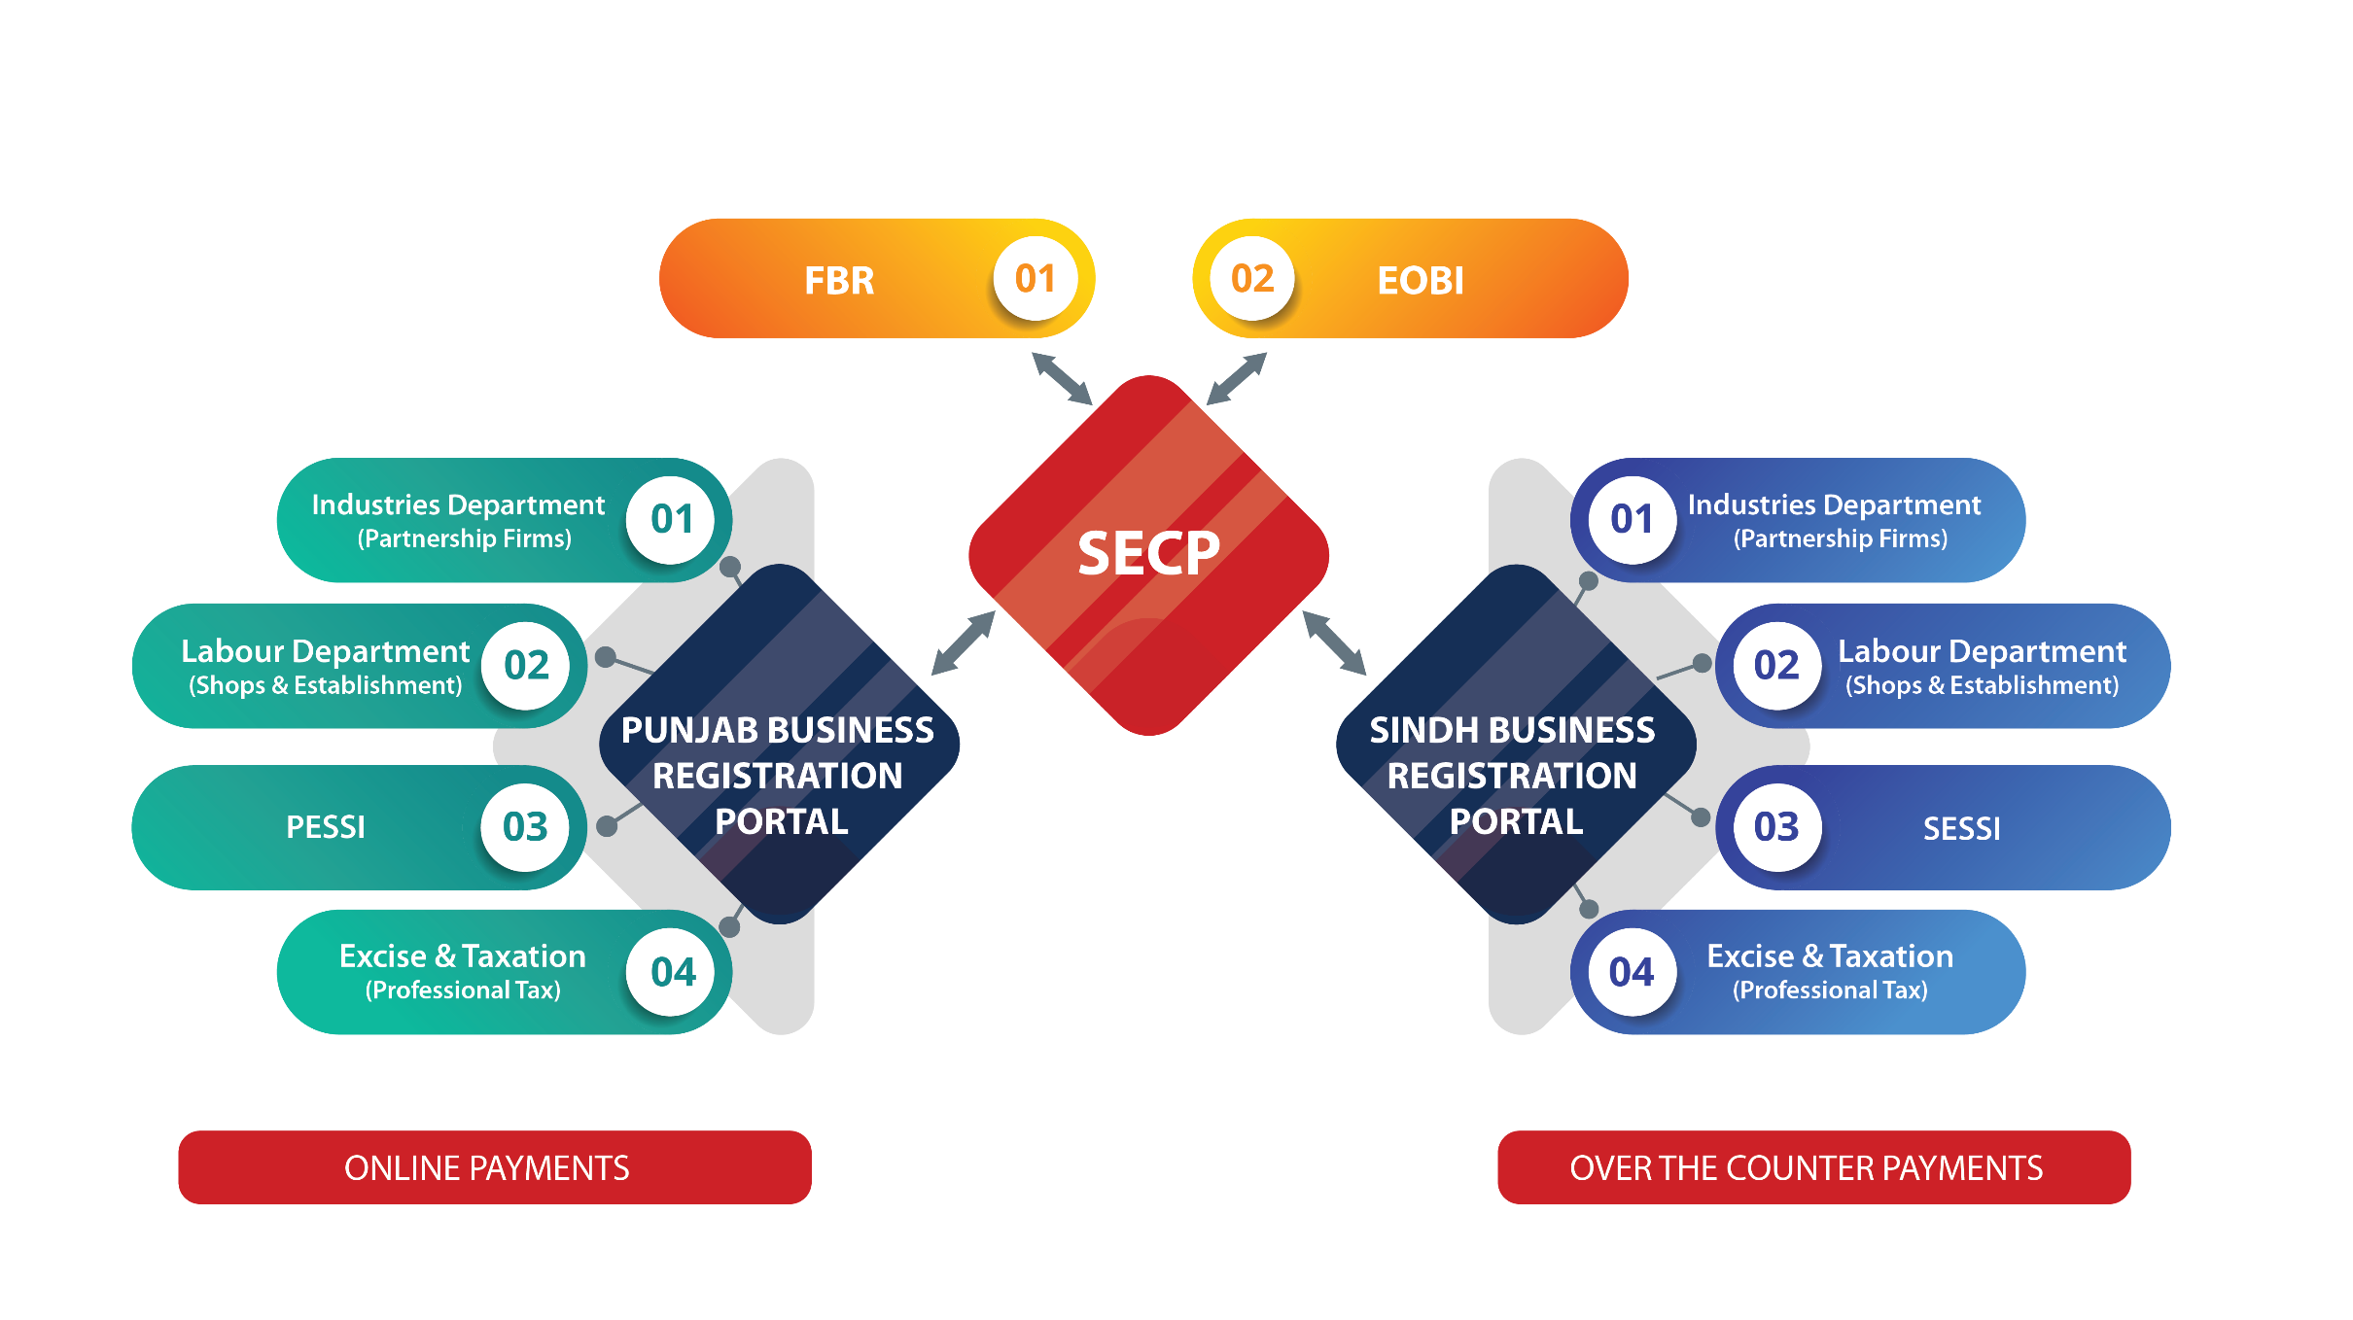
Single Integrated Process to Register a Business
Launched in Punjab
Replicated & Launched in Karachi, Sindh
Notes:
To facilitate citizens in Doing Business and improving Pakistan’s Ease of Doing Business Ranking, Punjab Information Technology Board (PITB) in collaboration with the Industries, Commerce & Investment Department (IC&ID) and The World Bank launched “Punjab Business Registration Portal”
Provides a single platform to business entities enabling them to register with the following provincial departments in one go:
Industries, Commerce & Investment Department (for Partnership Firm)
Labour and Human Resource Department (for Shops & Establishment)
Excise & Taxation Department (for Professional Tax enrollment)
Punjab Employee Social Security Institution
Interlinked with SECP's e-Services which enables to register instantaneously with the concerned provincial departments, while registering a company at SECP, in a single step.
Facilitates in making the payments over the counter or online via mobile app, ATM and/or IBFT
Replicated for Sindh and Sindh Business Registration portal launched

Slide 7
Features
Online single registration platform
Instant certificate issuance
Reduced time, procedures & cost
SMS & E-mail alerts
Improved public satisfaction & reduced public interaction with departments
Integration with federal departments:
SECP (Completed)
FBR (In-process)

Slide 8
Registration Statistics
Punjab | Sindh (Karachi)
PROVINCIAL: 44,890 | PROVINCIAL: 10,596
Partnership Firms: 20,504 (Industries Department) | Partnership Firms: 3,288 (Industries Department)
Shops & Establishment: 21,586 (Labour Department) | Shops & Establishment: 7,096 (Labour Department)
PESSI: 2,799 | SESSI: 212
Professional Tax Enrollment: 1,017 (Excise & Taxation) | Professional Tax Enrollment: 179 (Excise & Taxation)
SECP: 16,108 | SECP: 6,627
Stats as on: 17/02/21
Notes:
Lahore (w.e.f) Aug, 2017
Karachi (w.e.f) Feb, 2019

Slide 9
PAYING TAXES - Monthly Contribution Portal

Slide 10
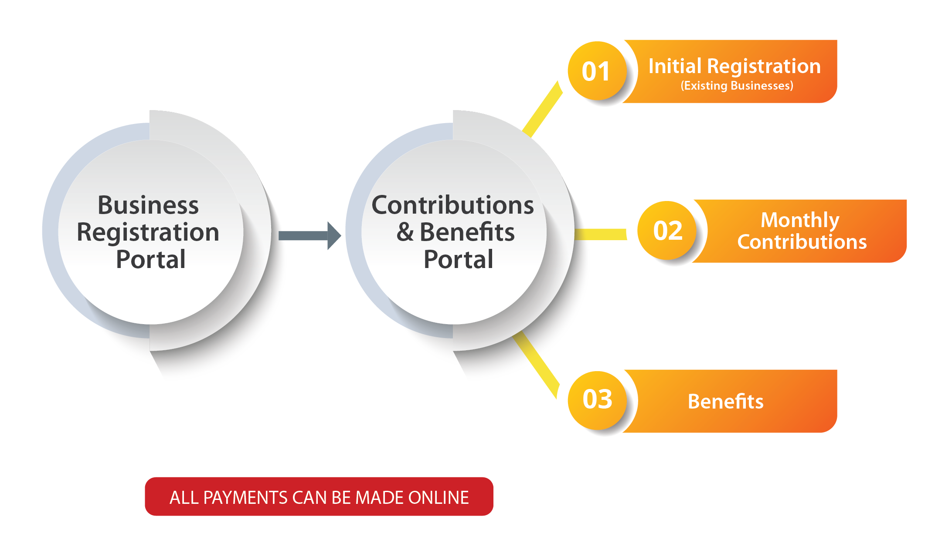
Monthly Contributions for Social Security (PESSI)
Rolled out in Punjab
Replicated for SESSI
Notes:
To facilitate business units in Paying Taxes (Monthly Contributions for Social Security), Punjab Information Technology Board (PITB) in collaboration with PESSI rolled out an online portal in Dec 2018
Enables the business entities to submit their monthly contributions
Provides automatic calculation, tracking of submitted contributions and timely issuance of payment acknowledgment receipts
Payments can be made online or over the counter
Further, enables the business entities to manage the list of their employees, along with their dependent's data
Social Security Registration Card for secured workers is also available online
Replicated for SESSI in Sindh
Details of the beneficiaries will also be maintained in the future

Slide 11
Features
Secured workers data management
Reduced time & effort for submitting the employee’s details & generation of online C1 form
Online submission of Monthly Contributions
Ledger Management
SMS & E-mail alerts
Online generation of F-5 form - Late payment mechanism
E-card facility for secured workers (In-process)

Slide 12
Contribution Statistics
Punjab | Sindh (Karachi)
Active Logins: 27,440 | Active Logins : 13,597
Total Contribution Collected: PKR 13.4 Billion | Total Contribution Collected: PKR 1.9 Billion
Stats as on: 17/02/21
Notes:
w.e.f Dec 2018 (Lahore Only)

Slide 13
Thank You!

Slide 14
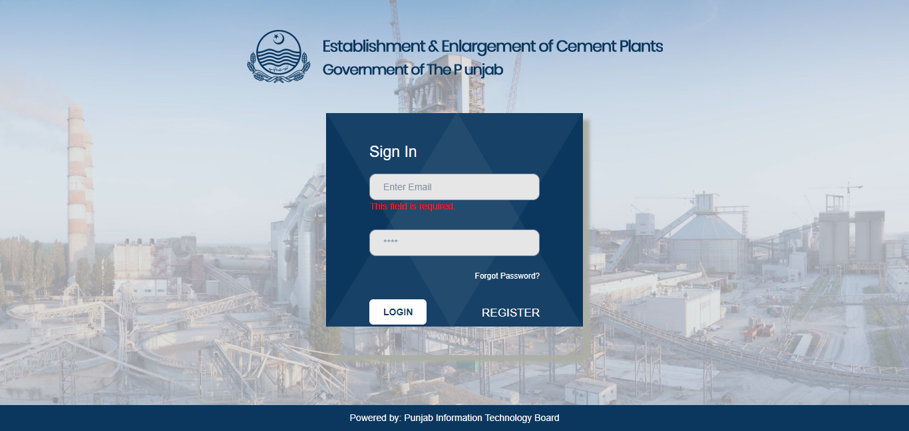
CEMENT PLANTS
One window platform for Establishment/Enlargement of Cement Plants

Slide 15
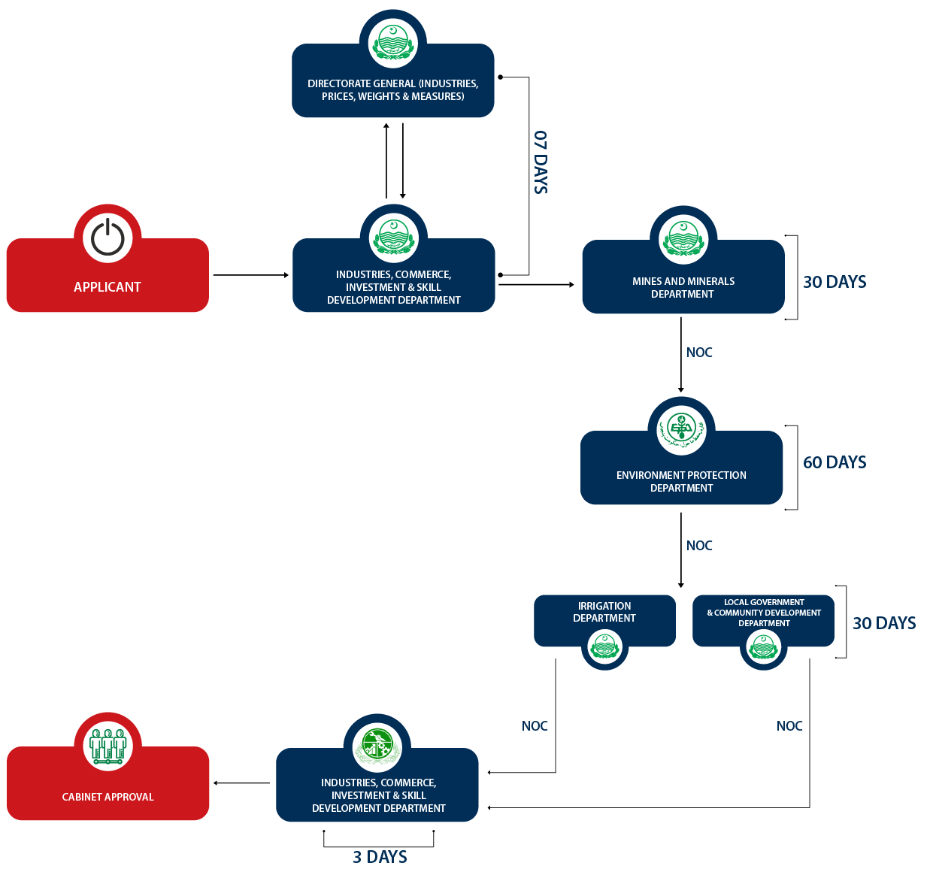
All Departments are working collectively to issue NOC for establishment of cement plants

