Slide 1
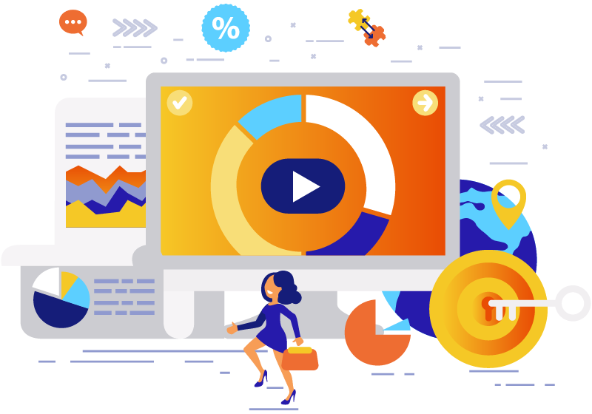
Digital Marketing & Advertising for SMEs
USAID Small and Medium Enterprise Activity
Usman Latif
usmanlatif.com

Slide 2
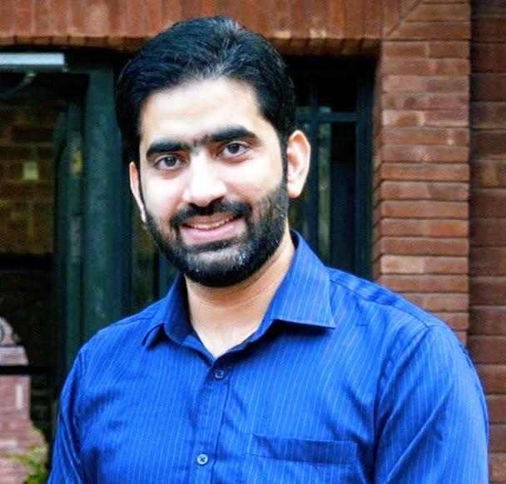
USMAN LATIF
MARCOM TECHNOLOGIST & GROWTH HACKER
visit: www.usmanlatif.com

Slide 3
WHAT DO I DO?
MARCOM WORKS™
www.marcom.works
DIGITAL MARKETING PAKISTAN™
www.digitalmarketing.pk

Slide 4
WHAT DO I DO?
LUMS
DigiSkills.pk

Slide 5
DIGITAL GURU
GREEN BELT
DIGITAL GURU
BLUE BELT

Slide 6
Agenda for Level 1 Training
Why Digital? - the state of digital media
Introduction to Communication and its role in marketing
Digital Marketing Techniques & Funnels
Introduction to Main Techniques of Digital Marketing
Search Engine Optimization
Search Engine Marketing
Social Media Marketing
Email Marketing
Growth Hacking
A hands on Demo for Level 2 Training

Slide 7
STRUCTURE OF THIS TRAINING
What can you expect in this training and how are the three levels organized?

Slide 8
Main Structure of this Training
1- Communication & its Role in Marketing
2- Digital Marketing Funnels
3- Basic Elements of Digital Marketing Strategy

Slide 9
STATE OF DIGITAL MEDIA
Digital Media and its importance.

Slide 10
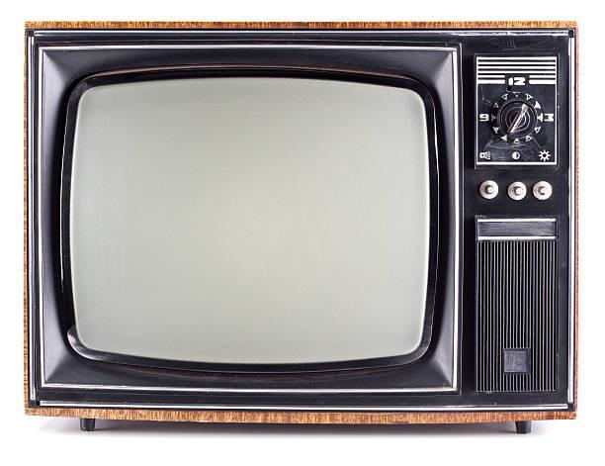
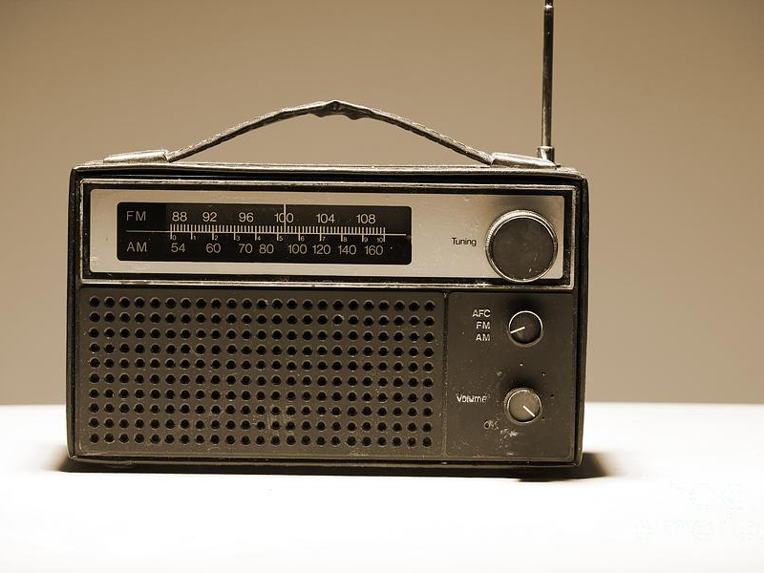

Slide 11
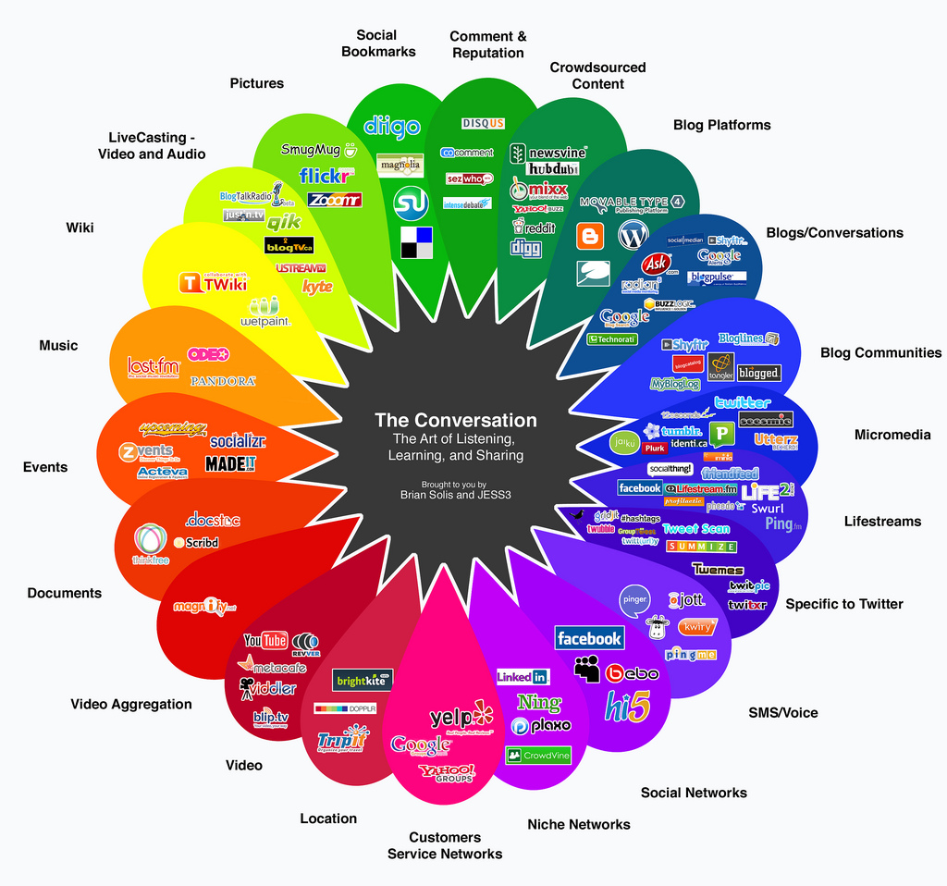
2008
Conversation Prism © Brian Solis & Jess3

Slide 12
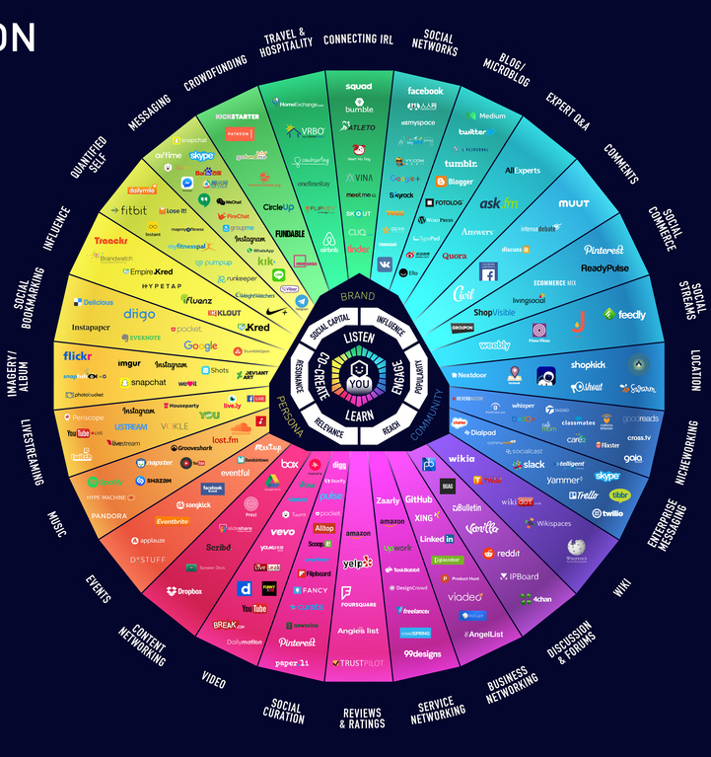
2017
Conversation Prism © Brian Solis & Jess3

Slide 13
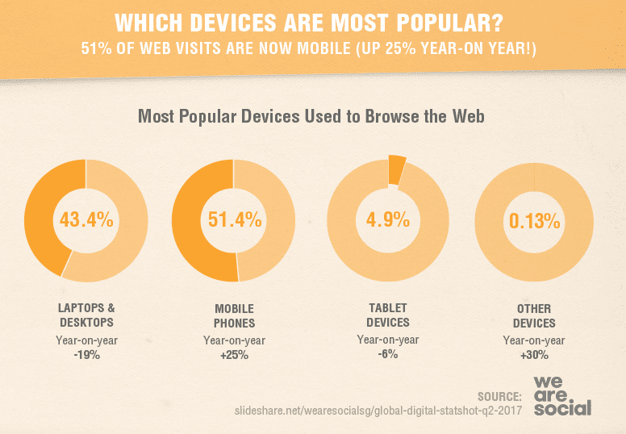

Slide 14
55 Million
Digitally Connected Consumers In Pakistan

Slide 15
52 Million
Smartphone Users In Pakistan

Slide 16
93% Online Experiences
Start With A Search Engine

Slide 17
100B / month Google.
15% Of Daily Queries Are New To Google

Slide 18
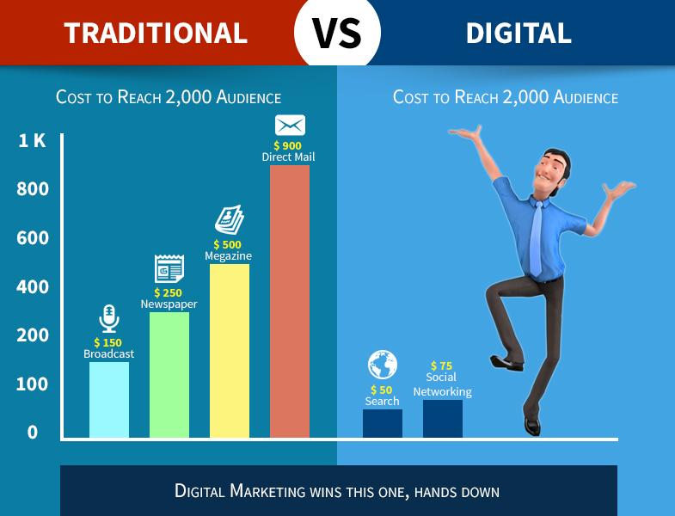

Slide 19
WHY DO WE NEED MARKETING?
Importance of Marketing for SMEs or any business.

Slide 20
Draw a Business Plan on Whiteboard

Slide 21
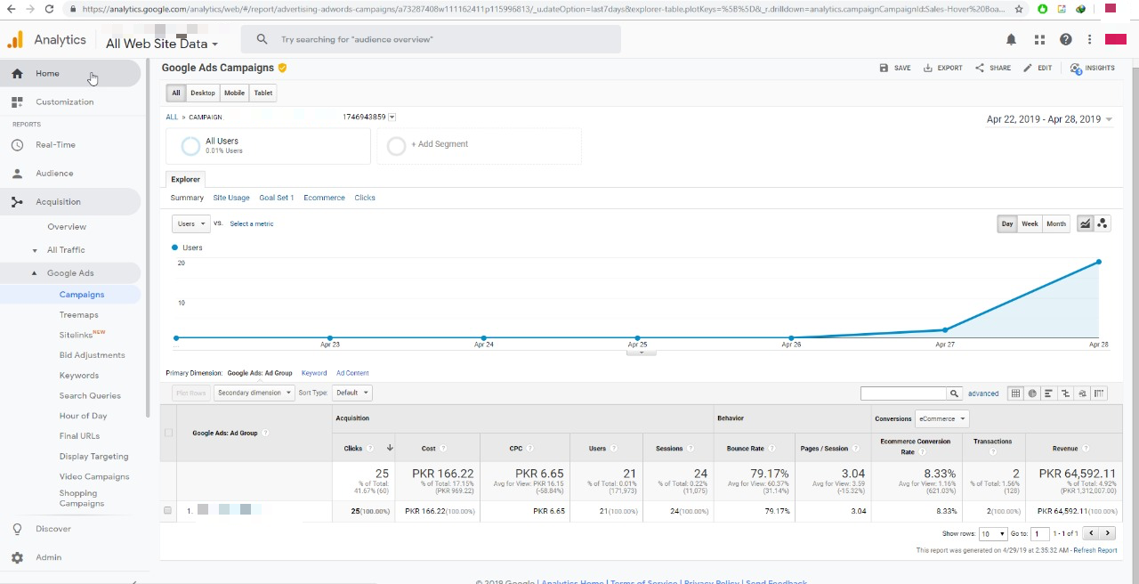

Slide 22
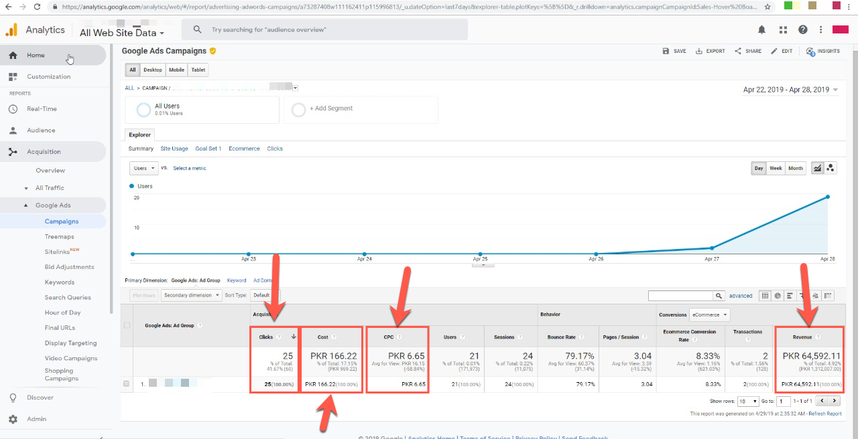

Slide 23
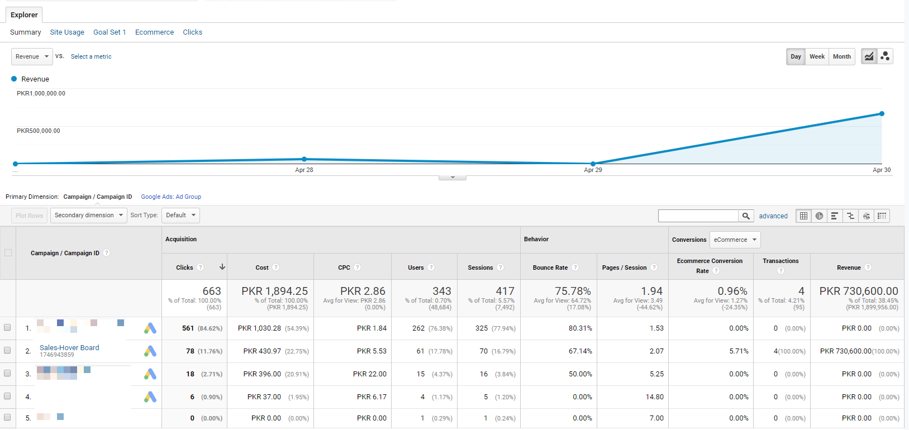

Slide 24
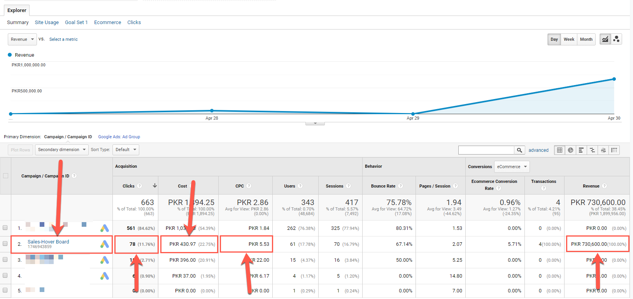

Slide 25
WHAT IS DIGITAL MARKETING?
How does it work?

Slide 26
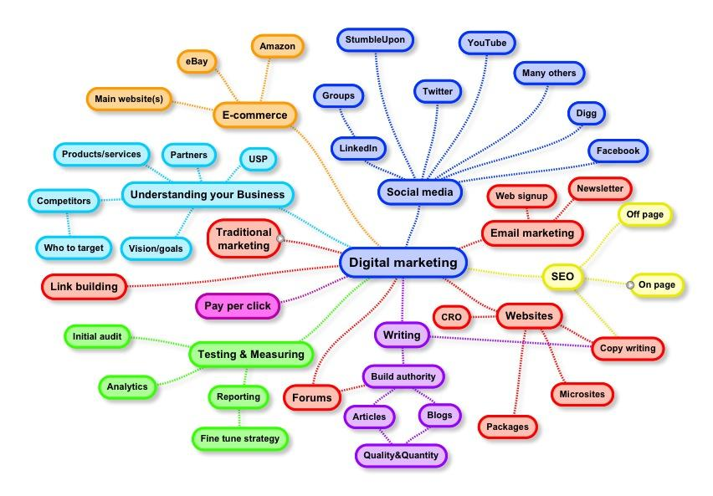

Slide 27
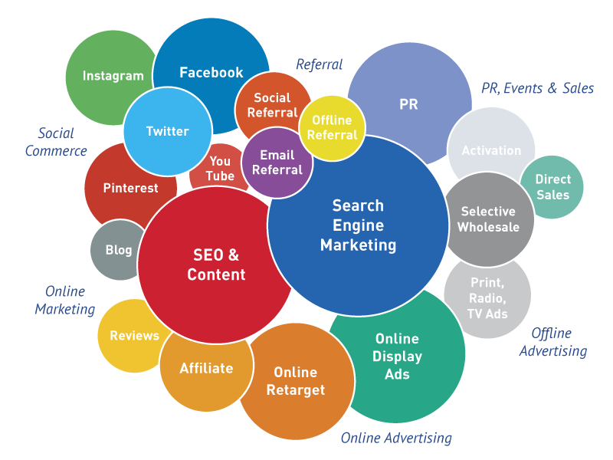

Slide 28
WHAT IS MARKETING?
How does it work?

Slide 29
The activity, set of institutions, and processes for creating, communicating, delivering, and exchanging offerings that have value for customers, clients, partners, and society at large.
American Marketing Association

Slide 30
The activity, set of institutions, and processes for creating, communicating, delivering, and exchanging offerings that have value for customers, clients, partners, and society at large.
American Marketing Association

Slide 31
WHAT IS COMMUNICATION?
The role of communication in Digital Marketing?

Slide 32
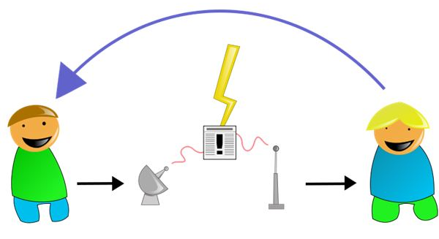

Slide 33
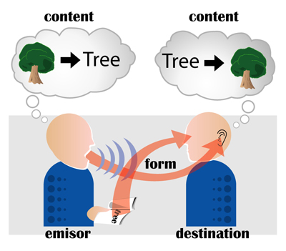

Slide 34
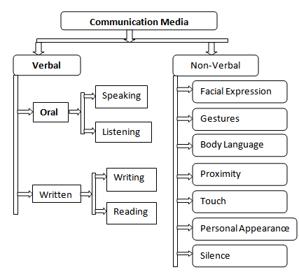

Slide 35
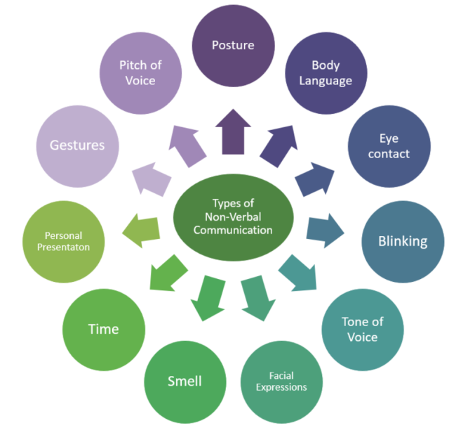

Slide 37
Forms of Communication
Interpersonal Communication
Intra Personal Communication
Group Communication
Mass Communication

Slide 38
DIGITAL MARKETING TECHNIQUES & FUNNELS
Understand digital marketing techniques and how can they all make a funnel together.

Slide 39
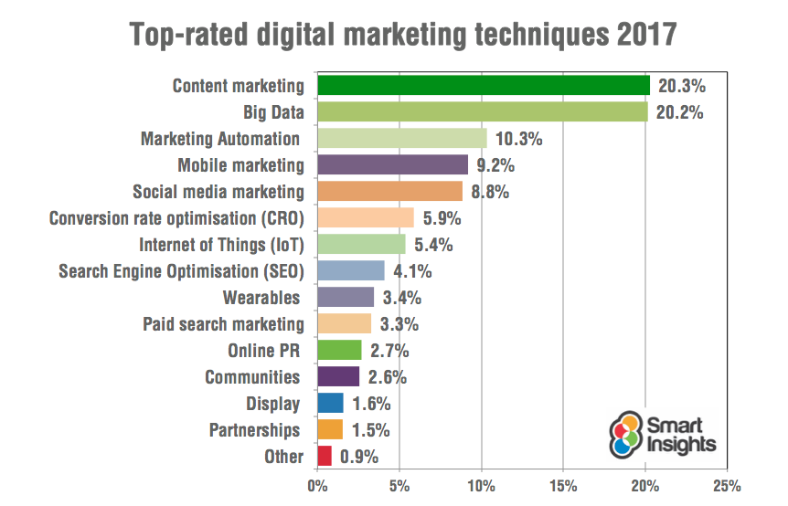

Slide 40
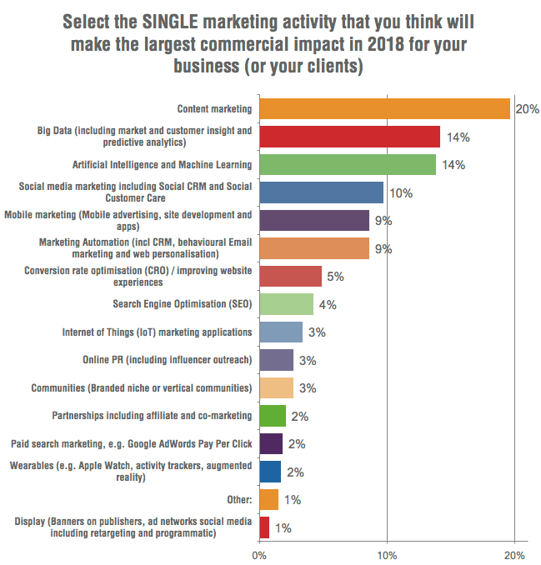

Slide 41
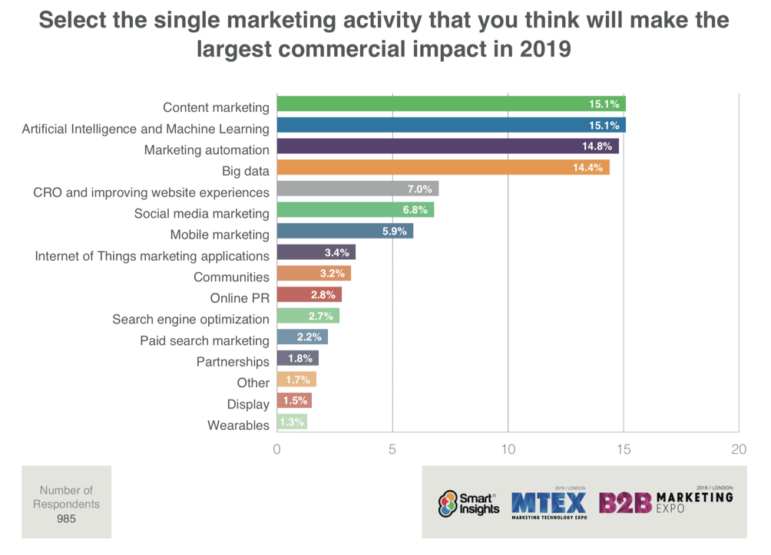

Slide 42
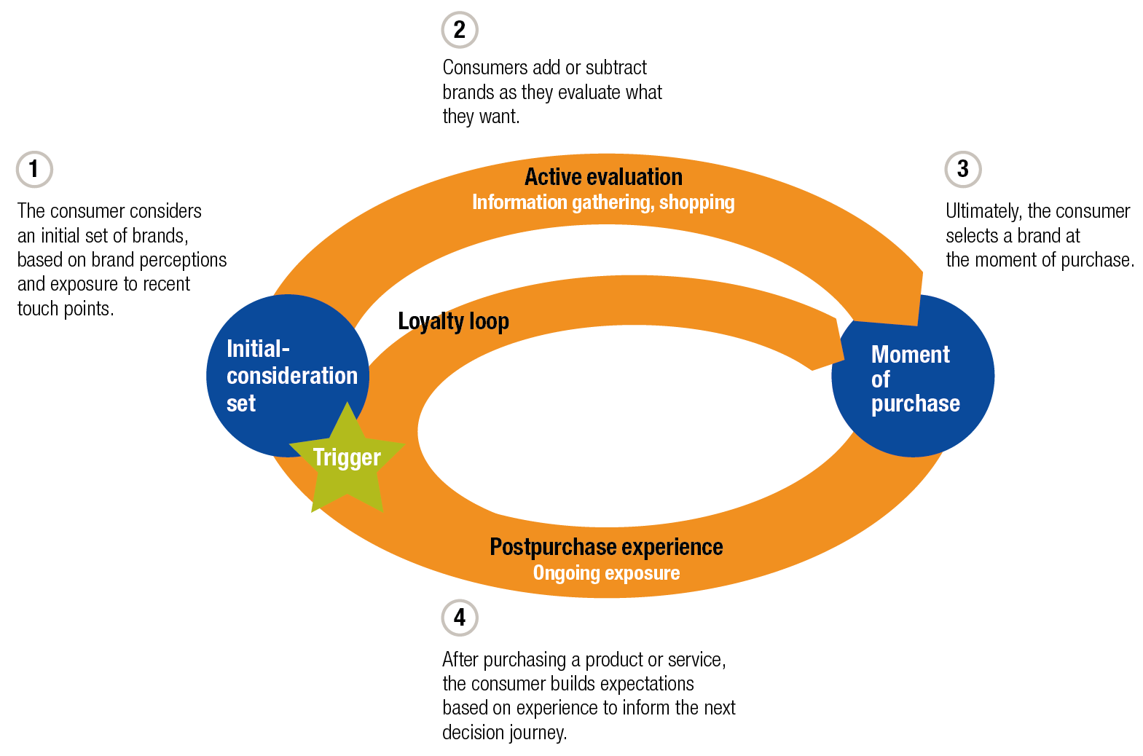

Slide 43
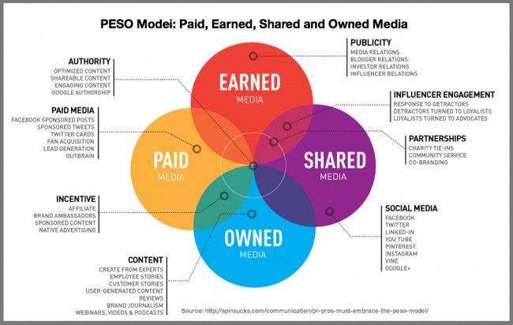

Slide 44
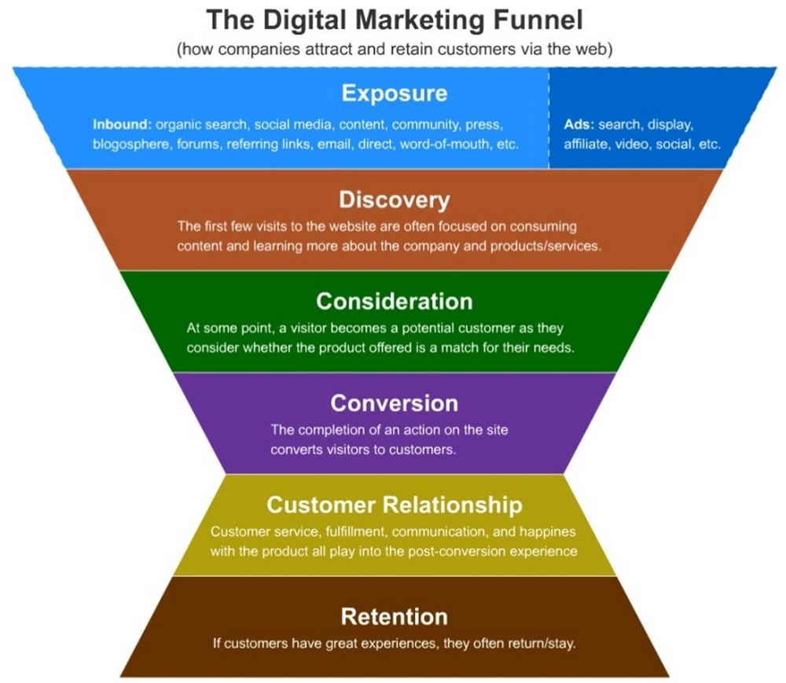

Slide 45
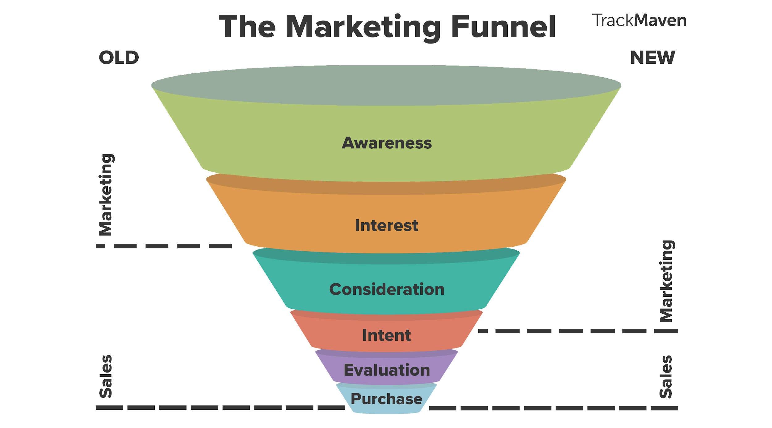

Slide 46
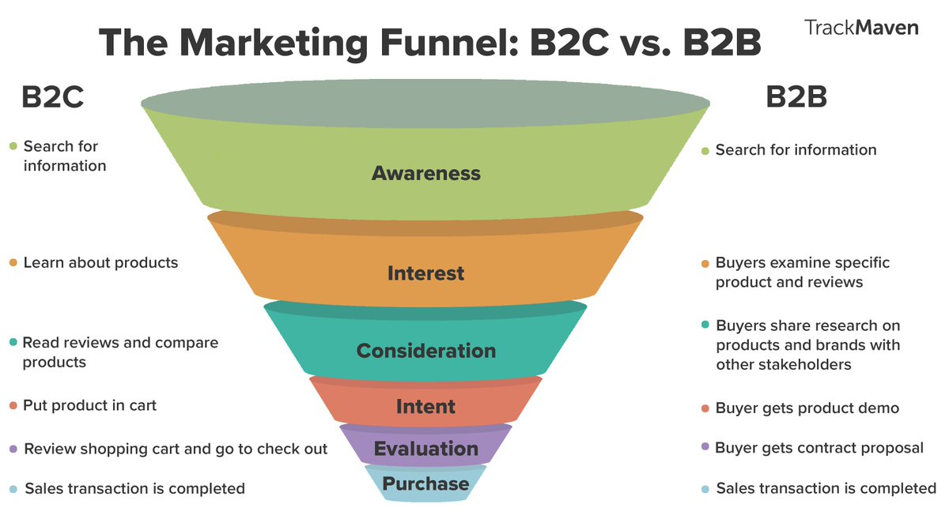

Slide 47
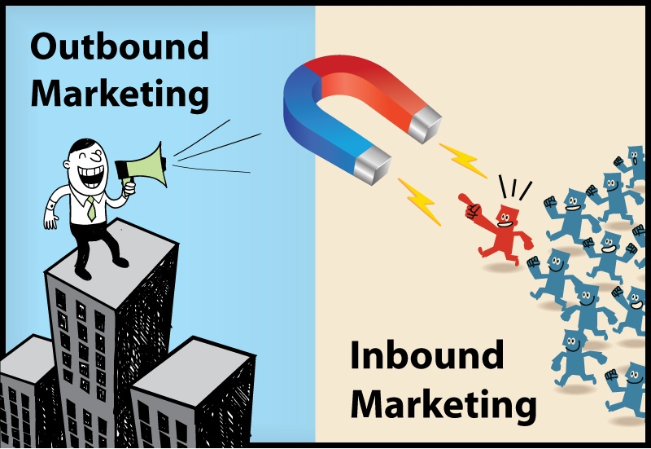

Slide 48
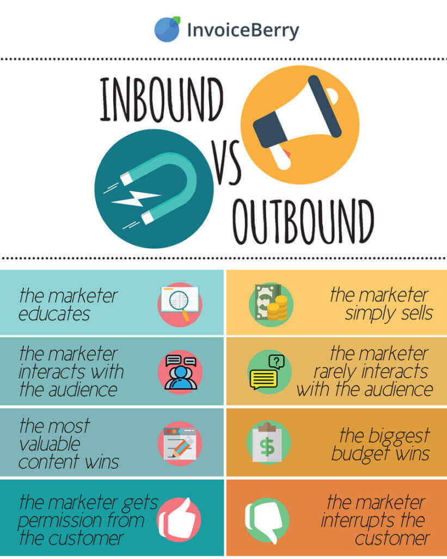

Slide 50
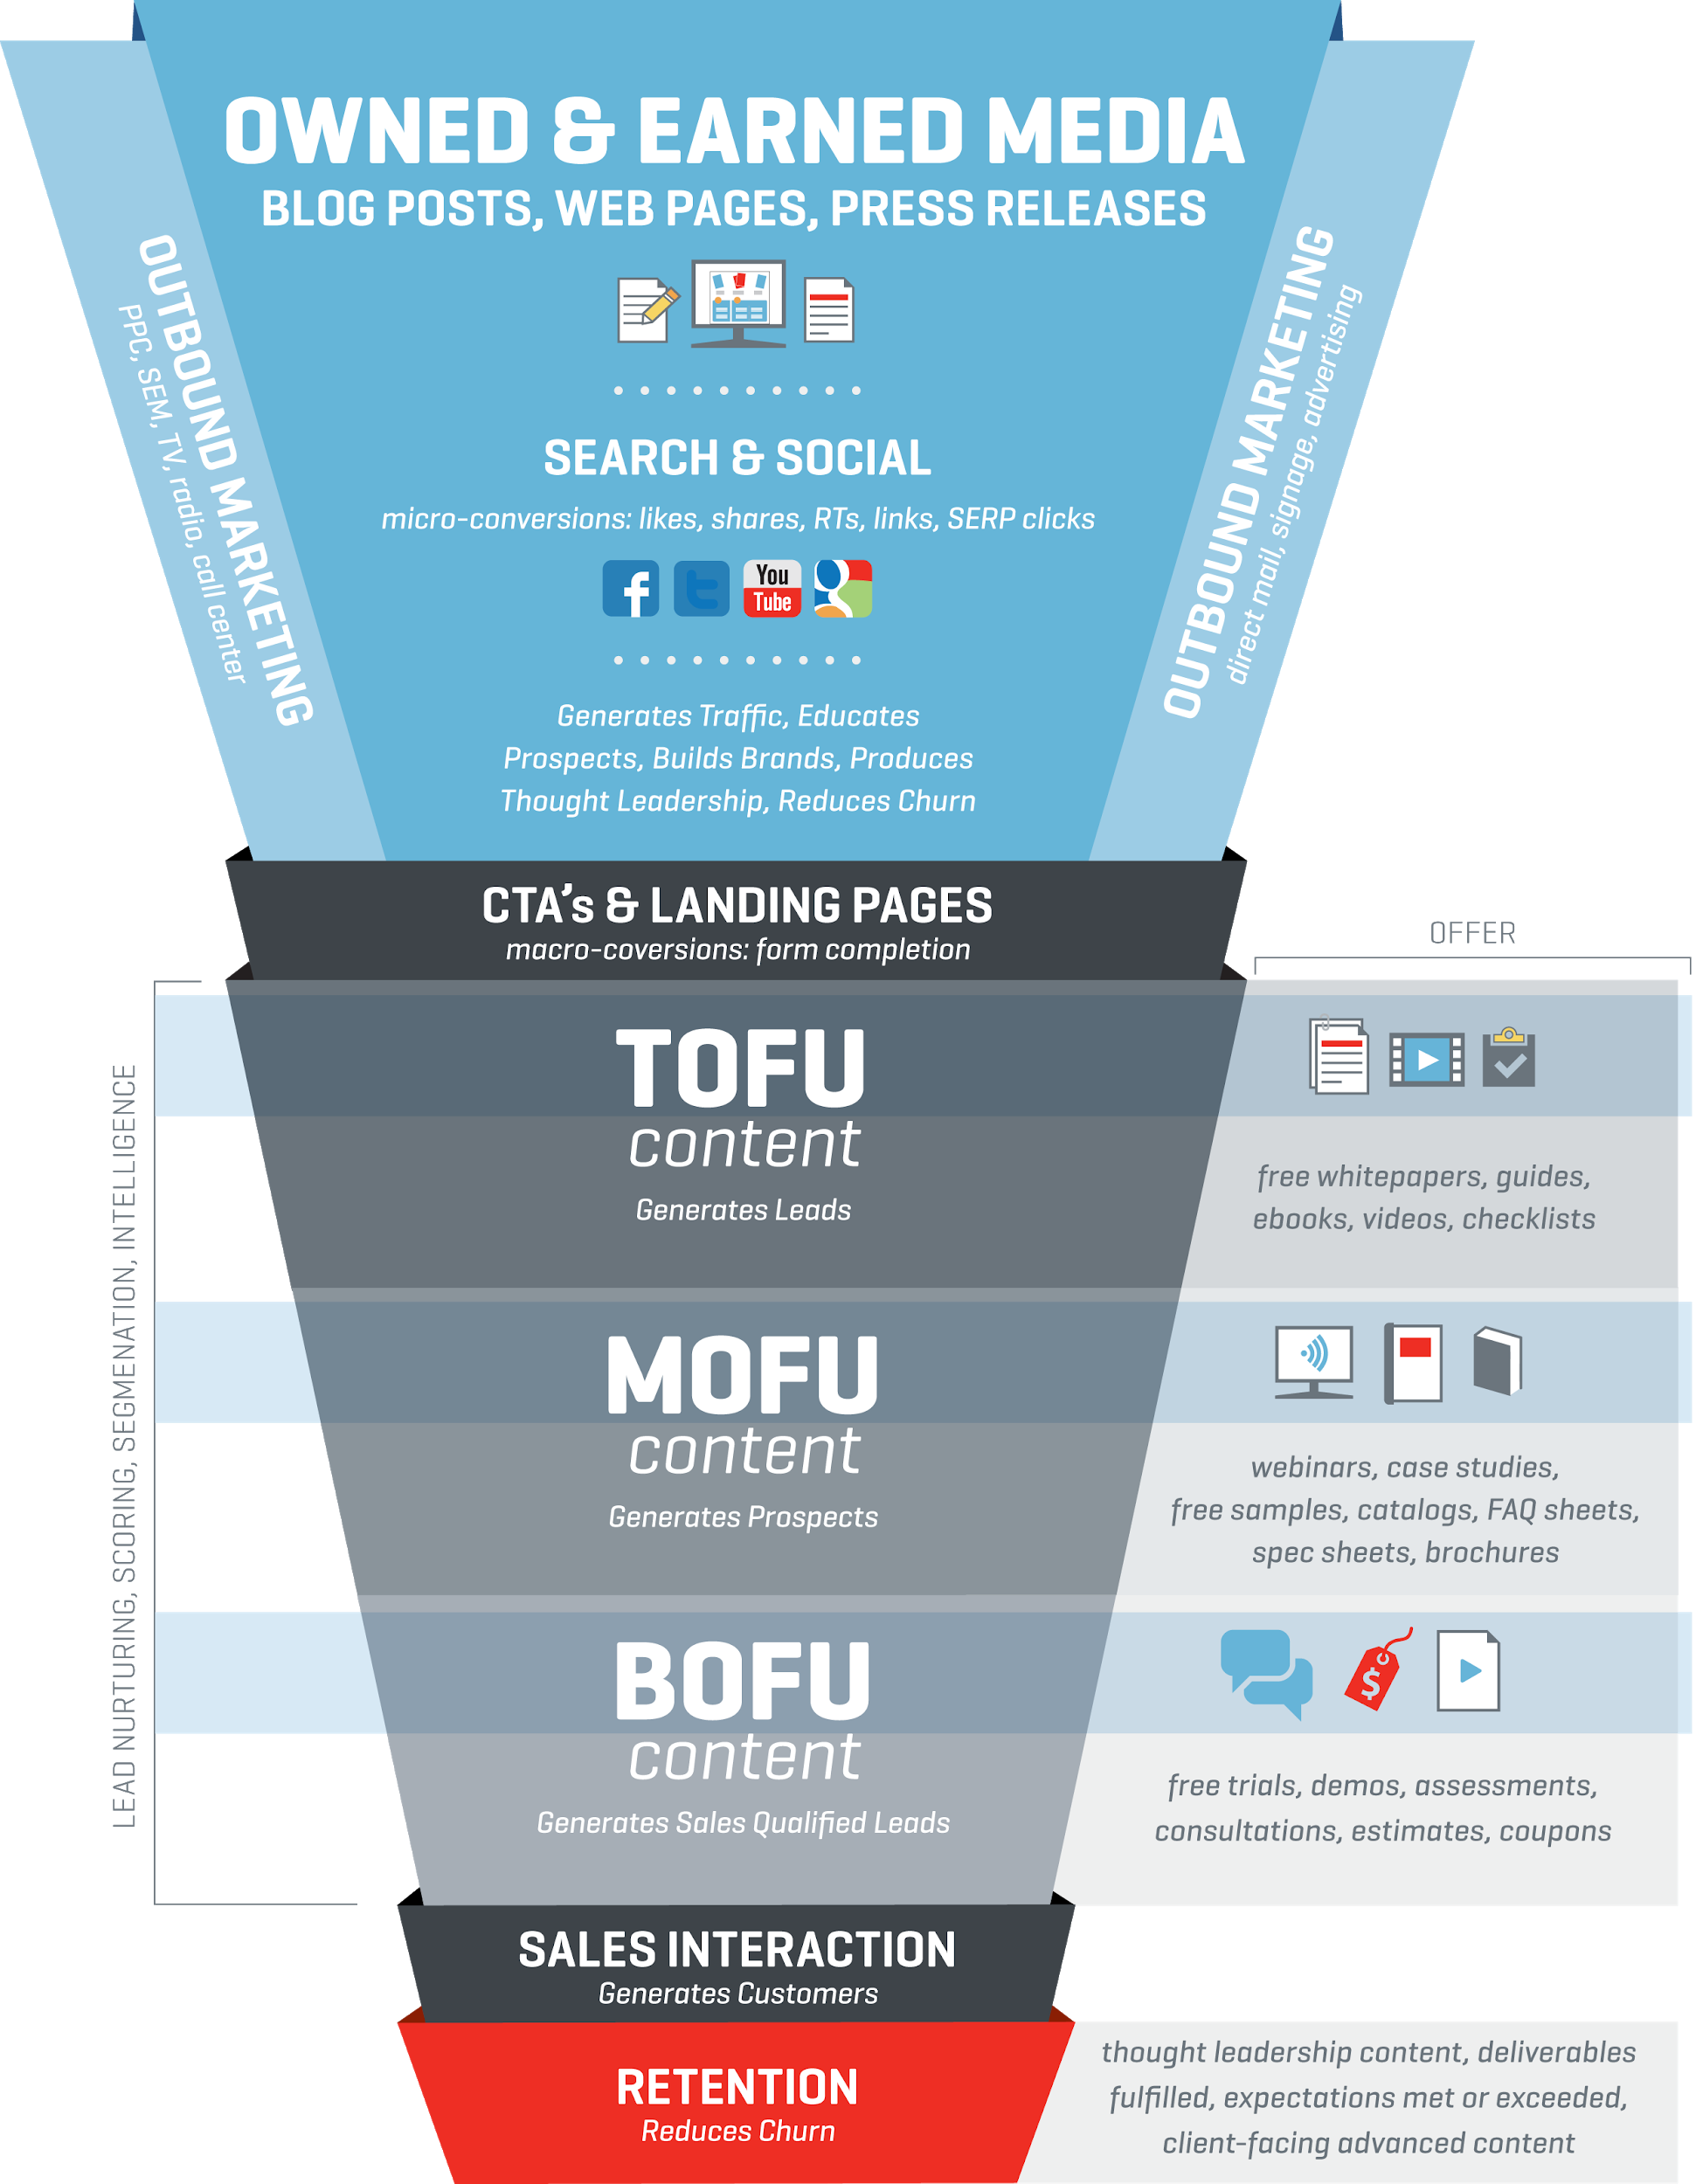

Slide 51
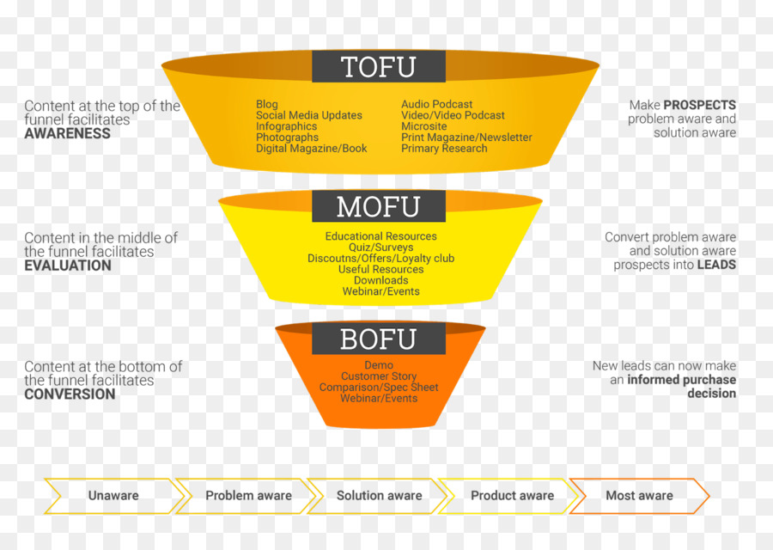

Slide 52
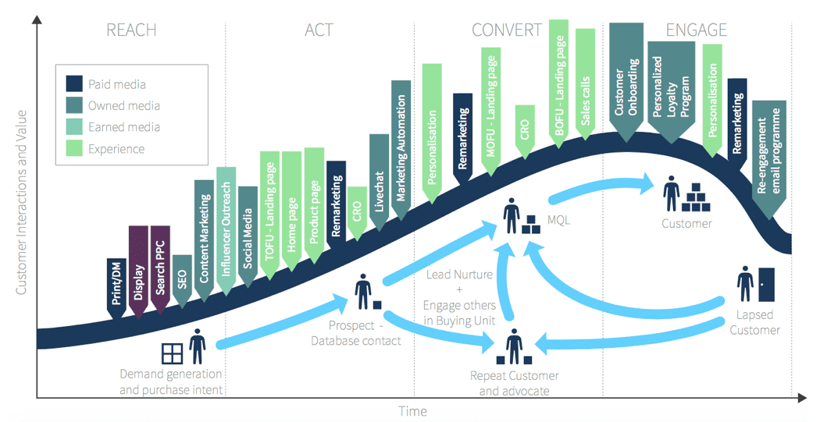

Slide 53
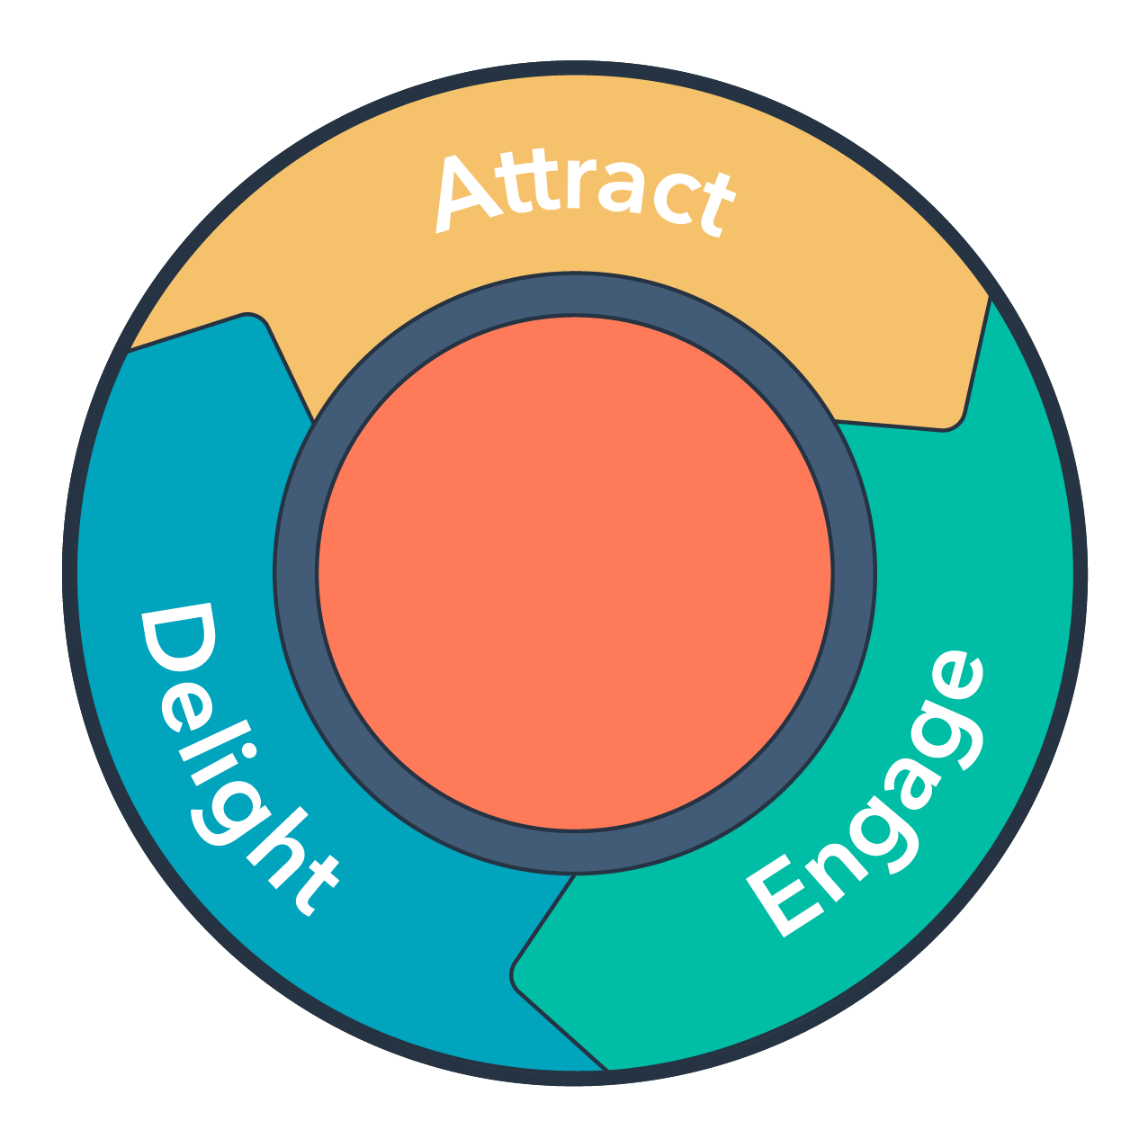

Slide 54
Educate
Earn
Engage

Slide 55
INTRODUCTION TO THE MAIN DIGITAL MARKETING TECHNIQUES
SEO, SEM, SMM, Email Marketing and Growth Hacking with Digital Marketing

Slide 56
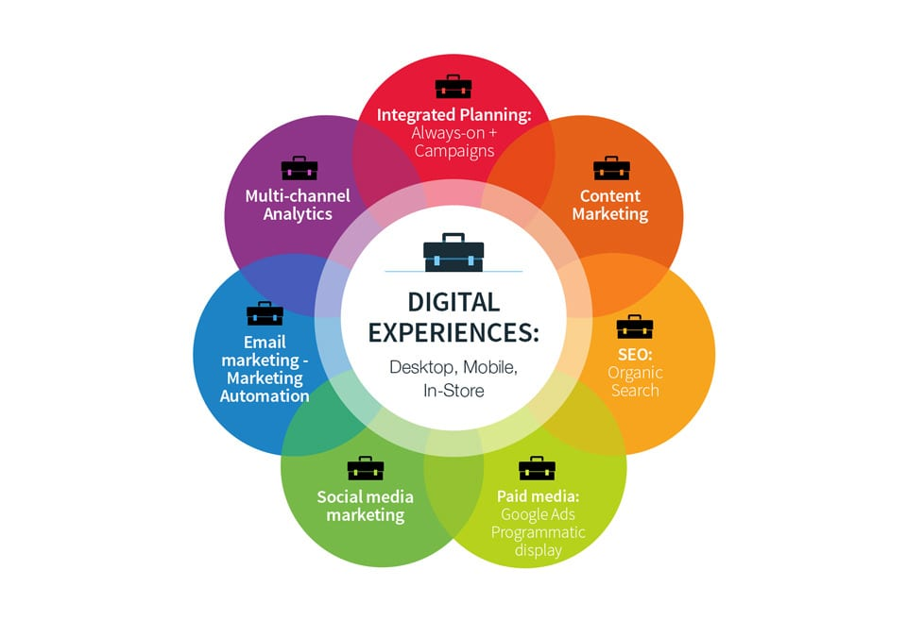

Slide 57
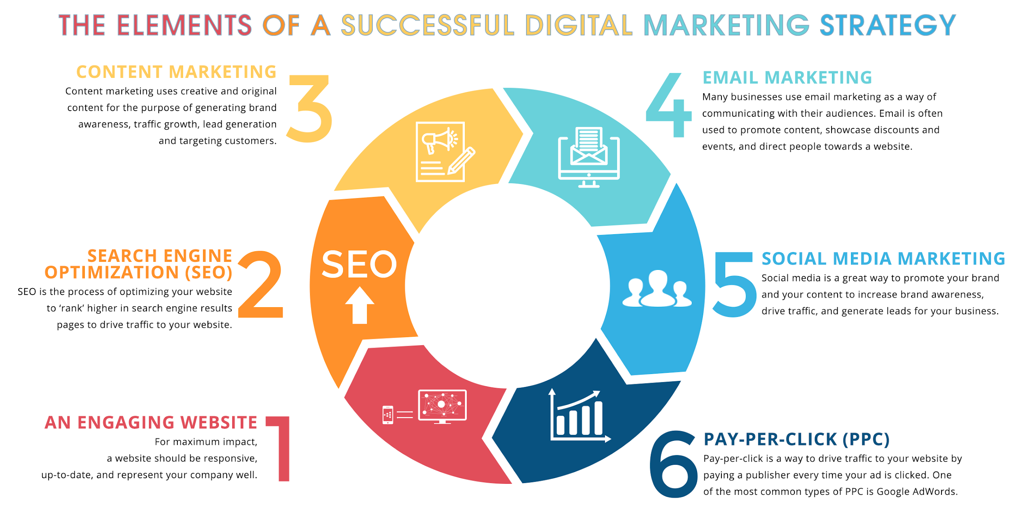

Slide 58
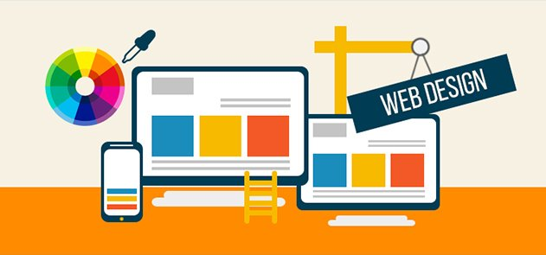

Slide 59
“75% of consumers admit that they judge businesses’ credibility based on their website design.”
A Stanford web credibility research, according to Kinesis Inc.

Slide 61
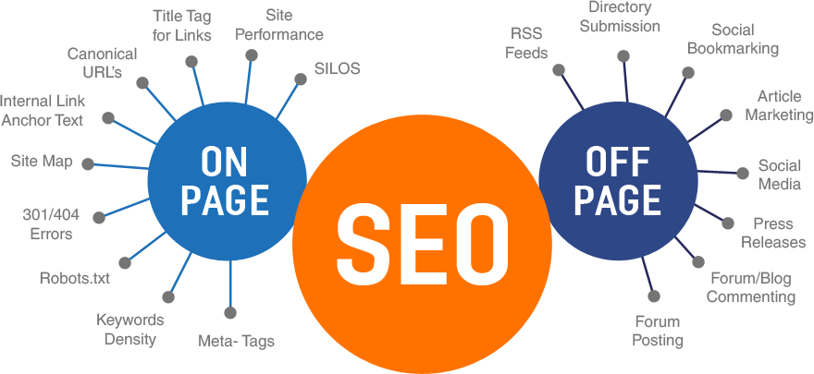

Slide 62
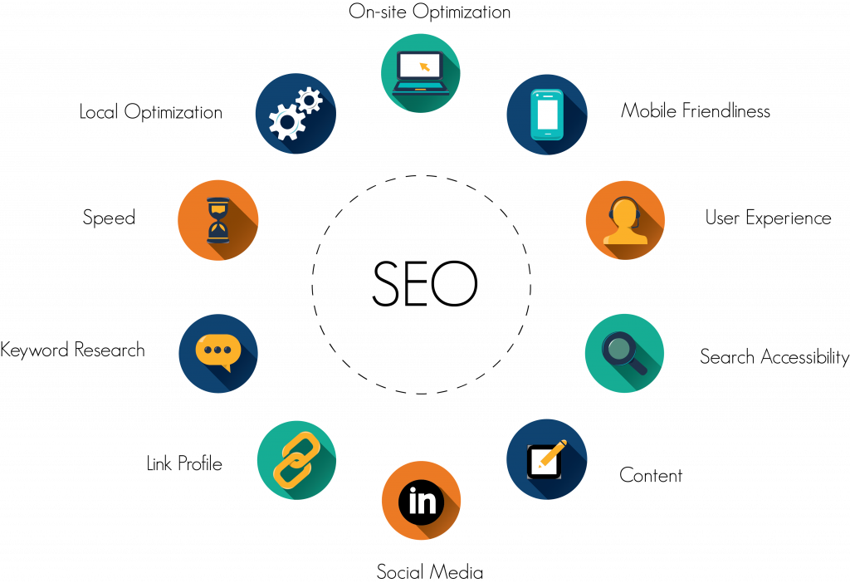

Slide 63
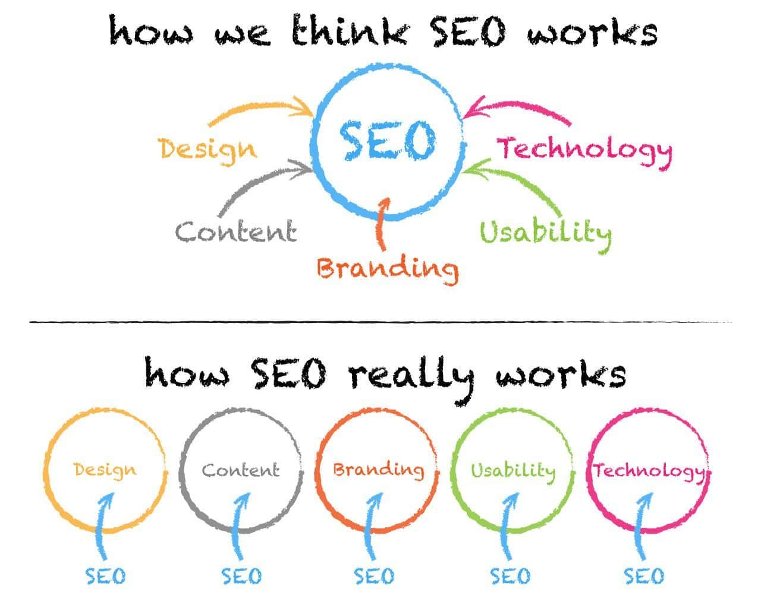

Slide 65
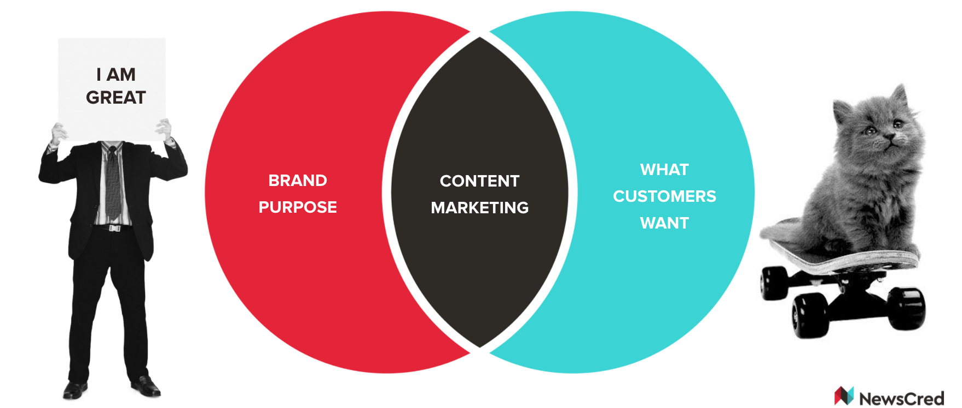

Slide 67
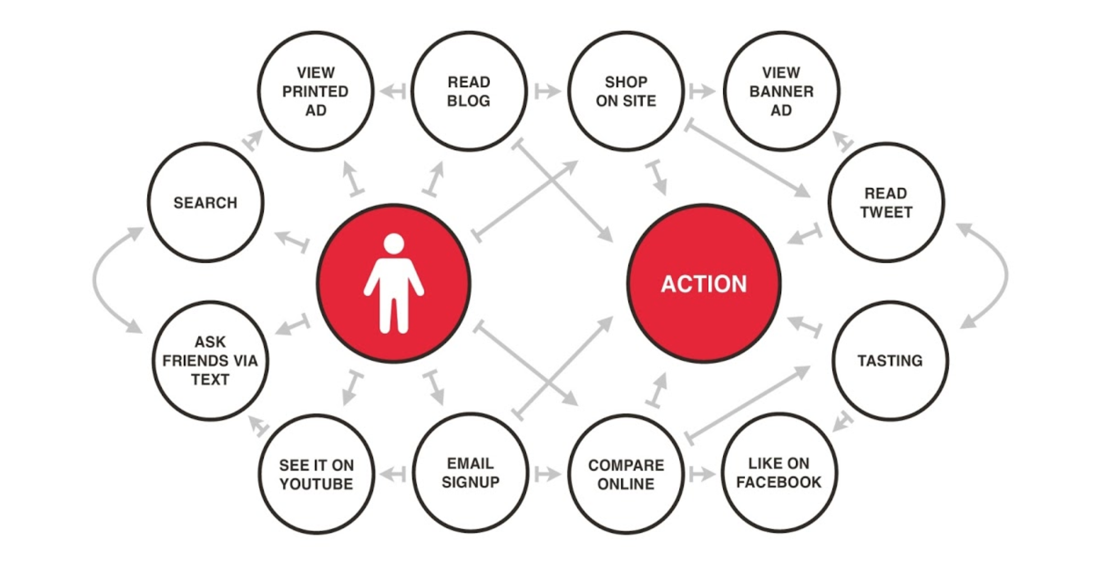

Slide 68
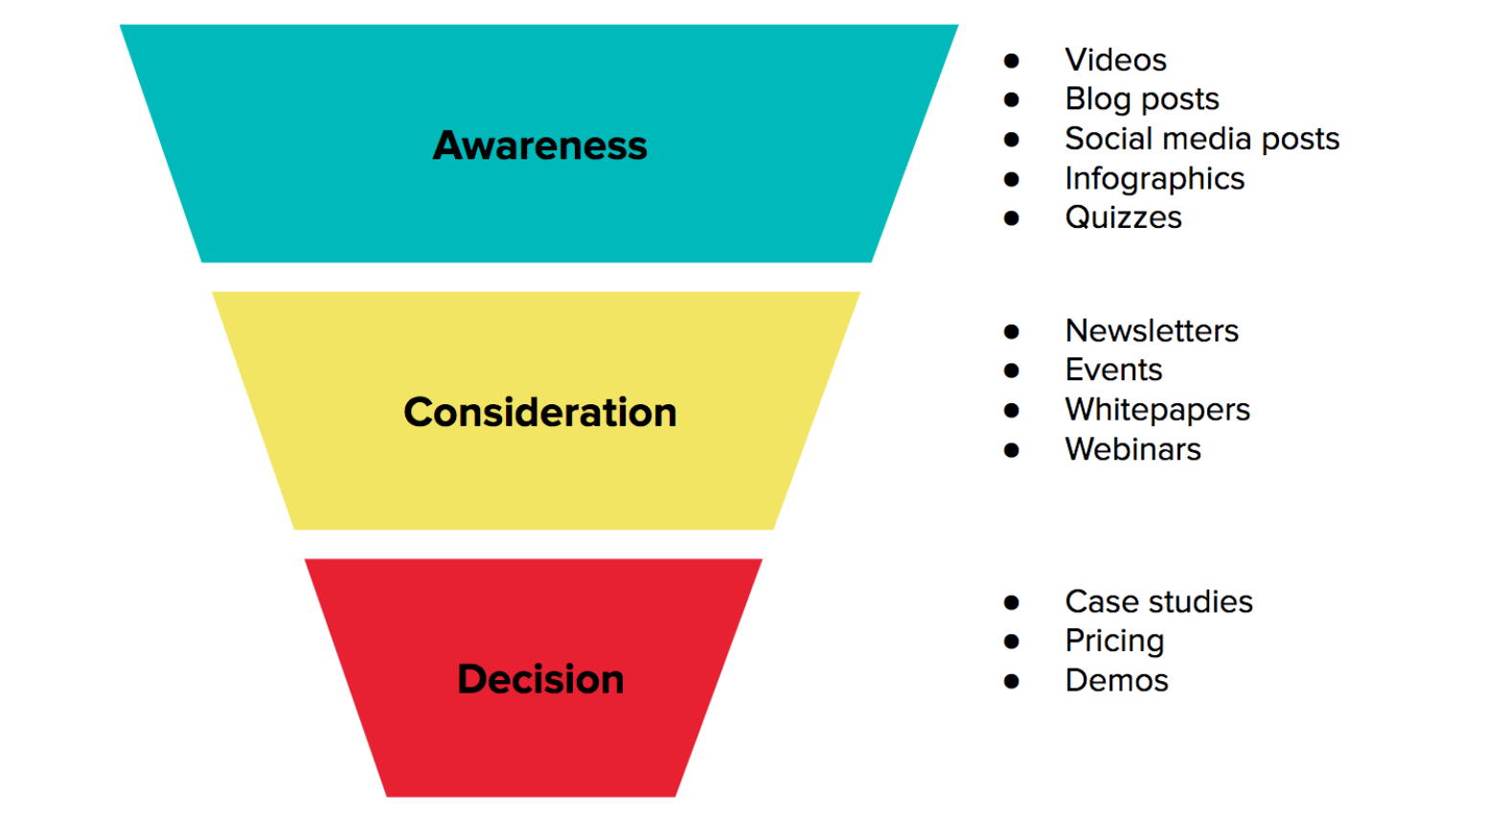

Slide 69
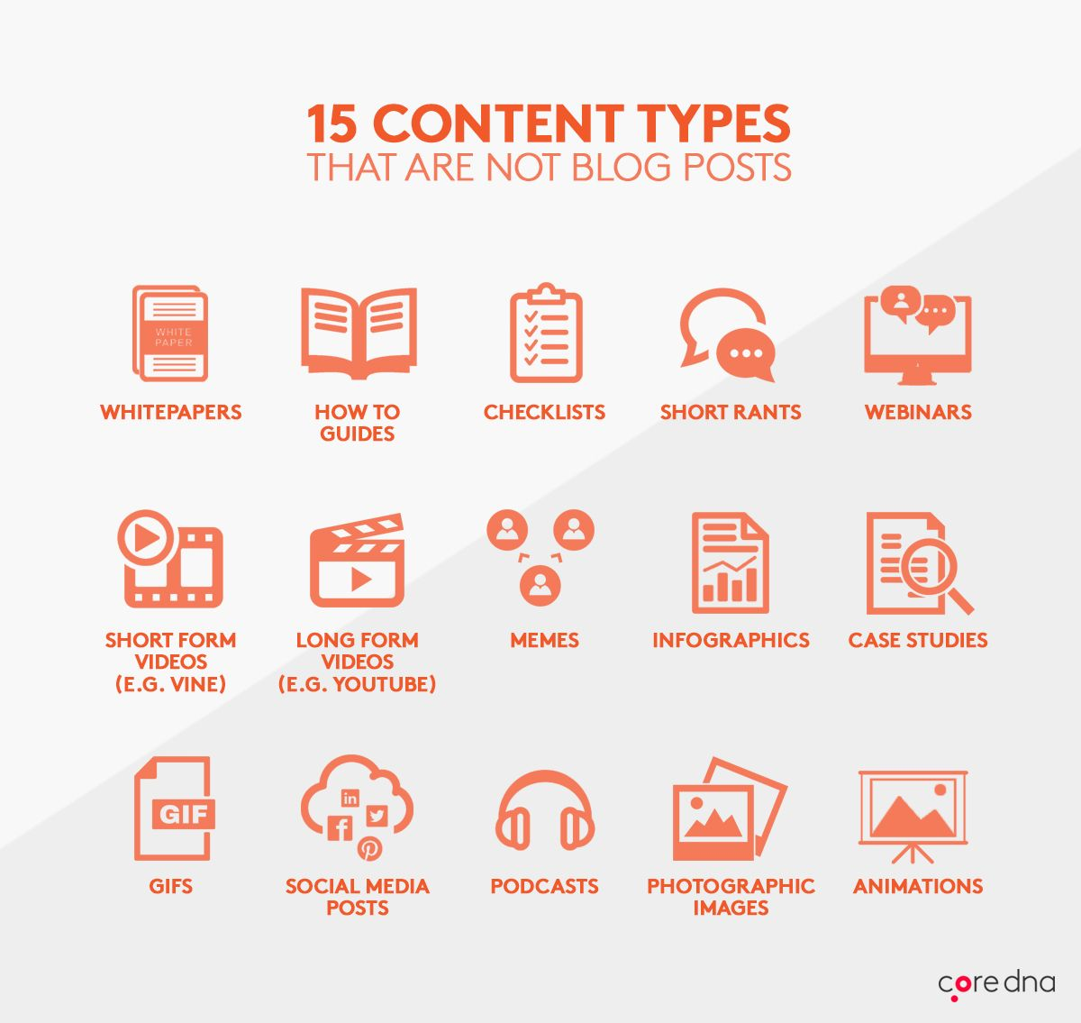

Slide 70
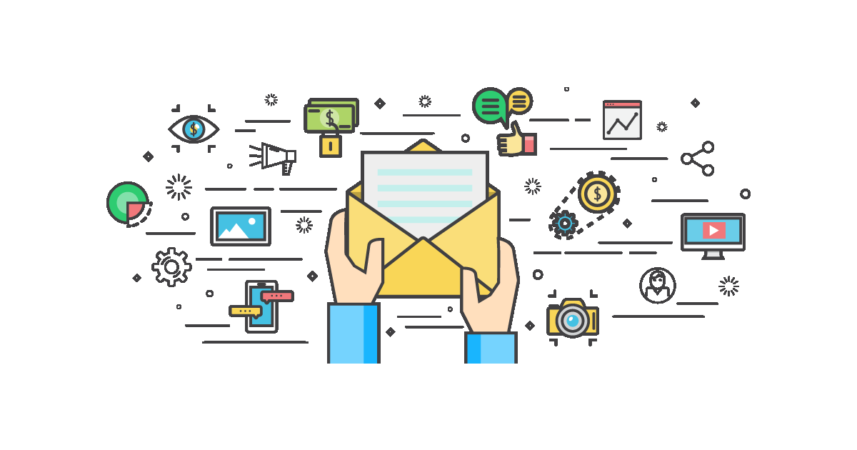

Slide 71
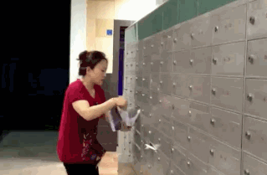

Slide 72
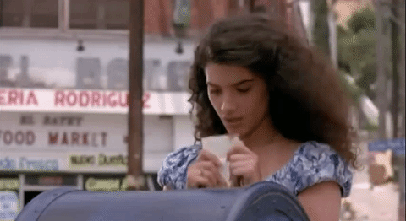

Slide 73
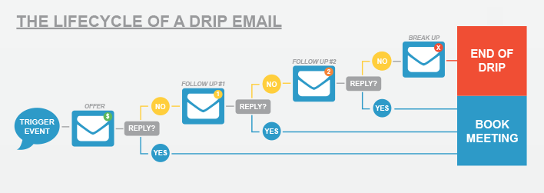

Slide 76
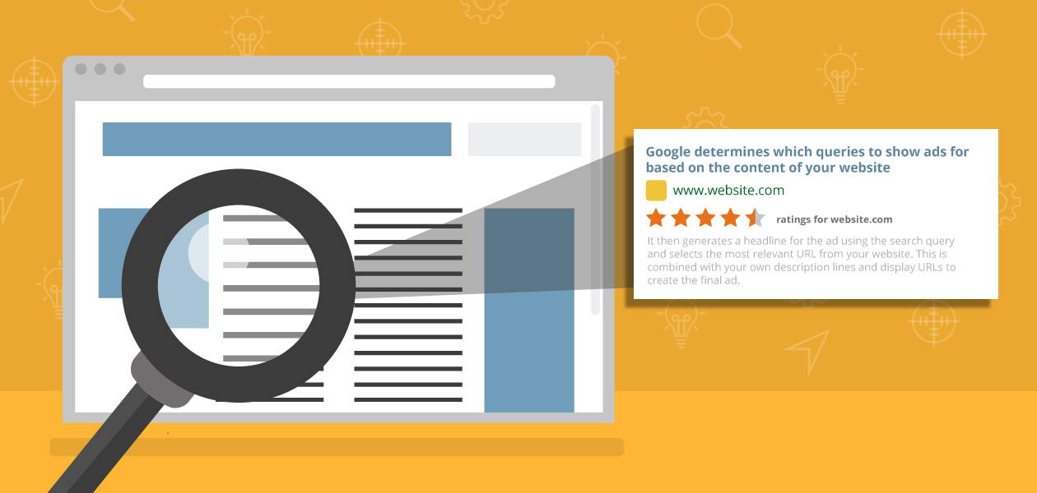

Slide 77
THANK YOU
USMAN LATIF
Marcom Works™
Digital Marketing Pakistan™
+92-312-4000551
usman@digitalmarketing.pk
usman.latif@marcom.works

