Slide 1
TDAP’s
Input for
NeCC Meeting
November 26, 2021

Slide 2
TDAP’s Strategy
for
E-Commerce

Slide 3
Platform Diversification
Market Diversification
Product Diversification
TDAP’s Strategy for
E-Commerce
3D Strategy
3 Diversifications

Slide 4
The Diversifications
Product Diversification
To explore niche products
Market Diversification
To explore all the markets via e-commerce
Platform Diversification
To explore country specific platforms too

Slide 5
1. The Product Diversification
Processed Food & Spices
Textile (Fabric & Carpet)
Handicrafts
Leather
Home Textile
Sports Goods
Footwear
RM Garments
Cutlery & Cookware
Chemicals

Slide 6
2. The Market Diversification
10 Regions!

Slide 7
2. The Market Diversification
Europe I
UK
Ireland
Netherlands
France
Europe II
Spain
Portugal
Germany
Italy
Europe III
Denmark
Sweden
Norway
Poland
Middle East
GCC
Turkey
Egypt
Iran
ASEAN
Indonesia
Malaysia
Singapore
Thailand
Latin America
Brazil
Argentina
Chile
North America
Canada
USA
Mexico
Central Asia
Russia
CARs
Oceania
Australia
New Zealand
East Asia
Japan
South Korea
China

Slide 8
3. The Platform Diversification
Amazon
Jingdong
Solostocks
eBay
GC B2B
OPB China
Rakuten Ichiba
MercadoLibre
Alibaba
Ozon
Lazada
noon.com

Slide 9
Pillar 3 of National E-Commerce Policy:
SME and youth empowerment through e-Commerce
Status of Amazon Seminars & Onboarding of 3P Vendors

Slide 10
Amazon Training by TDAP
To equip Pakistani businesses with required skills and knowledge for selling on Amazon
High fees around 1000 US$ being charged by private sector companies, TDAP is conducting these trainings free of cost . . .

Slide 11
Training Modules

Slide 12
Module 01
Amazon Seller Registration procedure
General Introduction and Advantages of Ecommerce platforms
Introduction of Amazon: pros and cons of selling on Amazon
Step-by-Step Guide to Registration Process
Selling plans and options available with Amazon

Slide 13
Module 02
Product Projection and Account Management
Guide on how to add New Products (Product Listing)
How to Manage Inventory
How to Write Product Detail
Product Display Page
How to Answers the Queries?
How to write Product Specification / Contents
Search Engine Optimization for your Products

Slide 14
Module 03
Payments Procedures
Amazon fee structure
Payment Processing Time
Payment/Deposit Method for the Sellers
SBP Regulations

Slide 15
Module 04
Transport and Logistics
Transport and Logistics options available
Tracking number of Shipments
Rate Chart of different Logistic companies
FBA and FBM Logistics Challenges and way forward

Slide 16
Outcome & Feedback
Companies are able to register hassle free and will sell in a more engaging way.
Feedback being sought from the participants for improvement . . .

Slide 17
Phase 01
Training imparted in following 6 cities:
Karachi | 11-Aug-2021 (Virtual)
Hosted by Karachi Chamber of Commerce & Industry
Mirpur | 1-Sep-2021
Hosted by Mirpur Chamber of Commerce & Industry
Rawalpindi | 2-Sep-2021
Hosted by Rawalpindi Chamber of Commerce & Industry
Faisalabad | 4-Sep-2021
Hosted by Faisalabad Chamber of Commerce & Industry
Sahiwal | 7-Sep-2021
Hosted by Sahiwal Chamber of Commerce & Industry
Sialkot | 9-Sep-2021
Hosted by Sialkot Chamber of Commerce & Industry

Slide 18
Phase 01
Training imparted in following Trade Bodies:
PTEA | 21-Oct-2021
Hosted by Pakistan Textile Exporters Association
APBUMA | 22-Oct-2021
Hosted by All Pakistan Bedsheets & Upholstery Manufacturers Association
FCCI | 25-Oct-2021
Hosted by Faisalabad Chamber of Commerce & Industry
FCSTI | 27-Oct-2021
Hosted by Faisalabad Chamber of Small Traders & Industrialist
PHMA | 28-Oct-2021
Hosted by Pakistan Hosiery Manufacturers Association

Slide 19
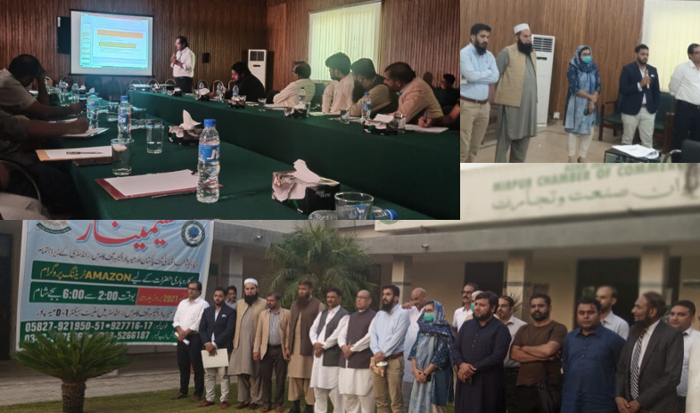

Slide 20
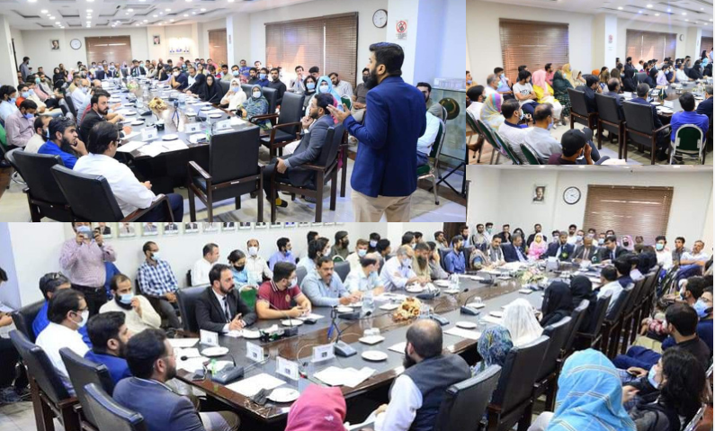

Slide 21
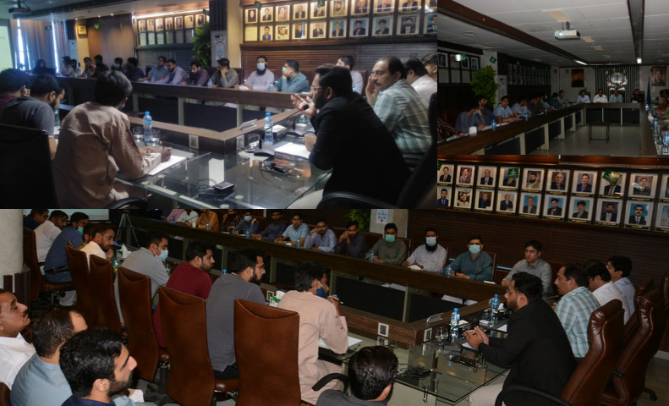

Slide 22
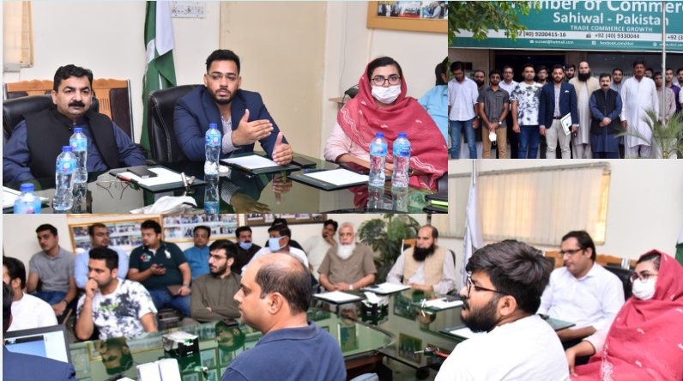

Slide 23
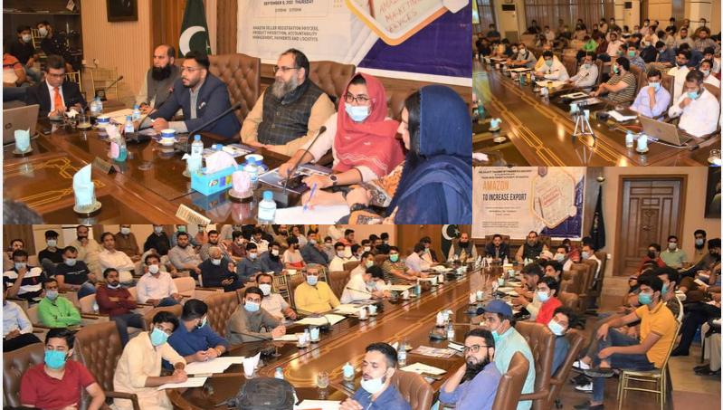

Slide 24
More on Amazon . . .
Individual Country Series
Tapping Markets via E-Commerce
Series of webinars in collaboration with TIOs to tap the markets of their respective countries via Amazon/E-Commerce

Slide 25
Pillar 3 of National E-Commerce Policy:
SME and youth empowerment through e-Commerce
Collaboration between
TDAP & SMEDA

Slide 26
Collaboration between TDAP & SMEDA
1 – TDAP and SMEDA have signed MoU on 17th September, 2020 to empower
youth, SMEs and women entrepreneurs in promotion of their businesses.
2 – SMEDA is yet to share the project proposal for the implementation of the
MoU.
3 – SMEDA has shared other proposals on Export Readiness Program
and e-Tijarat portal.
4 – However, no meeting could be arranged with SMEDA
despite multiple requests.

Slide 27
Pillar 9 of National E-Commerce Policy:
Global Connectivity and Participation in Multilateral Negotiations
3. Transformation of TDAP into a digitally savvy and services oriented organization
Update on
B2B Portal

Slide 28
TDAP’s B2B Portal
1 – An IT firm has been hired for the development of TDAP’s B2B Portal.
2 – This firm has been awarded the contract of
(a) Development (b) Maintenance (c) Modification & (d) Hosting
of the portal for two years.
3 – A Service Level Agreement (SLA) with the firm was signed on
June 30, 2021.
4 – The firm has started work on the development of portal and
has started onboarding companies from Karachi. (A total of
1000 companies shall be on boarded)
5 – The portal shall be launched in January, 2022.

Slide 29
Pillar 9 of National E-Commerce Policy:
Global Connectivity and Participation in Multilateral Negotiations
3. Transformation of TDAP into a digitally savvy and services oriented organization
Digital transformation
of TDAP(E-Office)

Slide 30
Digital Transformation Progress
1 - TDAP has achieved level three of e-office
2 - Presently TDAP HQ, Lahore & Islamabad are connected
to e-office server through NTC lease line
3 - Sub-regional offices are being connected via VPN
access.
4 - TDAP is in the process of upgrading the IT
infrastructure and IT equipment/inventory at sub-
regional offices.

Slide 31
Thank you.

