Slide 1
TDAP’s
Initiatives on
E-Commerce

Slide 2
Amazon Training by TDAP
To equip Pakistani businesses with required skills and knowledge for selling on Amazon
High fees being charged by foreign companies, TDAP is conducting these trainings free of cost . . .

Slide 3
Training Modules

Slide 4
Module 01
Amazon Seller Registration procedure
General Introduction and Advantages of Ecommerce platforms
Introduction of Amazon: pros and cons of selling on Amazon
Step-by-Step Guide to Registration Process
Selling plans and options available with Amazon

Slide 5
Module 02
Product Projection and Account Management
Guide on how to add New Products (Product Listing)
How to Manage Inventory
How to Write Product Detail
Product Display Page
How to Answers the Queries?
How to write Product Specification / Contents
Search Engine Optimization for your Products

Slide 6
Module 03
Payments Procedures
Amazon fee structure
Payment Processing Time
Payment/Deposit Method for the Sellers
SBP Regulations

Slide 7
Module 04
Transport and Logistics
Transport and Logistics options available
Tracking number of Shipments
Rate Chart of different Logistic companies
FBA and FBM Logistics Challenges and way forward

Slide 8
Outcome & Feedback
Companies are able to register hassle free and will sell in a more engaging way.
Feedback being sought from the participants for improvement . . .

Slide 9
Phase 01
Training imparted in following 6 cities:
Karachi | 11-Aug-2021 (Virtual)
Hosted by Karachi Chamber of Commerce & Industry
Mirpur | 1-Sep-2021
Hosted by Mirpur Chamber of Commerce & Industry
Rawalpindi | 2-Sep-2021
Hosted by Rawalpindi Chamber of Commerce & Industry
Faisalabad | 4-Sep-2021
Hosted by Faisalabad Chamber of Commerce & Industry
Sahiwal | 7-Sep-2021
Hosted by Sahiwal Chamber of Commerce & Industry
Sialkot | 9-Sep-2021
Hosted by Sialkot Chamber of Commerce & Industry

Slide 10
Phase 01
Training imparted in following Trade Bodies:
PTEA | 21-Oct-2021
Hosted by Pakistan Textile Exporters Association
APBUMA | 22-Oct-2021
Hosted by All Pakistan Bedsheets & Upholstery Manufacturers Association
FCCI | 25-Oct-2021
Hosted by Faisalabad Chamber of Commerce & Industry
FCSTI | 27-Oct-2021
Hosted by Faisalabad Chamber of Small Traders & Industrialist
PHMA | 28-Oct-2021
Hosted by Pakistan Hosiery Manufacturers Association

Slide 11
Amazon Training
1 – Though there is no official figure on the number of companies
registered on Amazon after May 2021 from Pakistan.
2 –Many companies from Pakistan have registered.
3 - Many companies are in process of verification by Amazon.
4 – MoC has requested Amazon to release the official figure.

Slide 12
Pillar 3 of National E-Commerce Policy:
SME and youth empowerment through e-Commerce
Collaboration between
TDAP & SMEDA

Slide 13
Collaboration between TDAP & SMEDA
1 – TDAP and SMEDA have signed MoU on 17th September, 2020 to empower
youth, SMEs and women entrepreneurs in promotion of their businesses.
2 – SMEDA is yet to share the project proposal for the implementation of the
MoU.
3 – SMEDA has shared other proposals on Export Readiness Program
and e-Tijarat portal.
4 – However, no meeting could be arranged with SMEDA
despite multiple requests.

Slide 14
Export Readiness Program
The intervention aims to improve the export readiness of SMEs in promising sectors of the economy and improve their export prospects through comprehensive export coaching, business development & handholding activities.

Slide 15
Export Readiness Program
1 – Providing knowledge transfer and business information on markets,
marketing, technology trends, processes, project management, competition,
etc.
2 –Identifying and benchmarking strong suppliers/ services providers and
introduce them to potential markets
3 –Facilitating development of an integrated marketing plan for
participating companies
4 – Providing matchmaking and promotion opportunities

Slide 16
Pillar 9 of National E-Commerce Policy:
Global Connectivity and Participation in Multilateral Negotiations
3. Transformation of TDAP into a digitally savvy and services oriented organization
TDAP’s
B2B Portal

Slide 17
TDAP’s B2B Portal
1 – An IT firm has been hired for the development of TDAP’s B2B Portal which aims to digitize the conventional matchmaking done by TDAP.
2 – This firm has been awarded the contract of
(a) Development (b) Maintenance (c) Modification & (d) Hosting
of the portal for two years.
3 – A Service Level Agreement (SLA) with the firm was signed on
June 30, 2021.
4 – The firm has started work on the development of portal and
has started onboarding companies from Karachi. (A total of
1000 companies shall be on boarded)
5 – The portal shall be launched in January, 2022.

Slide 18
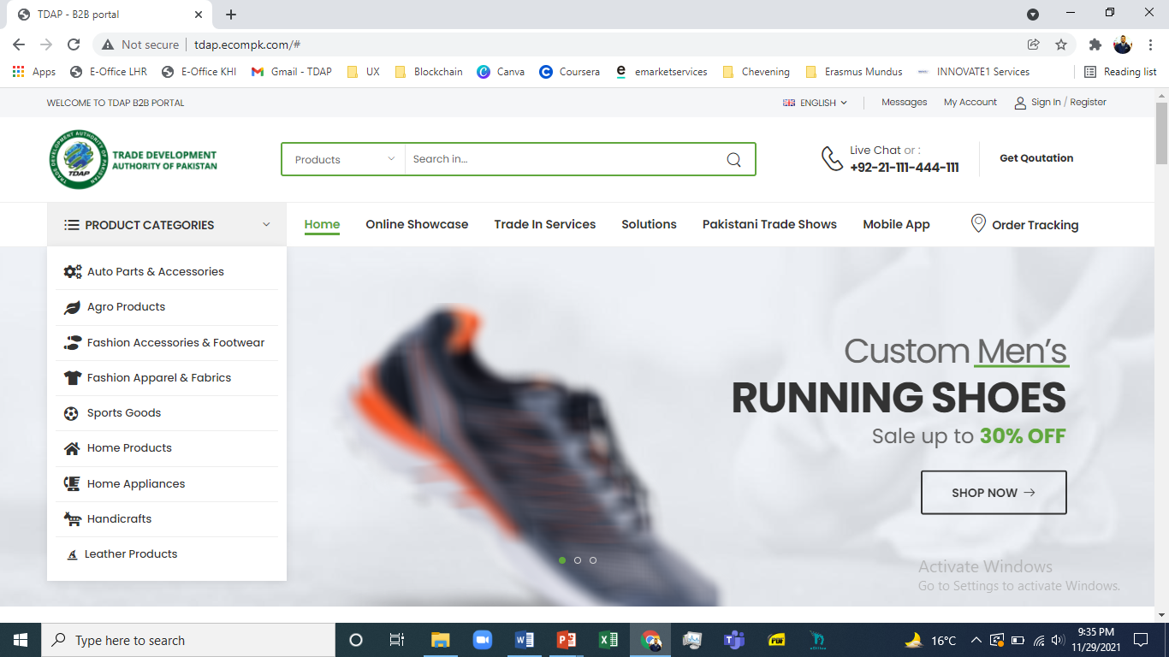

Slide 19
Collaboration with Alibaba
For E-Commerce
1
MoU under Negotiation
Second draft shared by Alibaba
Awaiting response on subscription fee reduction from Alibaba

Slide 20
Collaboration with Ozon
For E-Commerce
2
Collaboration under discussion
First Session held.
Awaiting response fro Ozon.

Slide 21
Collaboration with Solostocks
For E-Commerce
3
MoU under Negotiation
1st draft shared by Solostocks
Agreement Reached
Awaiting final draft from Solostocks

Slide 22
Collaboration with JD.com
For E-Commerce
4
Collaboration being planned
First Session held.

Slide 23
Thank you.

