Slide 2
Growth | Future
| Meezan Bank Limited

Slide 3
Presentation outline
Muaz Ashraf
Importance of banking
Why Islamic banking?
What distinguishes Islamic banking from conventional banking?
World wide position
Islamic Banking today
The way forward

Slide 4
Importance of Banking
Muaz Ashraf
Banking is the most important sector of the modern day economy.
It provides an opportunity to the household with surplus capital to select the best mix of investments in terms of return and tenors & security.
It provides an opportunity to businesses and Governments to finance their activities through obtaining surplus funds.

Slide 5
Muaz Ashraf
Why Islamic Banking?

Slide 6
Why Islamic Banking?
Muaz Ashraf
Importance of Purifying the Source of Income in Islam
The body which is nourished by non-pure sources is bound to hellfire.
On the day of Judgment, a person will not be moved from the place which he stands until he is asked about the sources of his income, and the ways he spent it.
Purifying the source of one’s nourishment is one of the important reasons for the acceptance of supplications by Allah.
Notes:
۔ المعجم الأوسط - (6 / 113):
عن أبي بكر الصديق قال قال رسول الله صلى الله عليه و سلم لا يدخل الجنة جسد غذي من الحرام
2۔
3۔ سنن الترمذي - (5 / 220):
عن أبي هريرة قال : قال رسول الله صلى الله عليه و سلم يا أيها الناس إن الله طيب ولايقبل إلا طيبا وإن الله أمر المؤمنين بما أمر به المرسلين فقال { يا أيها الرسل كلوا من الطيبات واعملوا صالحا إني بما تعملون عليم } وقال { يا أيها الذين آمنوا كلوا من طيبات ما رزقناكم } قال وذكر الرجل يطيل السفر أشعث أغبر يمد يده إلى السماء يا رب ومطعمه حرام ومشربه حرام وملبسه حرام وغذي بالحرام فأني يستجاب لذلك

Slide 7
Definition of Riba
Every Debt that pulls any kind of gain is Riba
Riba means any pre agreed excess compensation over and above the principal
Compensation may include monetary as well as non monetary benefits

Slide 8
Why Riba is Prohibited?
Muaz Ashraf
Key objective is to ensure Social justice
Cannot be achieved without Economic Justice
Economic justice requires a viable economic system supported by an efficient banking system
Interest results in concentration of wealth.

Slide 9
Distinguish
Islamic
Vs
Conventional Banking

Slide 10
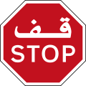
Objectives of Islamic Banking
Muaz Ashraf
Equitable Distribution & Circulation of Wealth in the society
Avoid all Impermissible transactions:
Promote participation based & asset Backed Financing
Fulfilling halal Needs of Customer
Ensuring Sharia Compliance in all transactions
Interest (Riba) | Gambling (Qimar) | Uncertainty (Gharar)
| Uqood-e-Fasida
Any excess on principle in Loan
Sale of Debt
Future Sale
Forward Sale
Sale Without Possession or Risk
Sale without Ownership
Sale of Unspecified Goods or Assets.
Bonds etc.
T-Bills etc.
Conventional Mortgage
Conventional REIT’s
Insurance

Slide 11
Distinguishing Features
Muaz Ashraf
Conceptual & Socio-religious level
Islamic banks are not money lenders
cannot deal in interest & non permissible industries/goods
Decision making has to be ethical and abide moral values
Business model & Governing framework
actively participates in trade and production process
Governing framework in terms of Sharia Advisor &/or SSB
Product Level Implementation
usually asset backed & involve trading/renting of asset & participation on profit & loss basis
Implementation is not just a mere change of paper work and terms but it involves
clarity of roles of contracting parties

Slide 12
What distinguishes Islamic Banking
Muaz Ashraf
Transactions are asset-backed
Transactions are money lending & Riba based
It is socially-responsible banking because it operates under Sharia restrictions
Involve in many impermissible transactions like Short selling, Sale of Debt, Speculation etc.
Permit financing of prohibited goods & Industries like alcohol, casinos etc.
Islamic
Does not permit financing of prohibited goods / Industries
Conventional
Ethics and moral values play a major role in investment decisions. Not a choice but a must
A matter of choice

Slide 13
The basic Difference Between Conventional and Islamic Mode of Finance
Conventional
Money
Client
Loan
Interest
Money
+
Money

Slide 14
The basic Difference Between Conventional and Islamic Mode of Finance
Islamic
Client
Goods | Services
Profit | Fee
Money

Slide 15
Islamic Banking
Inception & Today

Slide 16
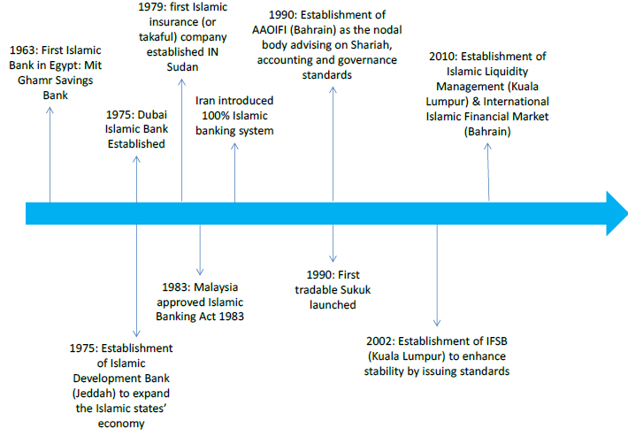
History Of Modern Islamic Banking

Slide 17
GLOBAL ISLAMIC FINANCE INDUSTRY LANDSCAPE

Slide 18
Global Islamic Finance Industry
Islamic Finance Industry
Takaful Insurance Companies
Modaraba Companies
Islamic Banks
Islamic Asset Management Companies
Sukuk
Islamic Leasing Companies

Slide 19
Global Islamic Finance Industry
Source: Islamic Finance Development Report 2020

Slide 20
Global Islamic Finance Industry
Total Asset size ~ US $2.88 Trillion
1,562 Islamic financial institutions including 526 ISLAMIC BANKs operating in 74 countries
46 countries with Islamic Finance Regulations
1,170 Shariah Scholars representing Islamic Financial Institutions
US 1.16 Billion CSR funds disbursed by Islamic Financial Institutions
972 Islamic Finance education providers
2,566 Islamic Finance research papers
$538 Billion value of outstanding Sukuk
$140 Billion value of Islamic Funds
336 Takaful companies across 47 countries; size of $51 Billion
57 Shariah Standards issued for Islamic financial institutions ( by AAOIFI)
Source: Islamic Finance Development Report 2020

Slide 21
Islamic Banking – A Success History
Muaz Ashraf
Different types of IFI have emerged globally
Islamic Commercial Banks
Islamic Investment Banks
Islamic Units of conventional banks
Islamic Funds
Islamic House Financing Schemes
International Financial Market
International Institutions of Islamic Banking

Slide 22
Global Bodies for Islamic Banking
Muaz Ashraf
AAOIFI
IFSB
IIRA
CIBAFI

Slide 23
Muaz Ashraf
Islamic Banking
In
Pakistan
“We must work our destiny in our own way and present to the world an economic system based on true Islamic concept of equality of manhood and social justice.”
Speech of Quaid-e-Azam at the opening ceremony of State Bank of Pakistan, Karachi July 1, 1948

Slide 24
Islamic Banking in Pakistan
Muaz Ashraf
Steps Taken for Promotion
Sharia Board established at SBP
Islamic products available to all services offered by conventional banks to fulfill sharia compliant needs of clients
Sharia compliant export refinance scheme launched
Model agreements for products developed by IBD of SBP
Sharia Audit/Compliance manuals have been developed
Various training courses and degree programs at universities
Tax laws are being rationalized to avoid double taxation of IFIs

Slide 25
Islamic Banking in Pakistan
Muaz Ashraf
Full Fledged Islamic Banks – 5
Meezan Bank
Al-Baraka Bank Pakistan Limited
Dubai Islamic Bank
Bank Islami Pakistan
MCB Islamic (MIB)
Many conventional banks operating Islamic Banking Branches: Bank of Khyber, Bank Alfalah, Habib Metro Bank, Bank Al Habib, Standard Chartered Bank, Soneri, HBL, UBL, Askari, NBP, Faysal/RBS etc. (18) – as they have accepted the reality and difference of Islamic banking.

Slide 26
Islamic Banking in Pakistan
Muaz Ashraf
Branch network of IB (including Windows) – 5,145
Asset base of IB – Rs. 4,797 Billion
Deposit base of IB – Rs. 3,822 Billion
Growth rate YoY of Asset base is around 32%
Growth rate YoY of Deposit base is around 29.7%
Share of IB in the overall Banking system stands at 18.7%
As of June, 2021; SBP IB Bulletin

Slide 27
Uniqueness of Islamic Banks
Muaz Ashraf
Commingling between Finance & Religion and ethics
Sharia Supervisory Boards (SSB)/Sharia Advisor
Studies Articles of associations and bylaws
Approval of all contracts
Contribute in designing new products
Audit the actual implementations
Issuance of Fatwas
Research - Training

Slide 28
Centre of Excellence in Islamic Finance (CEIF)
Research Infrastructure in Partnership with LUMS, IBA and IM Sciences
Incubator for research on contemporary issues
Comprehensive source of education, training and degree programs
International orientation and collaboration
Mobilizing local and international expertise
Strong quality assurance network
Innovation & capacity building

Slide 29
ISLAMIC FINANCING PRODUCTS

Slide 30
General Islamic Financing Modes
Islamic banking offers a wide range of solutions to meet long term, short term & consumer financing and investment needs.
Corporate Financing
Consumer Financing
Investment
Murabaha
Istisna/ Salam
Tijarah
Musharakah
Mudarabah
Diminishing Musharakah
Ijarah
Wakalah
Diminishing Musharakah
Ijarah
Istisna
Wakalah
Musawamah
Musharakah
Mudarabah
Wakalah
Inter bank
Musharakah
Mudarabah
Wakalah
Credit Sale of Sukuk

Slide 31
Short Term Financing Needs
Raw Material
Overheads / Utilities
Finished Goods
Trade receivable financing
Rental financing
Islamic Banking solutions
Murabaha - for working capital/consumer goods
Salam/Istisna - for overheads, utilities & receivable
Tijarah - for finished goods & receivables
Lease & Sub Lease – for rental financing
Transaction based Musharakah/Mudarabah

Slide 32
Murabaha
Murabaha is a particular kind of sale where the transaction is done on a “cost plus profit” basis i.e. the seller discloses the cost to the buyer and adds a certain profit to it to arrive at the final selling price.
Payment of Murabaha price may be:
At spot
In installments
In lump sum after a certain time

Slide 33
Murabaha
Basic rules for Murabaha financing:
Asset to be sold must exist.
Asset must be in the possession and ownership of seller
Asset should be specified
Sale price should be determined.
Sale must be unconditional.
Should not be used for un-Islamic purpose.

Slide 34
Murabaha
1. Payment of Cost
3. Payment of Murabaha price
Supplier
Bank
Client
2. Delivery of goods

Slide 35
Istisna
It is an order to manufacturer to manufacture a specific commodity for the purchaser
Manufacturer uses his own material
Quality & quantity should be agreed in absolute terms
Purchase price should be fixed with mutual consent
Upon delivery of the specified items (Constructive possession through physical inspection), Bank can appoint the Customer as its agent to sell the goods to its buyers.

Slide 36
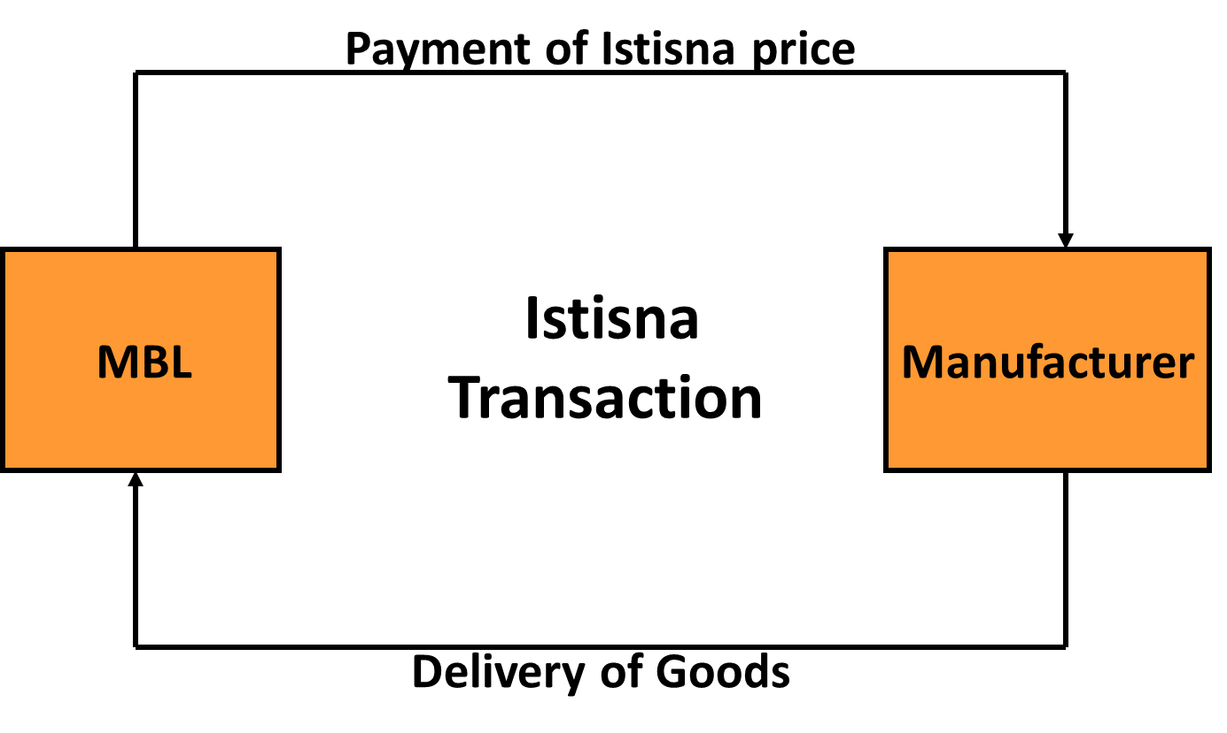
Istisna

Slide 37
Long Term Financing Needs
Acquisition/replacement/expansion of fixed assets, plant & machinery
Buying a car or house
New Project
Securitization
Islamic Banking Solutions:
Ijarah
Diminishing Musharakah
Sukuk & syndicated project financing

Slide 38
Ijarah
Ijarah means “To give something on rent”
Ijarah is an Islamic alternative of Leasing.
Leasing backed by an acceptable contract is an acceptable transaction under Shariah.
Several characteristics of conventional agreements may not conform to Shariah thus making the transaction un-Islamic and thereby invoking a prohibition.

Slide 39
Ijarah
Usufruct of asset
2. Transfer of Title
VENDOR
ISLAMIC
BANK
CUSTOMER
1. Payment of Purchase Price
Payment of Rental Fees
Notes:
IJARAH AND IJARAH MUNTAHIA BITTAMLEEK
The customer approaches the Bank with the request for financing
The client approaches the Bank showing interest in purchase of the commodity. He will present full description and detailed specification including the source of supply.
The Bank will run a credit valuation, the same way its done in conventional banking.
If the customer is a good risk, then the Murabaha margin (i.e. Bank’s profit on the market-up price) for him will have to be decided. The margin will be quoted, most probably as a per annum flat rate based on the total cost of acquiring the commodity by the Bank including the price and all related expenses.
If the customer agrees, he will be asked to sign a pledge agreement, committing him to buy such commodity once it is under the possession of the Bank. As part of the Murabaha transaction, the client will asked to present some securities to the Bank at the time of signing the pledge. These securities could be in the form of cash or any other liquid asset, equivalent to about 5% to 10% of the value of the deal.
The Bank purchases the item and makes payment to the vendor
The Bank will contact the vendor of the commodity specified by the customer and make arrangements for the acquisition. The Bank will make the required payment to the vendor for receipt of the commodity.
The Bank receives title of ownership from the vendor
The Bank is only able to execute the Murabah deal when the commodity’s ownership is completely transferred over to the Bank from the vendor.
The customer makes payment up-front or on a deferred basis
The customer will either pay the Bank the whole amount of the Murabaha contract (including a mark-up) up-front of make payments on a deferred basis.
The Bank transfers the title over to the customer upon payment
The Bank will transfer the ownership title of the commodity to the customer once the payment is received from the customer.

Slide 40
Diminishing Musharakah
In Diminishing Musharakah the financier and the client participate either in joint ownership of a property or an equipment
The share of the financier will be divided into a number of units
The client will purchase these units one by one periodically until he is the sole owner of the property
Client will also pay rental amount over the undivided portion of the asset owned by Bank

Slide 41
Diminishing Musharakah
Assets
Joint Ownership
BANK
Rent
CUSTOMER
Gradual Transfer of Ownership
Musharaka

Slide 42
The Way Forward

Slide 43
The Way Forward
Islamic banking is a viable alternative
Islamic alternates of Banking Products can be very effectively developed for all types of needs
However, there is a need for proper research and development.
Ulema, bankers and professionals need to coordinate more frequently.

Slide 44
The Way Forward
Muaz Ashraf
We will have to change our attitudes
IBIs can’t provide each and every financing solution like Prize Bond acceptance, facilitation to Insurance companies
Shariah compliance must be our USP
May Allah give us success in our efforts - Ameen
Notes:
USP: Unique selling Point

Slide 45
Any Question ?

Slide 46
Muaz Ashraf
جزاك الله خيرا

