Slide 1
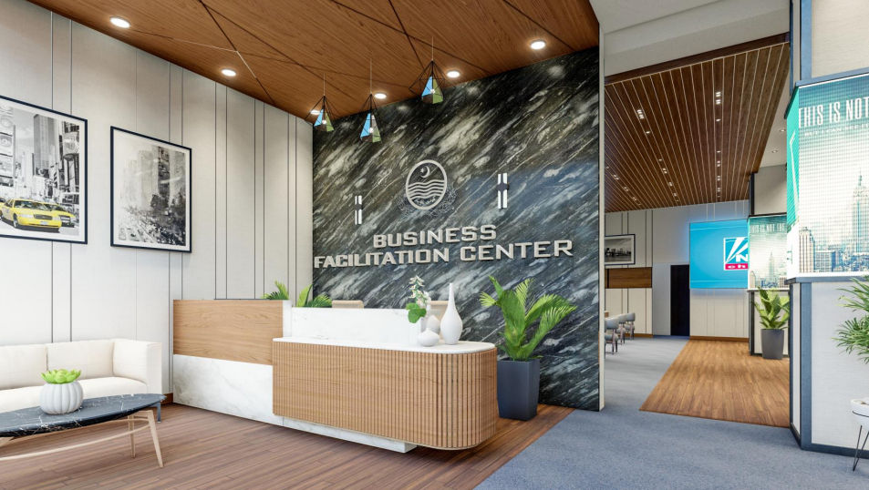
Business Facilitation Center (BFC) (One Roof)
Industries, Commerce, Investment and Skills Development
Industries, Commerce, Investment & Skills Development Department

Slide 2
Situational Analysis
Industries and Business required to obtain registrations, licenses and NOCs for starting a business and for running a business
Manual processing and number of visits to different departments at different locations
Impediment in Investment Promotion
Purchase of Plot in SEZs/IEs from different public sector developers
Delay in Approvals

Slide 3
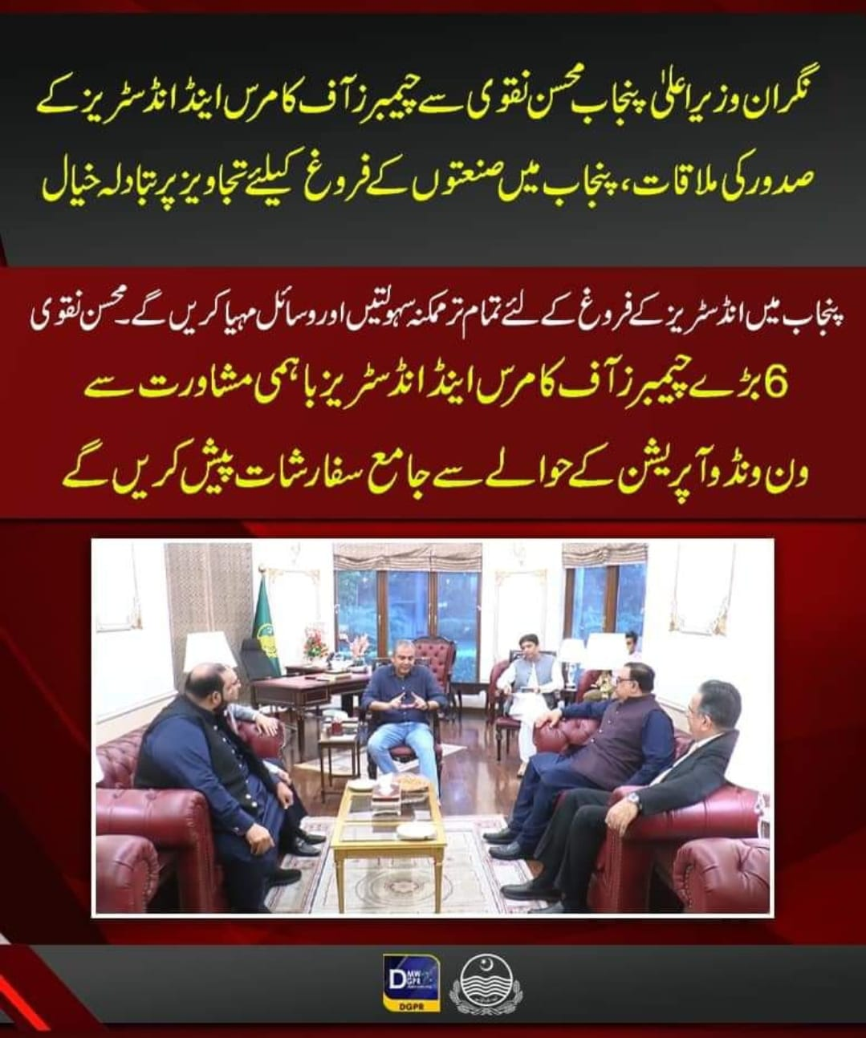
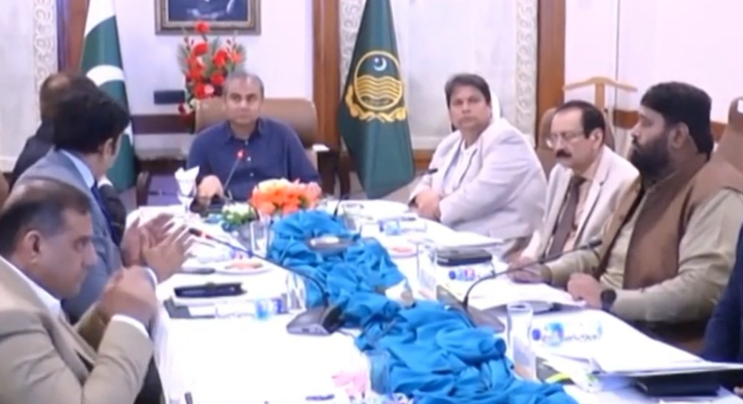
BFC Initiative

Slide 4
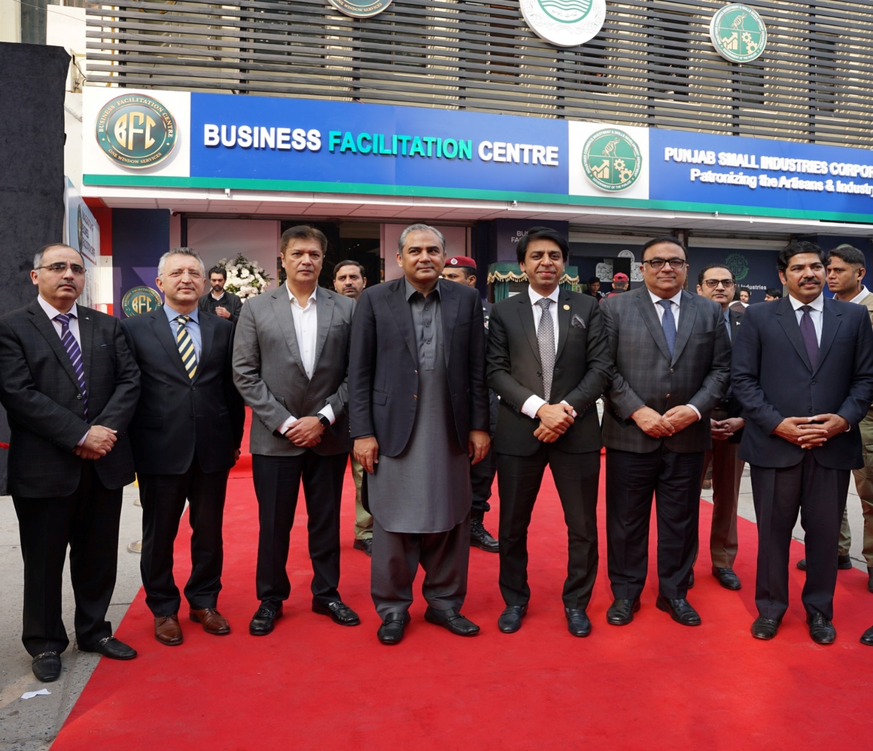
CHAMBERS OWNERSHIP

Slide 5
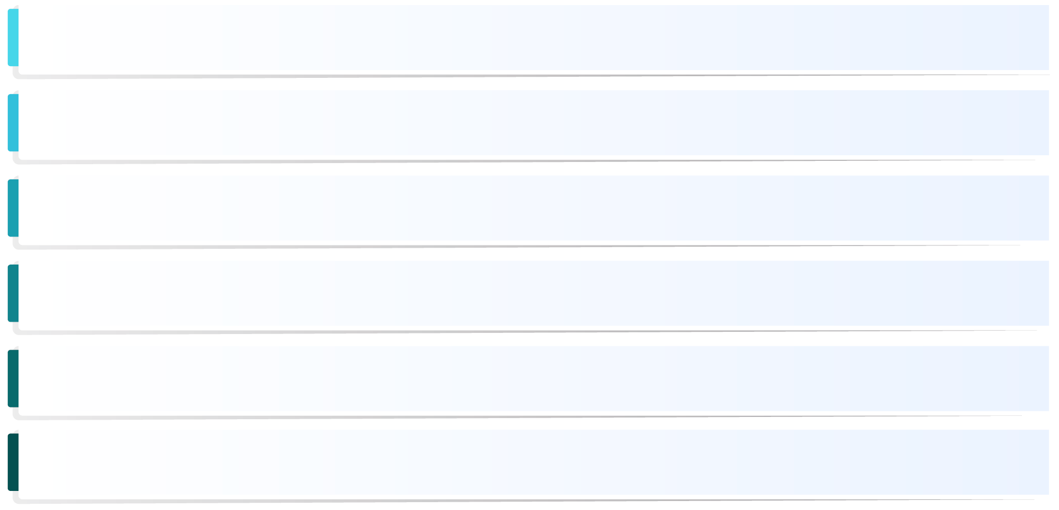
AIM of the Initiative
Investment Promotion in the Province
Automation and digitization of Government Processes
Promote Ease of Doing Business
One Roof for submission of documents and receiving of documents
Client Services for establishment of Industry in SEZs/IEs
Performance Monitoring and Query/Complaint Redressal Mechanism

Slide 6
Business Facilitation Center (One Roof)
One Roof Solution (Phase-I)
Query/Complaint Redressal Mechanism
Client Services Arrangements
Investment Promotion Counter
One stop for receiving applications and collection of processed document
All public sector SEZ/IEs developers under one roof
Regularly updated knowledge portal / website/app
Scalability in Phase-II (Provincial and Federal Government departments can be added)

Slide 7
Participating Departments
Sr.# | Name of Department | No. of Services / RLCOs
1. | Environment Protection Department | 32
2. | Forestry, Wildlife & Fisheries Department | 7
3. | Livestock & Dairy Development Department | 13
4. | Tourism, Archaeology & Museums Department | 4
5. | Energy Department | 4
6. | Directorate General (IPWM) | 11
7. | LG&CD Department | 9
8. | PIEDMC | 14
9. | Home Department (Civil Defense) | 01
10. | Special Economic Zones Authority (SEZA) Punjab | 01

Slide 8
Participating Departments
Sr.# | Name of Department | No. of Services / RLCOs
11. | Faisalabad Industrial Estate Development & Management Company | 10
12. | Punjab Small Industries Corporation | 5
13. | Lahore Development Authority | 5
14. | Parks & Horticulture Authority (PHA), Lahore | 3
15. | Traffic Engineering & Planning Agency (TEPA), Lahore | 1
16. | Water & Sanitation Agency (WASA), Lahore | 2
17. | Irrigation Department | 5
18. | Communication & Works (C&W) Department | 2
19. | Lahore Electric Supply Company (LESCO) | Facilitation Desks
20. | Sui Northern Gas Pipelines Ltd. (SNGPL)

Slide 9
Online Portal
www.bfc.punjab.gov.pk
Processes/NOCs are available on the dedicated website
https://bizknowledge.punjab.gov.pk/
Contains the list of all activities i.e. 105 services which can be availed from the participating departments, checklists containing required documents (alongwith sample documents/FAQs/common mistakes), applicable fees/fee schedule etc.

Slide 10
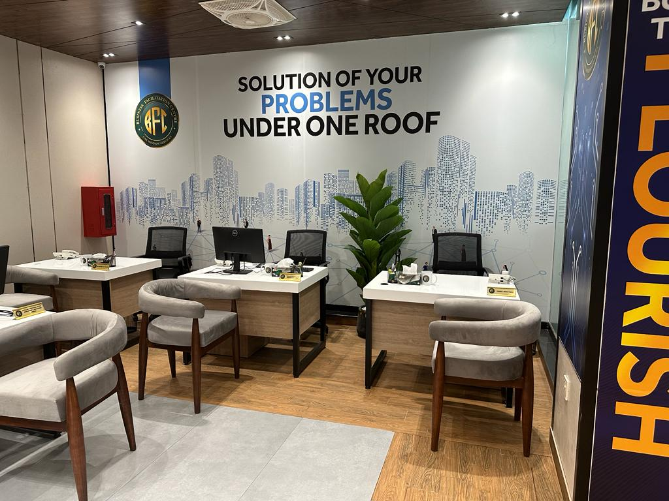
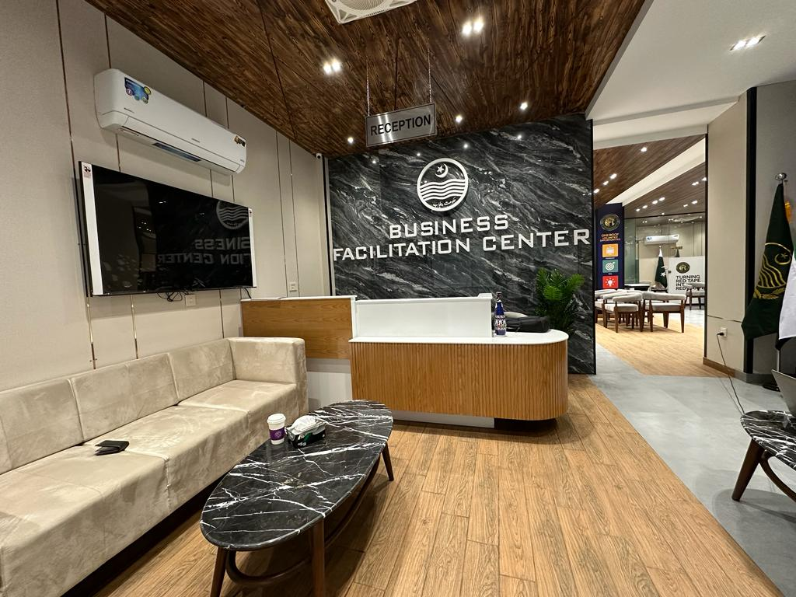
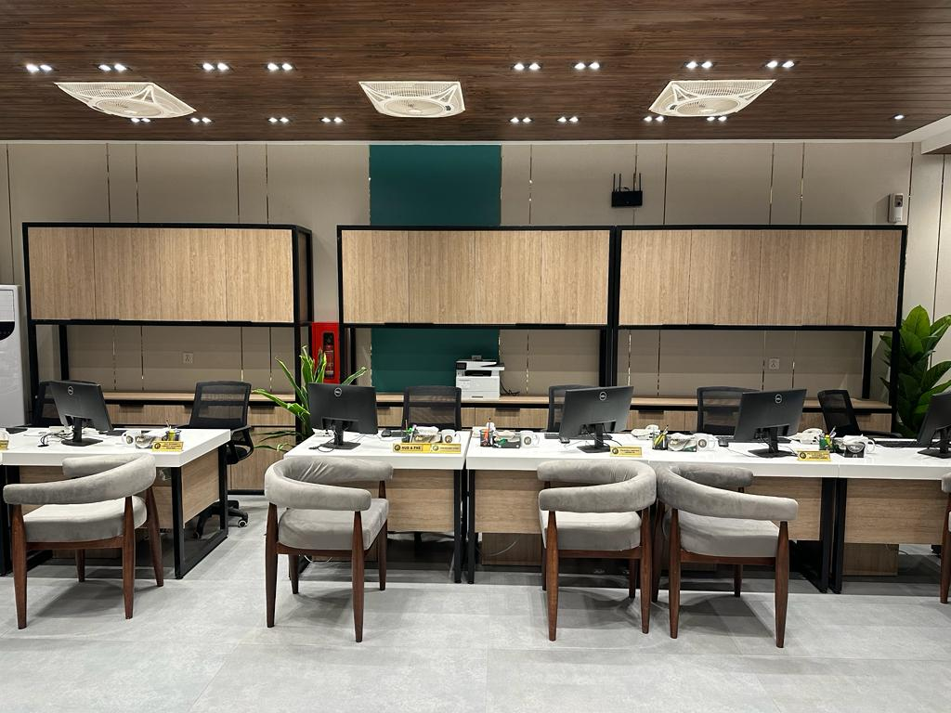
Business Facilitation Center, Lahore

Slide 11
Monitoring/Evaluation & Complaint Redressal
Status update on the website through Tracking ID
Client Services Manager from PBIT to deal with complaints at BFC
Departmental Representatives to guide the Client and provide feedback
Escalation of complaint to concerned Administrative Secretary who shall be responsible for its redressal
Operational Review Committee headed by Secretary ICI&SDD (notified)
Daily sitting of each Administrative Secretary and Senior officers of ICI&SDD (schedule prepared)
High Powered Steering Committee headed by the Chief Secretary Punjab (notified)

Slide 12
THANK YOU

Slide 13
