Slide 1
Energy Audits & Energy Management Program

Slide 2
Contents
Comprehensive Energy Audits
Case Study – Findings and Recommendations of an Energy Audit Project
Energy Management Program and the Implementation of Complex Energy Efficiency Projects
Case Study – Savings from an ongoing Energy Management Program
Page 2
Energy Audits & Energy Management Program

Slide 3
COMPREHENSIVE ENERGY AUDIT

Slide 4
Objectives
Objectives of energy audit are to identify and prioritize energy conservation, energy efficiency & demand management opportunities to bring sustainability and competitiveness in the business of the company.
Achieving sustainability in business by
Making business more competitive by
Reducing specific energy consumption
Improving Key Performance Indicators (KPIs)
Optimization of systems and processes
Improving productivity
Reducing CO₂ emissions
Reducing environmental impact
Reducing operational and utility costs
Improving industrial performance
Making informed investment decisions
Capturing financial returns from energy saving
Improving the bottom line
Drafting a future energy road map
Completing an energy audit gives a better picture of energy consumption and identifies opportunities for improvement, often delivering immediate cost savings.
Page 4
Energy Audits & Energy Management Program

Slide 5
Approach
To activate the implementation of identified energy saving projects immediately after the completion of energy audit project, we take the approach of dividing the entire project into following two phases:
PHASE 1
PHASE 2
Comprehensive Energy Audit
Energy Management Program
Preparation & Data Collection
Performance Assessment
Reporting & Presentation
Implementing the Projects
Measure & Verify Savings
Phase 2 is to implement the recommended projects and measures through a customized energy management program.
Page 5
Energy Audits & Energy Management Program

Slide 6
Scope & Methodology
Scope of comprehensive energy audit includes the technical energy review, on-site inspection & performance assessment of all systems and subsystems followed by a report.
Energy Review
Performance Assessment
Analysis & Reporting
Historical energy & production data collection
Development of trends & energy use indices
Benchmarking & regression analysis
Inspection of leakages & suboptimal practices
Surveys to audit the O&M practices
Performance assessment of all systems & subsystems
Development of energy saving measures
Financial analysis of energy saving measures
Implementation plan & future roadmap
Techno Commercial Proposal
Energy & Production Data Collection
On-site Performance Assessment
Analysis and Reporting
Presentation & Discussion on the Findings
Page 6
Energy Audits & Energy Management Program

Slide 7
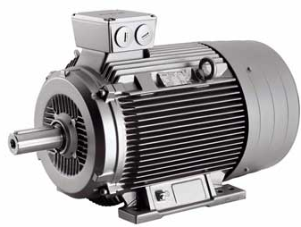
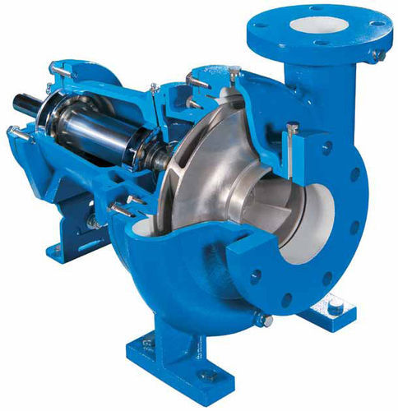
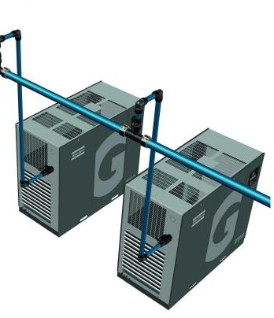
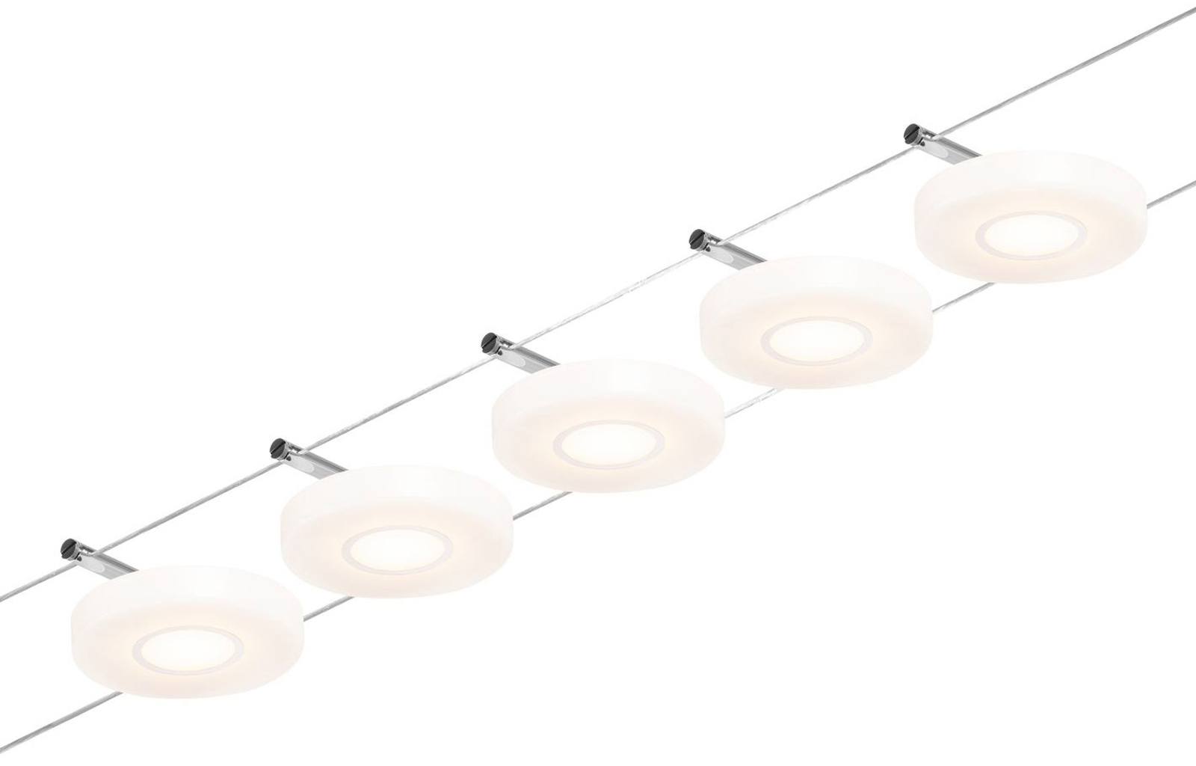
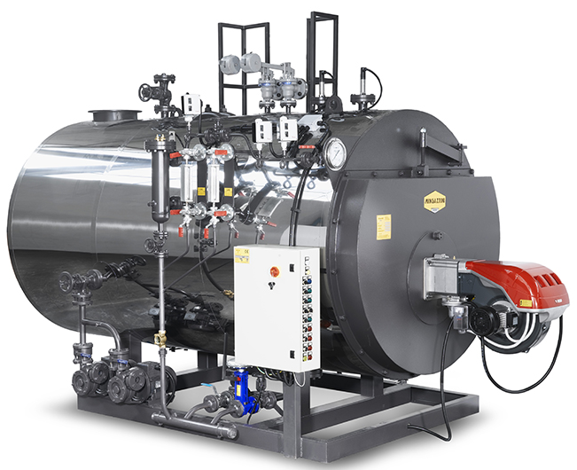
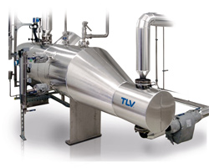
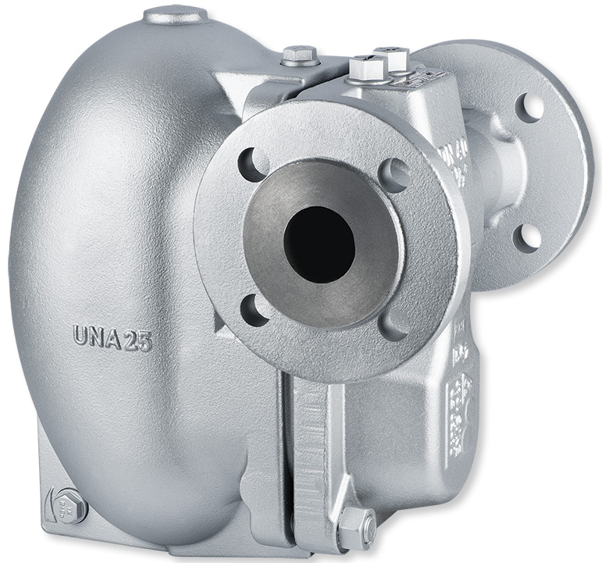
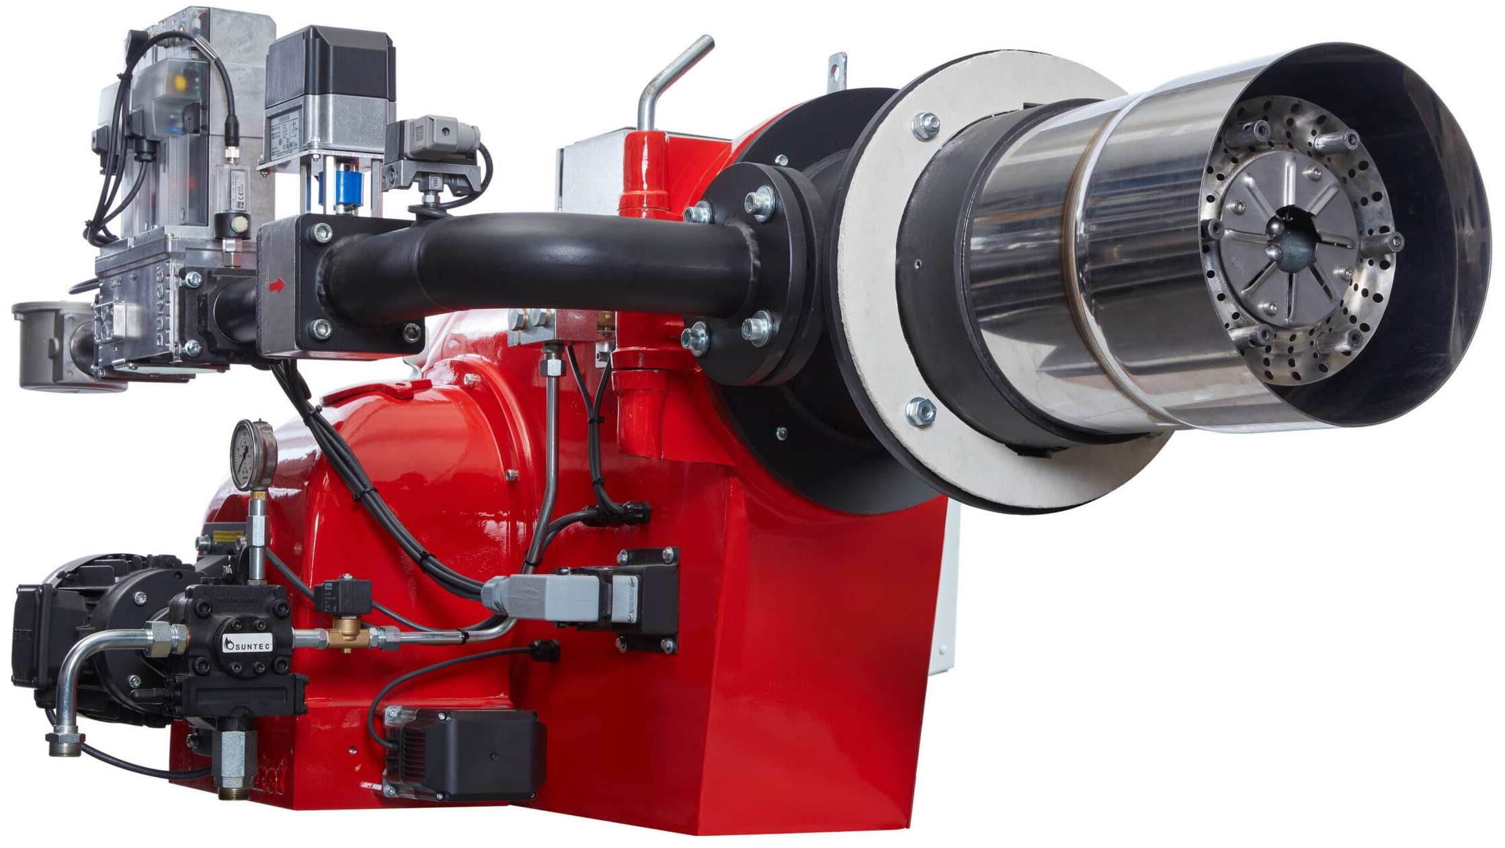
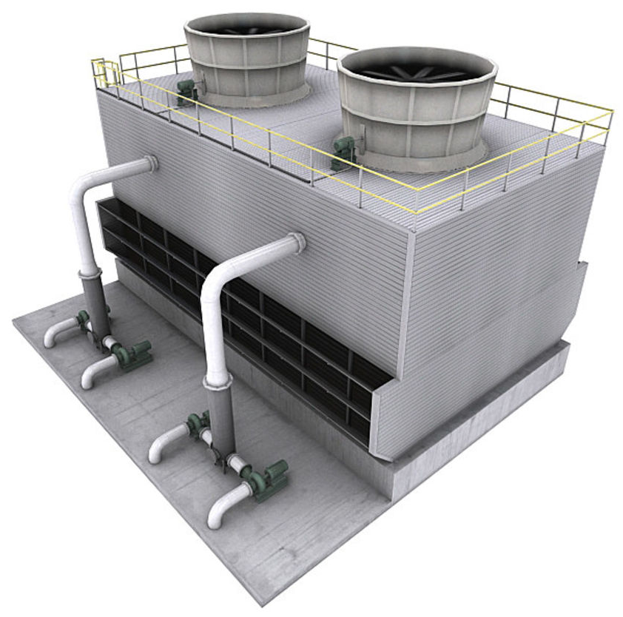
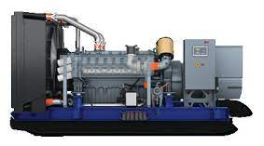
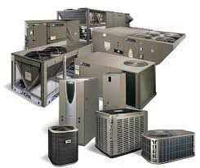
Onsite Testing & Inspection
Electrical System
Motors
Pumps
Compressed Air
Lighting System
Boilers
Steam Network
Steam Traps
Burners
Process Heating
Cooling Towers
Hot Water Generator
HVAC&R
Thermographic Study
Miscellaneous
Page 7
Energy Audits & Energy Management Program

Slide 8
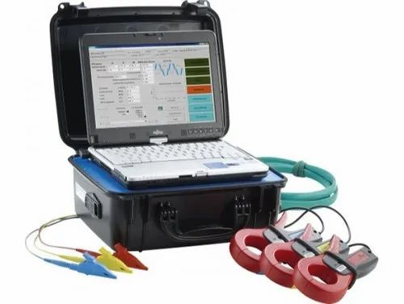
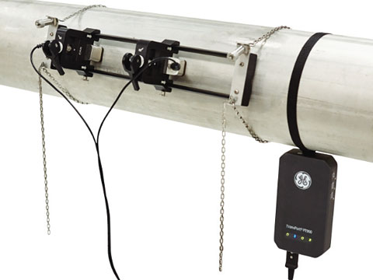
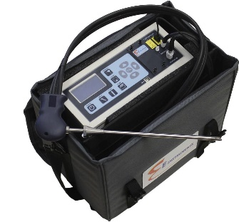
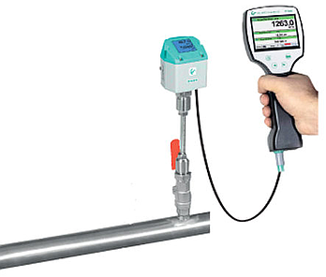
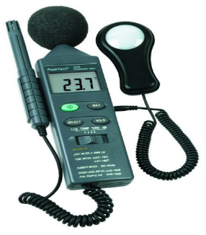
Tools and Instruments
PQA
MCSA
Ultrasonic Flow Meter
Ultrasonic Leakage D.
Lux Meter
Flue Gas Analyzer
Steam Trap Tester
Thermal Imager
Gas Flow Meter
Environmental Meter
Page 8
Energy Audits & Energy Management Program

Slide 9
CASE STUDY

Slide 10
Facility Overview
Major thermal and electrical utilities at the plant include electricity, steam, heated oil for process heating and compressed air.
Electricity
10 – 20% from Grid
80 – 90% from Captive Power Plant
Compressed Air
Compressors
Compressed Air
Steam
Coal Boiler
Gas Boilers
Biomass Boilers
WHRBs
Compressed Air
Compressed Air
Process Heating
Gas Dryers
Oil Heaters
Finishing Machines
Compressed Air
Compressors
Compressors
Compressors
Compressors
Page 10
Energy Audits & Energy Management Program

Slide 11
Annual Energy Use
In 2019, total energy expense is about 10* Million USD. Annual production in this year was over 35** Million Kg.
Electricity
Natural Gas
Coal
Corn Cob
41,000 MWh
129,000 MMBTU
48,000 Ton
4,000 Ton
Corn cob and part of coal and natural gas is used to produce steam. Rest of the coal and natural gas is used for process heating.
Coal share in total primary energy consumption is about 82% while rest 7% is electricity and 7% is natural gas.
Coal and electricity accounts for about 50% and 40% of total energy cost, respectively.
Page 11
Energy Audits & Energy Management Program

Slide 12
Major Systems Assessed in the Energy Audit Project
Steam System
Boilers, blow down, flue gas analysis, steam network, PRVs, steam traps, condensate return
Process Heating System
Thermal oil heaters, dryers, stenters, burners, combustion efficiency, waste heat recovery
Compressed Air System
Supply side (compressors, controls, dryers, storage), distribution network, demand side
Electrical System
Power quality analysis, study of voltage and current imbalance, power factor study
Electrical Motors
Logging motors parameters, efficiency assessment, over/ under capacity motors, VFD application
Pumping System
Performance assessment of pumping systems, Control system
Thermographic Studies
LT/HT panels, insulation checks on boilers, steam network and process heating systems
Energy Monitoring
Review of energy monitoring/ accounting system, digitalization assessment
Page 12
Energy Audits & Energy Management Program

Slide 13
Energy Performance of the Plant
KWh consumed to process per Kg of product
Tons of Steam consumed to process per Kg of product
Plant consumed 7% more electricity &16% more steam to process per Kg of product in 2021 compared to 2018.
Page 13
Energy Audits & Energy Management Program

Slide 14
COVID-19 Impact on Energy Performance
Electricity and Steam consumption in 2020, instead of going down as of sharp decline in production, WENT UP!
24% more Electricity & Steam consumption to process unit product in 2020 compared to 2018.
Leakages, suboptimal controls & O&M practices, absence of real-time monitoring & tracking system are responsible for unregulated demand.
This has suppressed the bottom line of the company by about 1.3 Million USD in Year-2020. Which is about 10% of total annual energy cost of plant.
18% decline in production
250K Tons Steam
254K Tons Steam
37.0 GWh
37.6 GWh
Page 14
Energy Audits & Energy Management Program

Slide 15
Energy and Cost Saving Estimates
Plant could achieve annual cost savings of about 1.2 Million USD by carrying out the measures and implementing the projects identified in the report.
Electricity
Natural Gas
Coal
3,183 MWh
7,500 MMBTU
7,600 Ton
1.2 Million USD
318,300 USD
48,500 USD
863,100 USD
Annual 8% savings in electricity consumption, 6% in natural gas consumption, and 16% in coal consumption have been identified, with a corresponding gross annual reduction of 24,500 Tons of CO2 emissions.
Page 15
Energy Audits & Energy Management Program

Slide 16
Major Recommendations
Few of the major projects proposed in the energy audit report are listed below:
Replace the failed and/or unsuitable steam traps with recommended type/size of steam traps.
Maximize the condensate recovery with recommended size of condensate return pumps.
Install separators, PRVs and temperature gauges at the specified locations.
Regulate the supply of steam to washers and dryers.
Use flash steam to produce hot water to use in machines where direct steam is being used.
Tune the air/fuel ratio of burners or install O₂ trim control system.
Redesign the in-efficient pumps that circulate the RO water to process application and boiler make-up water.
Recover the waste heat from dryers and stenters to save fuel.
Increase the size of the storage tank of compressed air system.
Install recommended type of fittings on end-use application of compressed air.
Optimize the load/unload hours of fixed speed compressors.
Optimize the lux level in different areas of the plant.
Insulate the damaged/ bare surfaces.
Enhance the digitalization of the plant as per the recommended road map.
Implement the data driven energy analytics system.
Page 16
Energy Audits & Energy Management Program

Slide 17
ENERGY MANAGEMENT PROGRAM

Slide 18
Customized Energy Management Program
Customized energy management program has been designed based on findings of energy audit project to execute energy saving projects strategically. Implementation of the program is in progress.
Tier 1
Tier 2
Tier 3
Tier 4
Prioritizing Improvements
Implementing Energy Conservation Measures
Fixing leakages, developing protocols, programs & controls, behavioral changes to prevent wastage, training & capacity building
Implementing Energy Efficiency Recommendations
Retrofitting and upgrades, pumps, condensate return lines, CAS, Motor Upgrades, HVAC system, Oxygen trim controllers, waste heat recovery projects
Compressed Air System Optimization
Planning the implementation of Measures
Steam System Optimization
Metering, Monitoring, & Baseline Development
Process Heating System Optimization
Measuring and Verifying the energy/ cost savings achieved
Developing Energy Management System
Motor Driven Systems Optimization
Planning and Implementing data driven Energy Analytics System
Energy Management
Energy Conservation
Energy Efficiency
Systems Optimization
Page 18
Energy Audits & Energy Management Program

Slide 19
ISO 50001:2018 Energy Management System
Technical consultation and support is provided to design & implement ISO 50001:2018 Energy Management System.
P
D
C
A
1. PLAN
2. DO
Top Management
Energy Team
Energy & Operations
Policy Making
Resource Allocation
Reporting Structure
Scope
Mandate
Objectives/ Targets
Promoting EM
Plan
Approval
Energy Review
Training Plan
Implementation Plan
Energy Awareness
Procurement/ Legal
Capital Projects
Feasibility Studies
Op. Improvements
Training Delivery
Awareness Session
Procurement
Documentation
3. CHECK
Preventive &
Corrective Actions
Project Management
Project M&V
Energy MT&R
Variance Analysis
4. ACT
Preventive &
Corrective Actions
Management
Review
Internal Audit
of the System
Page 19
Energy Audits & Energy Management Program

Slide 20
CASE STUDY

Slide 21
Optimization of Process Heating System
Coal | 6 M Kcal
Coal | 6 M Kcal
Gas | 8 M Kcal
Coal | 6 M Kcal
Coal | 6 M Kcal
Running 24/7
Running 24/7
Standby
Change Over
Running 24/7
Heater 4
Heater 3
Heater 5
Heater 1
Heater 2
Loading = 62%
18 ton/ day
0.9 million PKR/ day
Loading = 68%
20 ton/ day
1 million PKR/ day
Loading = 55%
16 ton/ day
0.8 million PKR/ day
Demand
ST 07
ST 08
ST 11
ST 12
ST 13
D 07
Demand
D 11
ST 16
ST 18
ST 19
ST 20
ST 23
Building 1
Demand
ST 06
ST 09
D 06
D 08
D 10
D 12
Building 2

Slide 22
Achieving savings of 0.5 Million PKR/ day by burning a mix of fuels. 15 Million PKR has already been saved by 20th July 2022.
1st Intervention on 4th June
Adjusted Baseline
Savings
Baseline
Actual Reported
20% cost savings (about 20 crore PKR/ Year) without any investment in the operating cost of process heating.

Slide 23
Fuel consumption per month varies between 1,450 – 1,650 Tons. Goal is to keep it less than1,500 Ton/ month.
By this, 3 - 4% additional cost savings could be achieved by optimizing & regulating the supply & demand.
This would be equivalent to about 20 – 40 Million PKR/ Year.

Slide 24
Savings achieved from no-capex measure 1 & measure 2 would be partially invested to implement measure 3 & measure 4 to gain a net savings of 150 Million PKR in first year.
1st Measure | No Capex
2nd Measure | No Capex
3rd Measure | 80 Million
4th Measure | 80 Million
1st Measure
1st Measure
1st Measure
4th Measure
3rd Measure
2nd Measure

Slide 25
Over 2 Million USD savings would be achieved every year by optimizing the supply and demand side of process heating system. This would result in a significant drop in the Carbon emissions as well.
Total savings of 1st Year
490 M PKR savings/ year
No Upfront Cost
Payback is in 4 months

