Slide 1
Upcycling of Plastic Waste for Circular Economy: Strategies and Characterization
Prof. Asif Ali Qaiser, PhD
Chairman, Department of Polymer & Process Engineering, University of Engineering & Technology, Lahore.
Email: asifaliqaiser@uet.edu.pk
19 August 2023
Gujranwala Chamber of Commerce and Industry (GCCI)

Slide 6
Plastics Trades Pakistan 2021
1.65MT
1.57B US$
226M US$
198M US$
84M US$

Slide 7
Plastic waste hierarchy in the EU Waste Framework Directive (WFD) 2008/98/EC

Slide 8
Disposal Methods for Polymer Waste
1. Recycling into identical or similar new products.
2. Recycling into less-demanding new products-preferably one with a long service life.
3. Depolymerizing by pyrolysis into basic monomers or fuels.
4. Incineration, with or without recovery of energy of combustion, and with or without presorting to cull out recyclable materials.
5. Greater use of biodegradable plastics where appropriate.
6. Greatly reduced use of plastics intended for disposable uses, such as diapers, no-deposit bottles, and other packaging.
7. Substitution of materials, such as paper or glass, for plastics in packaging.
8. Using less polymer in the product by better design and better materials.
If all plastic packaging were replaced with paper or glass, the volume of solid waste would increase by 250%, the cost of packaging by 210%, and the use of energy for packaging by 200%.

Slide 10
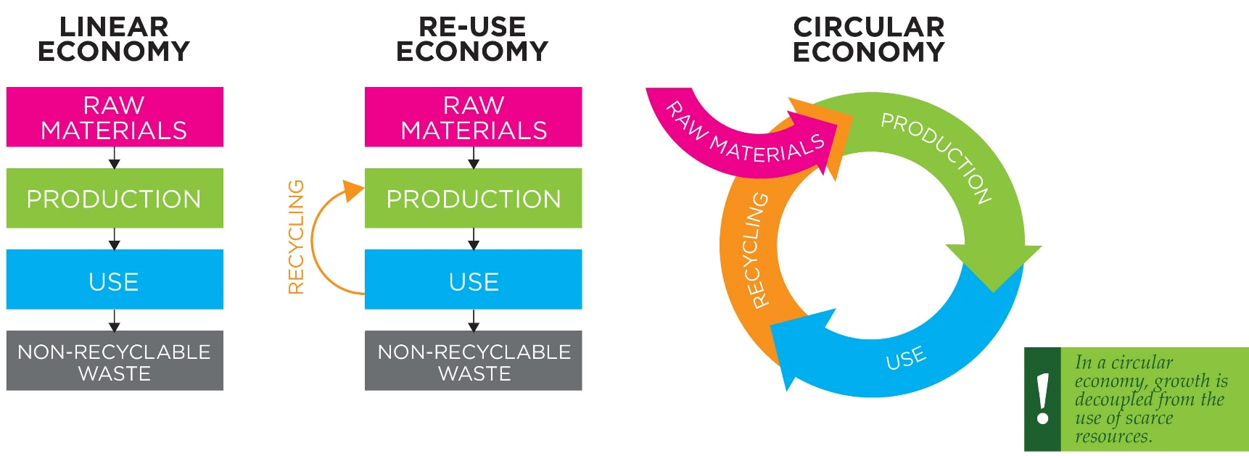
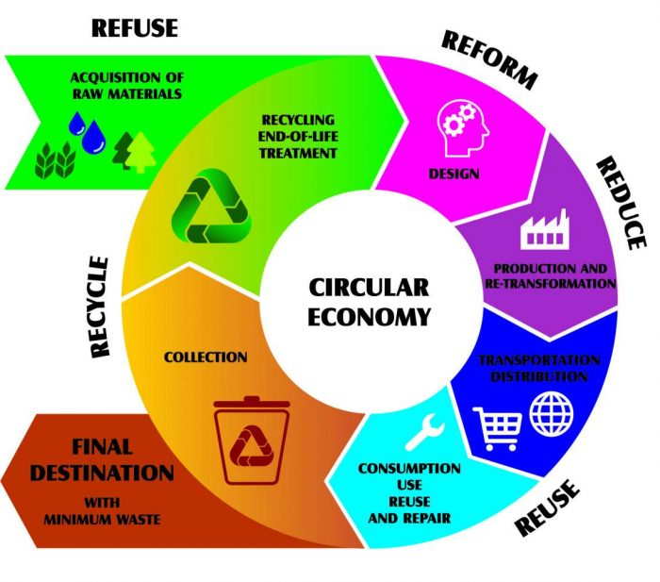
What is Plastic Circular Economy?

Slide 11
Circular Plastic Economy

Slide 12
Upcycling vs Recycling Technologies

Slide 13
Plastics Waste in Construction Industry

Slide 14
High C- Fuels and Activated Carbon

Slide 15
Upcycling and catalytic degradation of plastic wastes

Slide 16
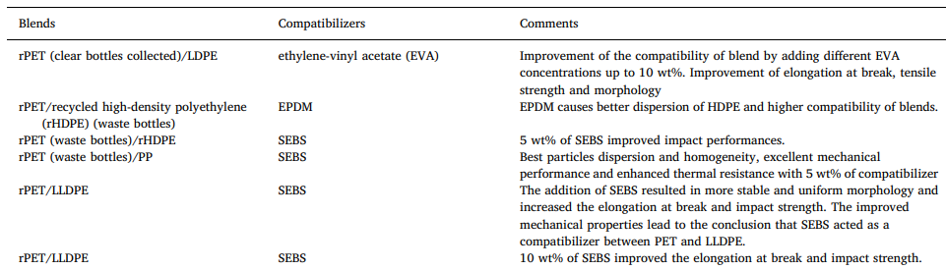
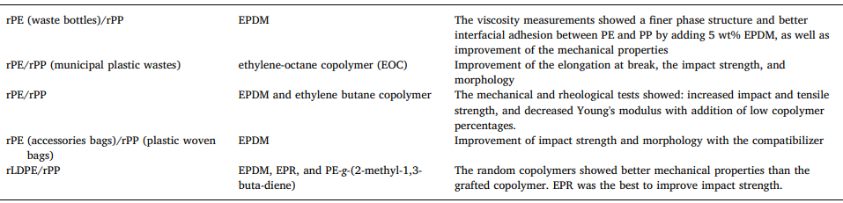
Upcycling with Co-Polymer Blending

Slide 17
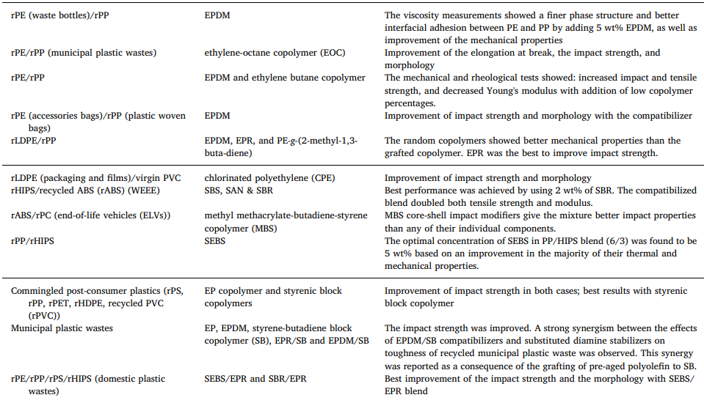
Upcycling with Co-Polymer Blending

Slide 18
Upcycling of Plastic waste through Reactive Compatibilization

Slide 19
Upcycling of Properties of Comingled Waste-Work Done at UET

Slide 21
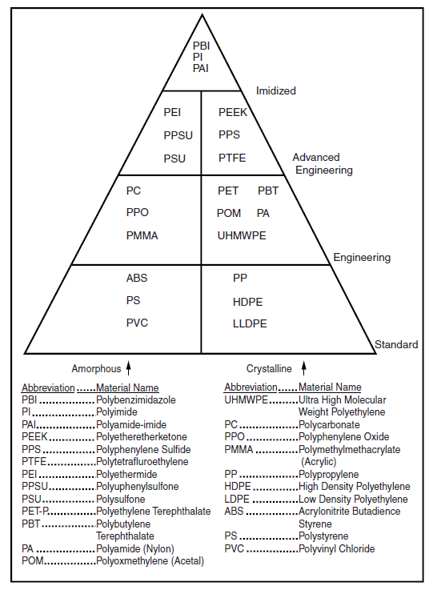
Plastic Materials Classification
Thermoplastics, Thermosets
Amorphous and (Semi-) Crystalline
polymers
Costs
Commodity: Thermoplastics-up to 150 ºF
Engineering Thermoplastics-up to 250 ºF
Advanced Engineering-up to 450 ºF
Imidized- up to 800 ºF

Slide 22
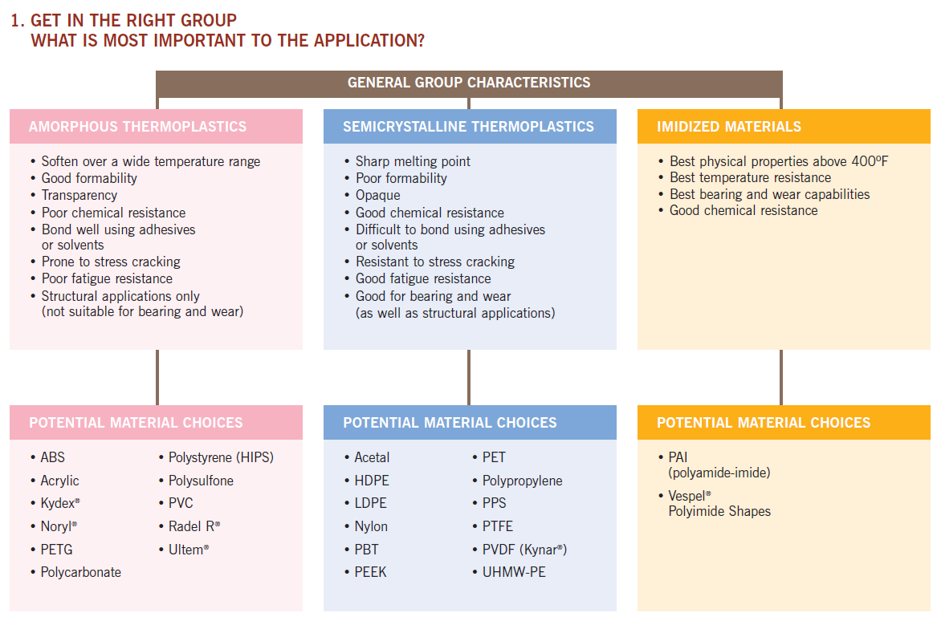
Materials Selection Guide

Slide 23
Types of Plastics Testing and Characterization
Mechanical testing including tensile, flexural, shear and compressive properties
Physical testing including density, hardness and scratch resistance
Thermal testing including DSC, DMTA,TMA, TGA, HDT and Vicat Softening Points
Rheological testing including capillary, rotational, Melt Flow Rate/Index and DSV
Barrier including WVTR, OTR and various gases
Weathering and Chemical Resistance testing including UV, temperature, humidity, repeated sterilization and environmental impact
Adhesion property testing
Flammability testing to industry standards, including automotive, aerospace and building specifications
Optical testing including color, haze and gloss
Electrical testing

Slide 24
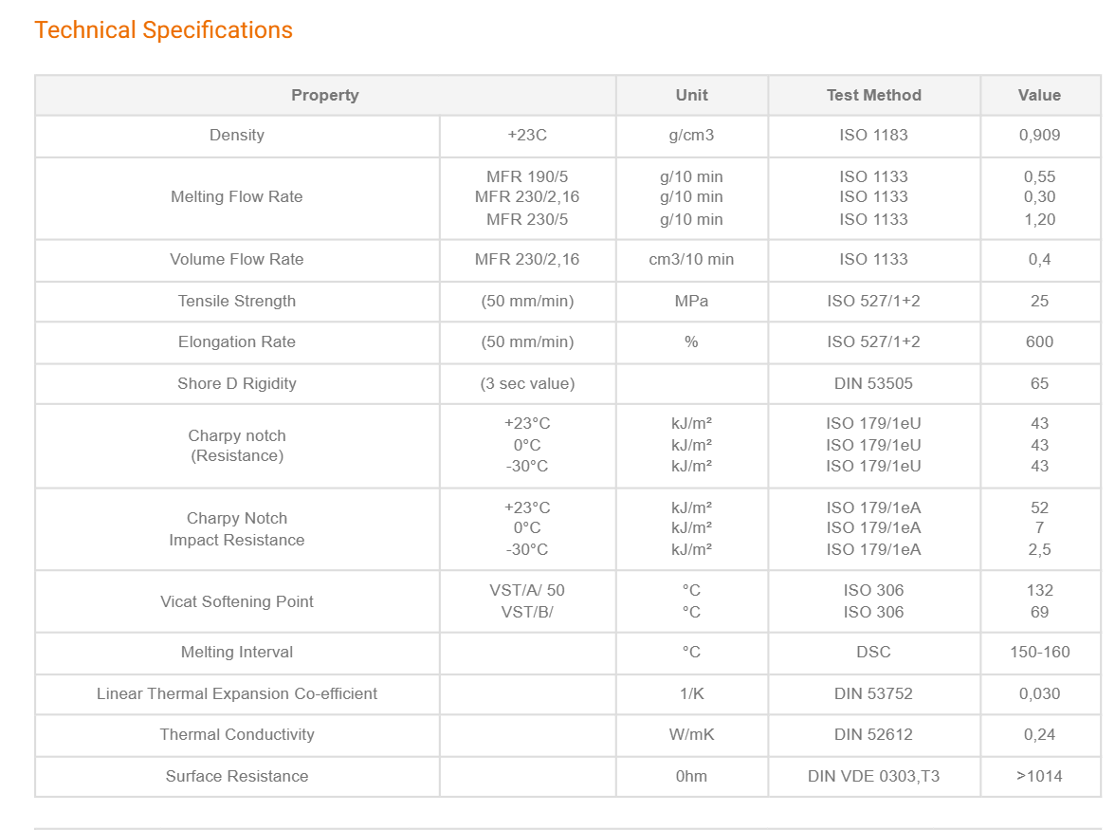
FIRAT PPRC PIPE- TDS

Slide 25
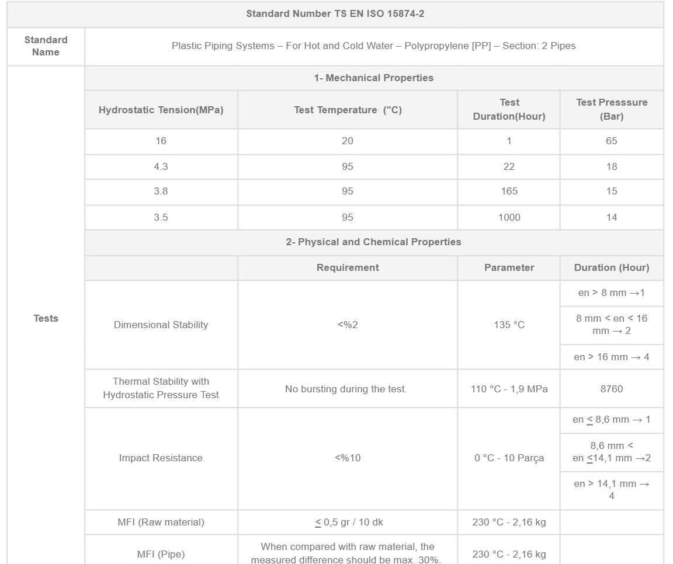

Slide 26
Plastics Testing

Slide 29
Thank You!

