Slide 1
Prevention of Aflatoxin in rice
By Dr. Mubarik Ahmed

Slide 2
MYCOTOXINS
Derived from two words
Myco meaning fungus
Toxin meaning toxic material
Mycotoxins are toxic metabolites produced by fungi in any organism that they infect

Slide 3
TYPES OF MYCOTOXINS
Don
T- 2 Toxin
Aflatoxin
Zearalenone
Alterotoxins
Clavicelp toxins
Aspergillus toxins
Ochratoxins, Patuline, Citranine
Fumonisin
Deoxynivalenal

Slide 4
WHAT ARE AFLATOXINS?
Aflatoxins are naturally occuring metabolites synthesized by two types of fungi – Asparigus flavus and Aspargillus parasiticus
Aflatoxins contaminate dietry staples including maize, rice, ground nuts, chillies, dry fruits, animal feed, milk, etc
They are more abundant in tropical regions with high temperatures and humidity viz Sub-Saharan Africa and South East Asia

Slide 5
TYPES OF AFLATOXINS
There are 4 types of aflatoxins found in cereals
B1 (AFB1)
B2 ( AFB2)
G1 (AFG1)
G2 (AFG2)

Slide 6
WHY ARE AFLATOXINS IMPORTANT
Aflatoxins are proven to be mutagens, carcinogens and teratogens
They produce disease called “Aflatoxicosis”
Aflatoxin B-1 produces cancer and affect liver by producing liver cirrhosis, necrosis and carcinoma and by suppressing by the immune system

Slide 7
Permissible limits for Aflatoxins
Different contries have set different limits of tolerance
COUNTRY | LIMIT
India | 30 ppb
Pakistan | 30 ppb
USA | 20 ppb
Australia | 15 ppb
China | 20 ppb
Egypt | 10 ppb (5 B1)
Japan | 10 ppb
Russia | 5 ppb B1
European Union (processed) | 4 ppb ( 2 B1)
European Union (unprocessed) | 10 ppb (5 B1)

Slide 8
EU Limits For Rice (ppb)
TYPE OF RICE | TOTAL AFLATOXINS | AFLATOXIN B1
Finished Rice | 4 | 2
Unprocessed Rice | 10 | 5

Slide 9
Interceptions of Rice in EU due to Aflatoxins (2022)
Total interceptions due to aflatoxins: 53
(This includes interceptions in brown and white rice exported to European Union during 2022)

Slide 10
Aflatoxin contamination reported in rice in Pakistan
Origin | Type of Rice | Type of Aflatoxin | Percentage Contaminated | Range (PPB) | Reference
City Area | SK Basmati | B1 | 13.3 | 1.1 - 32.9 | Firdous et al (2014)
 | Basmati | B1 | 18.3 | 1.0 - 15.4 | Firdous et al (2014)
 | Parboiled | B1 | 42.9 | 1.1 - 9.2 | Firdous et al (2014)
 | Brown | B1 | 36.4 | 2.1 - 25.3 | Firdous et al (2014)
Export Area | Brown | B1 | 52 | (0.56) | Firdous et al (2012)
 | White | B1 | 40 | (0.49) | Firdous et al (2012)
 | Parboiled | B1 | 59 | (0.73) | Firdous et al (2012)
Retail Markets / Industries | Rice | B1 | 56 | (8.23) | Majeed et al (2013)
Local Markets / Superstores | Rice | B1 | 35 | 0.04 - 7.4
 |  | AFt | 56 | (19.54)
Local Markets | Brown Rice | B1 | 83 | 0.21 - 10.4 | Iqbal et al (2013)
 |  | AFt | 83 | 0.21 - 11.89 | Iqbal et al (2013)
 |  | AFB1 | 87 | 0.1 - 10.88 | Iqbal et al (2013)
 |  | AFt | 87 | 0.1 - 12.39 | Iqbal et al (2013)
Agriculture Fields | Rice | AFt | 45 | (13.91) | Iqbal et al (2012)
Random | Rice | AFB1 | 77.74 |  | Roamer Labs (2017)
Random | Brown Rice | AFB1 | 95.4 | 1.07 - 24.65 | Asghar et al (2013)
 |  | AFB2 | 7.6 | 0.52 - 2.62 | Asghar et al (2013)

Slide 11
AFLATOXINS
It is a chemical produced by two fungus
Aspergillus flavus
Aspergillus parasiticus
Not all strains of these species produce aflatoxins
In absence of Aspergillus no aflatoxin is produced

Slide 12
Partial list of foods in which aflatoxin is of concern and is attached by Aspergillus
Cereals: Maize, sorghum, millet, rice, wheat
Oil Seeds: Groundnut, soybean, sunflower, cotton
Tree Nuts: Pistachio, almond, walnut, coconut
Spices: Paprika, chile, black pepper, coriander, turmeric, ginger
Dry fruits: Figs
Dairy: Milk, cheese, meat, eggs

Slide 13
HOW ASPERGILLUS IS DEVELOPED
Can occur in any stage of crop production:
While in field
During Harvesting
While in silage or storage
Spores can lay dormant for months to years, waiting for positive conditions

Slide 14
HOW FUNGUS SPREADS
Airborne – wind or indoor ventilation
Through insects and birds
Plant to Plant
Animal to Animal
During transportation
During movement of grain from one store to another

Slide 15
CONDITIONS THAT AFFECT FUNGAL GROWTH
Relative humidity over 70%
Temperature over 30c
Stress to plant such as drought, flood or insect damage
High moisture content of crop (20% or higher)

Slide 16
Pre - Harvest factors that contribute to aflatoxins
High temperature
High humidity
Over irrigation
Heavy rains
High crop density
Chronic drought
Hygeine

Slide 17
Post-Harvest factors that contribute to aflatoxins
High temperature
High humidity
High moisture content

Slide 18
Key to Aflatoxins Management
Harvesting of mature crop
Immediate thrashing after harvest
Immediate and appropriate drying after harvest
Cooling of paddy right after drying before bagging
Storage in well ventilated and clean stores
Proper periodic aeration in case of silo storage

Slide 19
Farm Level
Use of disease free and healthy seed
Implementation of GAP, GDP, GSP using suitable pesticides for the control of pests and diseases
Proper drying using suitable drying surfaces
Measure to control mixing of damaged and undamaged crop
Development of rapid and cheap procedures for determining aflatoxin by the farmers
Technical support to the farmers

Slide 20
Market Level
Using suitable, ventilated stores for storage
Reorganisation of central market structure to eliminate the mixing of fresh and old crop
Developing a system to assess aflatoxin
Training and resource development for operators working in the marketing channel
Provision of support to farmers on quality level
Implementation of grading standards based on scientific lines

Slide 21
Public Sector
Investment and support to the public sector organisations for undertaking research on pre and post harvest problems
Development of legislature framework for preventing the marketing of substandard products
Organising training of stakeholders through farmer field schools and other dissemination procedures
Development of reference laboratories for determining aflatoxins

Slide 22
Aflatoxin Detection Methods
Aflatoxins can be detected using one of the following procedures:
Liquid Chromatography - Mass Spectrometry (LC-MS)
High Pressure Liquid Chromatography (HPLC)
Enzyme-Linked Immuno Sorbent Assay (ELISA)
Thin Layer Chromatography (TLC)
The first two procedures are considered to be fairly accurate and the other two are used for routine testing

Slide 23
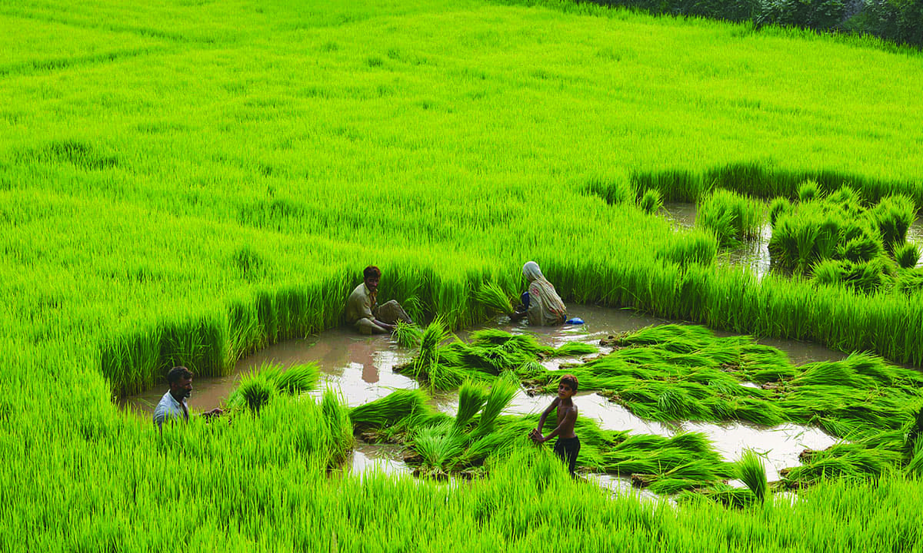
Wet Harvesting

Slide 24
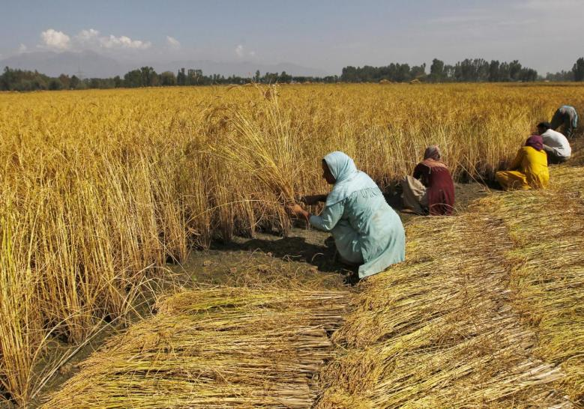
Dry Harvesting

Slide 25
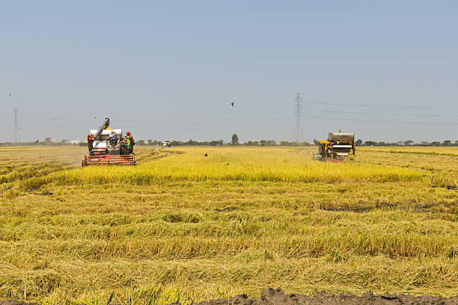
Mechanical Harvesting

Slide 26
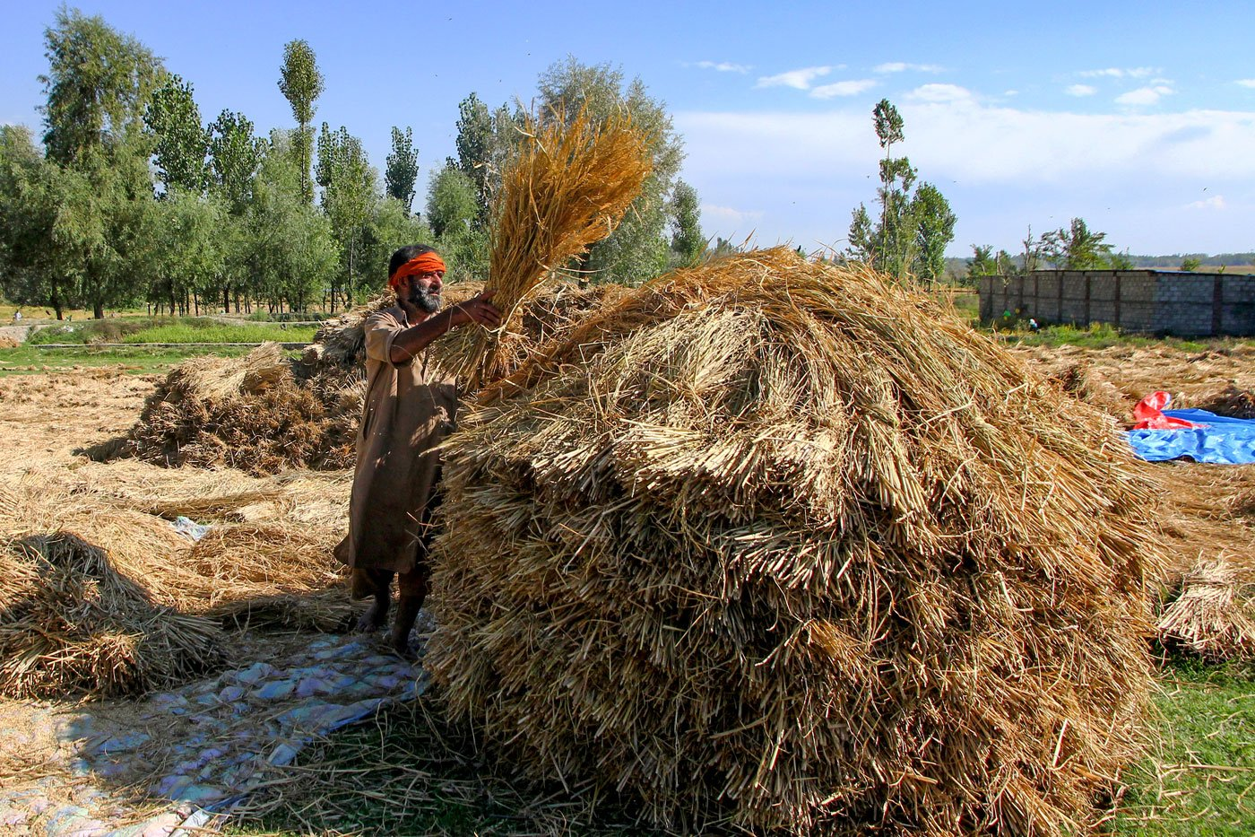
Harvest Piling

Slide 27
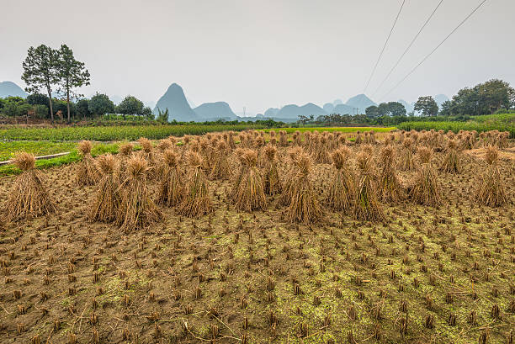
Recommended Harvest Piling

Slide 28
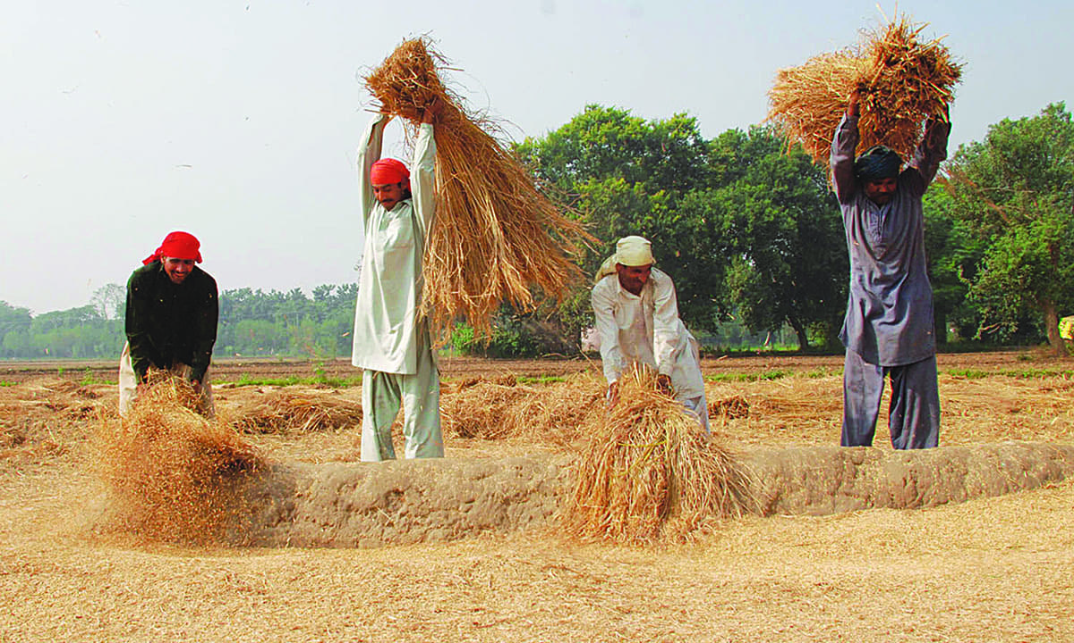
Manual Threshing

Slide 29
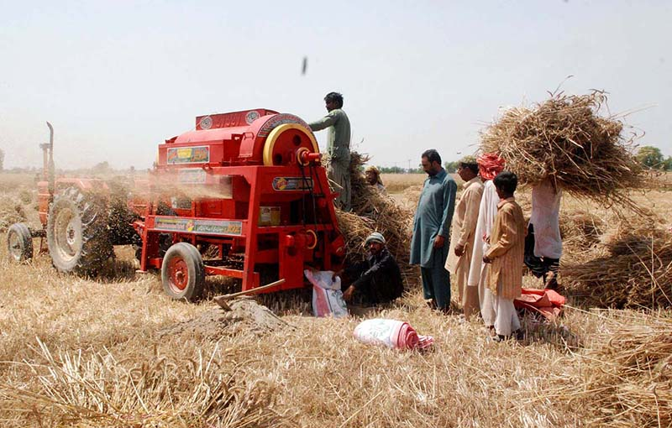
Mechanical Threshing

Slide 30
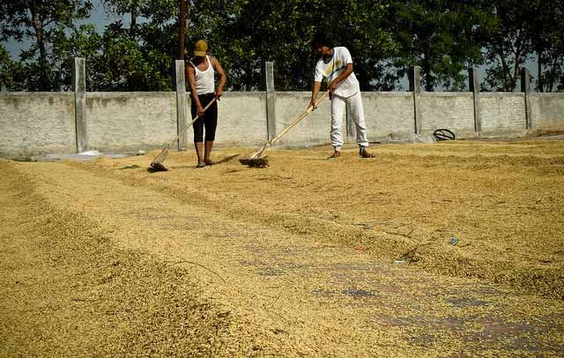
Sun Drying

Slide 31
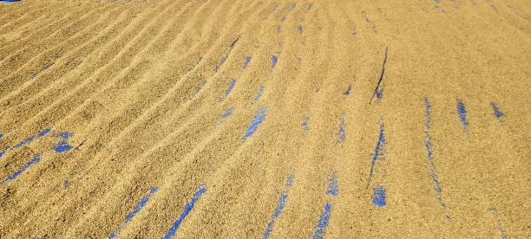
Recommended Sun Drying

Slide 32
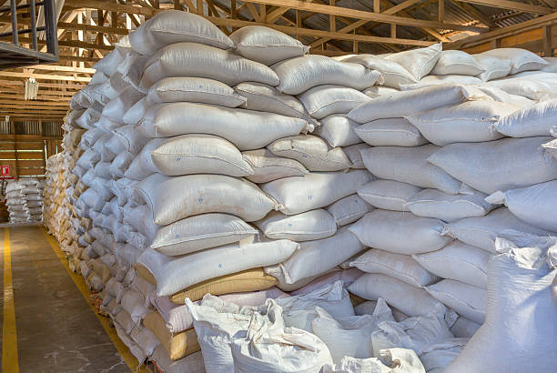
Bag Storage

Slide 33
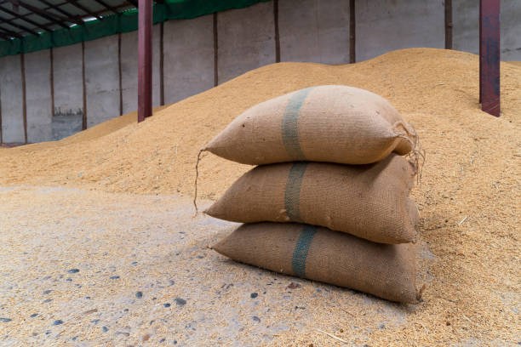
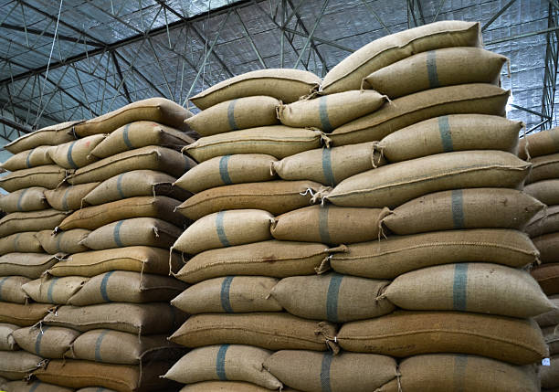
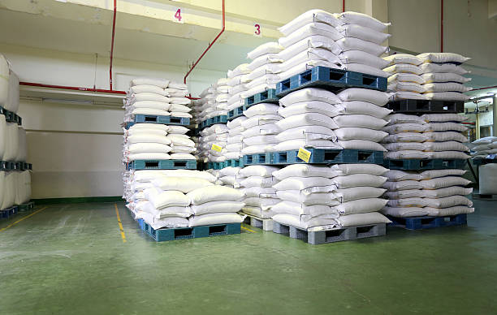
Bag Storage

Slide 34
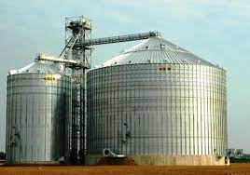
Silo Storage

Slide 35
Thank you!

