Slide 1
PSW Subscription and Registration with Customs
Noman Ahmad (Business Analyst, PSW)

Slide 2
Background
Before PSW, there was no subscription process. For User-ID creation in WeBOC, users were required to physically appear to Deputy/Assistant Collector WeBOC for creation of User-ID
All verification/KYC was undertaken manually on the basis of submission of paper documents
Personal appearance was mandatory with appointment from concerned officer which requires waiting time resulting into delays
For payment of fee through voucher, visit to bank is required with no option of electronic payment
For different roles, user was required to issue separate User-ID

Slide 3
PSW Subscription
In PSW, the subscription is the first step that will allow users to get access to the electronic platform in line with the Know Your Customer (KYC) principle.
The subscription process will involve obtaining and validating key user data with other government entities such as
Federal Board of Revenue (FBR)
Pakistan Mobile Number Portability Database (PMD)
National Database & Registration Authority (NADRA)

Slide 4
Salient Features of PSW Subscription
Scope: NTN holders, FTN holders, and Non-NTN\Non-FTN holders can subscribe in PSW.
Real time data validation/KYC: Subscription process is 100% automated through real time data validations with FBR, NADRA and PMD.
Paper/contact less processing: Subscription application shall be auto processed, and User ID shall be automatically issued by the system.
E Payment: Subscription Fee shall be paid online through 1Link using Alternate Delivery Channel (ADC).
Authenticity of Subscriber: Subscriber authenticity shall be ensured through Biometric verification from NADRA and mobile number ownership through PMD.

Slide 5
Benefits of Subscribing to PSW
Ease of doing Business: The subscriber no longer has to submit 22 paper documents which were previously being submitted to obtain registration with Customs for performing cross border trade.
Cost of doing business: The subscribers are required to pay only Rs. 500/- as subscription fee eliminating fully all overheads
Time saving: The average processing time of acquiring User ID (UID) is reduced from 10 days to a few minutes.
Value-added benefits: After acquiring PSW Subscription, the subscribers can avail themselves of several value-added benefits including single declaration, EIF/EFE elimination, auto routing of regulatory requirements, etc.

Slide 6
Process of PSW Subscription

Slide 7
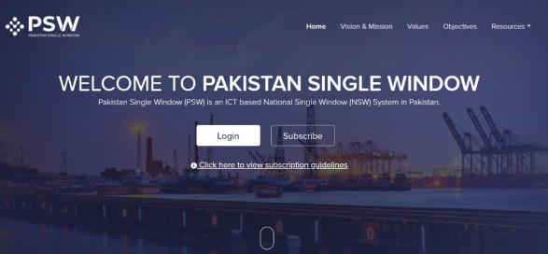
Subscription Process
Step 1:
Click the “Subscribe” button on the PSW Home page

Slide 8
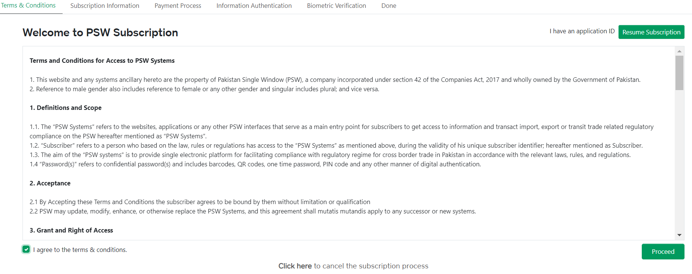
Subscription Process
Step 2:
Read the terms and conditions, accept Terms and Conditions, and click on “Proceed”
button

Slide 9
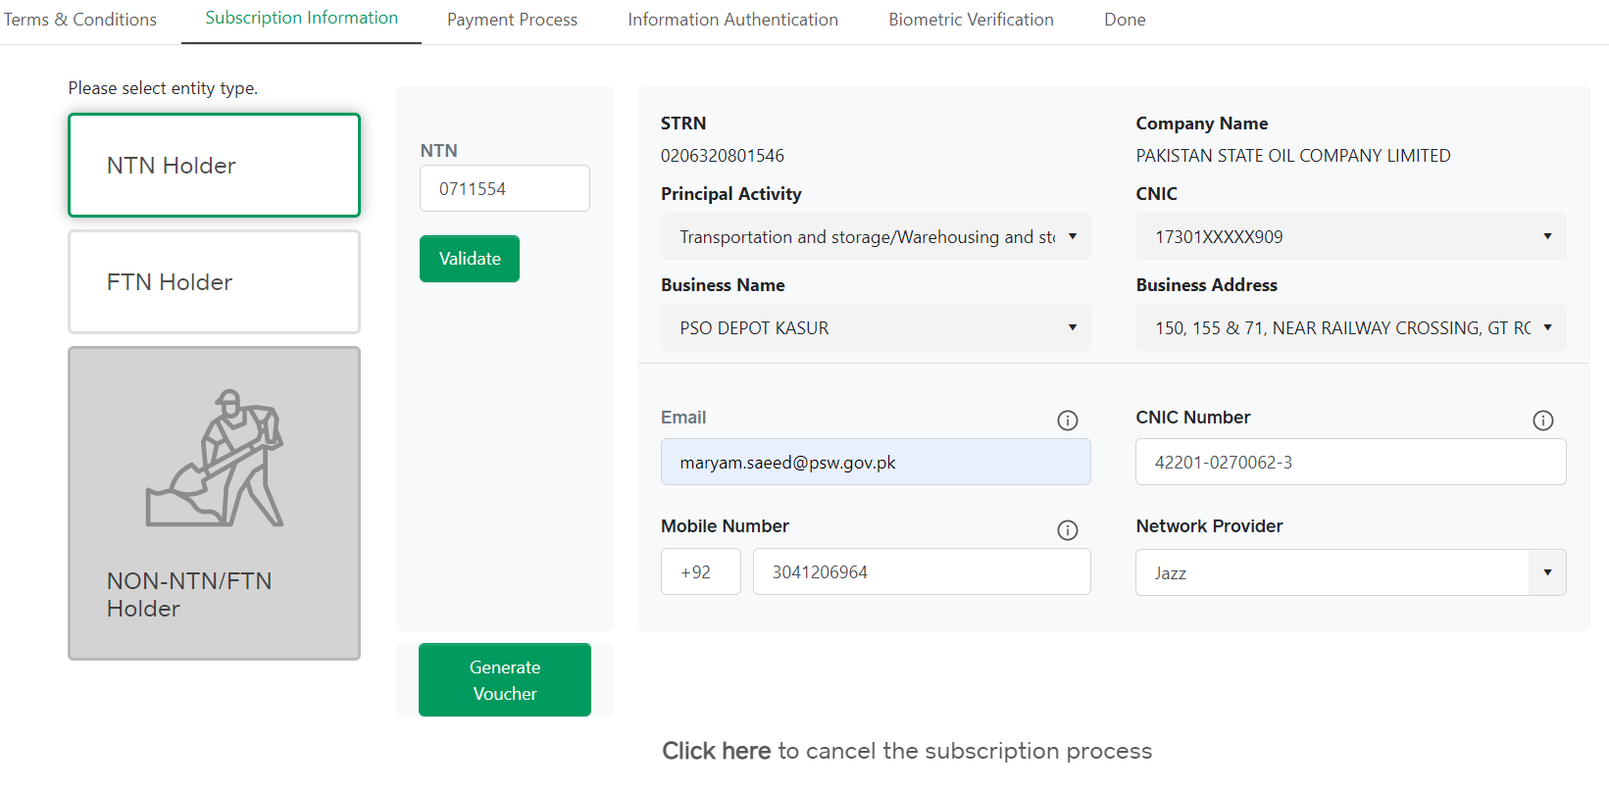
Subscription Process
Step 3:
Enter NTN and provide CNIC and Mobile Phone details

Slide 10
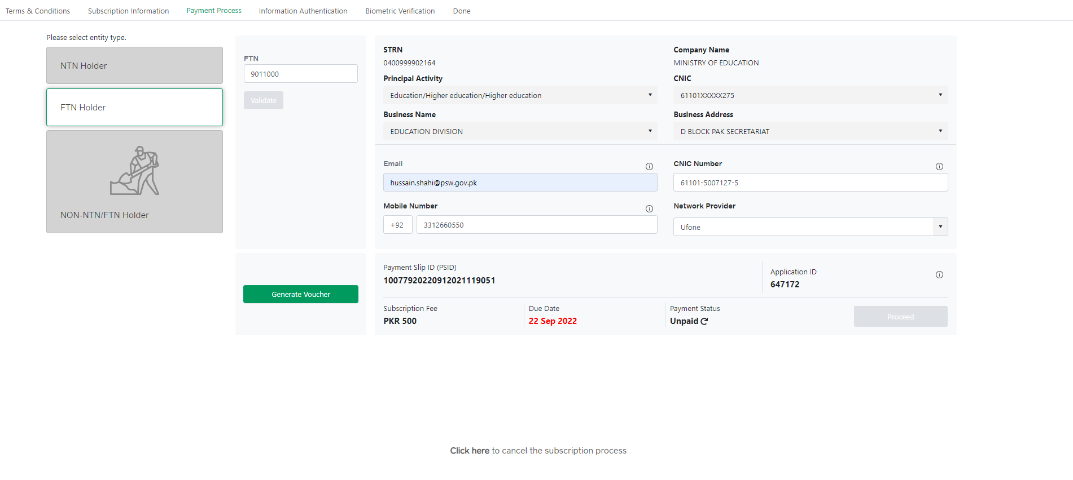
Subscription Process
Step 4:
Deposit the non-refundable subscription fee, through system generated Payment Slip
ID (PSID)

Slide 11
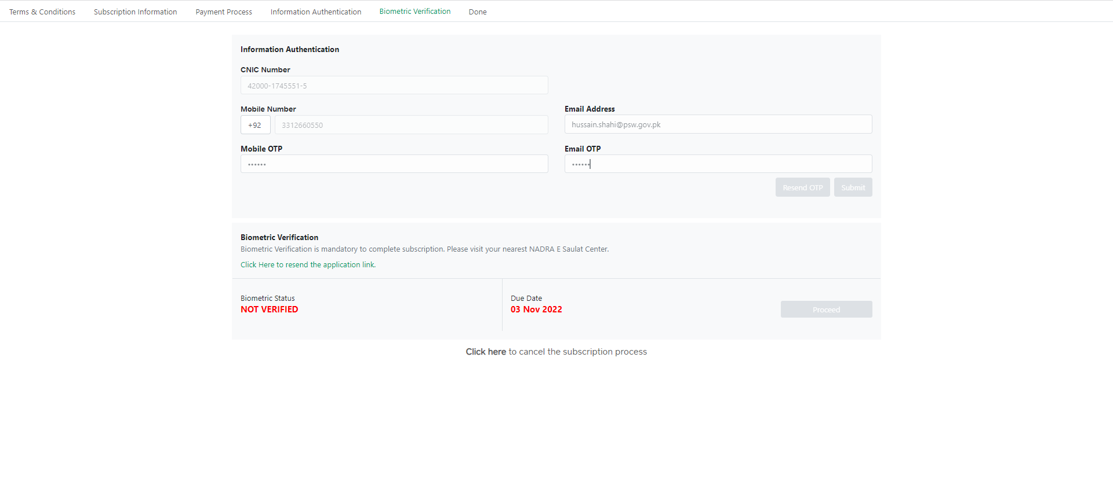
Subscription Process
Step 5:
Biometric verification of the subscriber at any NADRA e-Sahulat franchise is required
to complete the PSW subscription

Slide 12
Subscription Process
Step 6:
After successful biometric verification, a link shall be sent to the registered email address with the UID (User ID) after which the subscriber shall be able to create a unique password to access the PSW Portal.

Slide 13
Process of PSW Registration with Customs

Slide 14
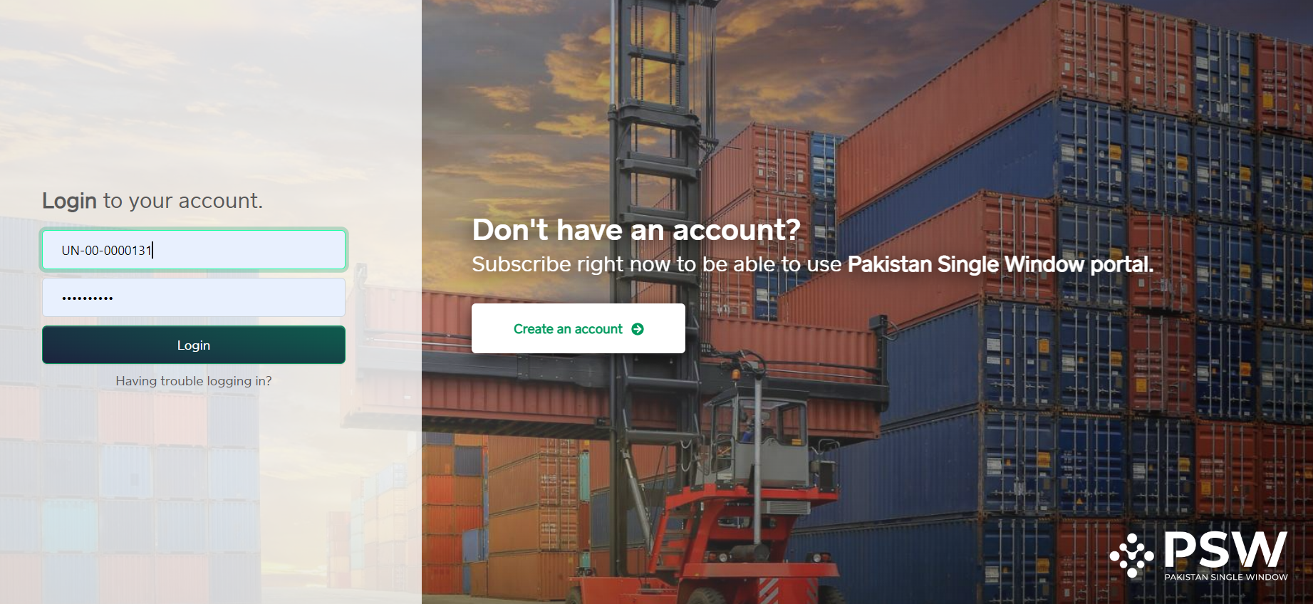
Registration Process
Step 1:
Login into PSW Portal with UID and password

Slide 15
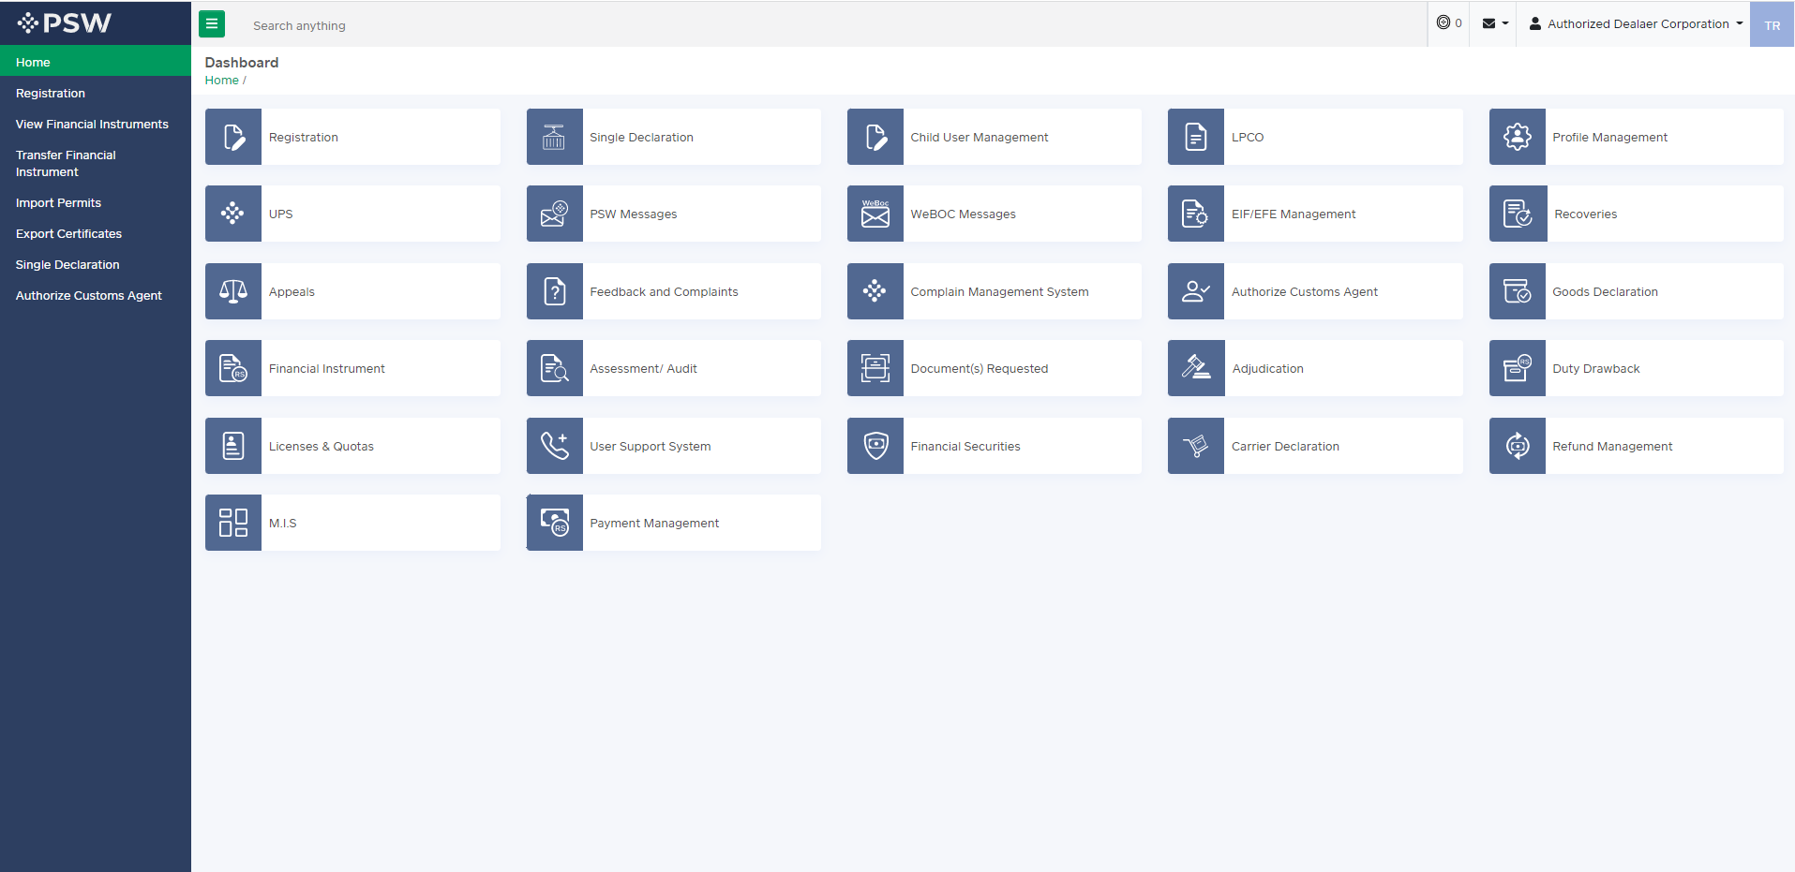
Registration Process
Step 2:
Click on ‘Registration’ from dashboard

Slide 16
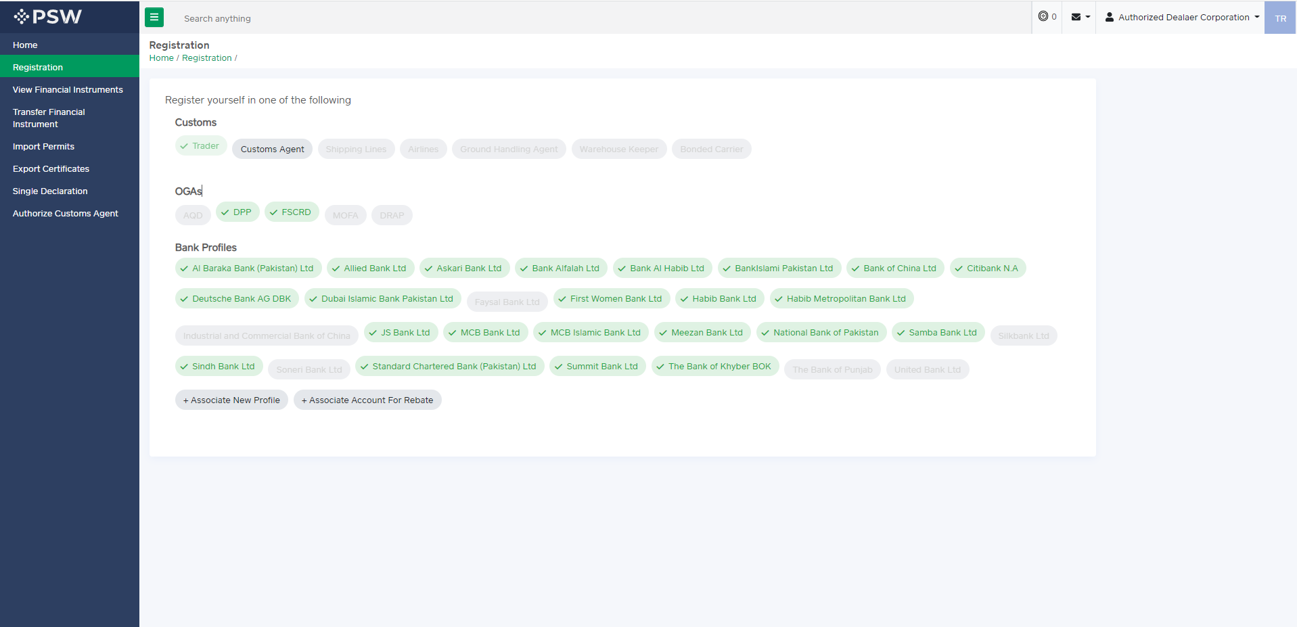
Registration Process
Step 3:
Select role as ‘Trader or ‘Customs Agent’

Slide 17
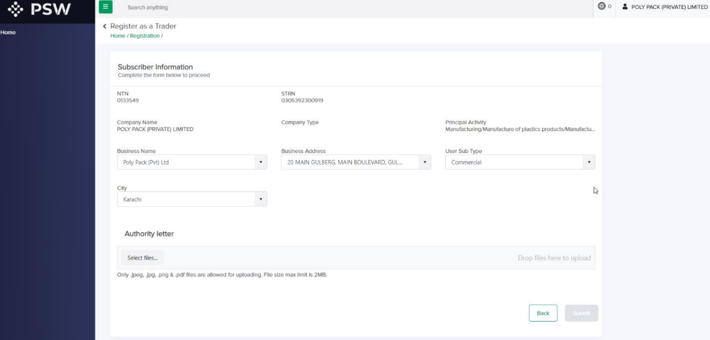
Registration Process - Trader
Step 4:
Select Business Name, Business address, User sub-type, and city. Upload Authority letter (if required) and click on Submit

Slide 18
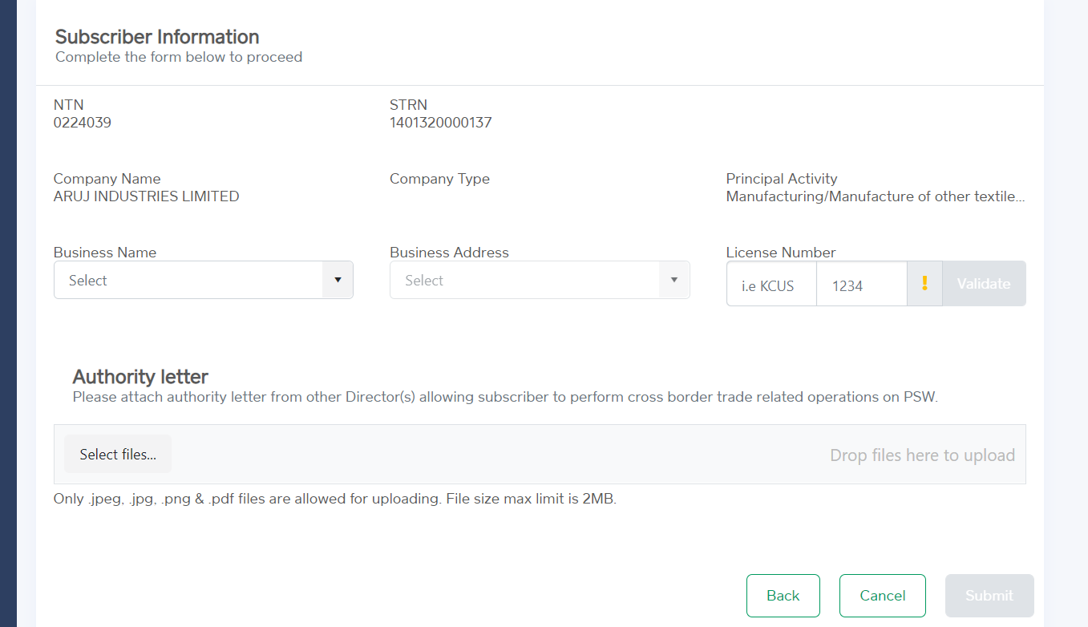
Registration Process – Customs agent
Step 4:
Select Business Name, Business address, and input License number. Upload Authority letter and click on Submit

Slide 19
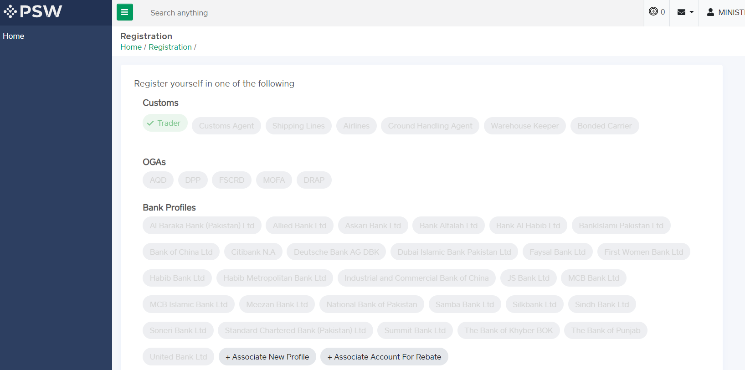
Registration Process
Step 5:
User registered successfully as ‘Trader’ or ‘Customs agent’

Slide 20
Association of Bank Profile in PSW

Slide 21
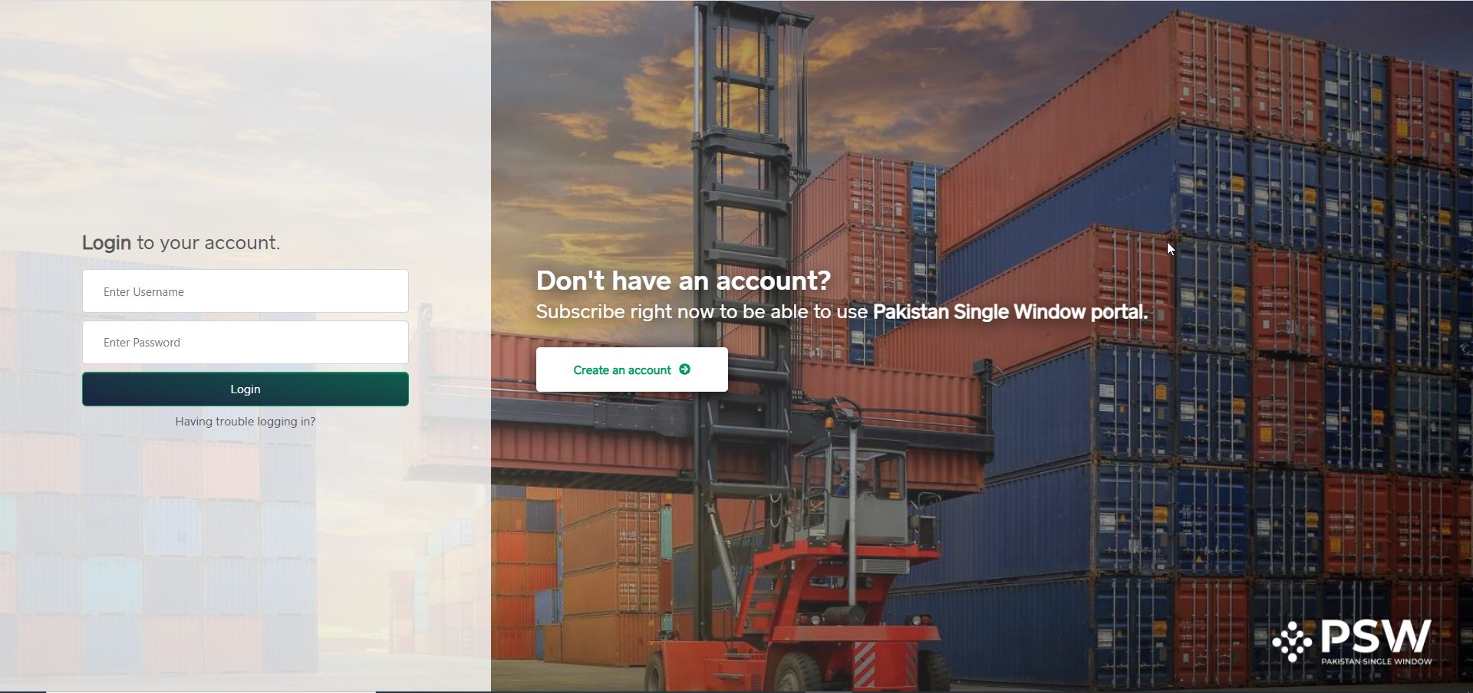
Association of Bank Profile
Step 1:
Login into PSW Portal with UID and password

Slide 22
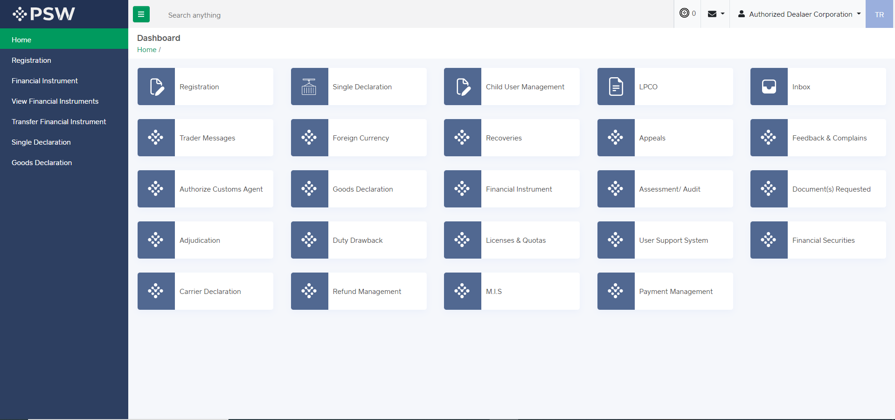
Association of Bank Profile
Step 2:
Click on ‘Registration’ from dashboard

Slide 23
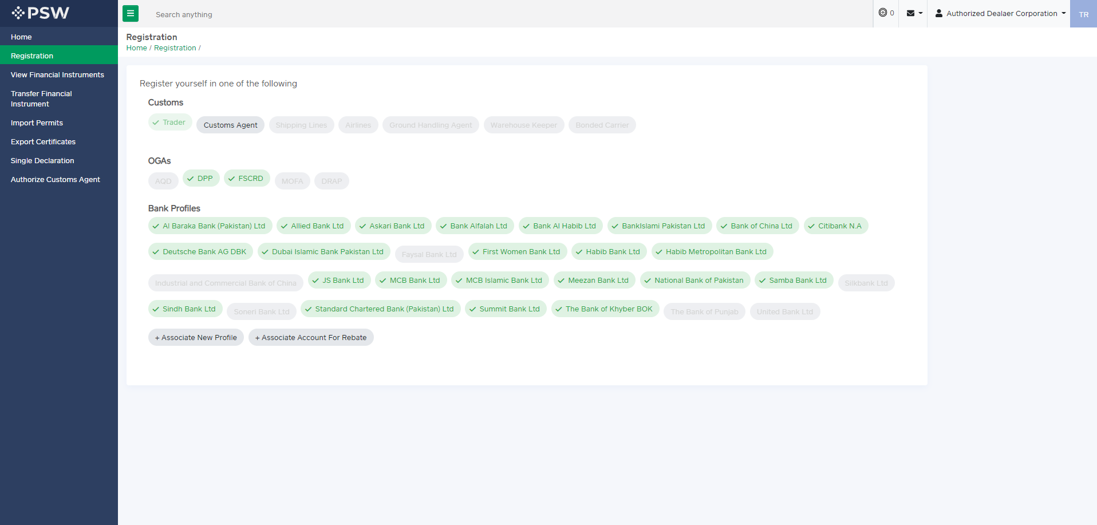
Association of Bank Profile
Step 3:
Click on ‘Associate New Profile’

Slide 24
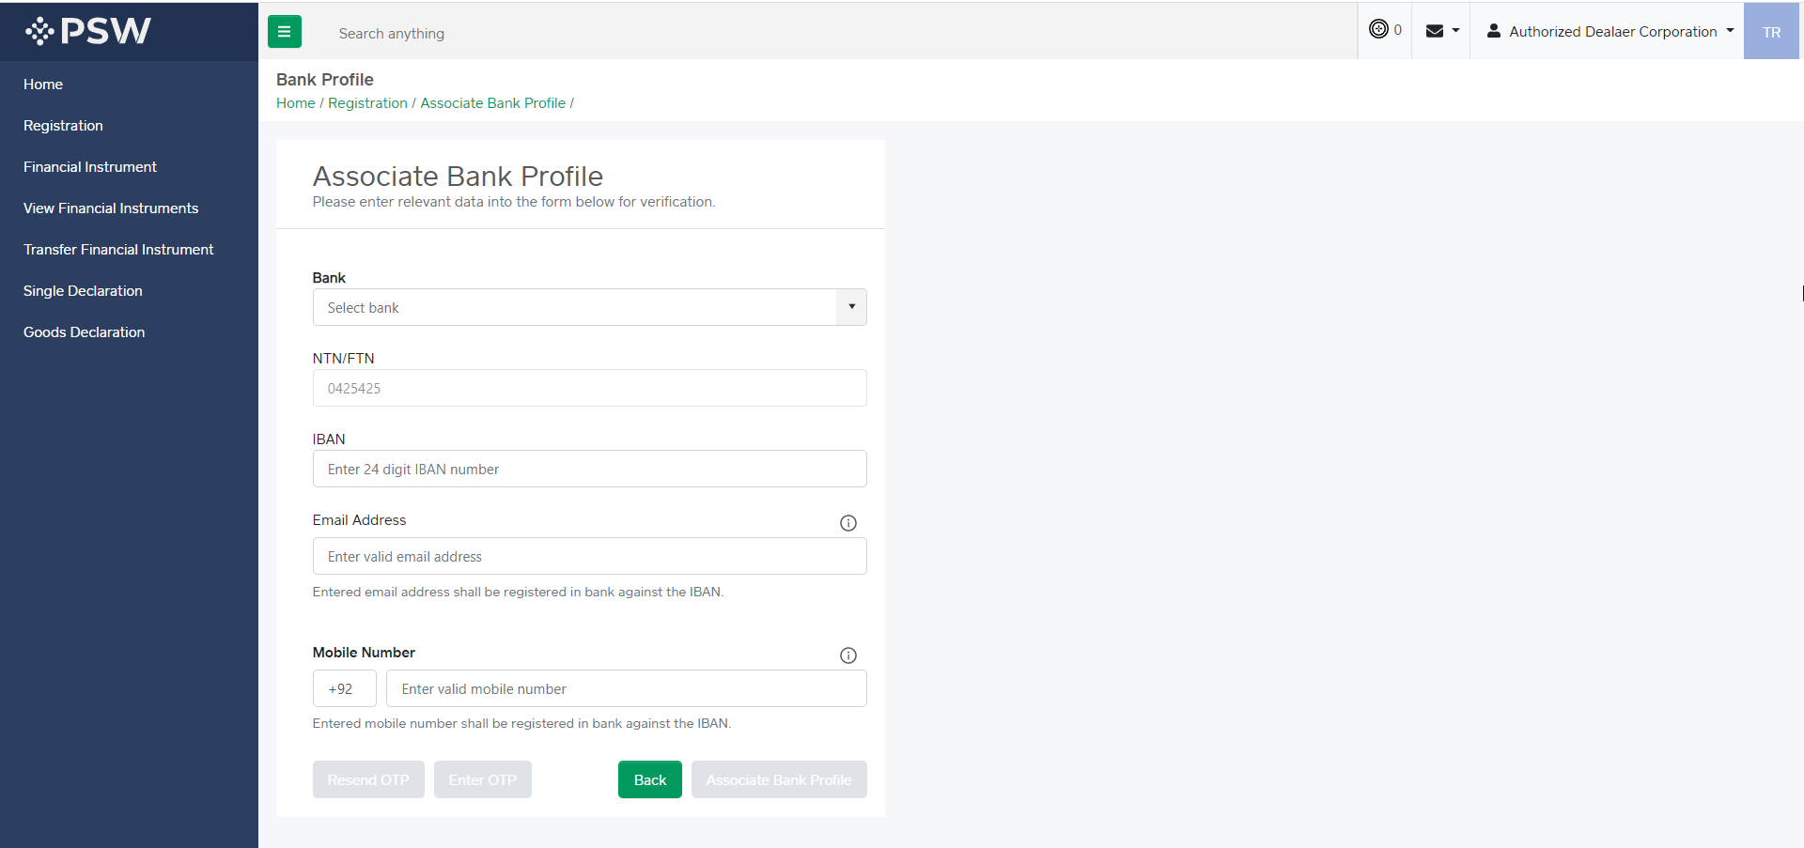
Association of Bank Profile
Step 4:
Input relevant data to associate bank profile

Slide 25
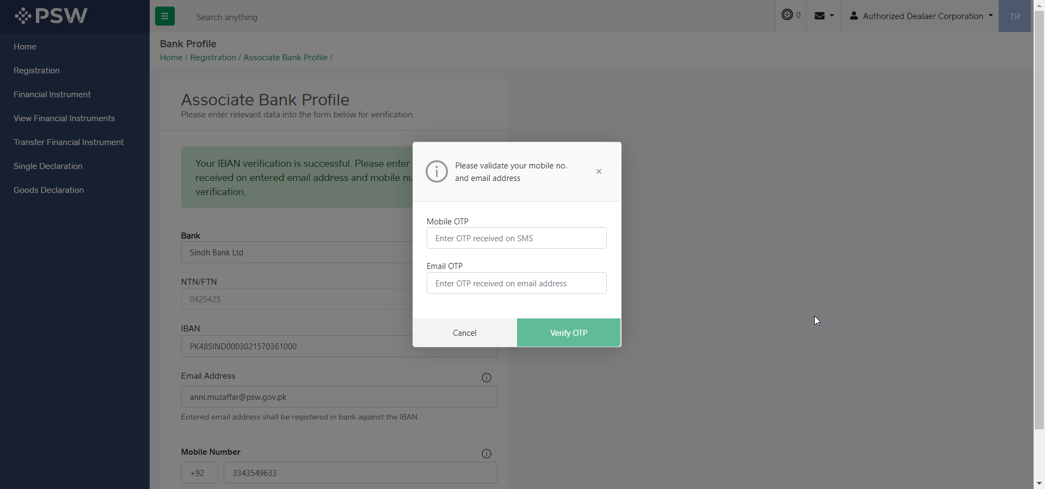
Step 5:
Input OTP received on Bank email and mobile

Slide 26
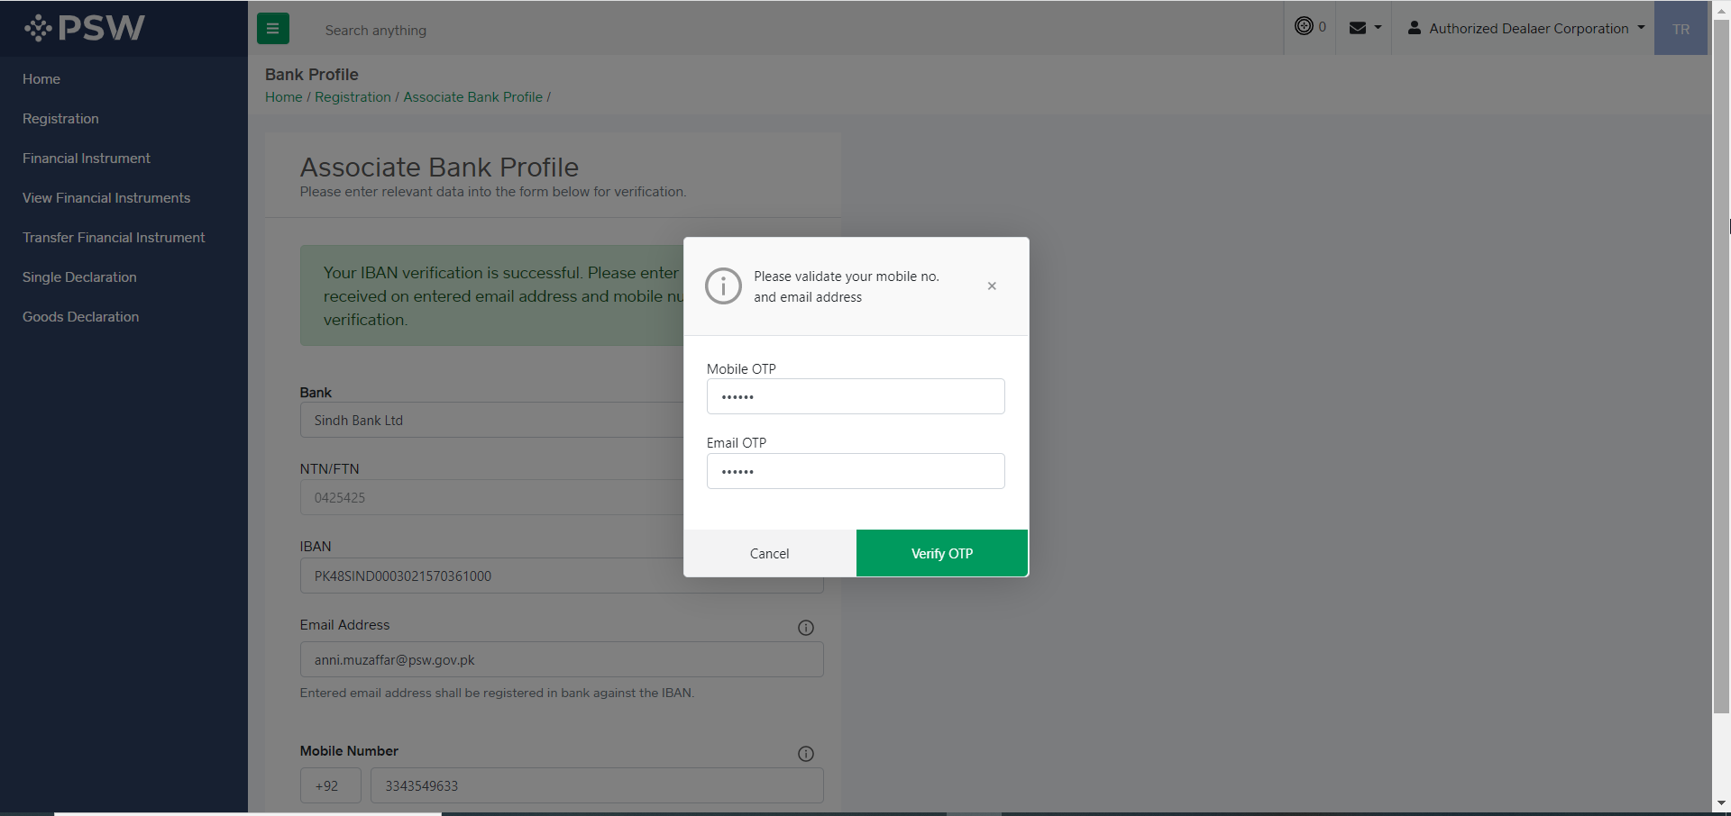
Association of Bank Profile
Step 6:
After entering OTP, click on verify OTP

Slide 27
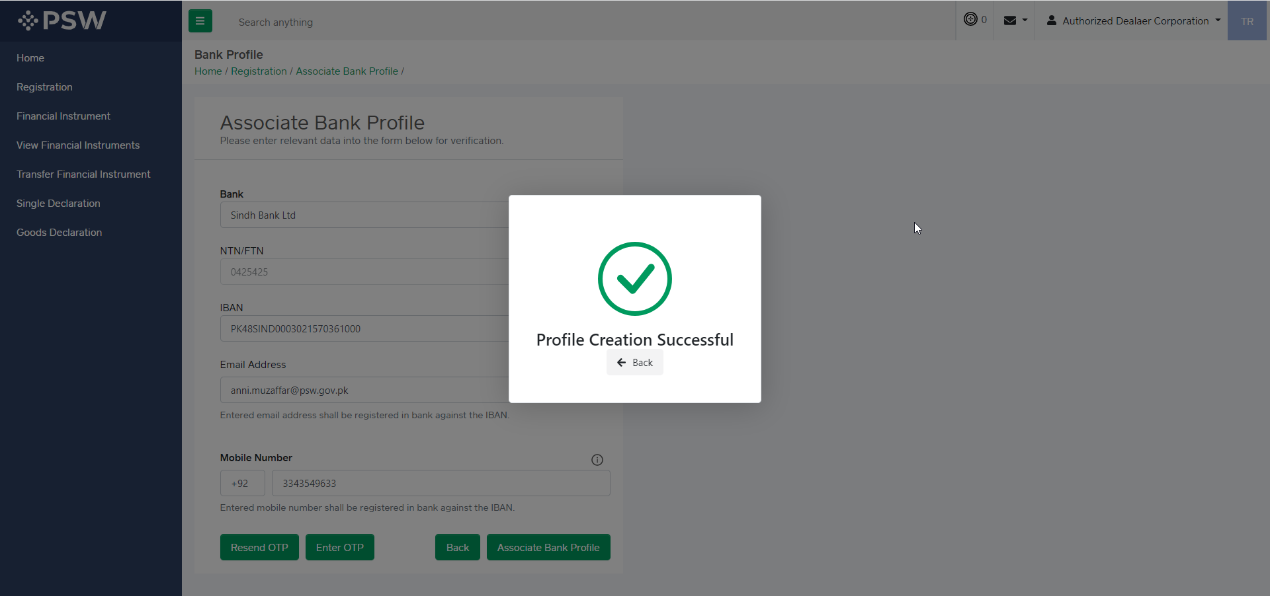
Association of Bank Profile
Step 7:
After successful OTP verification, Profile is created

Slide 28
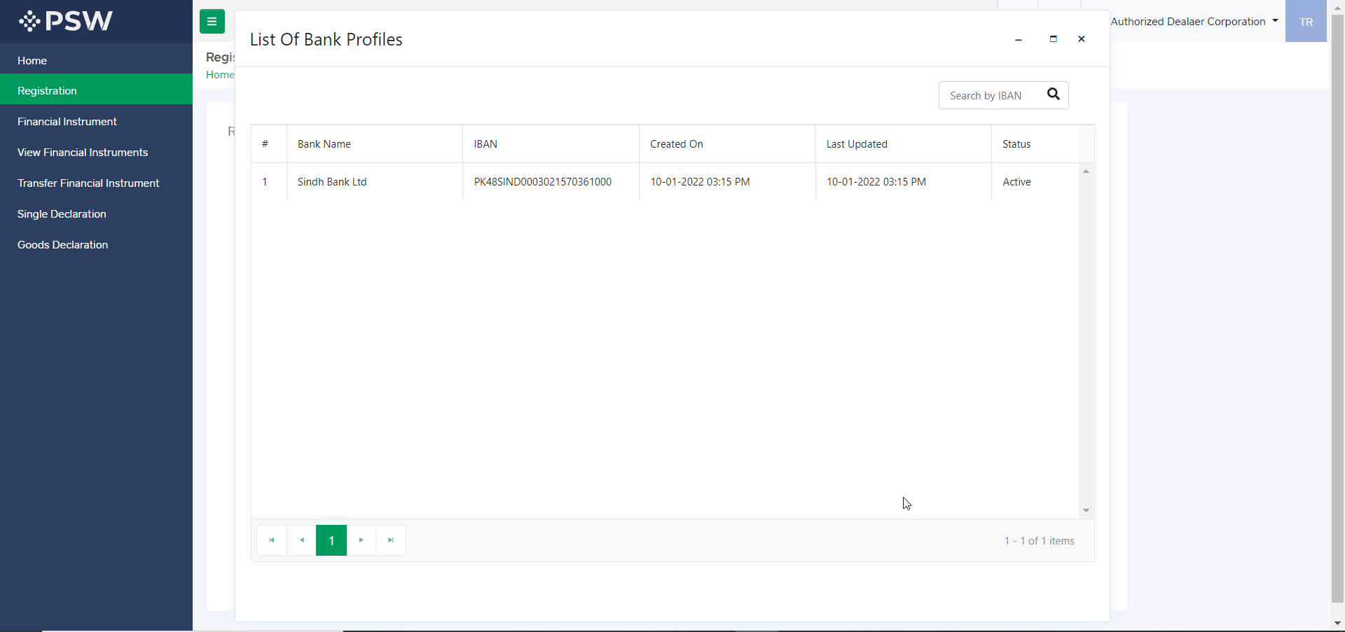
Association of Bank Profile
We can view the associated trader profile by clicking on the relevant bank

Slide 29
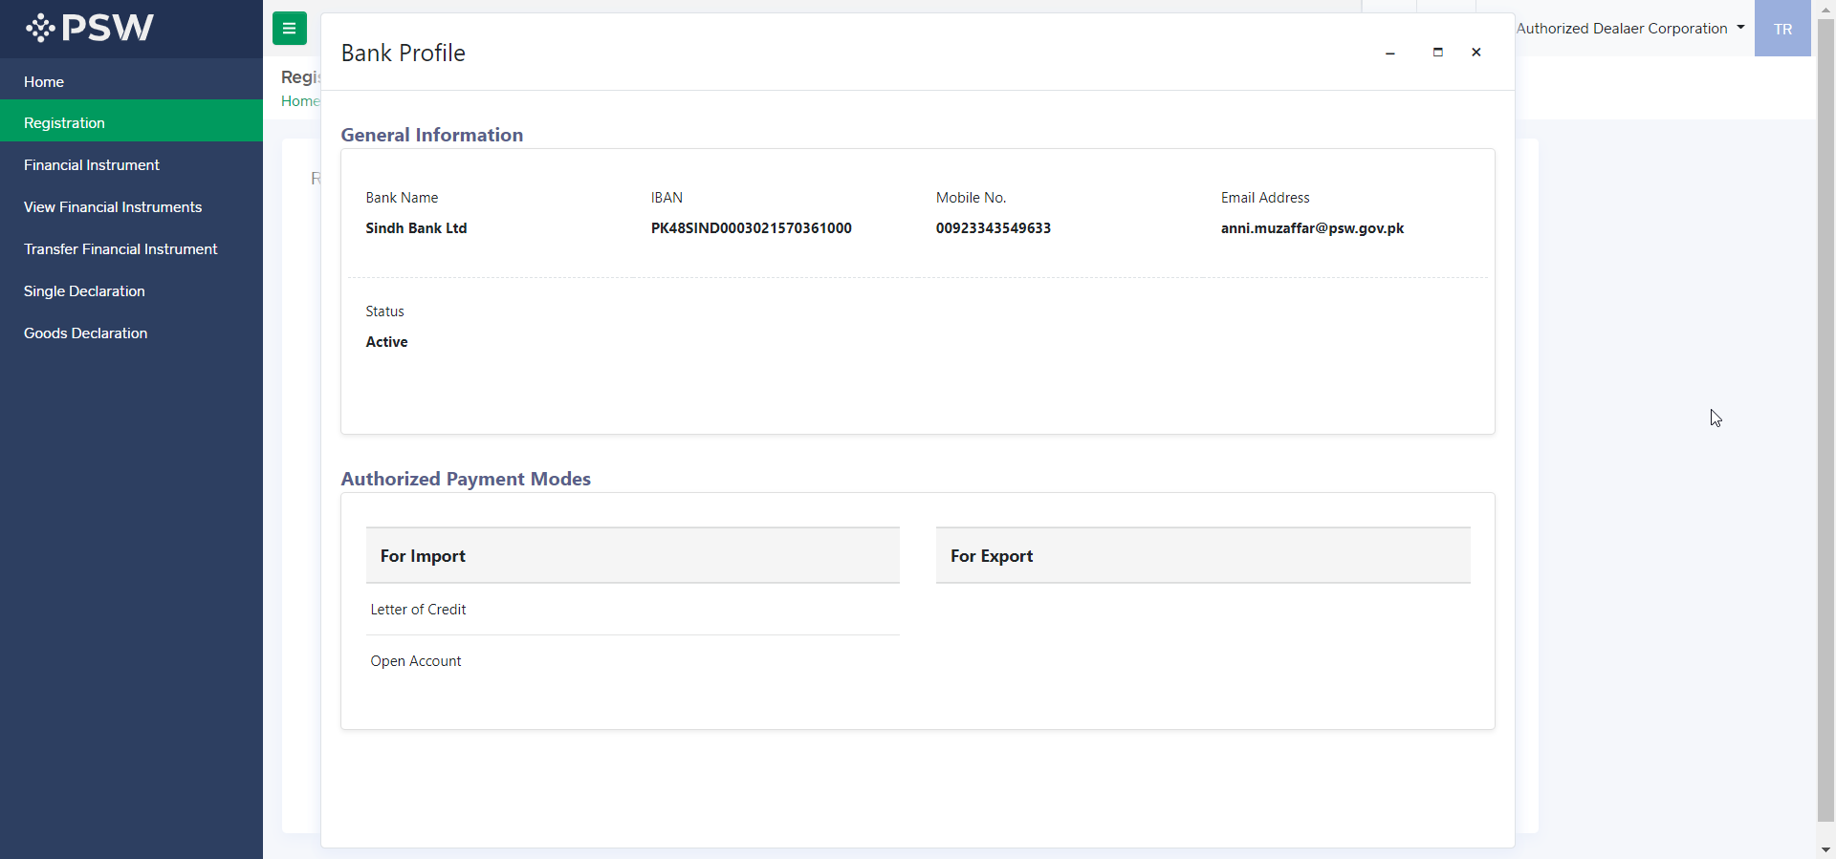
Association of Bank Profile
Here we can see the trader profile information along with the authorized payment modes

Slide 30
SINGLE DECLARATION EXPORT & IMPORT

Slide 31
What is Single Declaration?
Single Declaration is the submission of electronic data/information for clearance of import, export and transit related goods at a single point. Different Cross Border Regulatory Agencies prescribe data requirements which are often overlapping. To avoid repetitive submission of data, it is necessary to have a harmonized data set. The Single Declaration is actually based on the concept of developing a ‘harmonized data set’ so that for a trade transaction or a transport movement to take place, the concerned actors are not obligated to submit the same data repeatedly to different agencies. Information submitted once shall be re-used.
Regulatory permissions will be given without traders having to approach different agencies. Information relevant to different agencies shall be submitted to the concerned agencies for processing. Single declaration will only cover ‘clearance related’ applications and declarations of Customs and other government agencies.

Slide 32
Salient Features:
The Single Declaration being one of the core features of the PSW allows parties involved in trade and transport to lodge standardized information and documents on a single-entry point to fulfill all import, export, and transit-related regulatory requirements. The “Single Declaration - Exports” provides a single interface to its users for filing of export declarations.
The users will submit integrated import and export declarations that contain all regulatory/clearance related information required by the OGAs. Separate submission of forms/declarations to OGAs will be eliminated.
All data fields and requirements will be consolidated into a single data dictionary aligned to the WCO data model eliminating redundant information. This is to enable standardization and single request for data fields and incremental data submission.
The system will automatically route applications on the basis of declarations and mark for decisions to the relevant OGAs using clearly defined business rules to identify the OGA(s) whose specific action is required for release of the consignment.
The declaration will be filed on the basis of Integrated Tariff Management System triggering regulatory and Customs compliance requirements.
Of all the information provided by the trader, concerned agencies will be transmitted only that which pertains to them.
Single Declaration will promote trade facilitation by reducing dwell time and cost of clearance.

Slide 33
Process of Filing Single Declaration

Slide 34
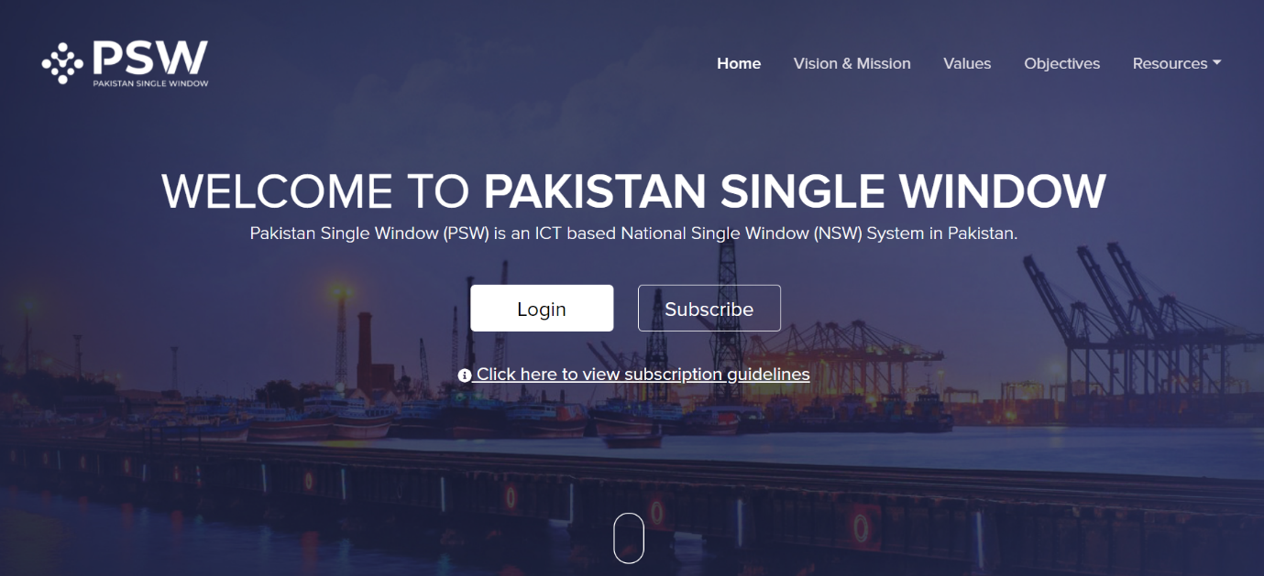
Filing of Single Declaration Export
User visits “www.psw.gov.pk” and click on the “Login” option.

Slide 35
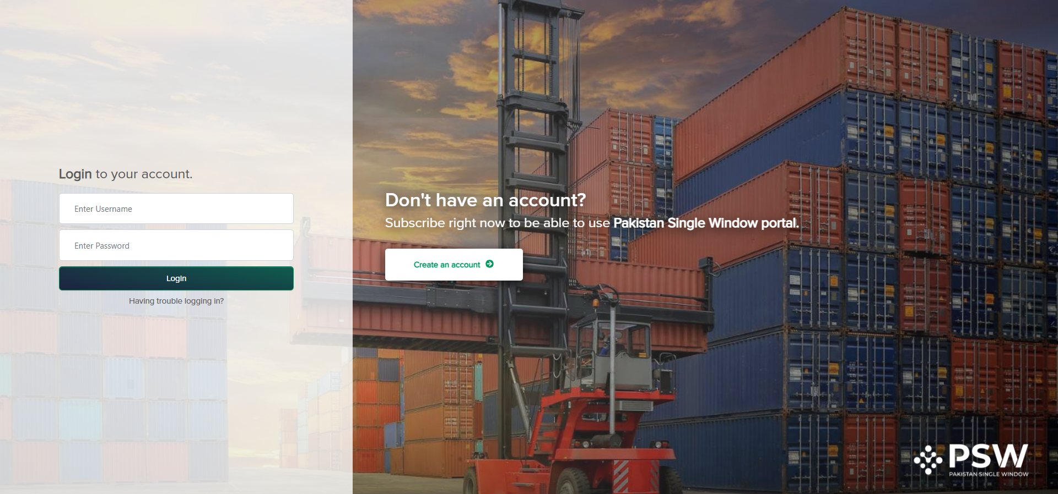
Filing of Single Declaration Export
User shall enter the login credentials and click on the Login option.
Once the login credentials are validated, user is redirected to the dashboard.

Slide 36
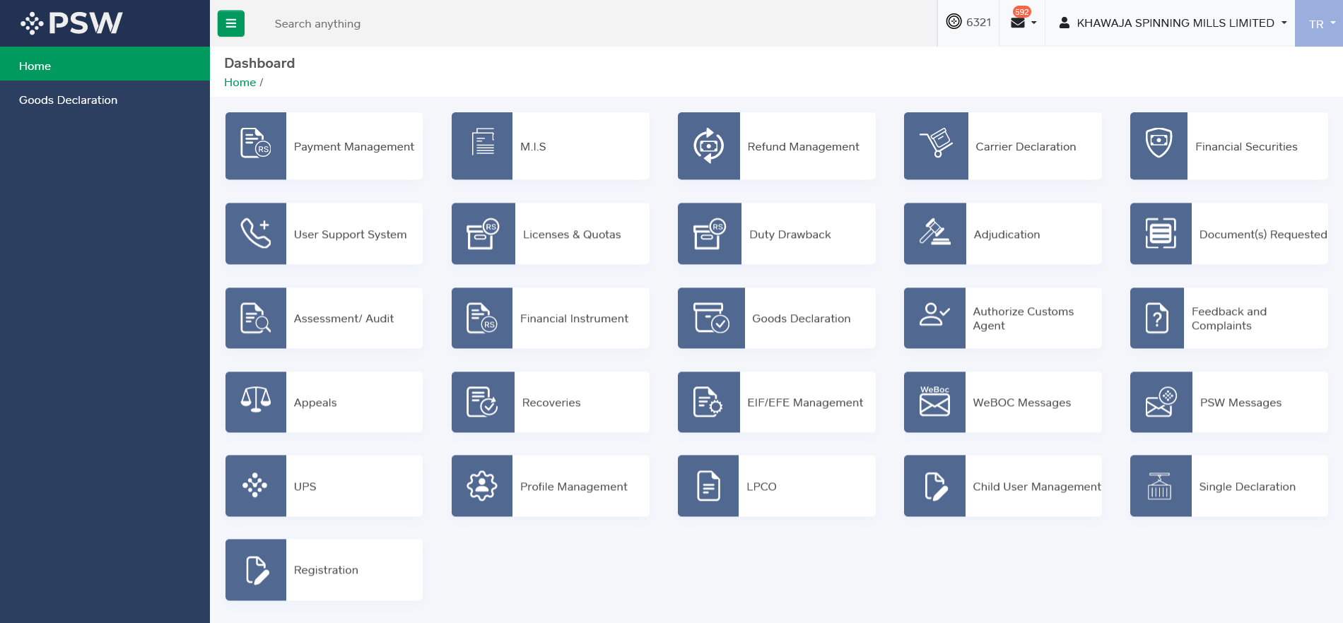
Filing of Single Declaration Export
User clicks on the “Single Declaration” option. Upon clicking on the option, “Single Declaration” interface appears.

Slide 37
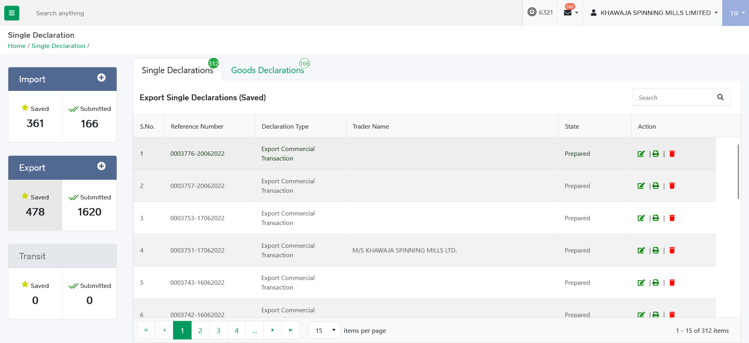
Filing of Single Declaration Export
From Single Declaration interface, user can view saved, submitted declarations and create a new declaration.

Slide 38
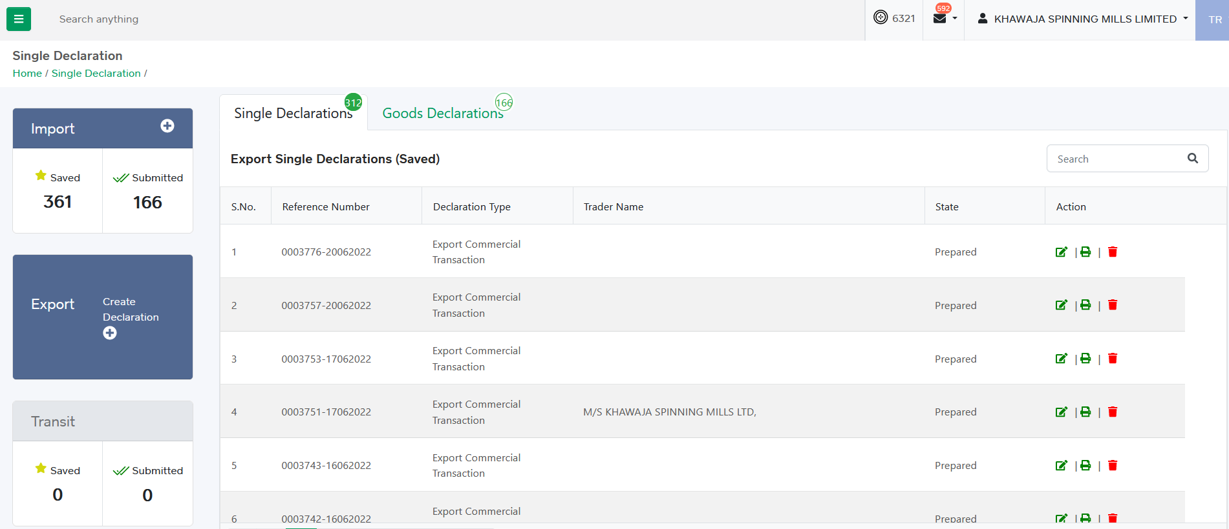
Filing of Single Declaration Export
Upon hover on “Export” option. “Create Declaration” option appears.
Upon click on the ‘Create Declaration’ option, system displays single declaration interface.

Slide 39
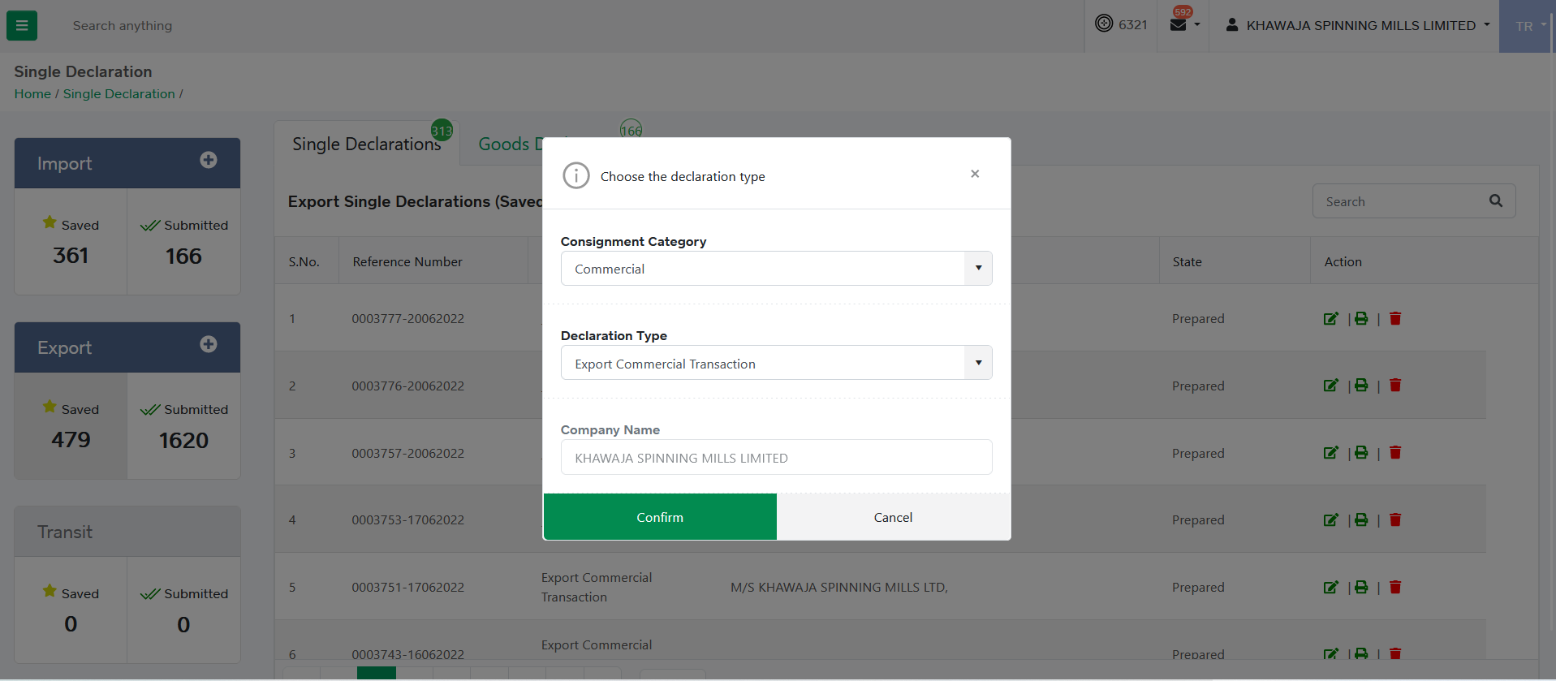
Filing of Single Declaration Export
Upon clicking on the ‘Create Declaration’ option, an interface appears for selection of Consignment Category and Declaration Type. User selects Consignment Category and Declaration Type and click on the ‘Confirm’ option.

Slide 40
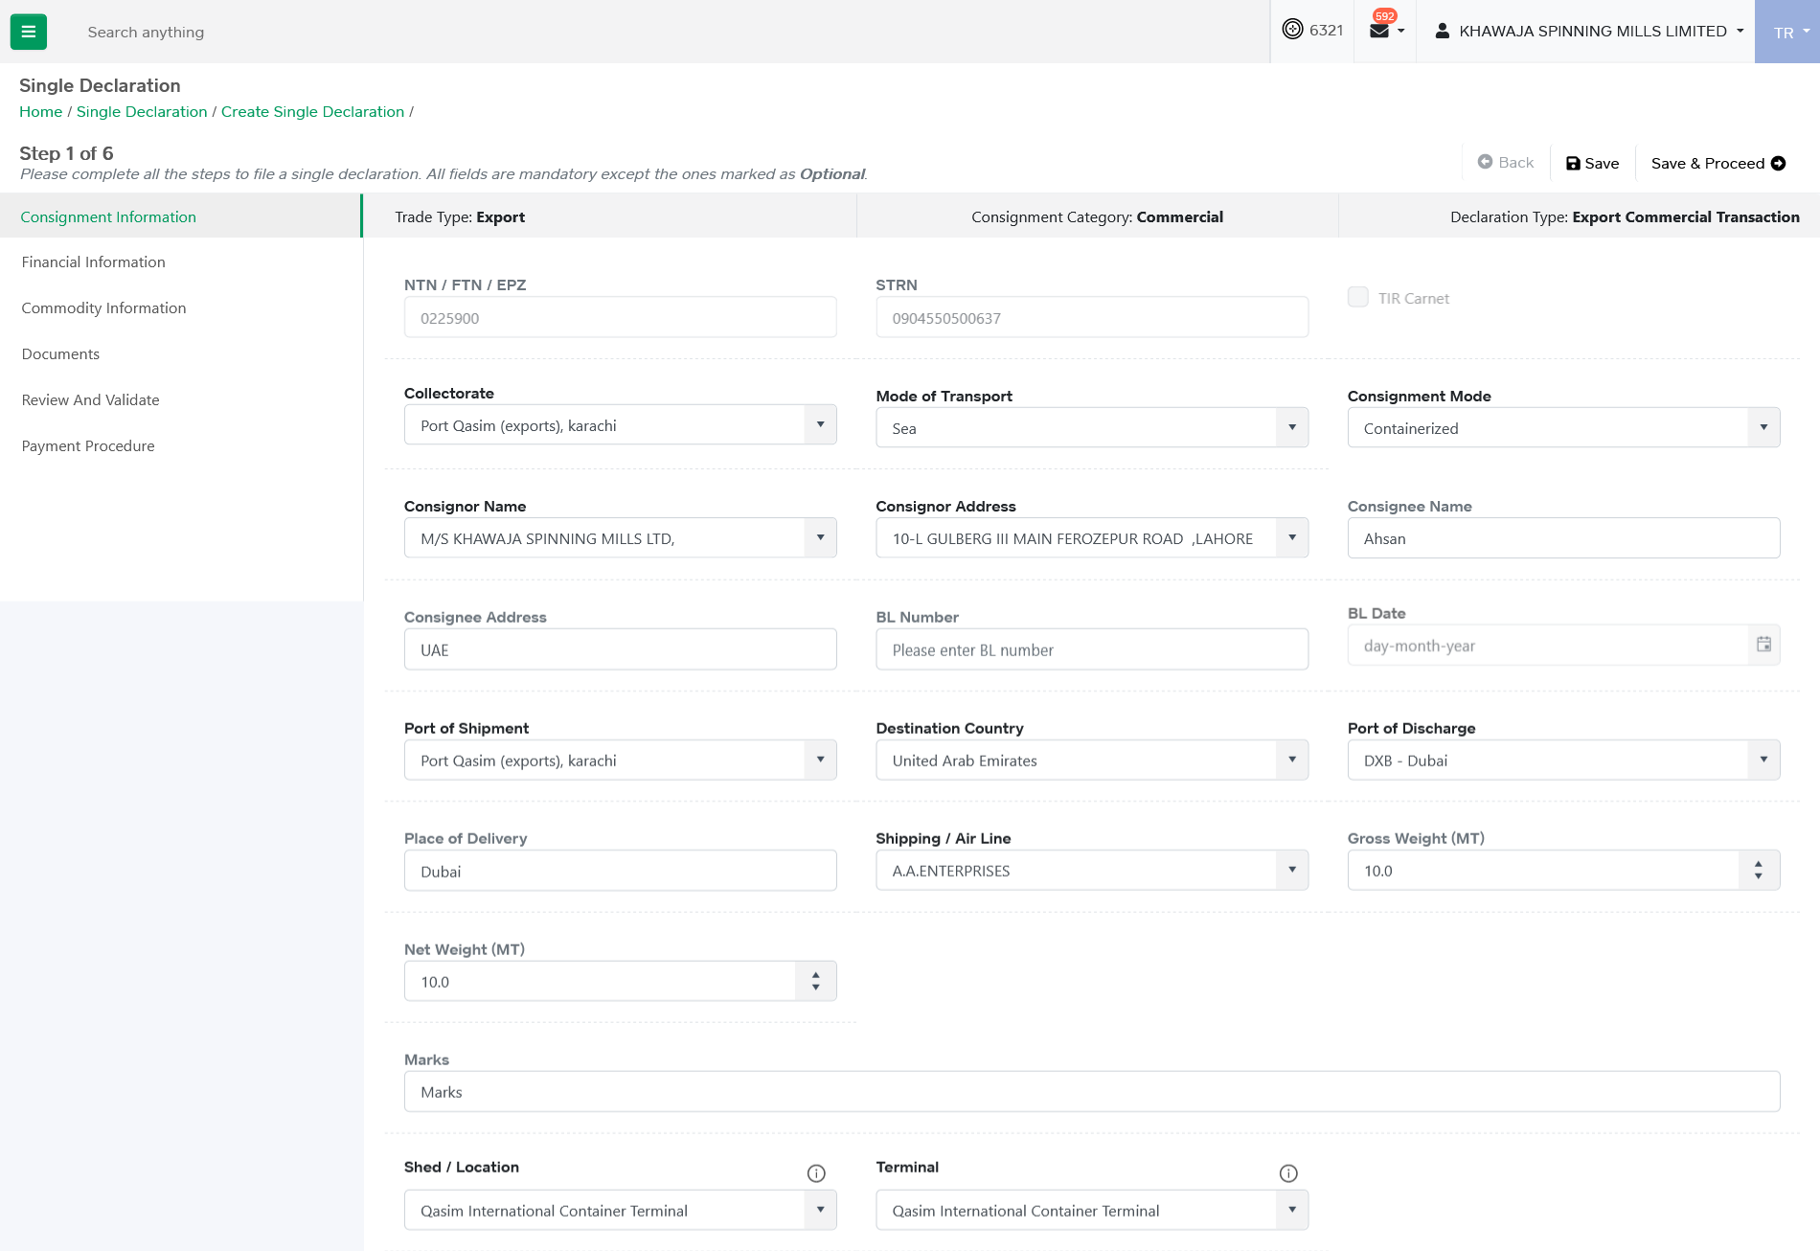
SD – Consignment Information
User provides the consignment information.

Slide 41
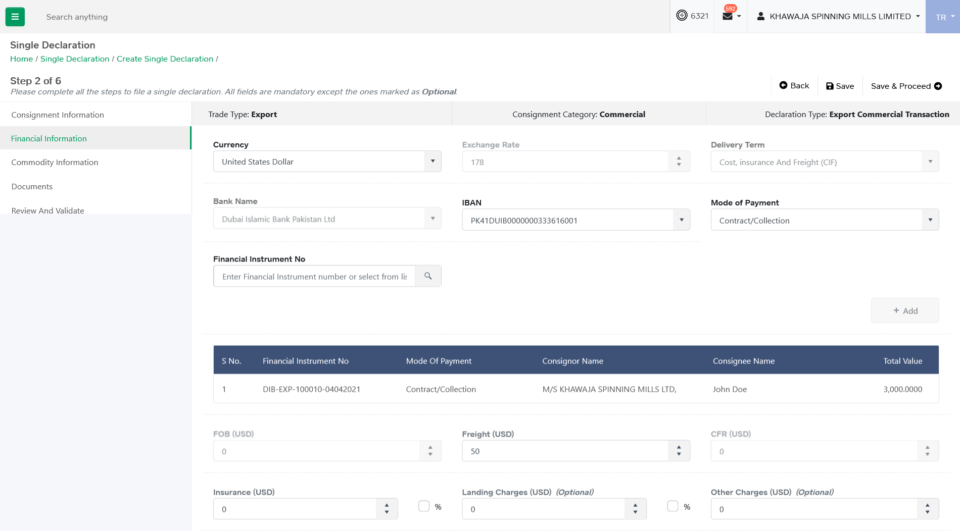
SD – Financial Information
User provides the financial information. User associate the financial instrument in declaration, if required.
In case of Open Account, financial instrument association is not required.

Slide 42
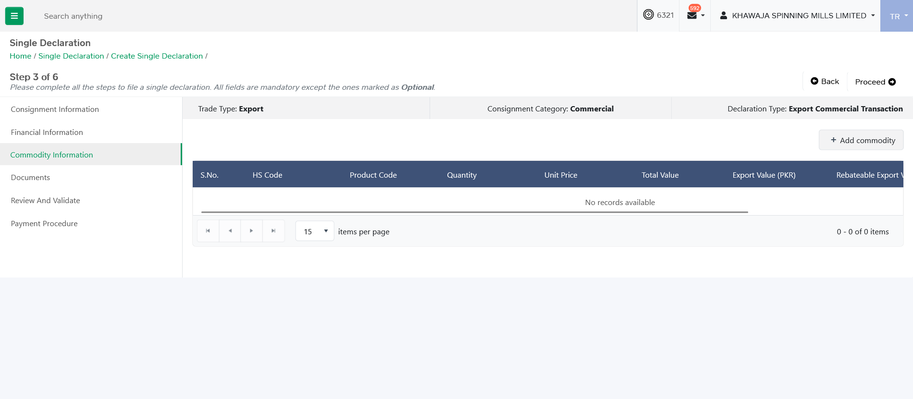
SD – Commodity Information
User provide commodities Information. Upon click on “Add Commodity” option, Commodity addition interface appears.

Slide 43
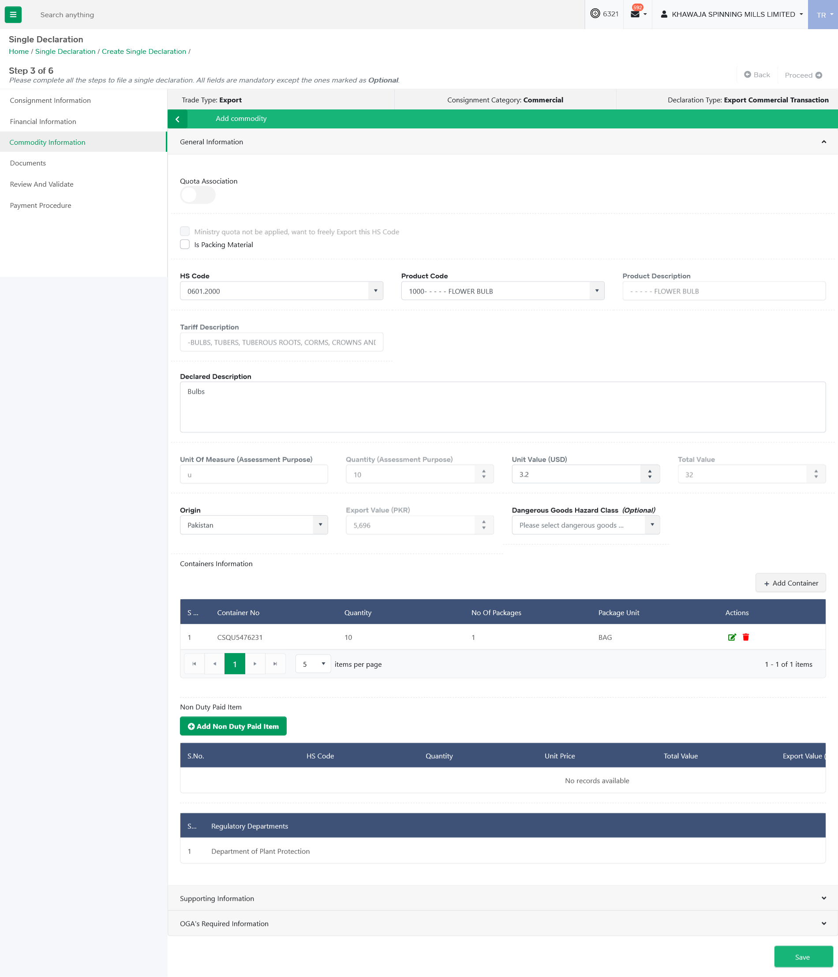
SD – Commodity Information
User selects the relevant product code against entered HS Code. Upon selection of product code, system displays regulatory departments from which consignment clearance is required.
User is able to declare Containers against commodity.
User is able to associate Export Concessionary schemes with commodity. If quota is associated, then user is able to provide locally purchased items information.
User is able to select the respective duty drawback with commodity.
User is able to associate the non-duty paid items information with commodity.

Slide 44
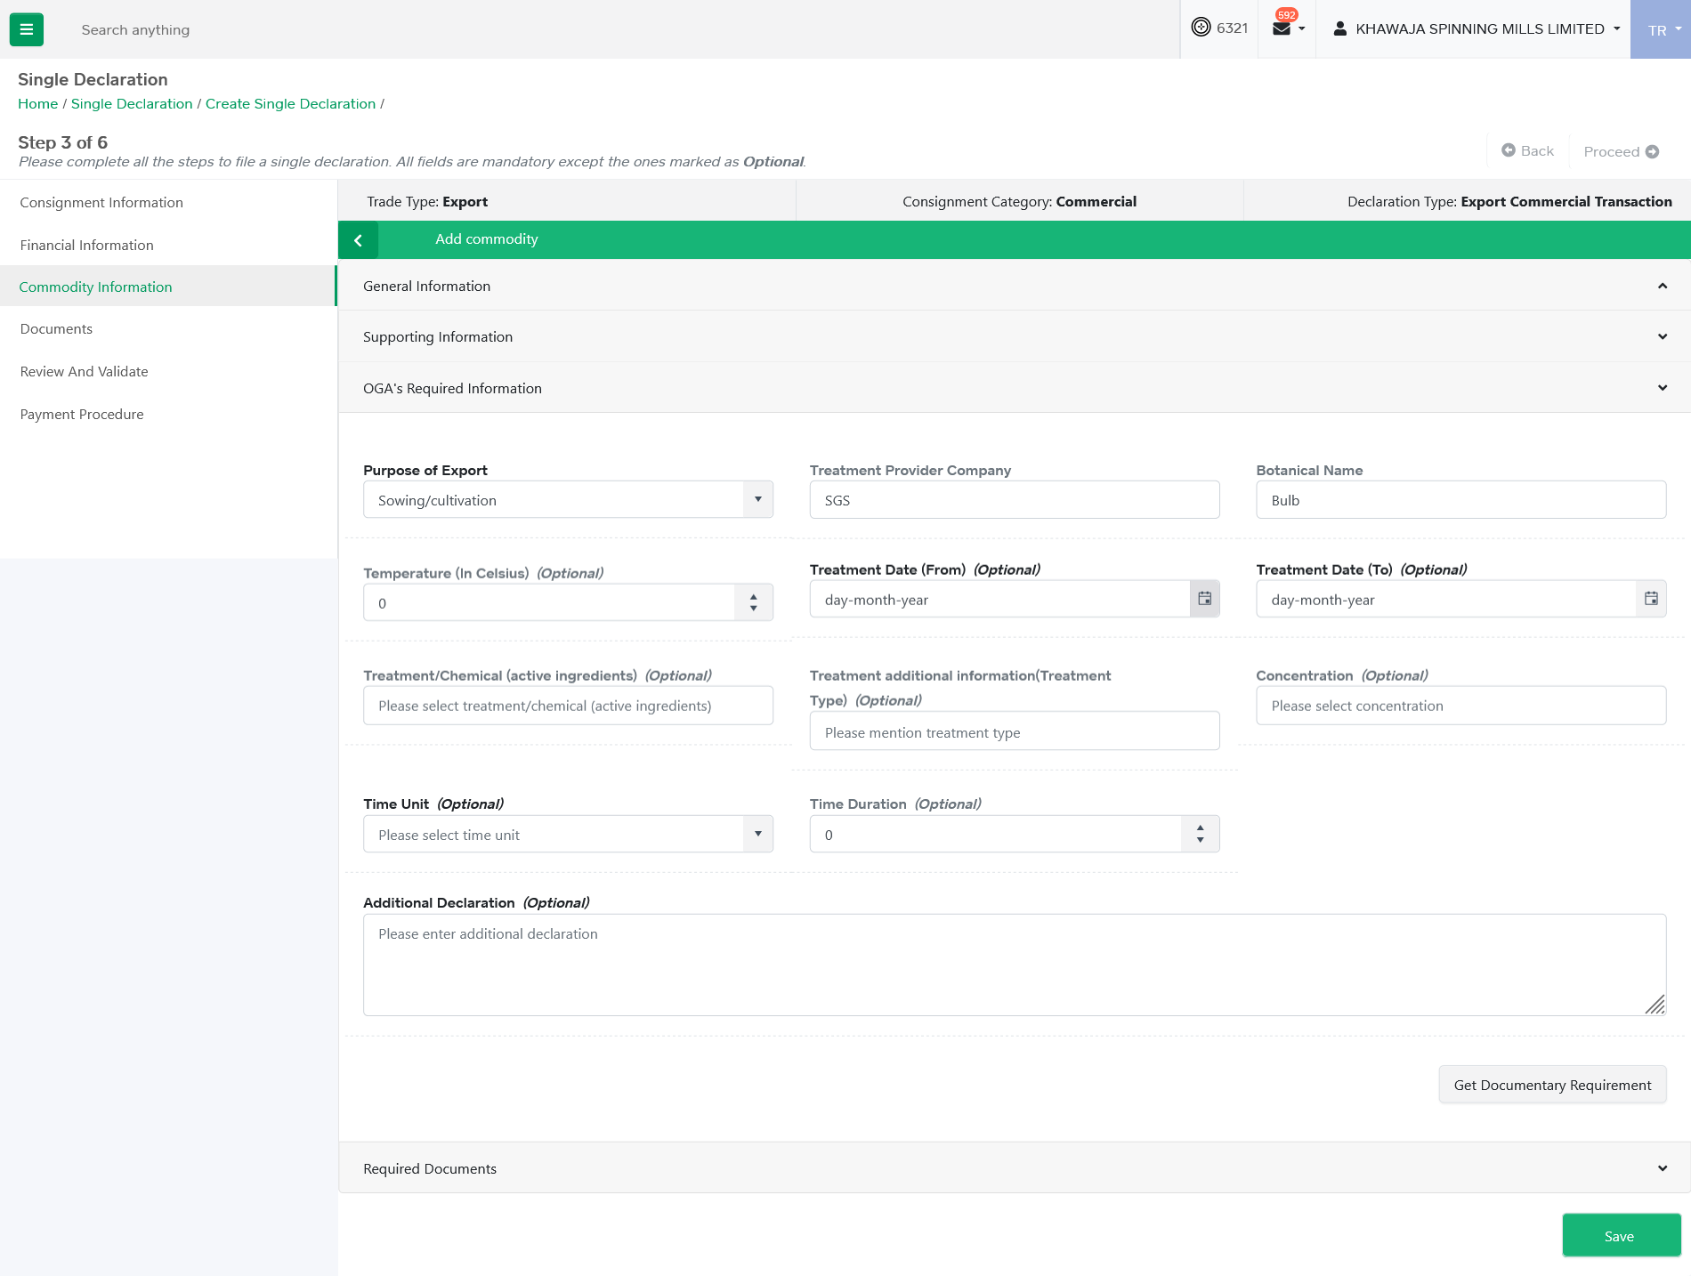
SD – Commodity Information
System check if selected product code requires additional data elements for processing of certificate/release order by OGAs. If additional data elements are required by OGAs then system display those additional data elements to user for input. User inputs the required information.

Slide 45
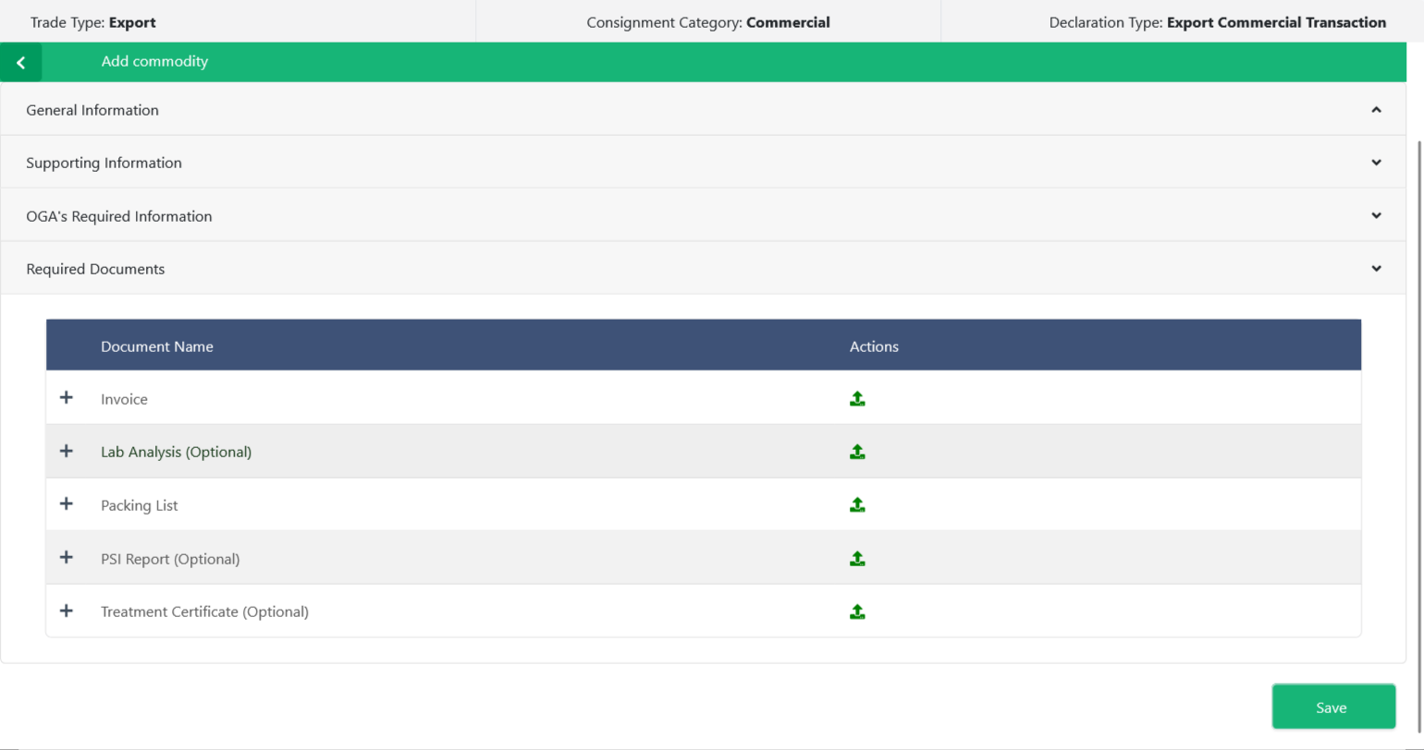
SD – Commodity Information
System checks if selected product code requires association of license/permit. If the required License/Permit has already been issued to the user, the same shall be associated with the declaration by the user.
System check if selected product code requires uploading of supporting documents required by OGA for issuance of certificate/release order. If such documents are required, then user associate/upload the documents.

Slide 46
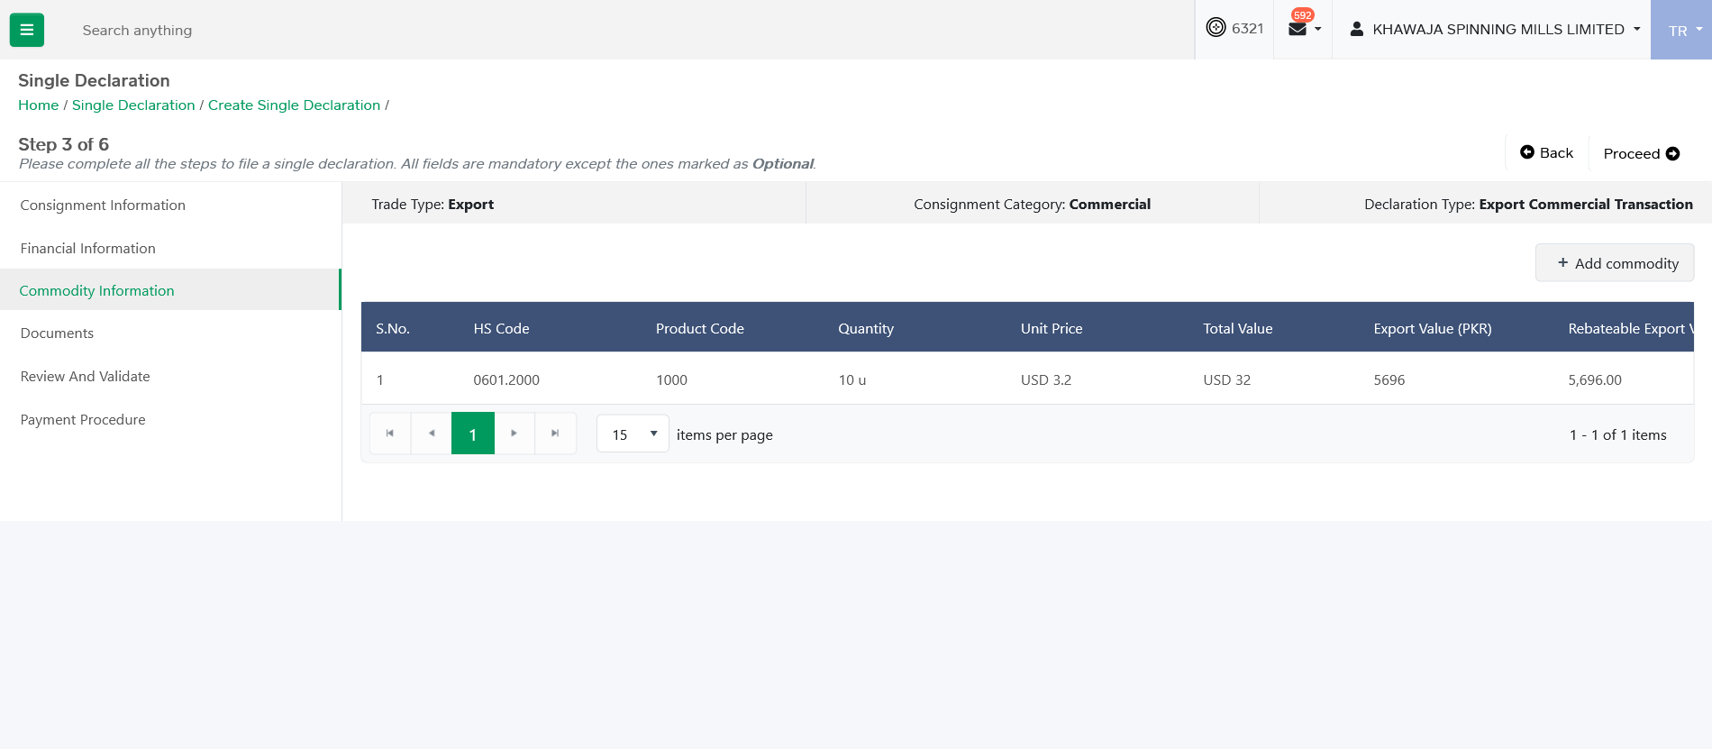
SD – Commodity Information
User clicks on ‘Proceed’ option to move to next step.

Slide 47
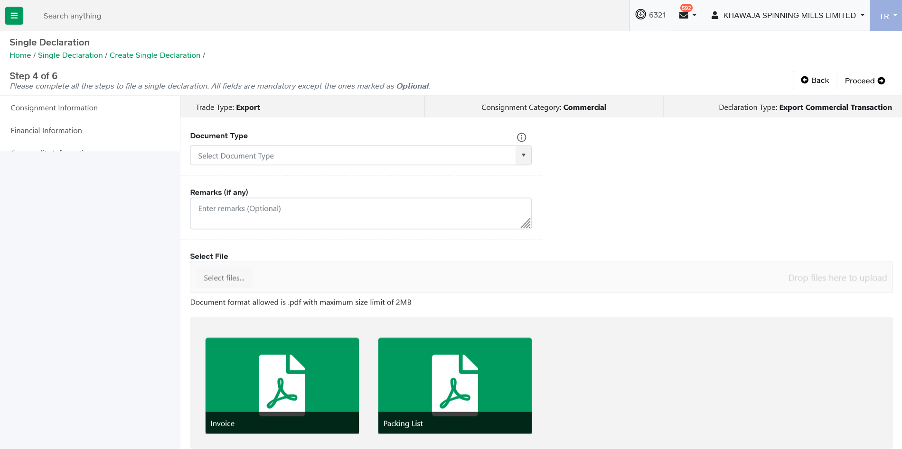
SD – Documents
User clicks on ‘Proceed’ option to move to next step.

Slide 48
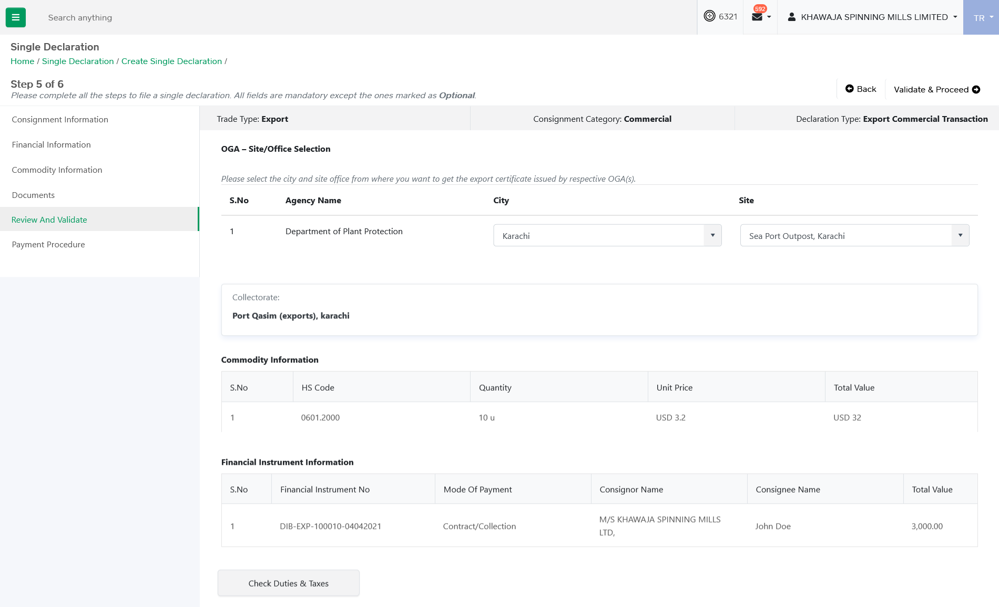
SD – Review & Validate

Slide 49
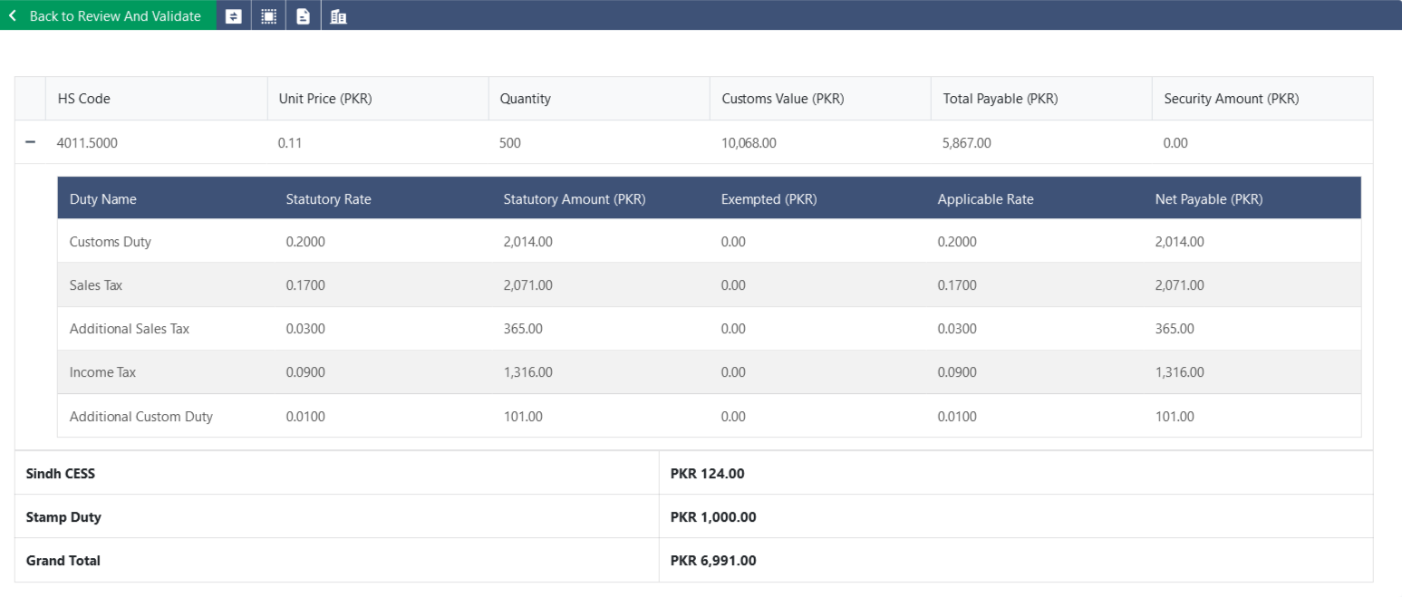
SD – Duties and Taxes

Slide 50
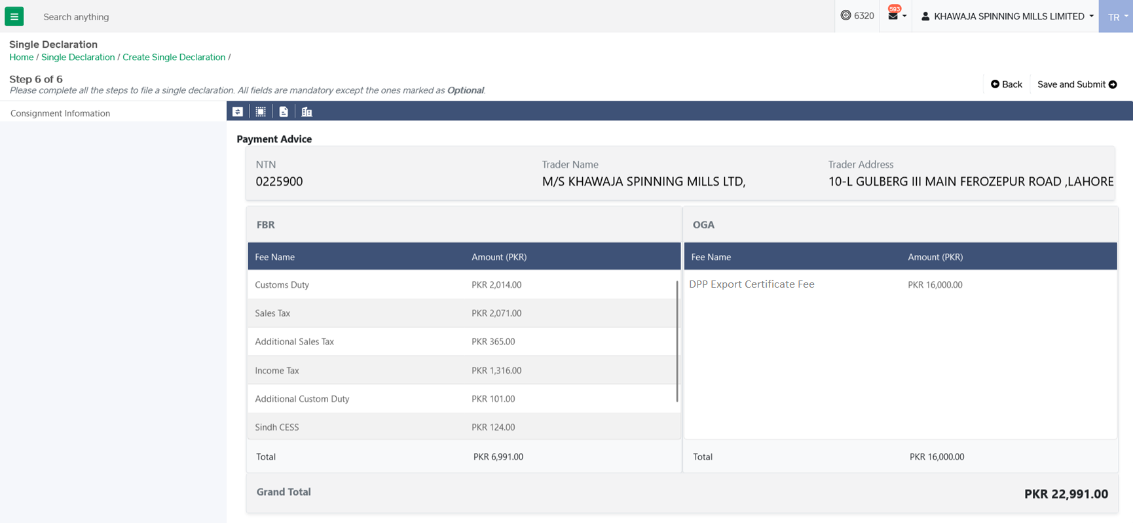
SD – Review & Validate

Slide 51
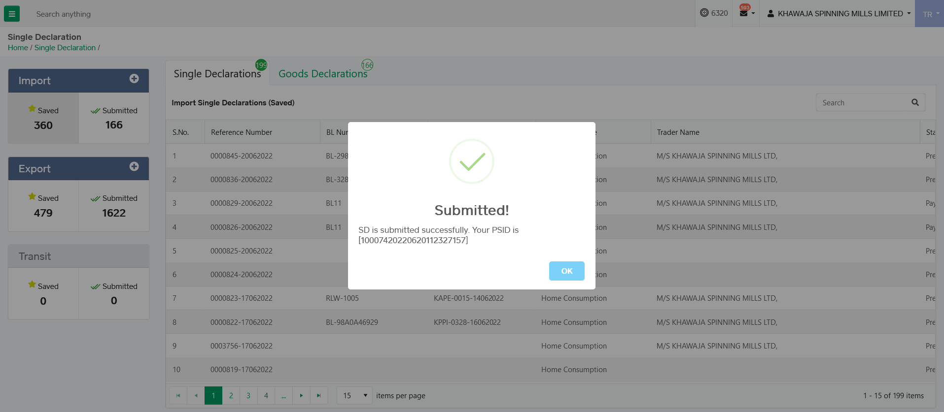
SD – SD Submission

Slide 52
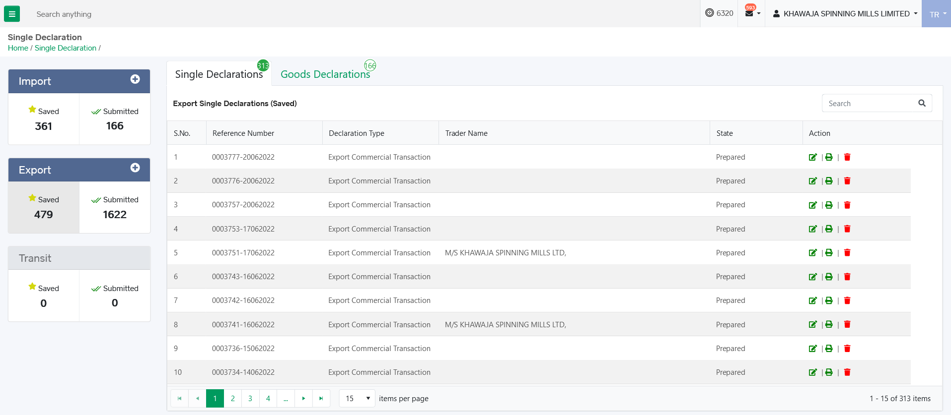
SD – Saved Declarations
From saved single declarations interface, user can perform following actions.
User can edit the saved single declaration.
User can print saved single declaration.
User can delete saved single declaration.

Slide 53
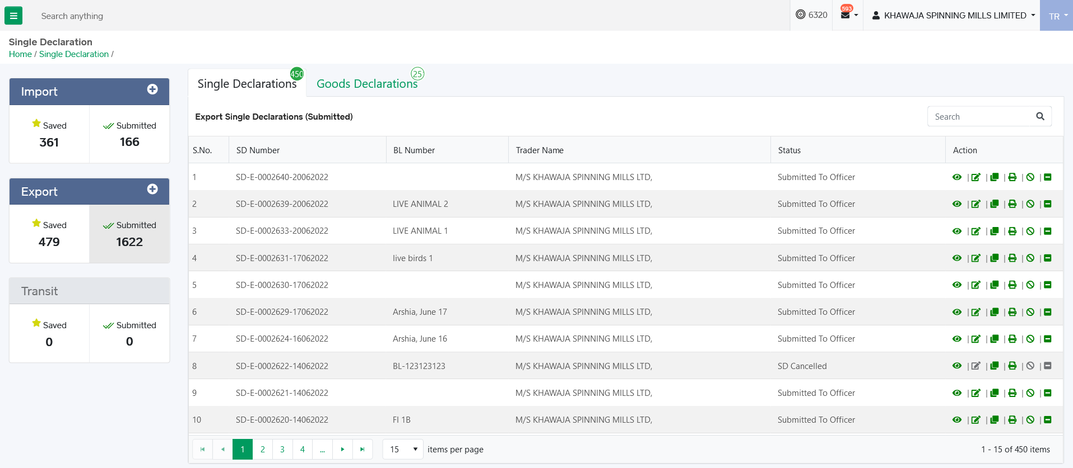
SD – Submitted Declarations
From submitted single declarations interface, user can perform following actions.
User can view the submitted single declaration.
User can amend the export single declaration.
User can clone submitted single declaration.
User can print submitted single declaration.
User can cancel submitted single declaration.
User can request for consignment drayoff for SD Export.

Slide 54
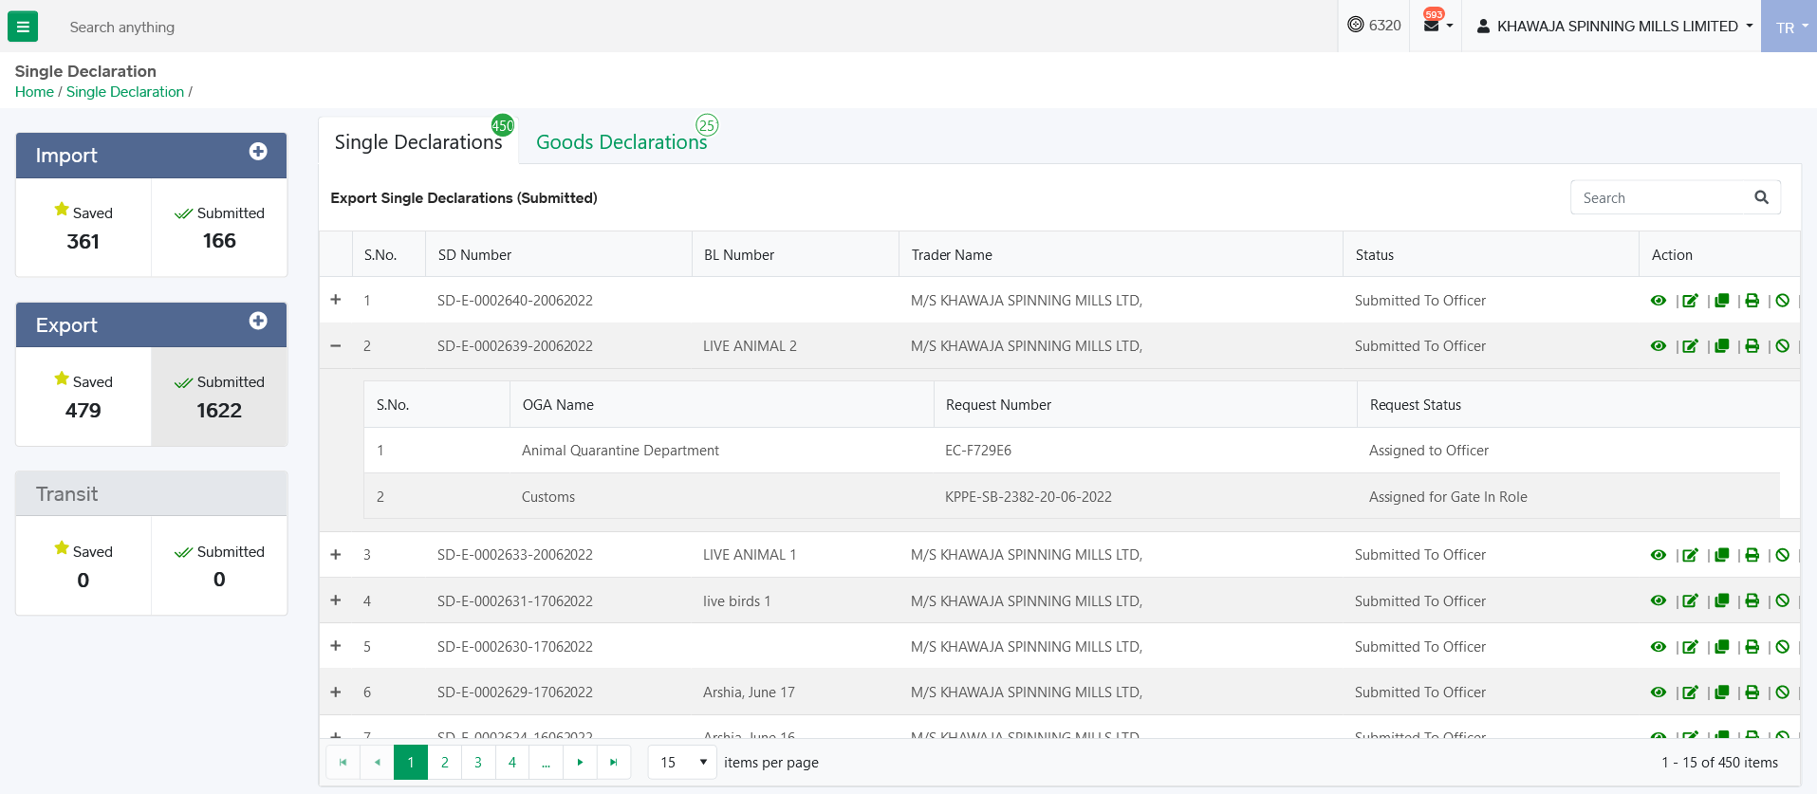
SD – Submitted Declarations
Through submitted single declarations interface, user can view documents and their status originated from SD.

Slide 55
THANK YOU!

