Slide 1
Notes:
In the name of Allah, Most Gracious, Most Merciful.

Slide 2
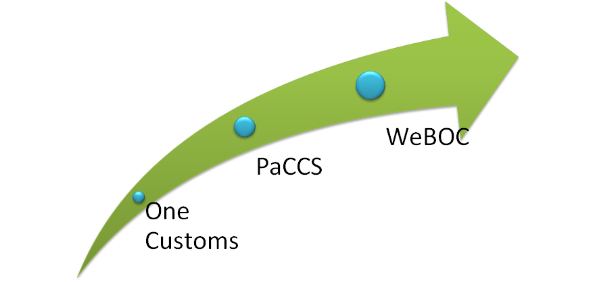
PSW

Slide 3
Pakistan Single Window
A Single Window is a facility that permits parties involved in trade and transport to lodge standardized information and documents with a single entry point to fulfill all import, export, and transit-related regulatory requirements. If information is electronic, then individual data elements should only be submitted once.
Notes:
One window system. All institution will work in a single window.
Many institutions were already been added in WeBOC. (Plant Protection, Animal Quarantine, Ministry of Foreign Affairs etc.
All register users in WeBOC will register again in PSW.
PSW has made many things very simple.

Slide 4
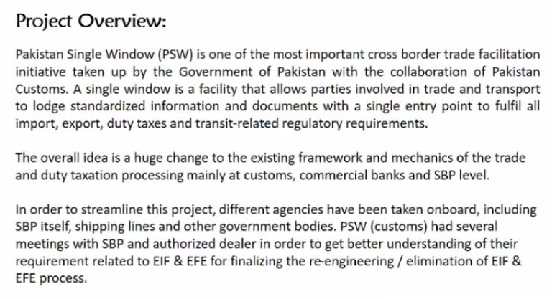

Slide 5
Features of PSW
Connect Government’s 49 Trade Regulators
Decrease Cost and Time
Registration Process Super Easy & Paperless/ Contactless
Eliminate Form-E and EIF Form
Government Departments Issues Documents Online in PSW
Perform Joint Inspection
Port Community System
Notes:
Registration is Paperless & Contactless which was very complex in WeBOC
Trader has to arrange almost 22 documents,
Removal of raised Objections
Physical appearance,
Custom officer visits the location
According to Customs it was 10 days process which actually takes months.
Now you can register in hours.

Slide 6
Benefits for the Government
Increase Revenue Yield
Improved Compliance
Enhanced Security Controls

Slide 7
Benefits for the Traders
Reduced costs and time
Faster clearance
Transparency & Predictability
Less Opportunity for interpretation of laws, regulations etc.

Slide 9
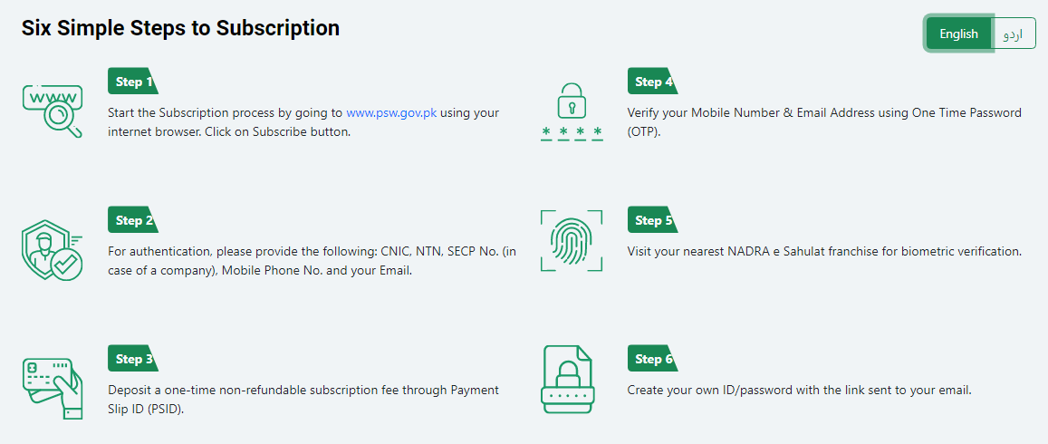
PSW Subscription

Slide 10
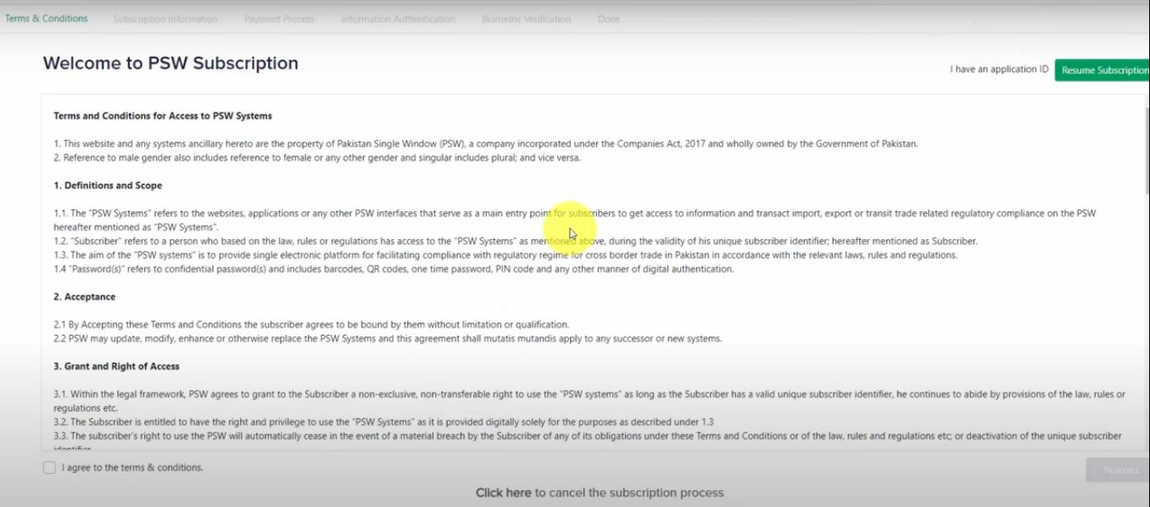
Notes:
Acknowledgement of Terms & Conditions
Click “I Agree to the Terms & Conditions” and Proceed

Slide 11
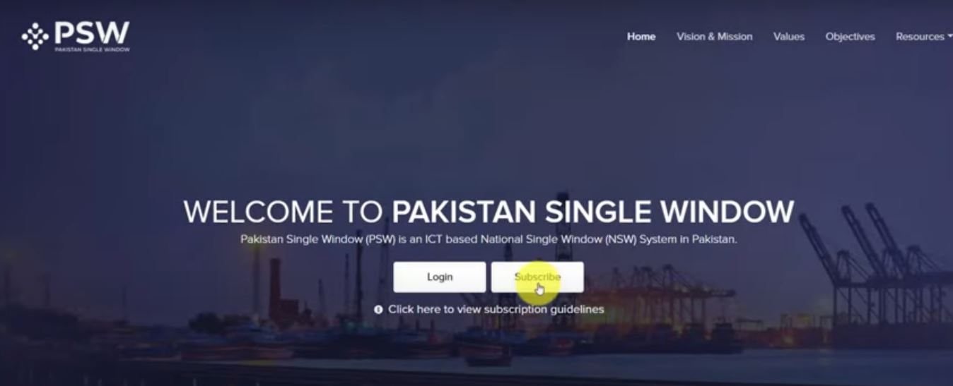
Notes:
Registration Process

Slide 13
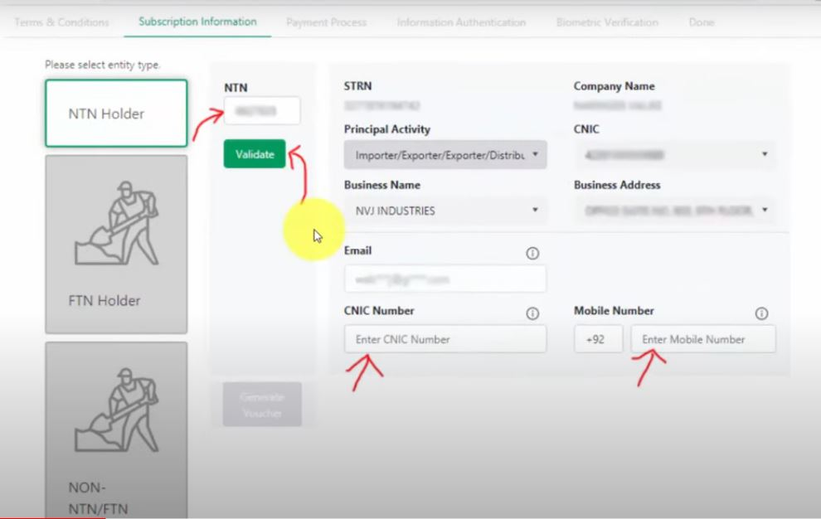
Notes:
Three Types of Users NTN FTN Non NTN/FTN
You have to provide NTN, Email, CNIC no & Mobile no
Email should be same as provided in IRIS database (NTN , Sales tax)
Generate Voucher

Slide 14
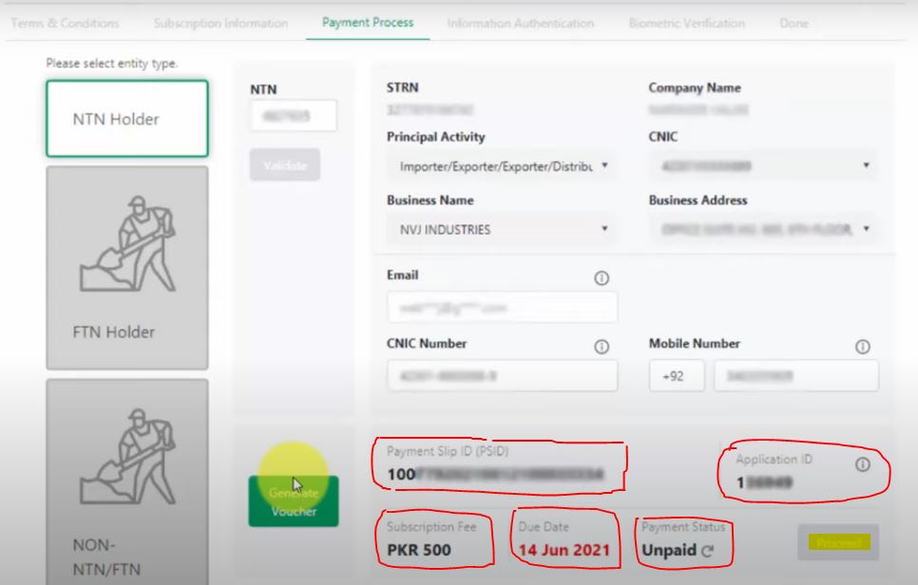
Notes:
PSID & Application ID has been generated (note down these two fields)
You will also receive email and SMS of this information

Slide 15
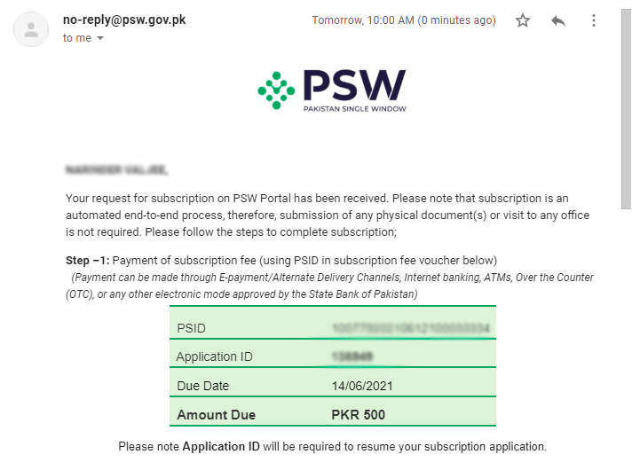
Email of Rs.500/- Voucher
Notes:
EMAIL SCREENSHOT

Slide 16
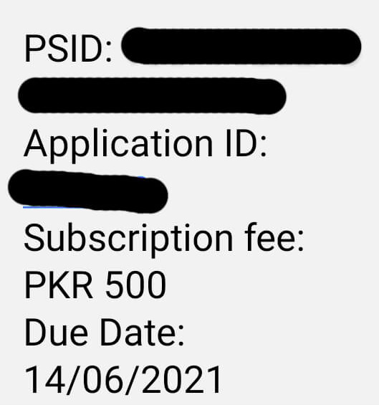
SMS of Rs.500/- Voucher
Notes:
SMS of Rs.500/- Voucher

Slide 17
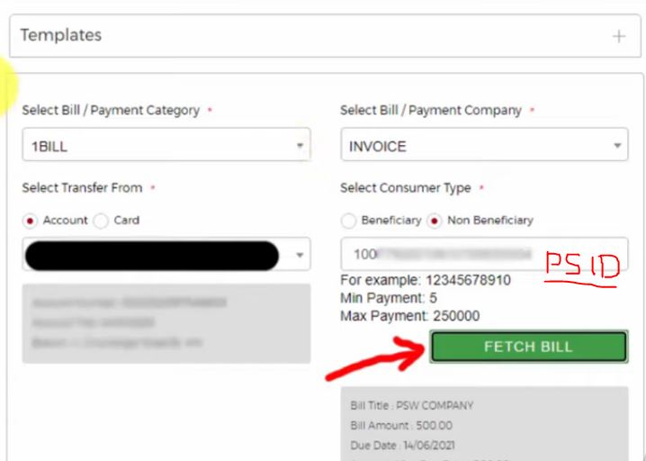
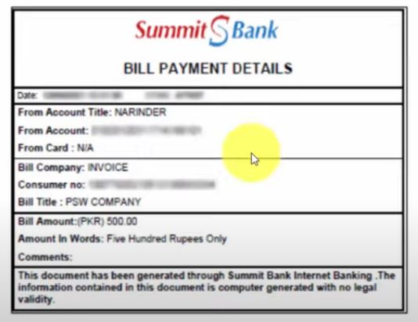
Notes:
Payment through bank

Slide 18
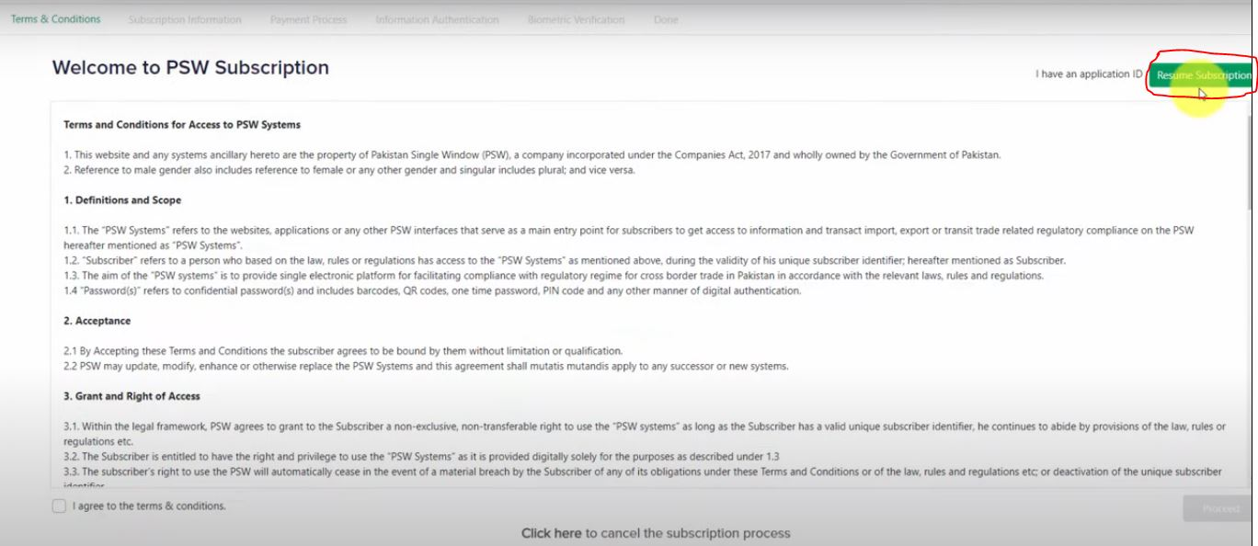
Notes:
Click Resume Application

Slide 19
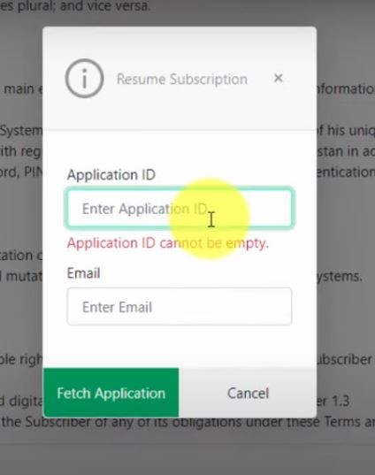
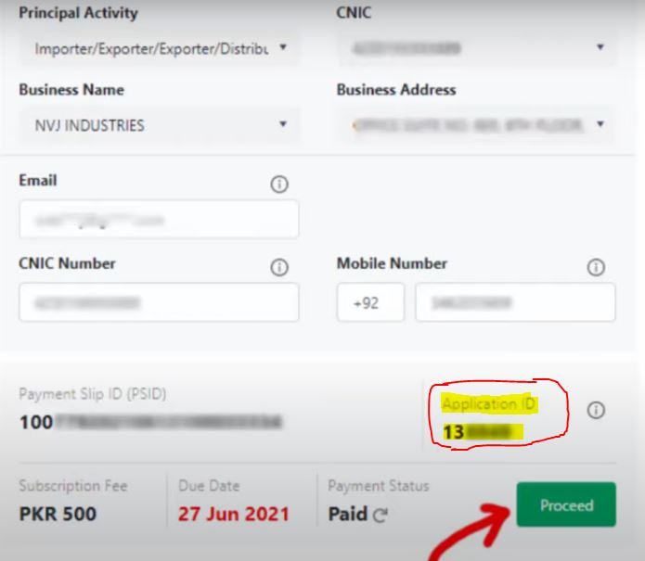
Notes:
Enter Application ID & Email ID
Application ID will be available in your email and SMS
Status of payment has been changed.
Proceed

Slide 20
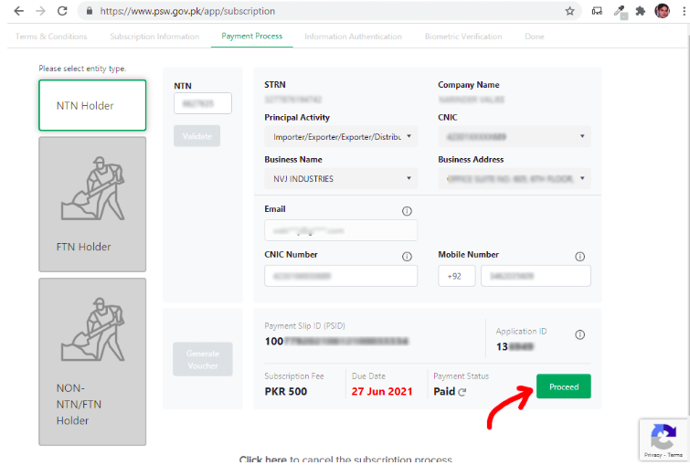
Notes:
Step 6
After payment, the system will update your ‘Payment Status’, and your application status changed to Paid.
Now simply click the process button to go next step.

Slide 21
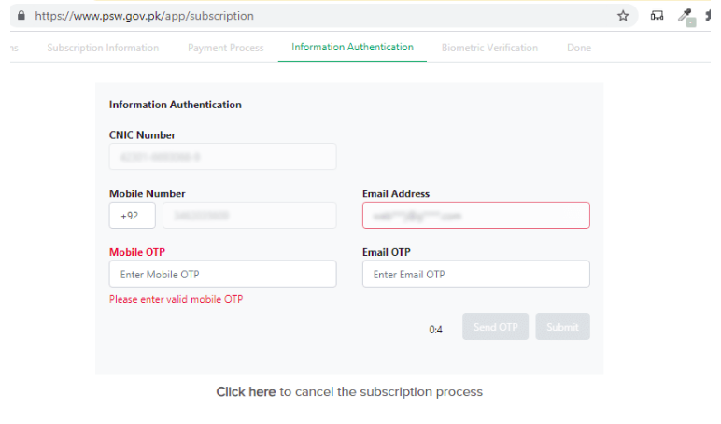
Notes:
Step 7
Now you are on an information authentication page, where you will verify your mobile number and email address.
Click on the ‘Send OTP’ button, this PSW system will send two OTP codes, one to your mobile number and one to your email address.

Slide 22
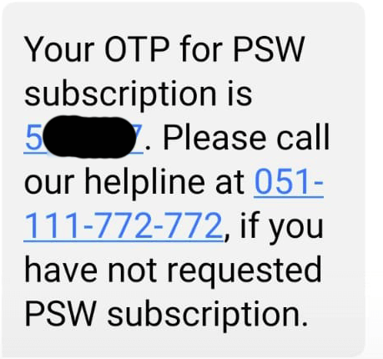
Notes:
Mobile OTP Code

Slide 23
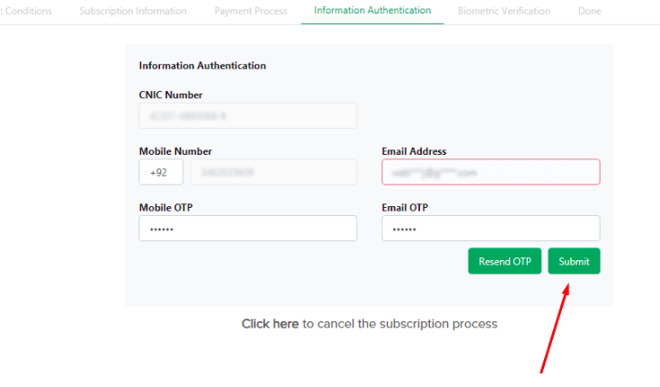
Notes:
Code receive through mobile SMS so type that code on the ‘Mobile OTP’ textbox.
Code received in email, type in ‘Email OTP’ textbox, and simply press Submit button.

Slide 24
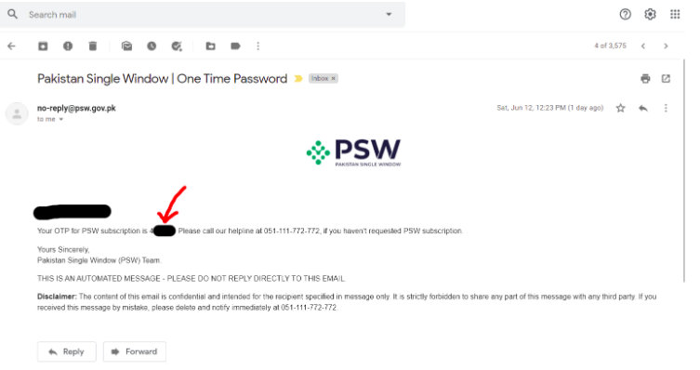
Notes:
ONE TIME PASSWORD

Slide 25
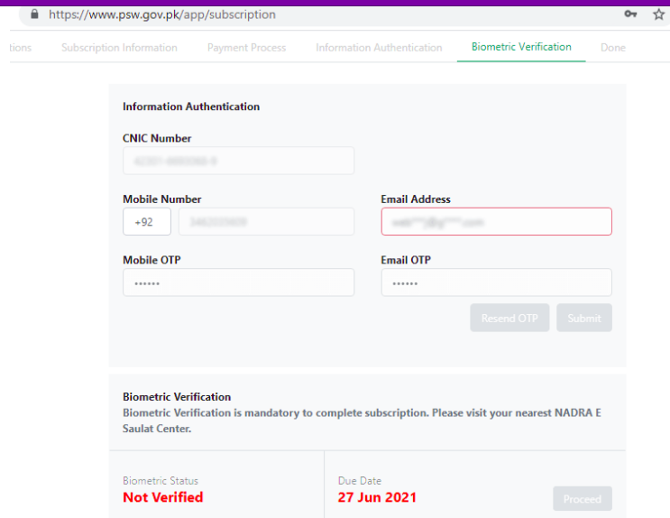
Notes:
PSW Biometric Verification
After which, the system will show you the ‘Biometric Verification’ page.
Biometric verification is mandatory to complete the subscription. Please visit your nearest NADRA E Saulat Center.

Slide 26
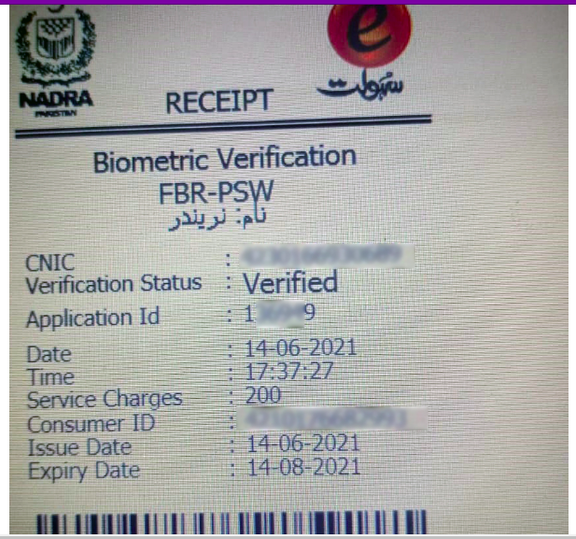
Notes:
BIOMETRIC RECEIPT.

Slide 27
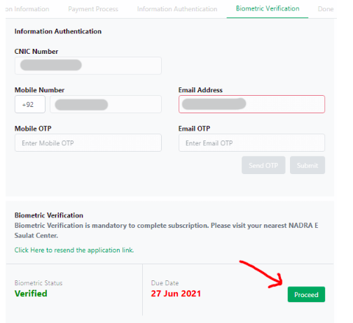
Notes:
This will take few hours to update your biometric verification status, as soon as your status verified the proceed button enables.

Slide 28
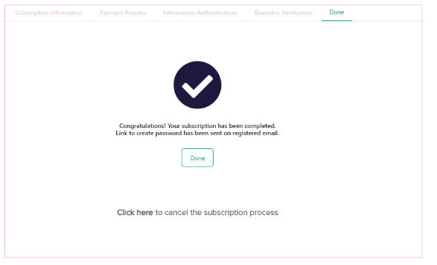
Notes:
Congratulation! Your subscription has been completed.
Link to create password has been sent on registered email.

Slide 29
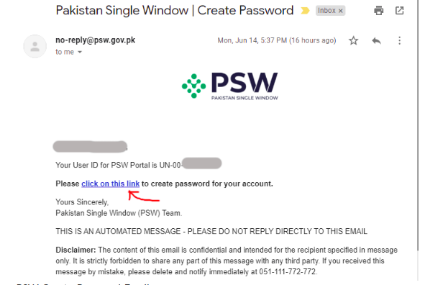
Notes:
PSW-Create-Password-Email
You will receive an email in which you can find a link, using that link you will create a password for your PSW Account.

Slide 30
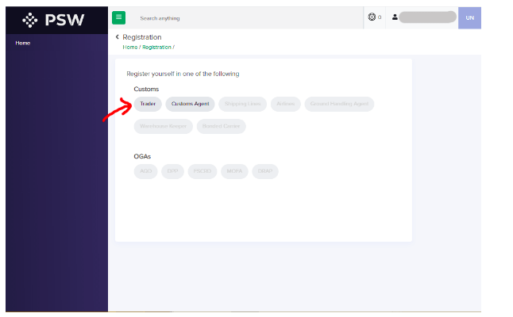
Notes:
If you are a trader so click on ‘Trader’ and if you are a customs clearing agent so click on ‘Customs Agent’.

Slide 31
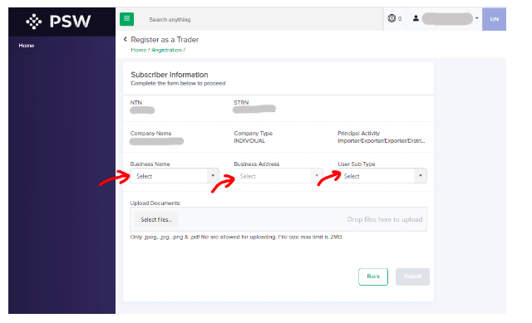
Notes:
Select Business Name, Business Address, and User Sub Type as Commercial.
Upload Documents (i.e NTN Verification in PDF Format).
After which, press the ‘Submit’ button.

Slide 32
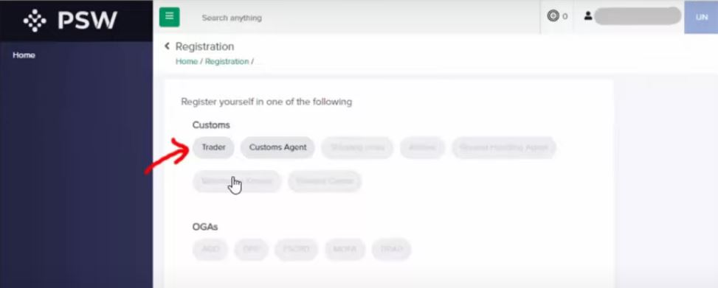
Notes:
Register yourself as Trader or Clearing Agent

Slide 33
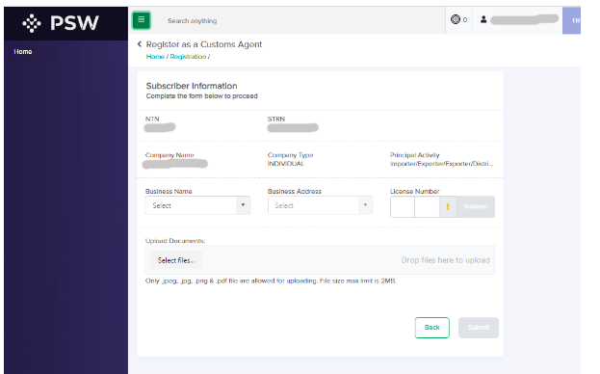
Notes:
How To Register in PSW (Pakistan Single Window) as a Customs Clearing Agent
Select Business Name, Business Address.
Type Parent Collectorate Code then License Number.
For Example:
KCUS1234

Slide 34
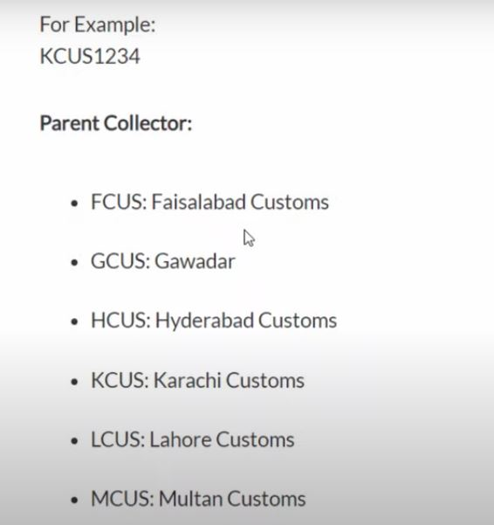
Notes:
List of Collectorate Codes is also available

Slide 35
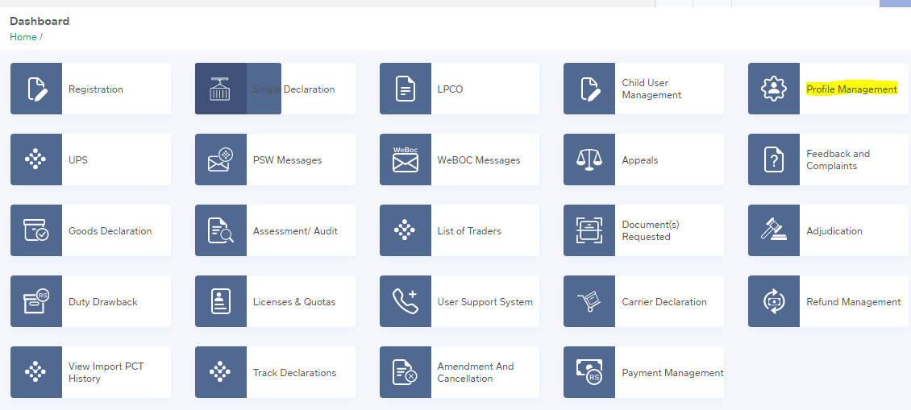
RENEWAL SUBSCRIPTION

Slide 36
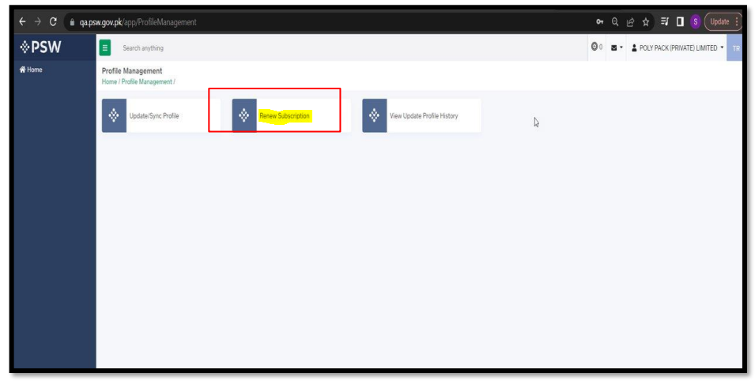

Slide 37
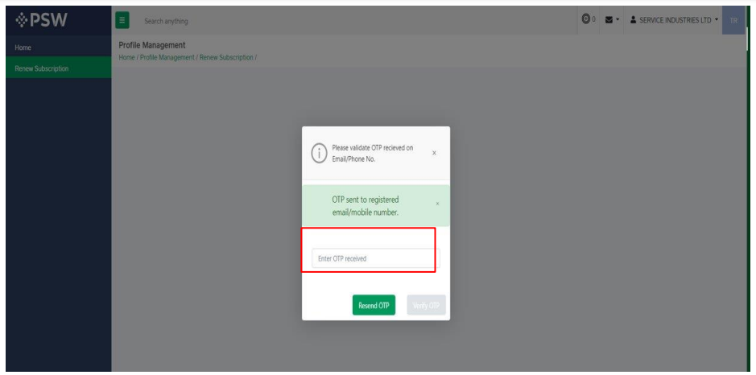

Slide 38
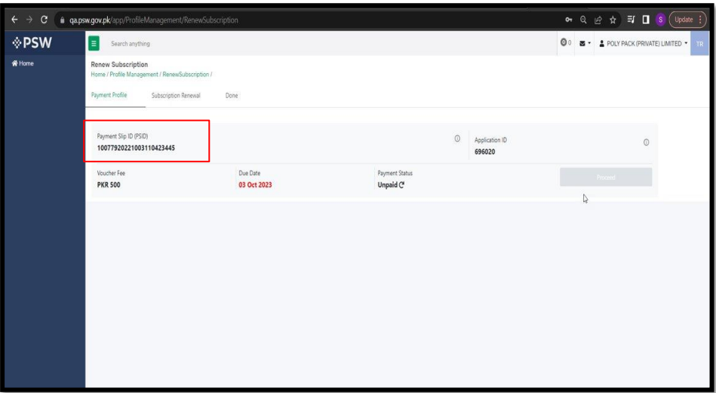

Slide 39
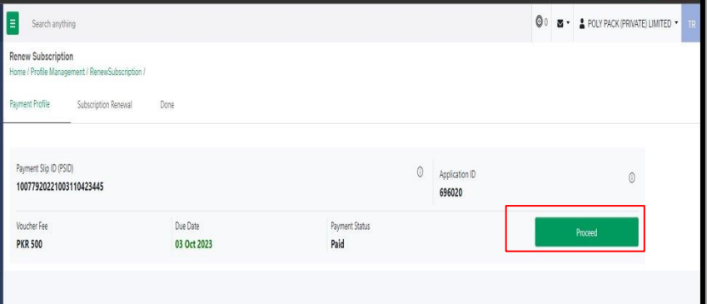

Slide 40
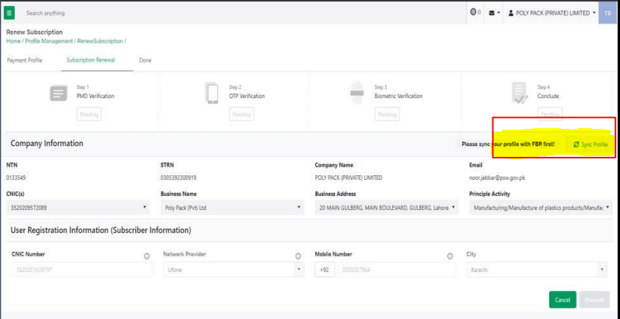

Slide 41
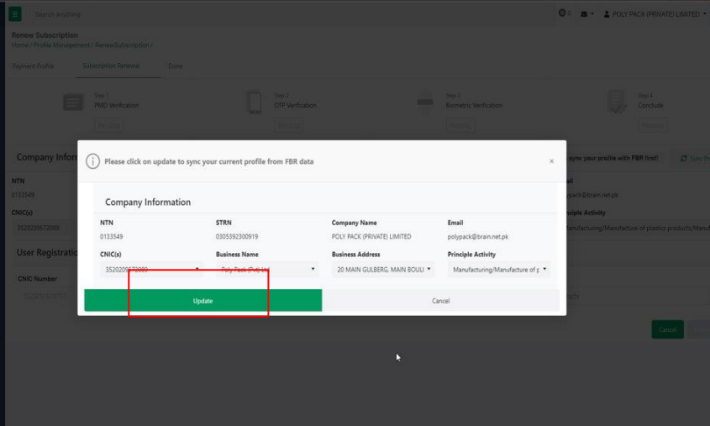

Slide 42
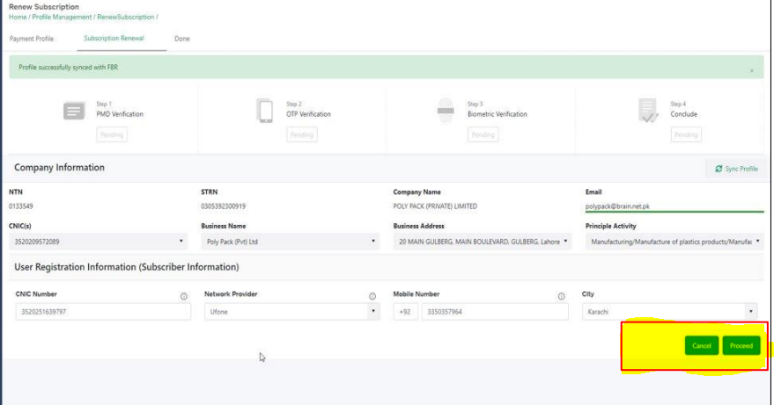

Slide 43
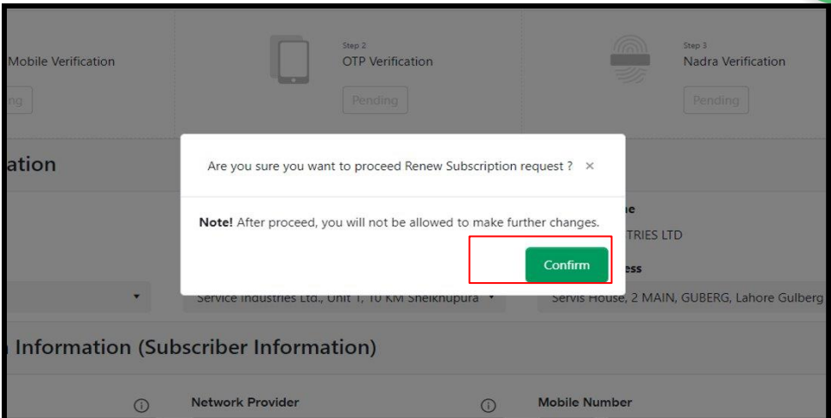

Slide 44
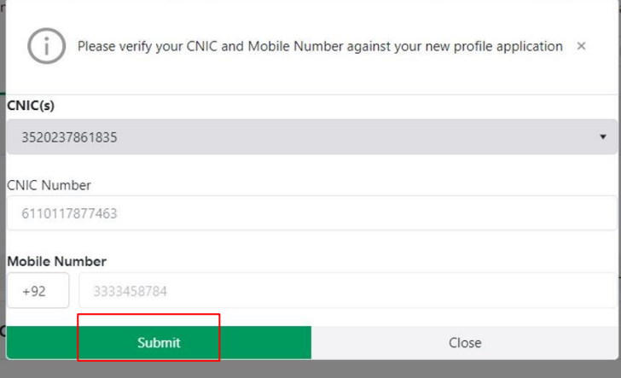

Slide 45
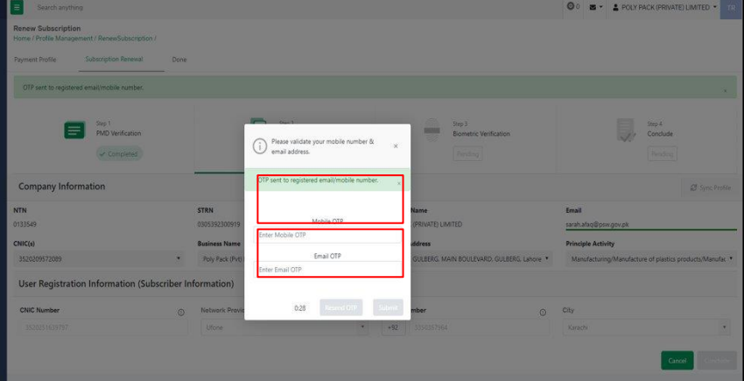

Slide 46
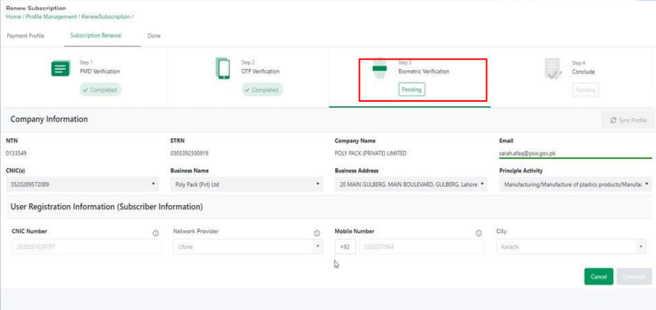

Slide 47
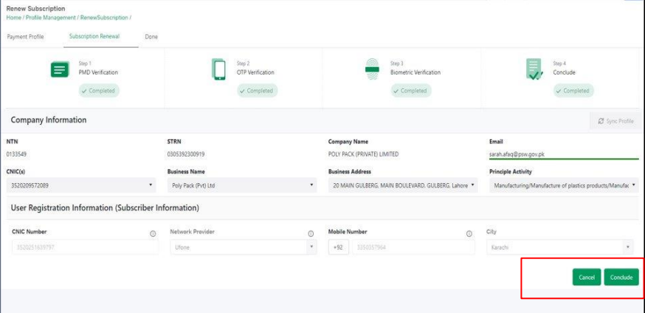

Slide 48
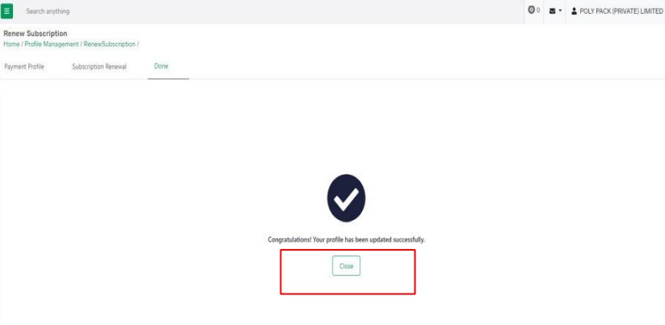

Slide 49
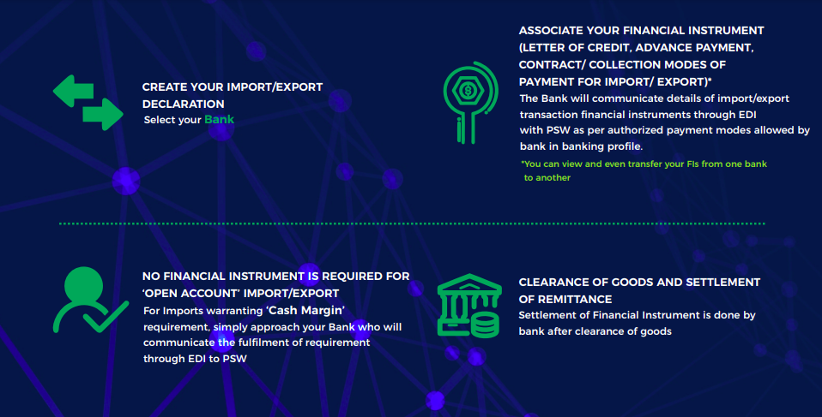
Financial Instrument
Notes:
List of Collectorate Codes is also available

Slide 53
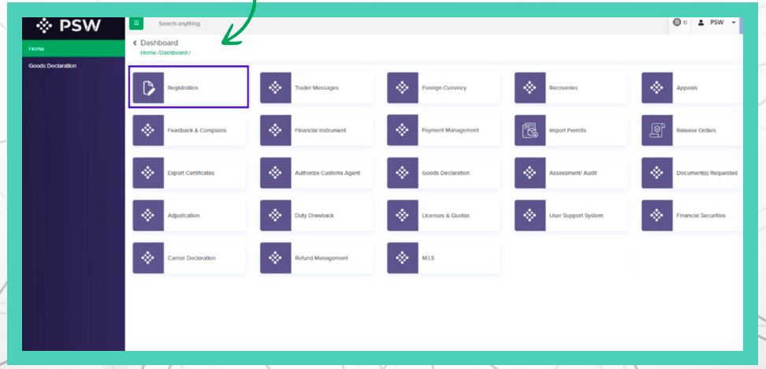
Associate Banking Profile
Notes:
List of Collectorate Codes is also available

Slide 54
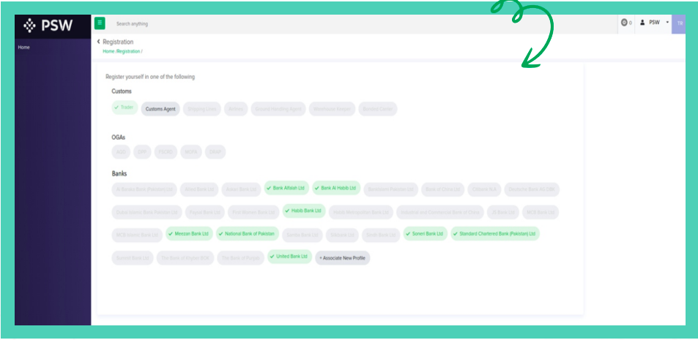
Associate Banking Profile
Notes:
List of Collectorate Codes is also available

Slide 55
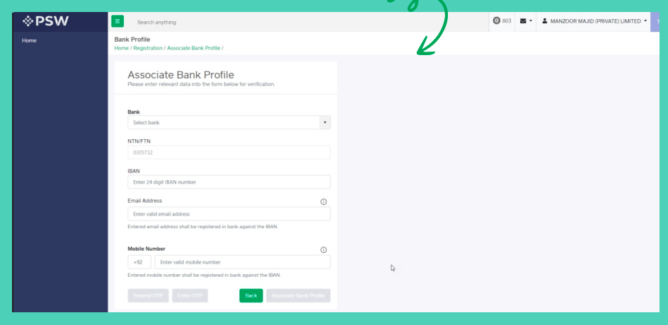
Associate Banking Profile
Notes:
List of Collectorate Codes is also available

Slide 56
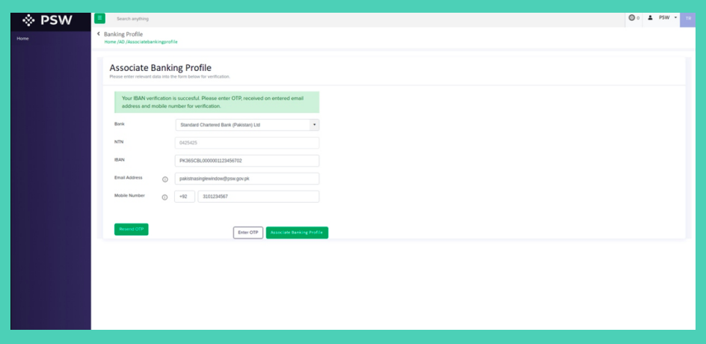
Associate Banking Profile
Notes:
List of Collectorate Codes is also available

Slide 57
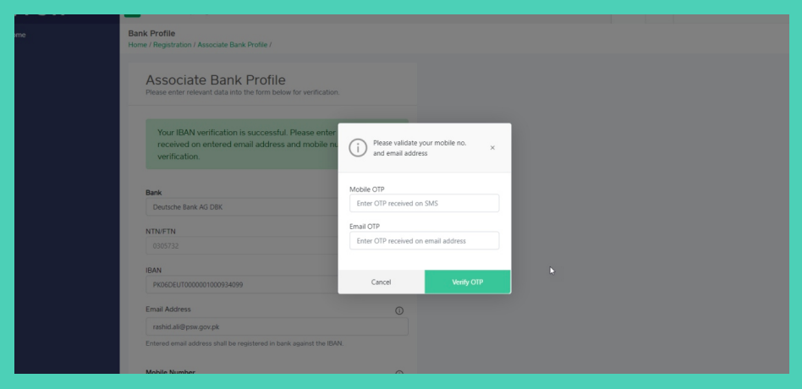
Associate Banking Profile
Notes:
List of Collectorate Codes is also available

Slide 58
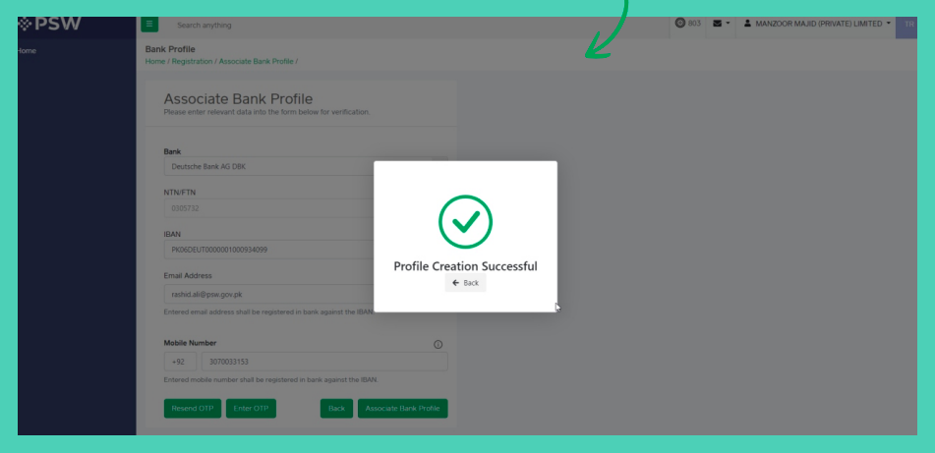
Associate Banking Profile
Notes:
List of Collectorate Codes is also available

Slide 59
Associate Banking Profile
Notes:
List of Collectorate Codes is also available

Slide 60
Associate Banking Profile
Notes:
List of Collectorate Codes is also available

Slide 61
Associate Banking Profile
Notes:
List of Collectorate Codes is also available

Slide 62
Associate Banking Profile
Notes:
List of Collectorate Codes is also available

Slide 63
Associate Banking Profile
Notes:
List of Collectorate Codes is also available

Slide 64
Associate Banking Profile
Notes:
List of Collectorate Codes is also available

Slide 65
Notes:
List of Collectorate Codes is also available

Slide 66
SINGLE DECLARATION (SD) IMPORT
CONSIGNMENT INFORMATION

Slide 67
FINANCIAL INFORMATION

Slide 68
COMMODITY INFORMATION

Slide 69
UPLOAD DOCUMENTS

Slide 70
REVIEW AND VALIDATE

Slide 71
PAYMENT PROCEDURE

Slide 73
Thanks
Presented By:
Mr. Farrukh Ameen (Manager PRAL)
Farrukh.ameen@pral.com.pk
Mr. Kamran Javed (User Support Officer)
Kamran.javed@pral.com.pk

