Slide 1
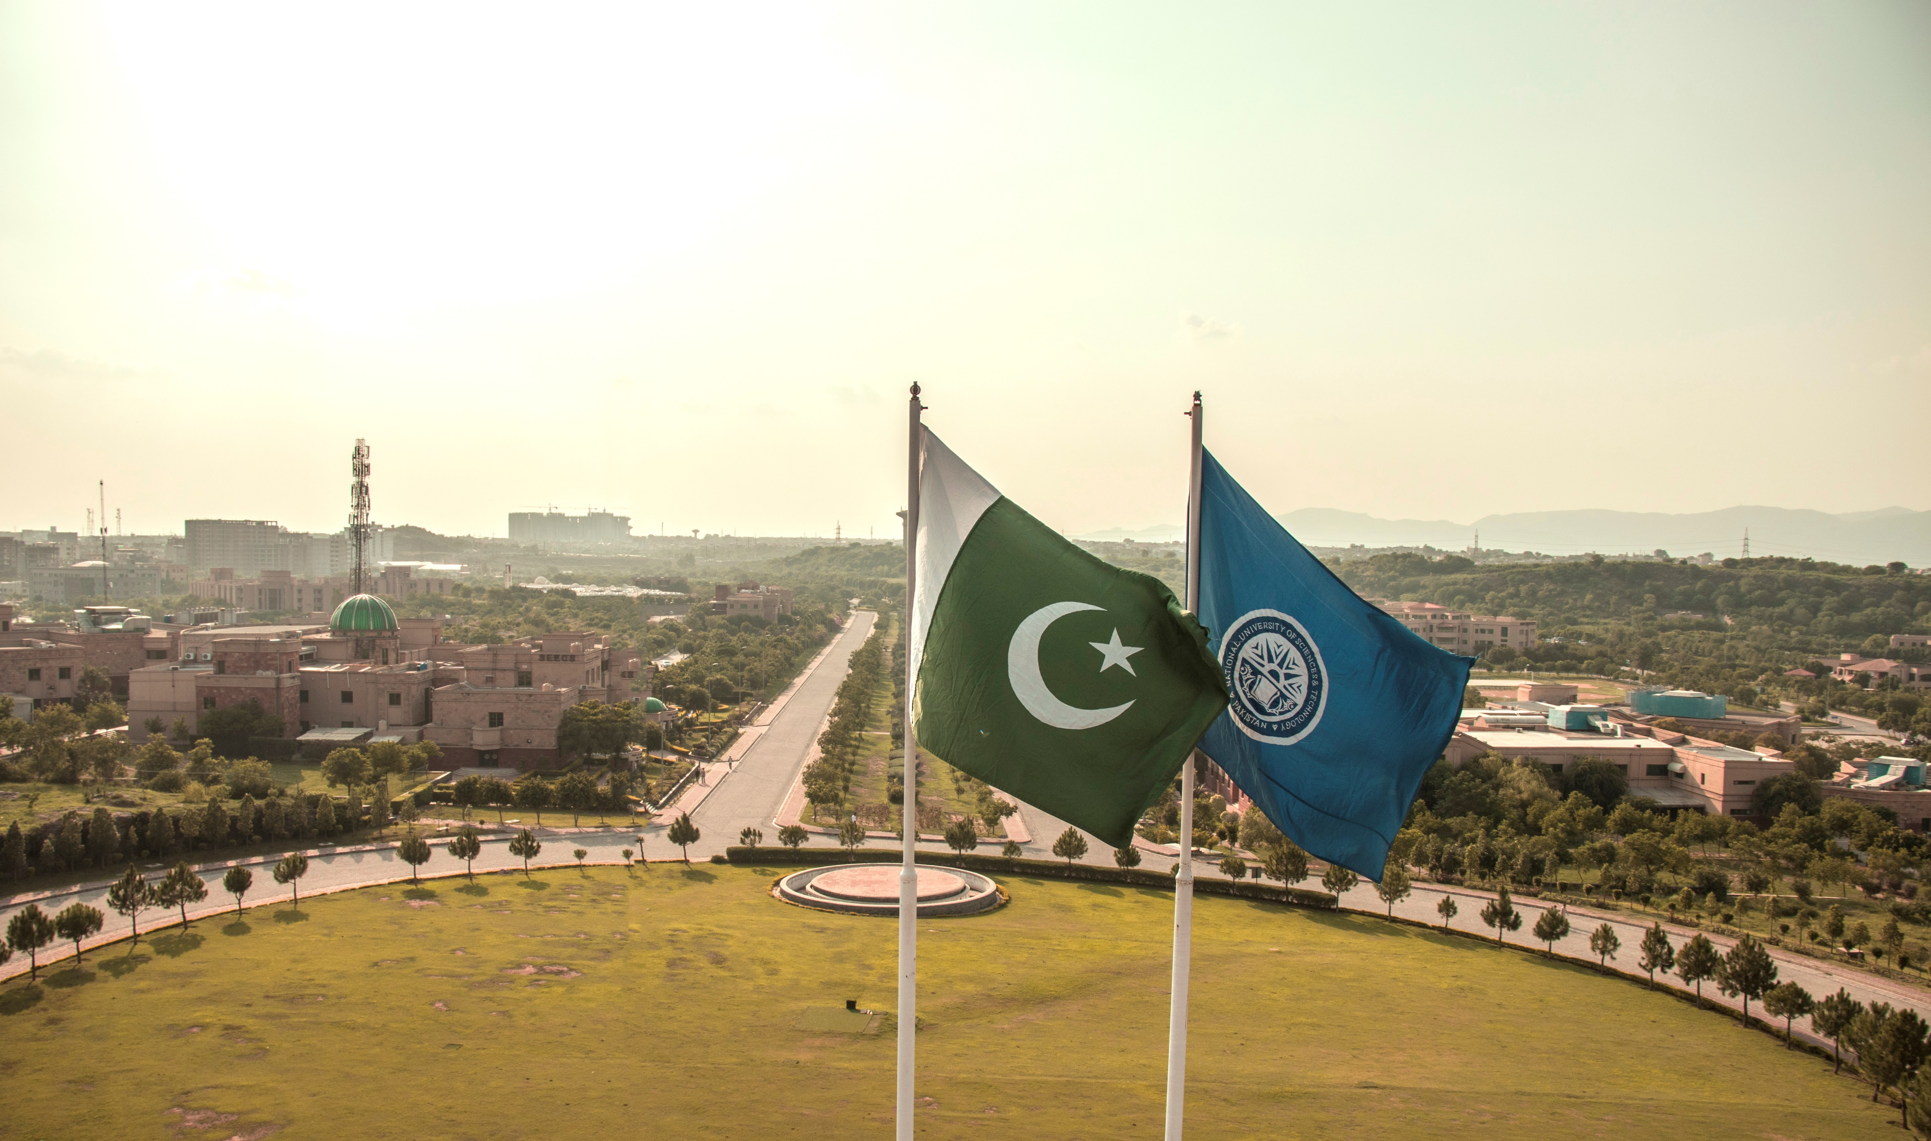

NATIONAL UNIVERSITY OF SCIENCES
& TECHNOLOGY (NUST), PAKISTAN
Islamabad | Rawalpindi | Karachi | Risalpur | Quetta

Slide 2
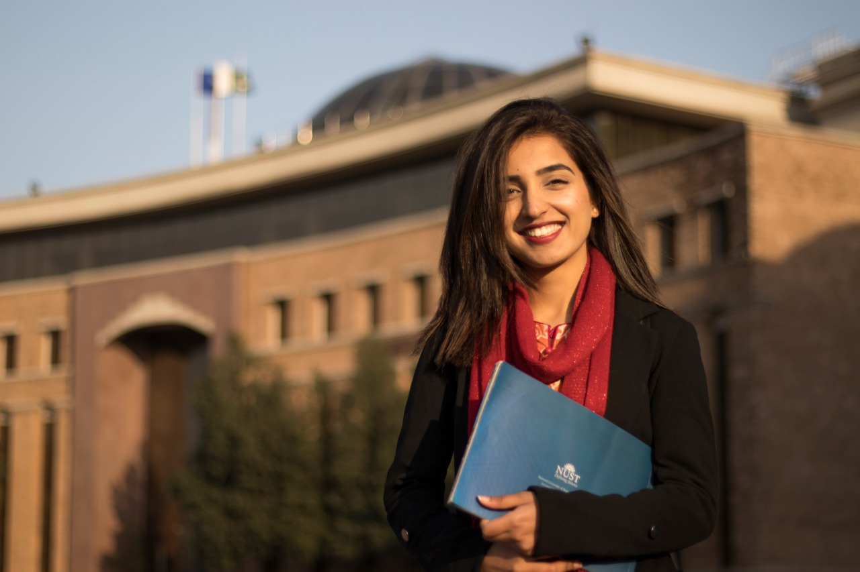

NUST-QS WORLD RANKING 2022
#41
Top 50
Young
Universities
#1
In Pakistan
#67
In Asia
#334
In World
334
2022
354
2021
AN ASCENT OF 194 POSITIONS IN LAST 6 YEARS
358
2020
400
2019
417
2018
Notes:
NUST is one of the leading University of Pakistan
According to QS World Rankings it is listed as 334 in the World, 67 in Asia and 41 among the leading 50 universities under the age of 50
Trajectory journey, with an ascent of 194 positions in last 6 years

Slide 3










NUST
AN EXPERIENTIAL
LEARNING SPREAD
PUBLIC SECTOR UNIVERSITY
Estb. 1991
19 Institutions
07 Campuses
Accessibility
NATIONAL FOOTPRINT
07
Disciplines
154
Academic Programs
1,495
Faculty Members
Multidisciplinary
Research Intensive
18,500
Students
48,288
Graduates
Comprehensive

Slide 4
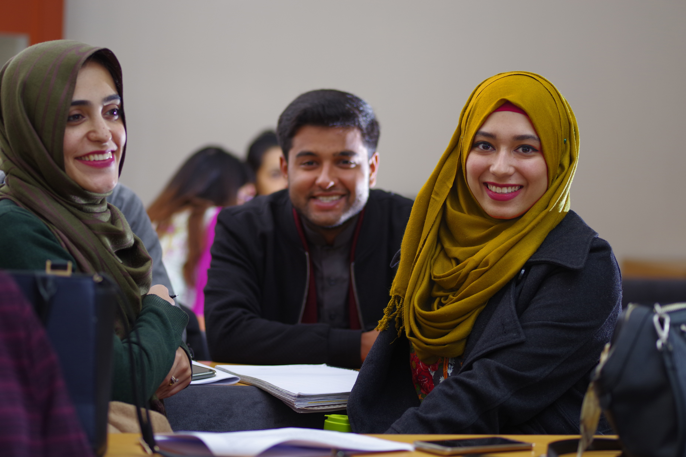




QUALITY EDUCATION
AT AFFORDABLE PRICE
FOR INCLUSIVE GROWTH
30%
Female Students
4%
UG Acceptance
35%
First Generation Students
1/3rd
Degree Cost against Top
tier HEIs in Pakistan
Washington Accord Ratified
All Engineering Programs

Slide 5



TIMES HIGHER EDUCATION IMPACT RANKING 2022
Among Top 200 in the World
# 4 in the World
SDG-7 (Affordable & Clean Energy)
UN
# 67 in the World
SDG-12 (Responsible Consumption & Production)
# 62 in the World
SDG-14 (Life Below Water)
Notes:
NUST lands among Top 200 world universities in Times Higher Education (THE) Impact Rankings 2022; retains 1st position in Pakistan
Secured first position in the country in 8 SDGs which include Clean Water and Sanitation (SDG-6), Affordable and Clean Energy (SDG-7), Industry, Innovation and Infrastructure (SDG-9), Sustainable Cities and Communities (SDG-11), Responsible Consumption and Production (12), Life Below Water (SDG-14), Life on Land (SDG-15), and Partnership for the Goals (SDG-17)
Special mention that in SDG-7, NUST has ascended 63 positions to be proudly ranked Number 4 in the world

Slide 6
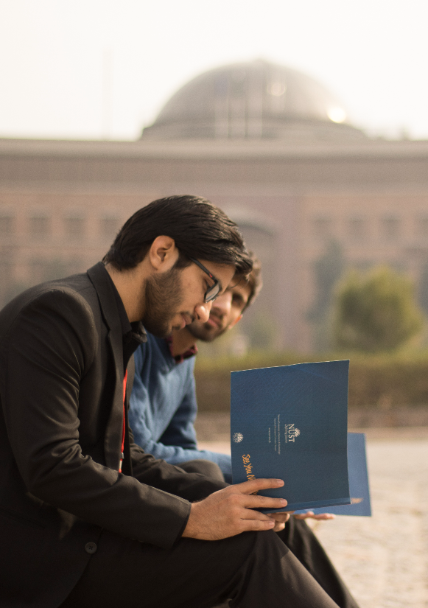
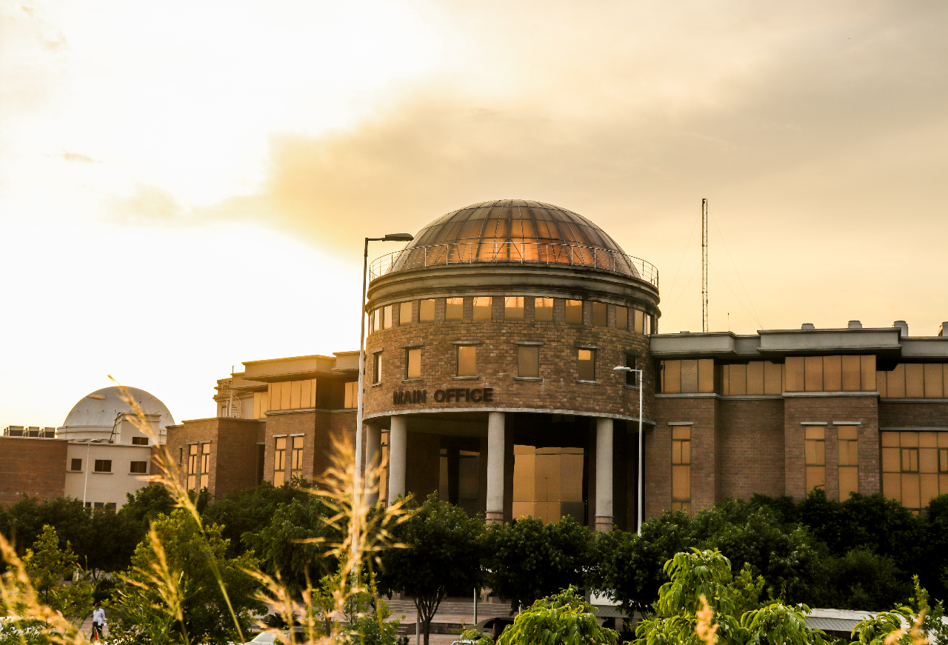
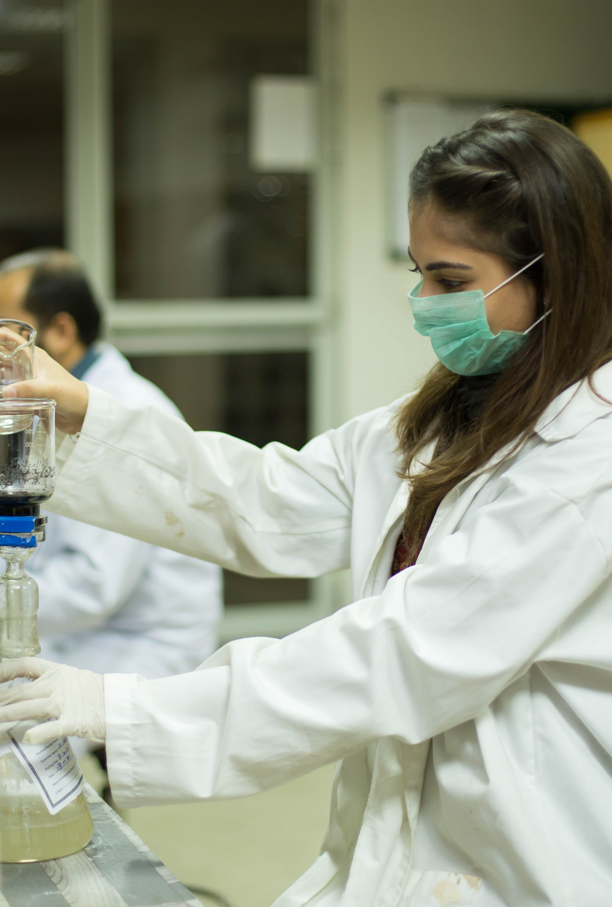
INTELLECTUAL CAPITAL

Slide 7
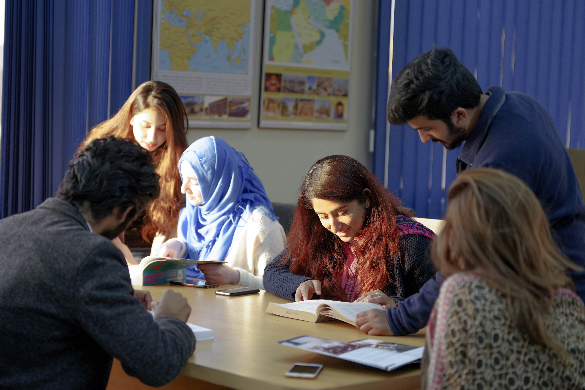
MULTIDISCIPLINARY STRENGTH
Engineering
Information Technology
Basic/Natural Sciences
Applied Biosciences
Social Sciences & Humanities
Art, Design & Architecture
Management and Leadership Studies
Military Art and Science
Peace and Conflict Studies
Upcoming: Health Sciences
Notes:
NUST offers diverse disciplines to equip students with knowledge in emerging fields

Slide 8

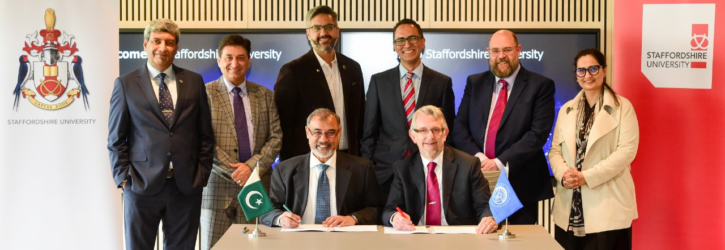
INTERNATIONAL
ACADEMIC LINKAGES
210 INSTITUITIONS IN 50 COUNTRIES
Faculty Exchange
Student Exchange
Joint Research
Twin Labs
Curriculum Development

Slide 9

CREATING A BETTER WORLD
ONE LEADER AT A TIME
104
in Employer Reputation
(QS World Ranking 2023)
94% Employability Rate
(within one year of graduation)
"
You can never go wrong with hiring from NUST. Their graduates are keen learners and adapt to any work environment. We have onboarded many engineers in recent past; and are grateful to the university for deploying future-ready engineers who are trained to envision solutions for tomorrow.
"
Mr. Najeeb Ullah Ghauri
CEO Netsol Technologies

Slide 10
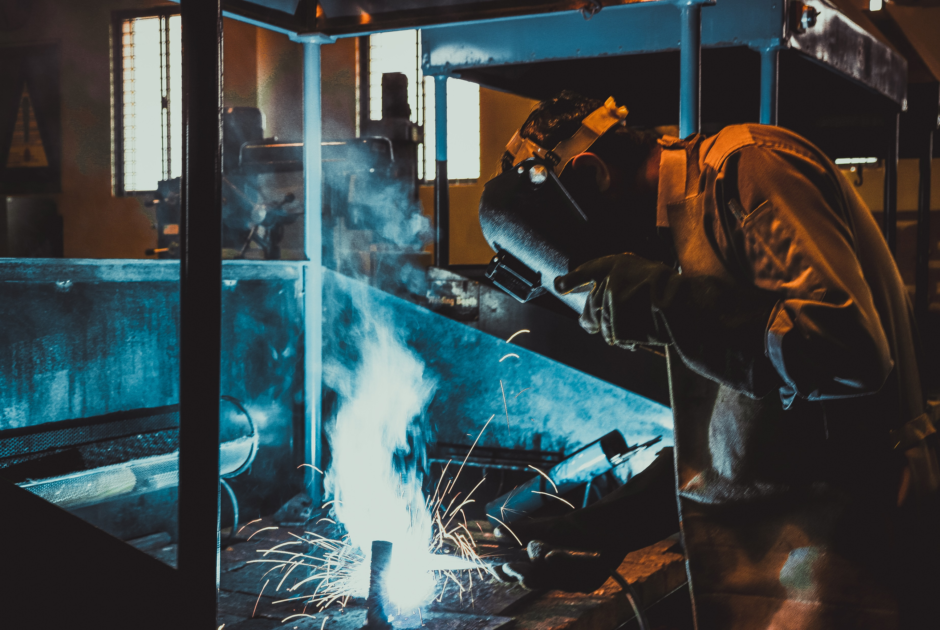
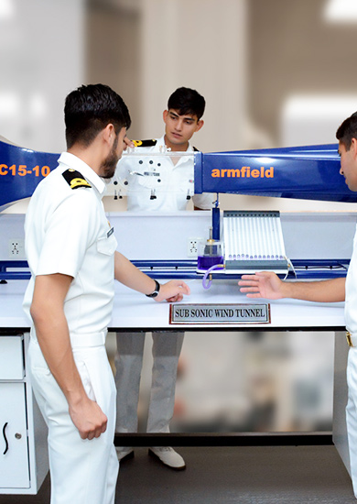
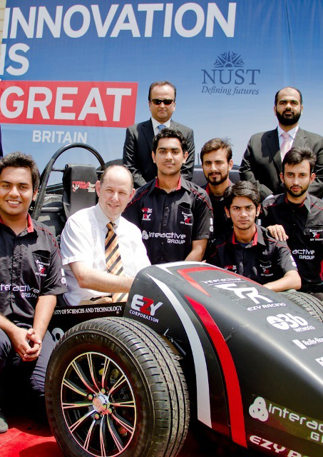
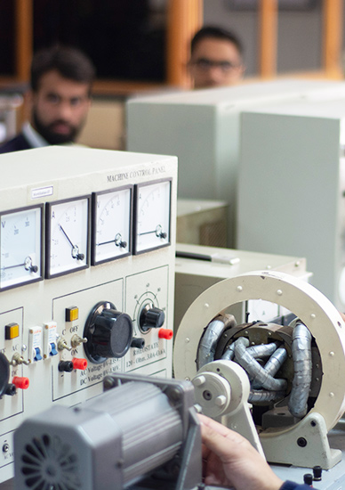
RESEARCH & INNOVATION ECOSYSTEM

Slide 11


GLOBAL
RESEARCH PARTNERS
220
673
Canada
Germany
UK
China
258
967
426
USA
203
South
Korea
793
UAE
KSA
946
2632
Malaysia
Others
424
Australia
292
15,134 Total Research Publications on WoS 7,819 Joint Research Publications
Notes:
18117

Slide 12
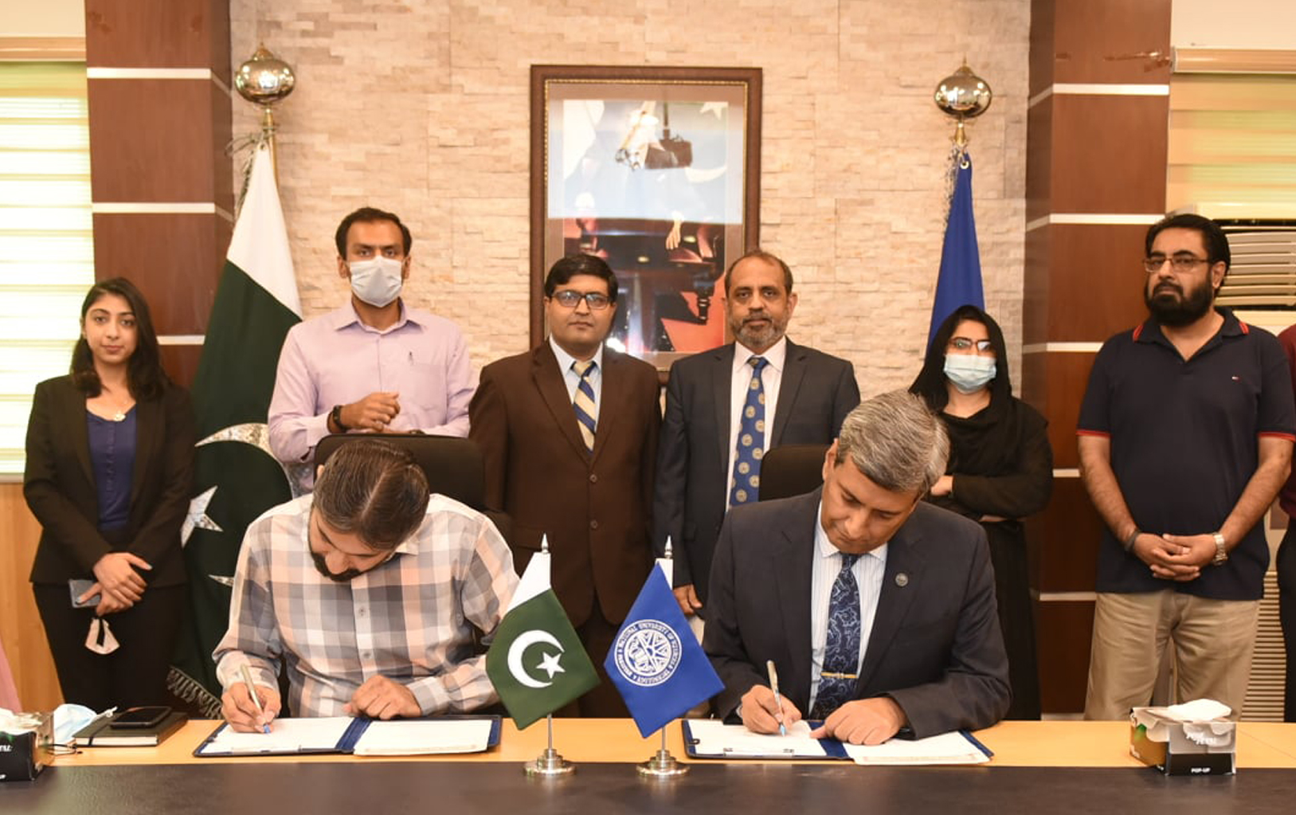
NUST INTELLECTUAL PROPERTY RIGHTS &
TECH TRANSFER ECOSYSTEM
Intellectual Property Life-cycle Management Ecosystem
1st PAKISTANI UNIVERSITY
TO TRANSFER TECHNOLOGY TO INDUSTRY
70 IPs
transferred
To industry
Lead WIPO Partner in the region for promotion of IP Policies
FILED IPs: 1000
AWARDED IPs: 208
Including international IPRs:
7 US
1 Korean
1 Patent Cooperation Treaty (PCT)

Slide 13
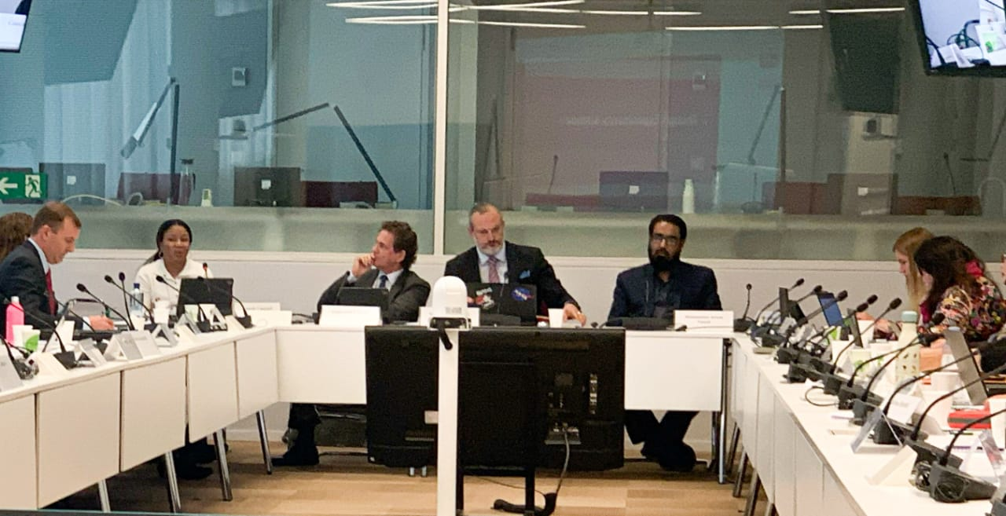

NUST- EKKO wins Better World Project 2023Internationally
Lead WIPO Partner in the region for promotion of IP Policies
Participation of Director ICON-NUST as Panelist in Annual Leader's Summit – Geneva Oct 2022
NEWS of EKKO winning Better World Project 2023
NUST Participated in AUTM’s better world Project and winning it globally by receiving record breaking votes.

Slide 14
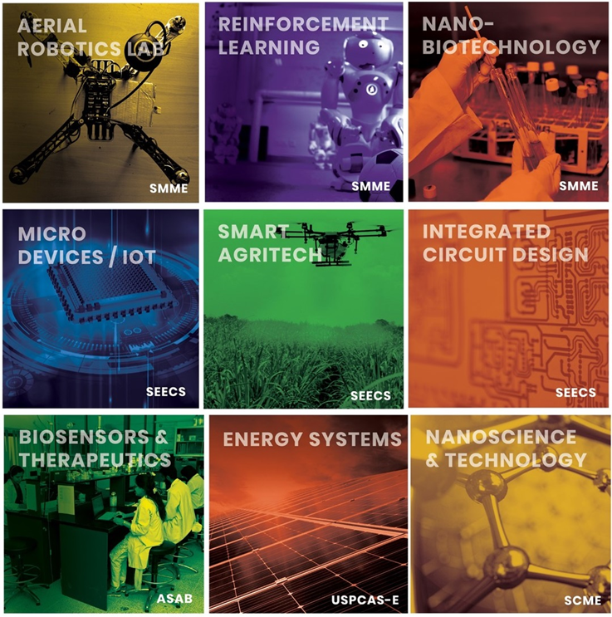
PAKISTAN’S 1st
INTERDISCIPLINARY RESEARCH CLUSTER
School of Interdisciplinary Engineering & Sciences
28 Hi-Tech Labs under One Roof
12 International Industrial Labs

Slide 15

4 NATIONAL CENTRES OF EXCELLENCE
IN DISRUPTIVE TECHNOLOGIES
NATIONAL CENTRE FOR
ARTIFICIAL INTELLIGENCE
NATIONAL CENTRE FOR
ROBOTICS & AUTOMATION
KEY LABS - NATIONAL CENTRE FOR
BIG DATA &
CLOUD COMPUTING
KEY LABS - NATIONAL CENTRE FOR
CYBER
SECURITY

Slide 16

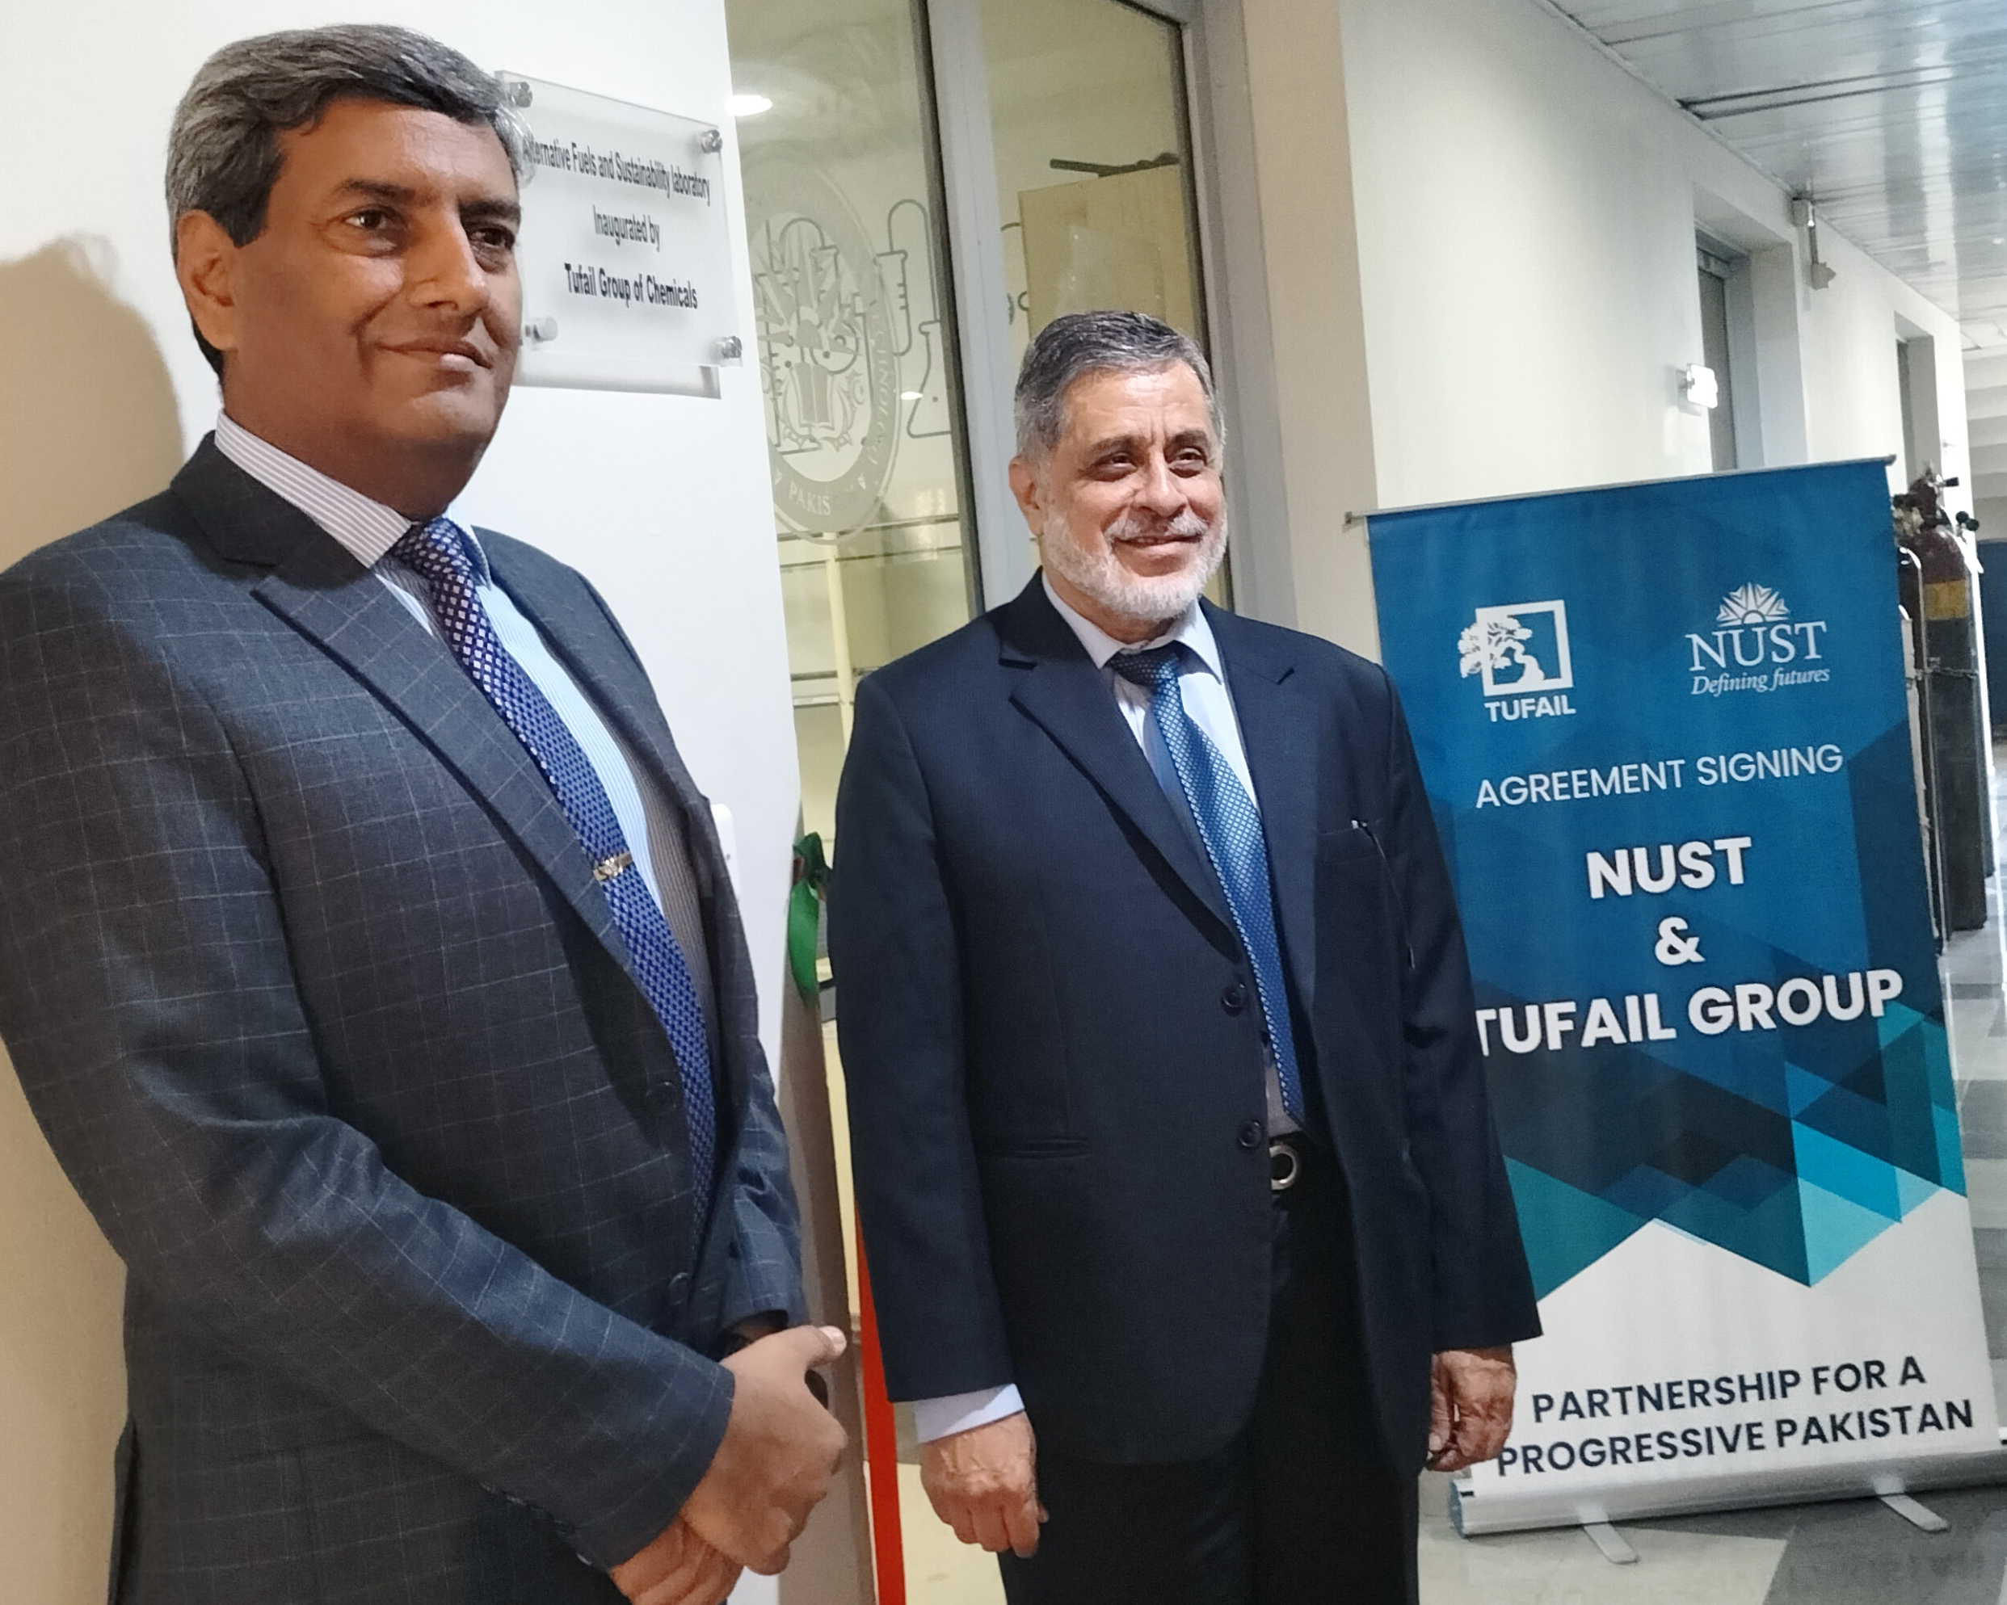
PARTNERSHIPS FOR A
PROGRESSIVE PAKISTAN
6 x
National Labs
5 x
International Labs
"
It gives me immense pleasure to see that NUST has risen to heights of research excellence in such a short span. We have recently opened a laboratory to work on alternate fuels and sustainability at NUST. Not only is this a small contribution to nation building, but also a direct investment in our own company's future.
"
Mr. Zubair Tufail
Chairman Tufail Group of Industries

Slide 17
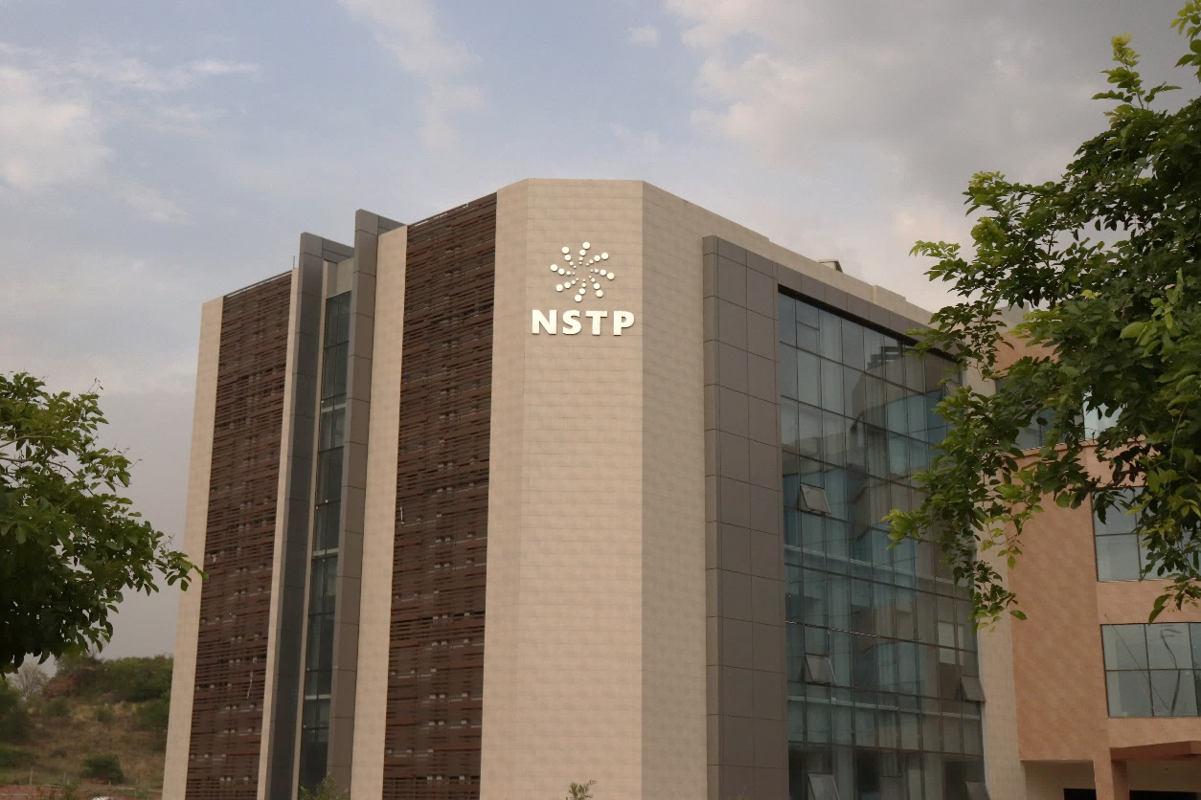
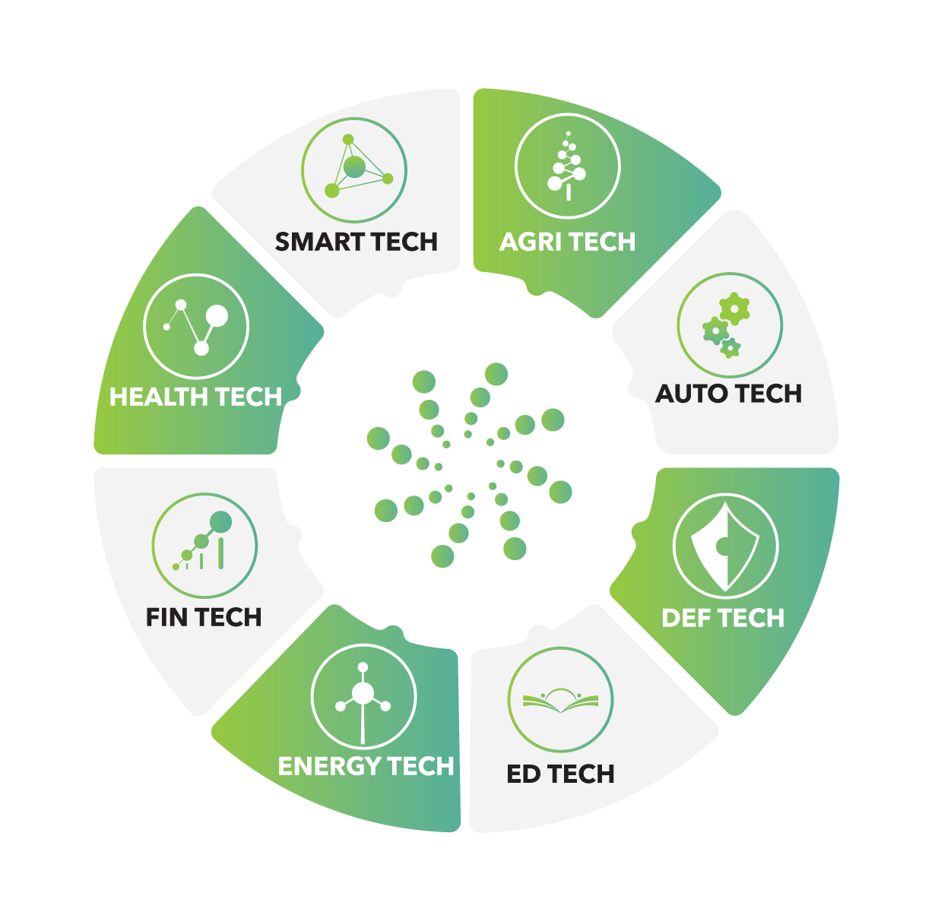
Estb.
2019
NATIONAL SCIENCE & TECHNOLOGY PARK
Pakistan's First Science and Technology Park
114 Hi-tech companies on board –
  51 Anchor tenants and SMEs
  63 Startups
  25 MNCs from 11 Countries
8 Thematic Sectors
High-tech Special Economic Zone (SEZ)
58 Acres of Land for Expansion

Slide 18
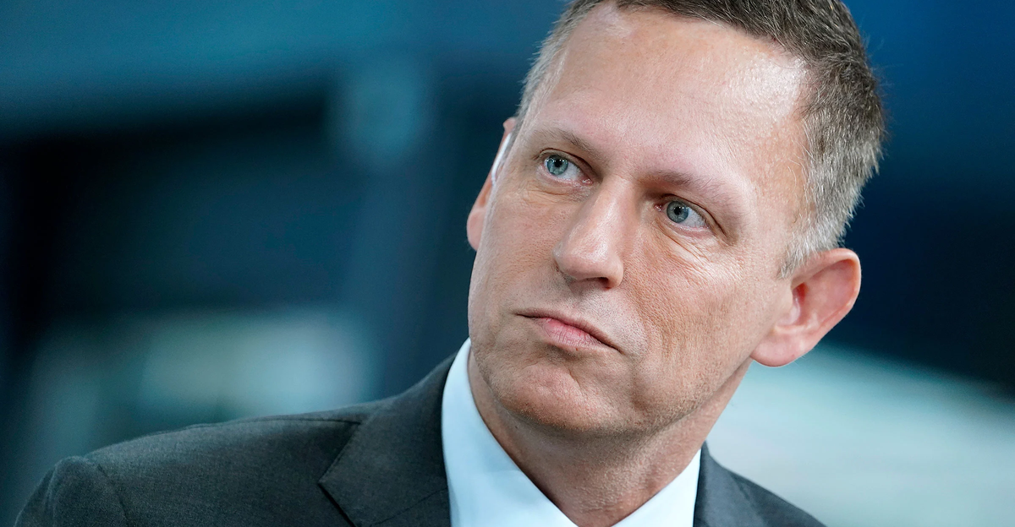
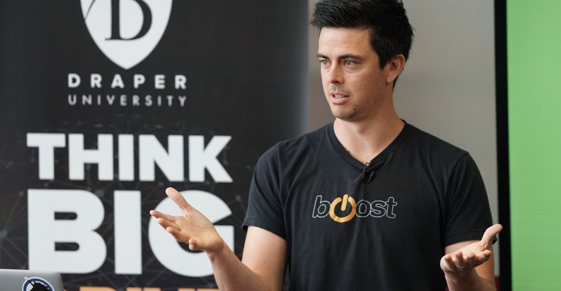
Recent Investments by International VCs
Vectara wins $20M in seed funding
Largest funding raised by NSTP Tenant
Peter Thiel backs PriceOye
Adam Draper invests in Orbit - Ed
$7.9M
$500,000
The company uses the latest innovations in artificial intelligence and neural network technologies for natural language processing to deliver unparalleled search relevance and uncovers the Intent of the user search.
PriceOye is Pakistan's largest e-commerce electronic marketplace that has raised funding from Peter Theil who was the co-founder of PayPal.
Orbit-Ed - a female-led startup working in the Ed-tech vertical that provides AR/VR training to corporates, has raised funding from Boost VC.

Slide 19
PARTNERSHIP
NODE
UNIVERSITY SCHOLARSHIP PROGRAMME

Slide 20

SOCIO-ECONOMIC
DEMOGRAPHICS OF STUDENTS
Lower | Monthly Income below PKR 40,000
Lower Middle | Monthly Income from PKR 40,000 tp PKR 80,000
Middle | Monthly Income from PKR 80,000 to PKR 150,000
Upper Middle | Monthly Income beyond PKR 150,000
Approximately 60% of the students face financial constraints with net monthly family income of less than PKR 80,000/-
*Based on averages for 8 years of admission data
Notes:
Socioeconomic Demographics of Students (slide can be skipped)
More than 60% of students at NUST have family incomes less than Rs. 80,000 per month.
And 17% students have monthly family incomes less than Rs. 40,000
NEED Initiative
NUST has made a commitment to support students who get admission on merit but cannot afford to get through their education because of financial constraints.
NEED initiative is short for NUST Endowment for Educational Development, aimed to make quality education available at affordable price for inclusive growth, and help NUST become a need-blind university.
1.6 Billion PKR already disbursed in the last 8 years. 1662 students have already benefitted from NEED Initiative.

Slide 21
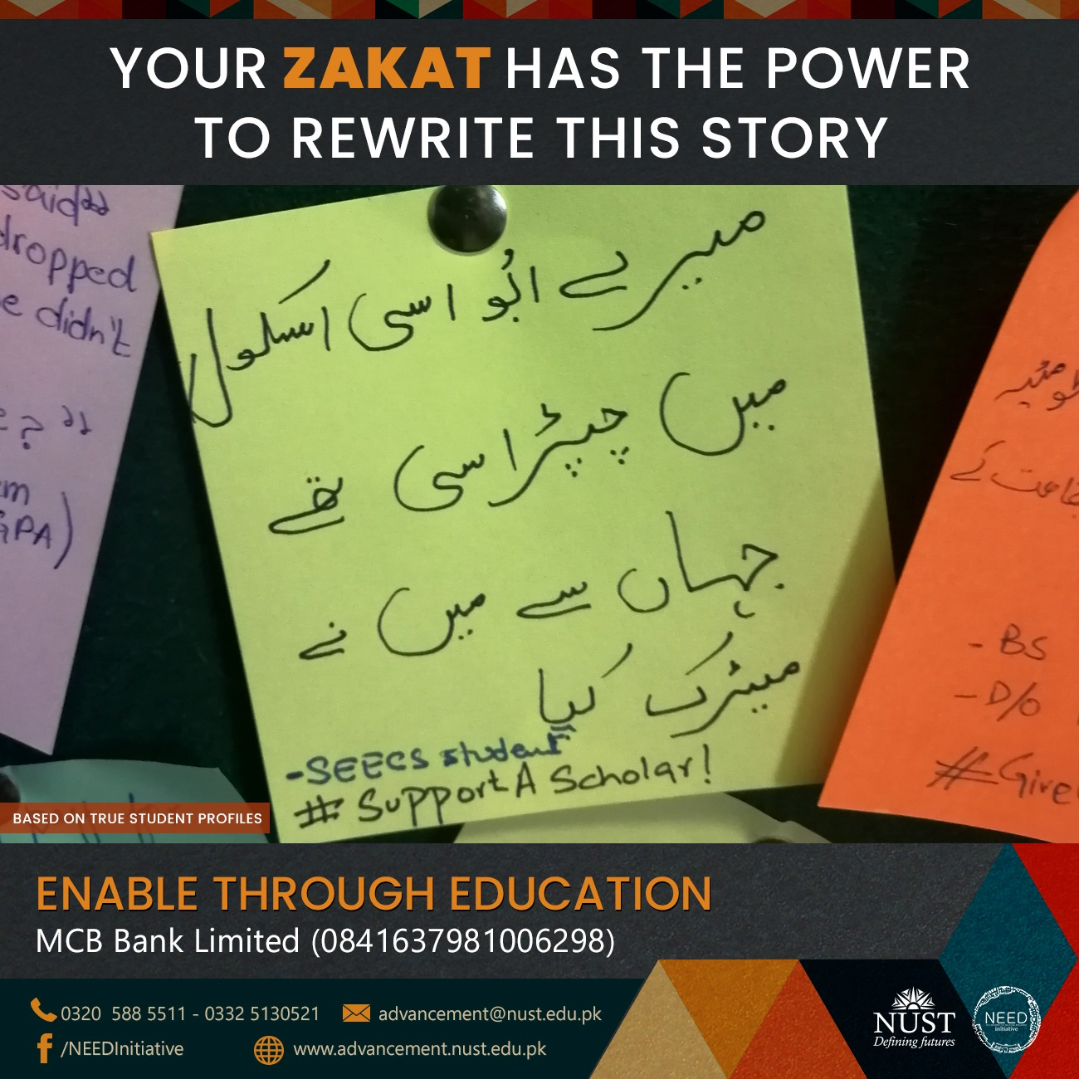
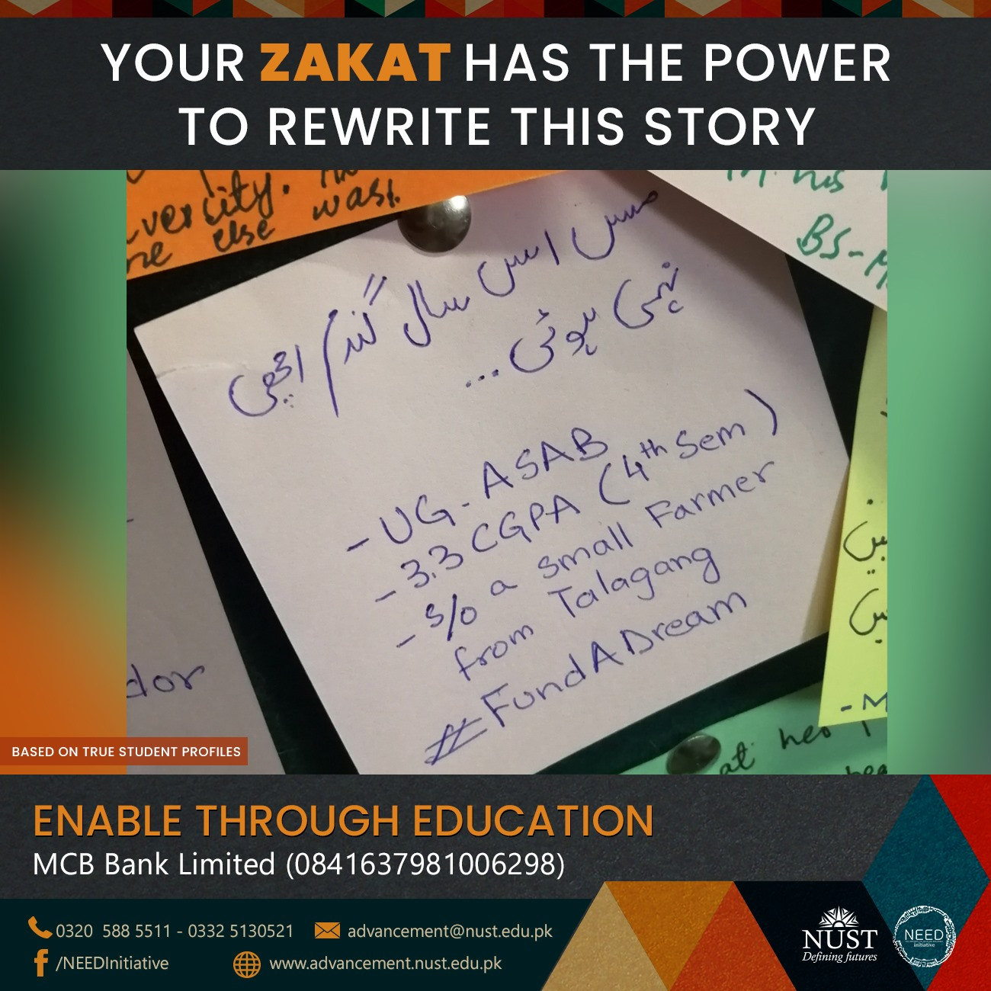
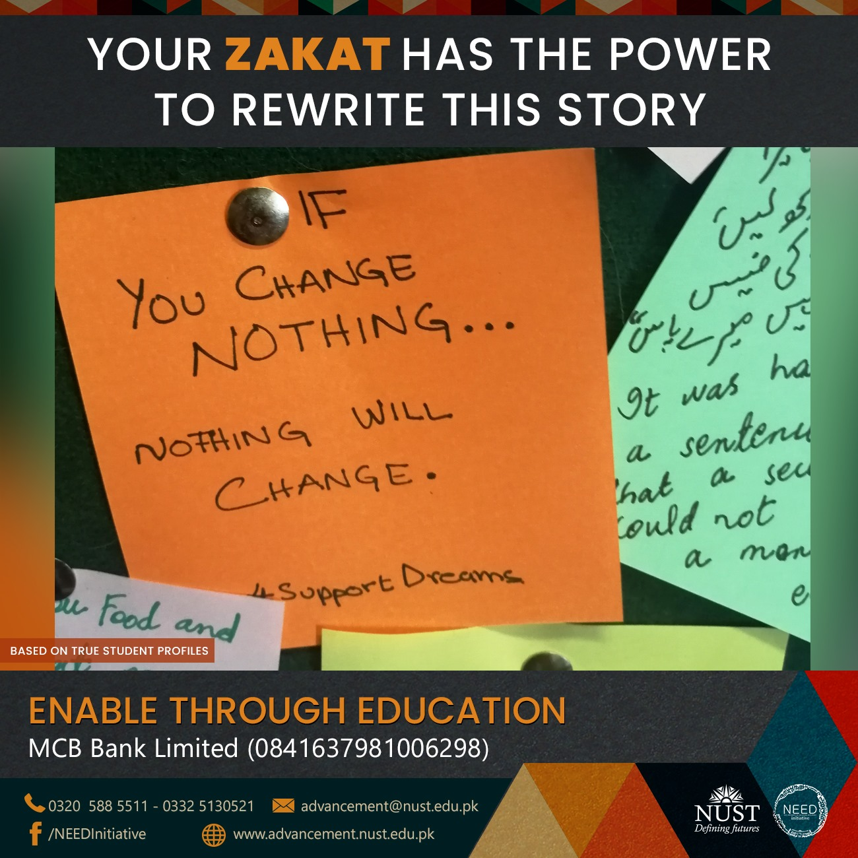
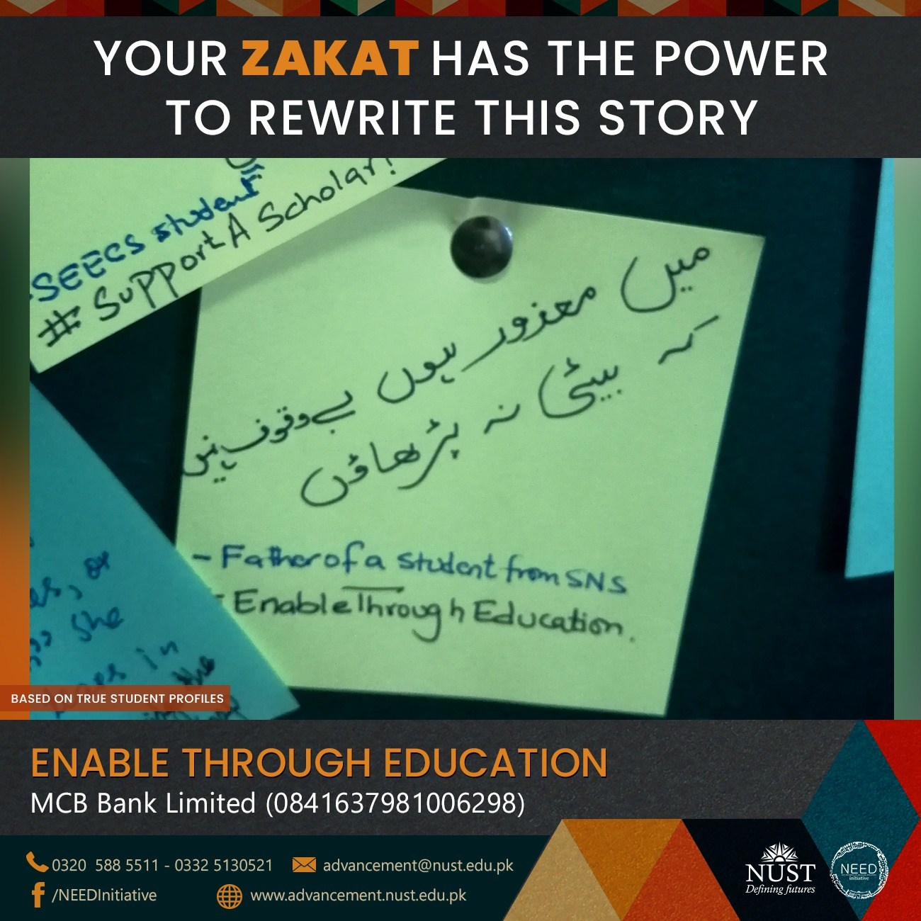
NOT JUST NUMBERS REAL PEOPLE;
REAL LIVES

Slide 22
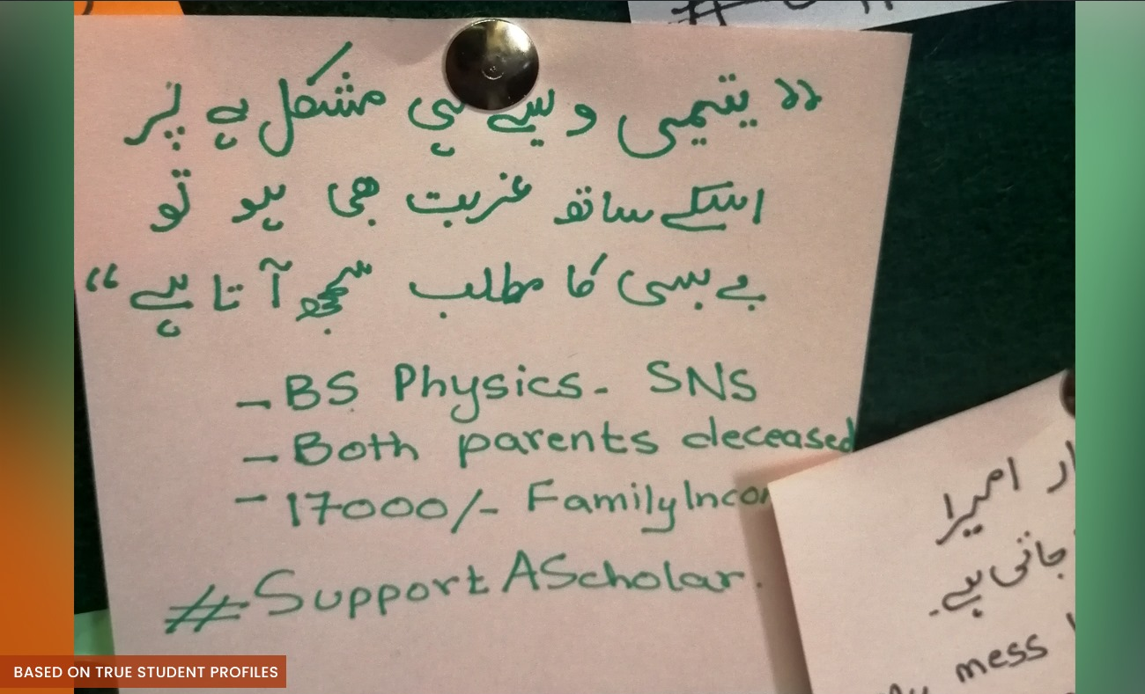
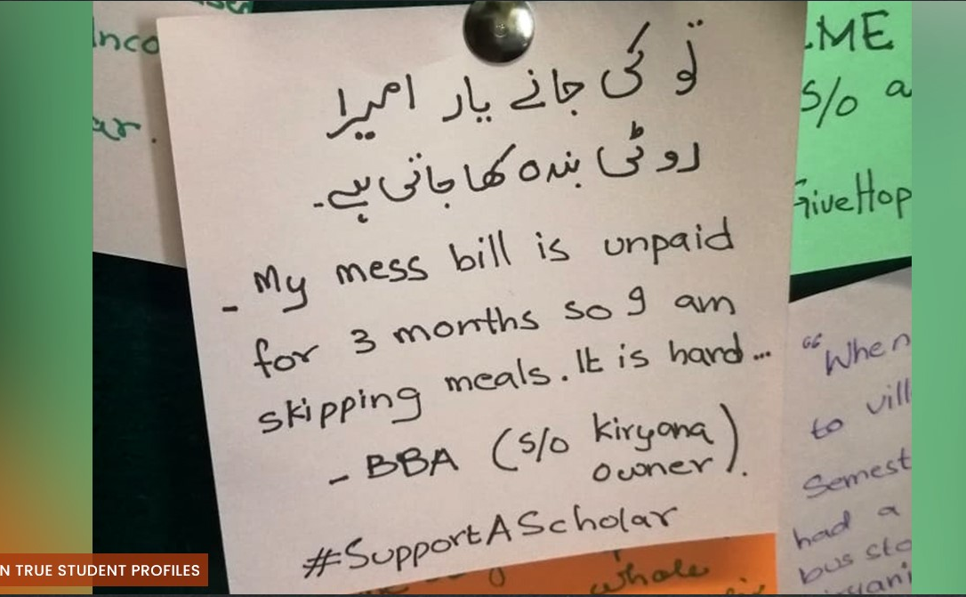
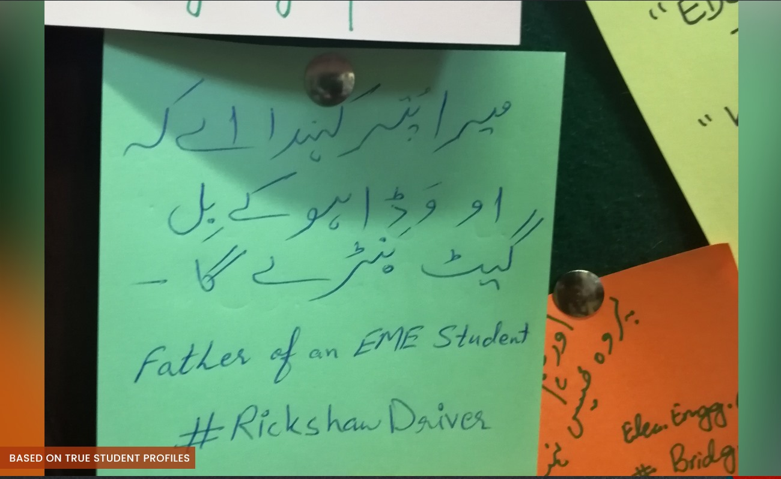
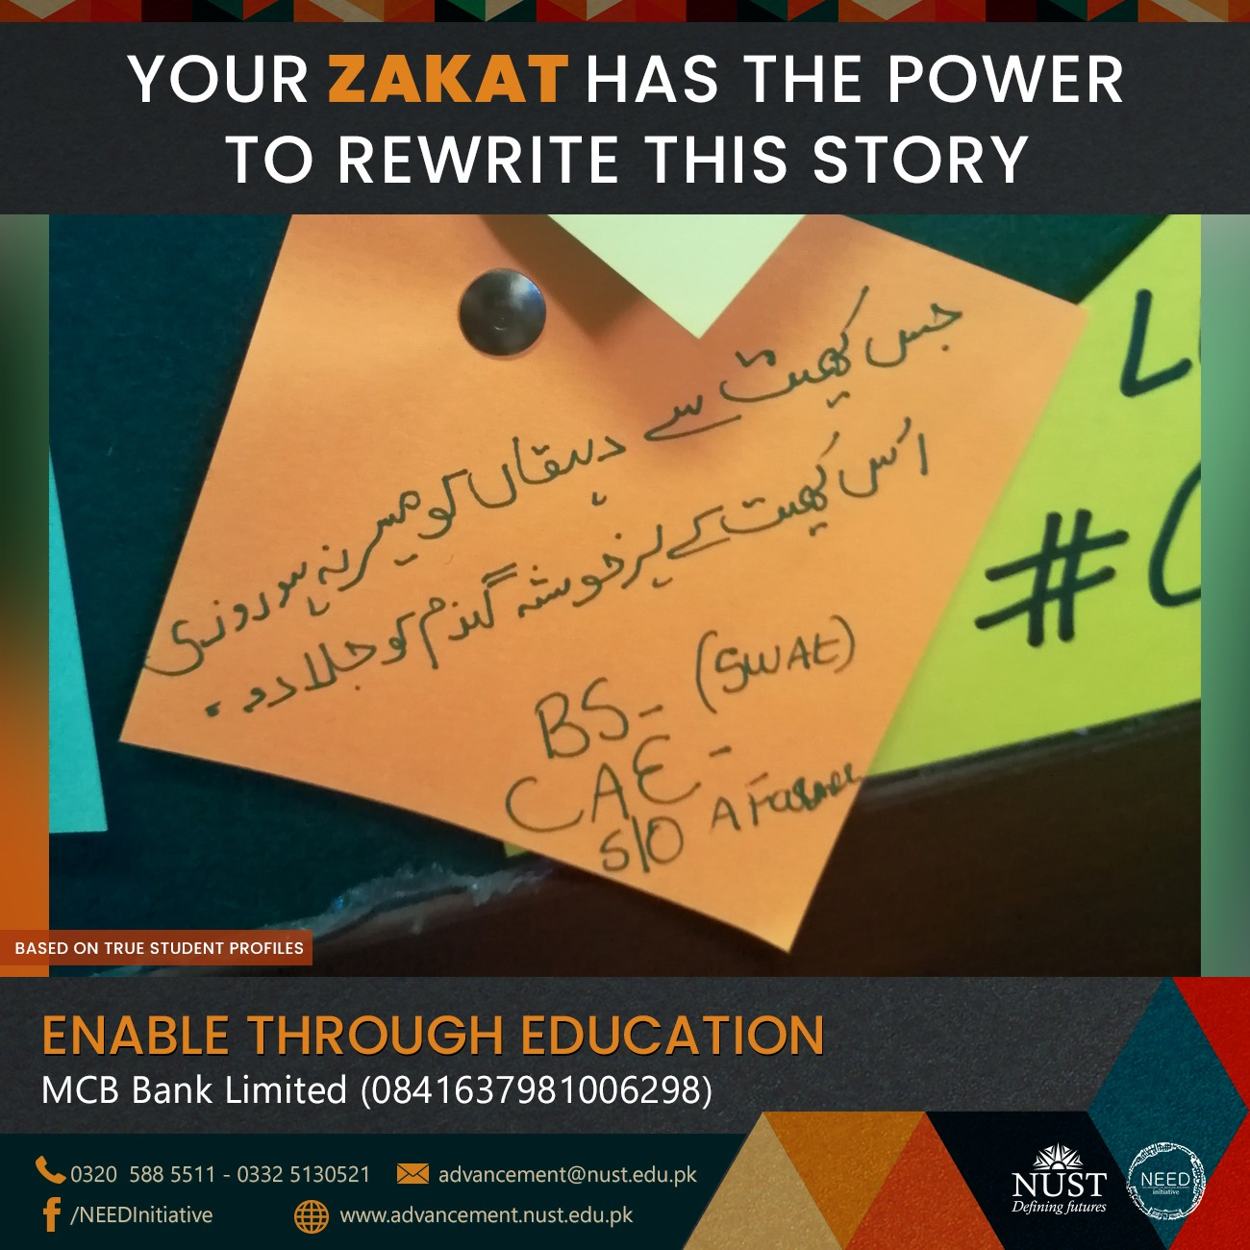
NOT JUST NUMBERS REAL PEOPLE;
REAL LIVES

Slide 23
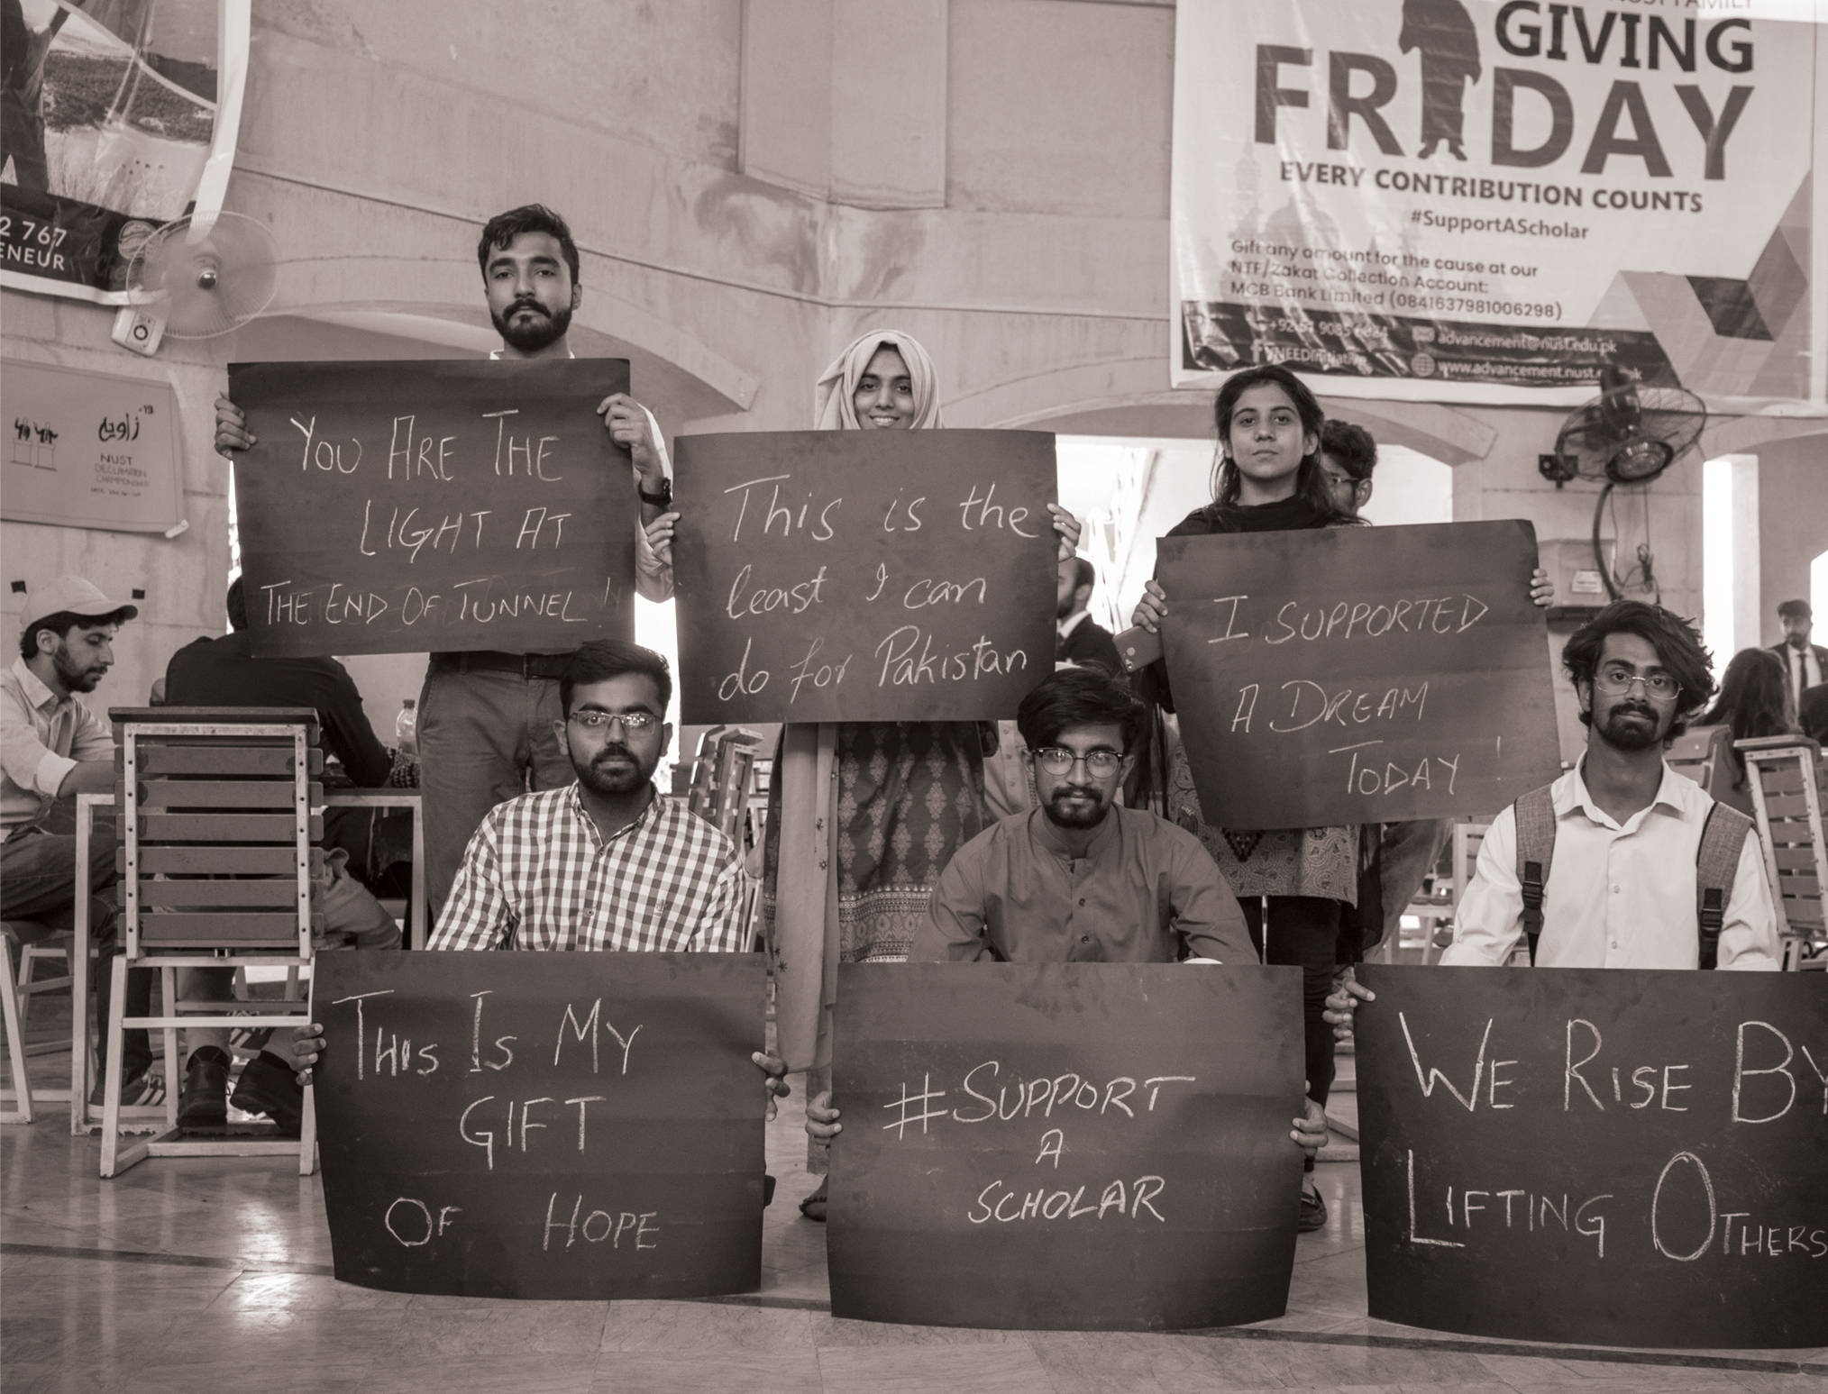

2594
Students
already on scholarships
NUST aspires to be a need-blind university with educational equity as a core value
The Program allows partners to establish free seats at NUST for financially challenged students; generating intergenerational equity and impact
Notes:
To join this initiative, potential partners may establish a circular endowment of PKR 12 million for maximum mileage. Under this sustainable model, the scholarship will be announced and allocated in each academic intake. This will be a continuous practice once every year in perpetuity. Thereby, creating more visibility for your organization each year, and mapping the financial impact on 4 students for each UG degree cycle (4 years degree).
However, to facilitate our potential donors, our programme provides flexibility by initiating the partnership with one endowment scholarship seat for only PKR 3.5 million. This one-time donation will support one undergraduate student on repeat, meaning when one beneficiary graduates, another will be allocated on the same slot.
On a parallel model, your organization can Adopt a Scholar and be part of their j0urney throughout. By contributing PKR 1 Million, one student is set free from stressing about their educational expenses. You can go the extra mile and support their hostel accommodation and messing as well (with an additional PKR 0.5 Million). However, when the student graduates, your gift graduates with them.
All donations are tax creditable and are collected by the NUST Trust Fund, which is a not-for-profit organization certified by the Pakistan Centre for Philanthropy.
A Customized Partnership exclusively for YOU!
We can design a customized programme that aligns best with the spirit of your organization; you may let us know the gender, domicile, and your preferred field of study - or you can leave it on us to pick the most deserving student that can benefit from your gift to NUST.

Slide 24
2594
Students
already on scholarships
NUST aspires to be a need-blind university with educational equity as a core value
The Program allows partners to establish free seats at NUST for financially challenged students; generating intergenerational equity and impact
LARGEST NUMBER OF SCHOLARSHIP APPLICANTS IN ANY YEAR!
2023
Notes:
To join this initiative, potential partners may establish a circular endowment of PKR 12 million for maximum mileage. Under this sustainable model, the scholarship will be announced and allocated in each academic intake. This will be a continuous practice once every year in perpetuity. Thereby, creating more visibility for your organization each year, and mapping the financial impact on 4 students for each UG degree cycle (4 years degree).
However, to facilitate our potential donors, our programme provides flexibility by initiating the partnership with one endowment scholarship seat for only PKR 3.5 million. This one-time donation will support one undergraduate student on repeat, meaning when one beneficiary graduates, another will be allocated on the same slot.
On a parallel model, your organization can Adopt a Scholar and be part of their j0urney throughout. By contributing PKR 1 Million, one student is set free from stressing about their educational expenses. You can go the extra mile and support their hostel accommodation and messing as well (with an additional PKR 0.5 Million). However, when the student graduates, your gift graduates with them.
All donations are tax creditable and are collected by the NUST Trust Fund, which is a not-for-profit organization certified by the Pakistan Centre for Philanthropy.
A Customized Partnership exclusively for YOU!
We can design a customized programme that aligns best with the spirit of your organization; you may let us know the gender, domicile, and your preferred field of study - or you can leave it on us to pick the most deserving student that can benefit from your gift to NUST.

Slide 25
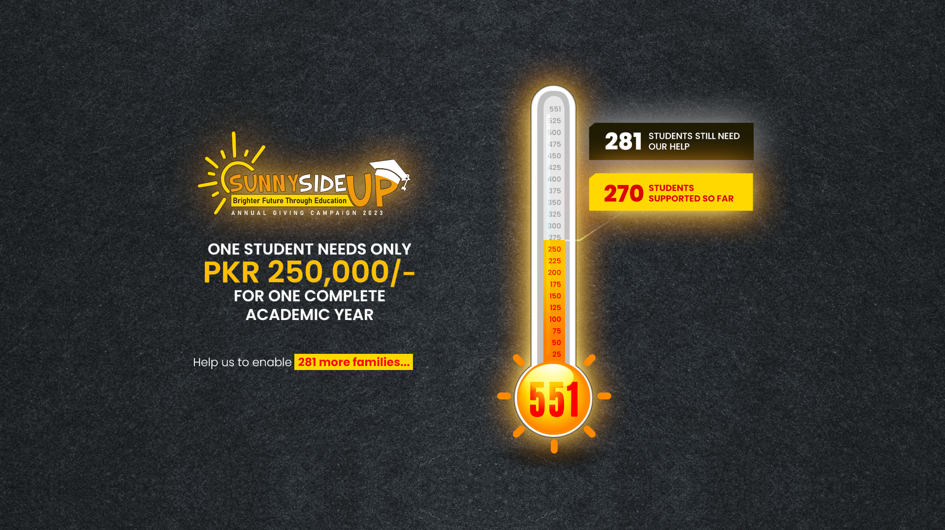


Slide 26



217 - 77 UG & 140 PG
THE GAP AS OF TODAY (27th March 2023)
 | UG | PG
50% | 15 | 23
100% | 62 | 117
87 Female
130 Male
55 Orphans
Financial Requirement for One Year
 | UG | PG
50% | 1.9 Million | 2.07 Million
100% | 16.12 Million | 22.1 Million
Total | 18.02 Million | 24.17 Million
PUNJAB

Slide 27
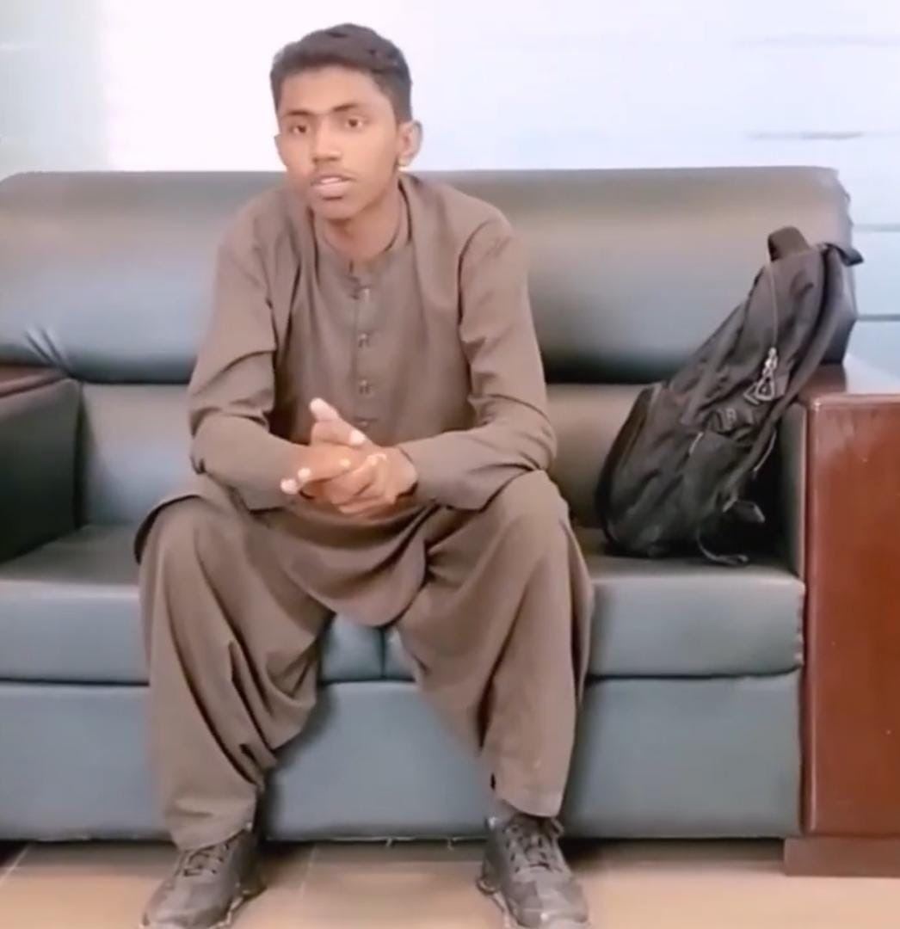
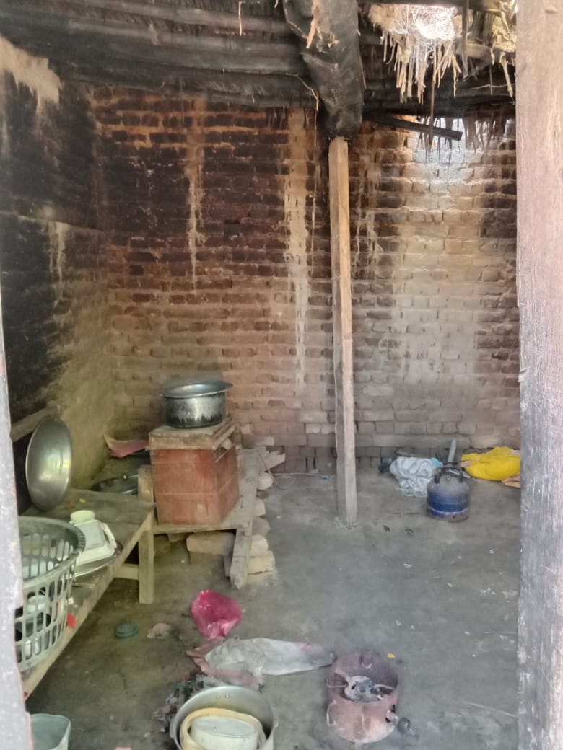
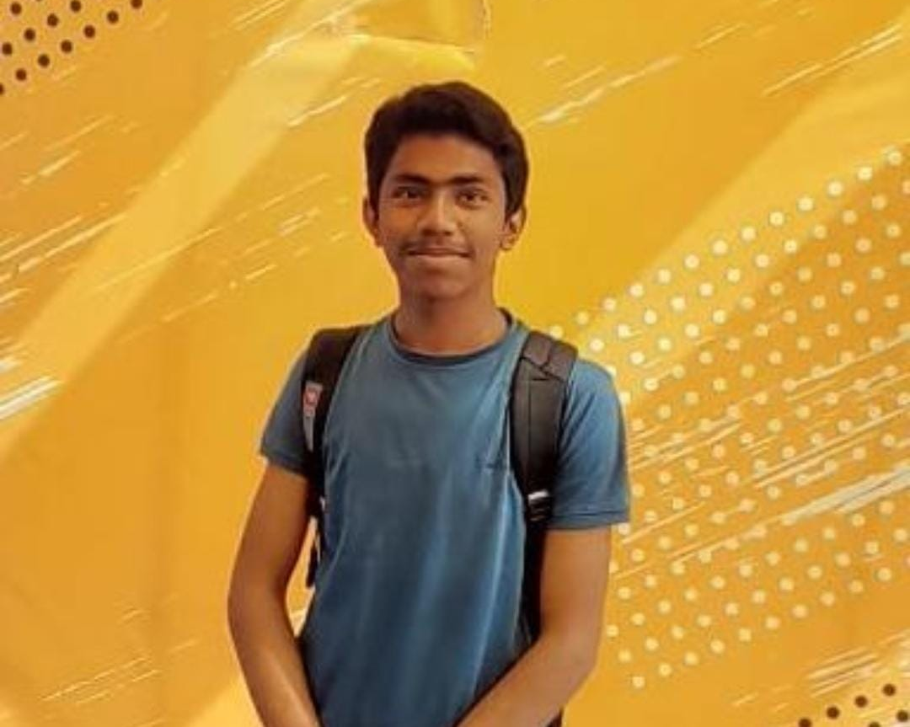
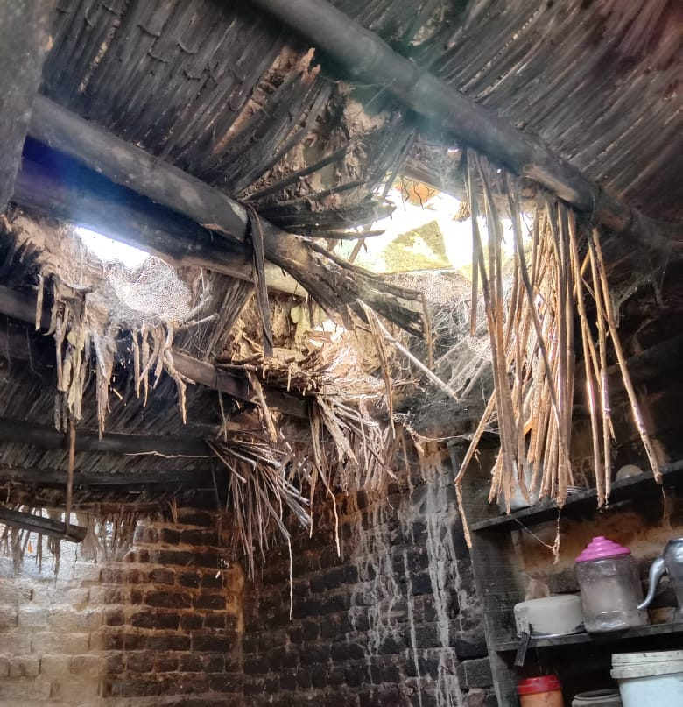
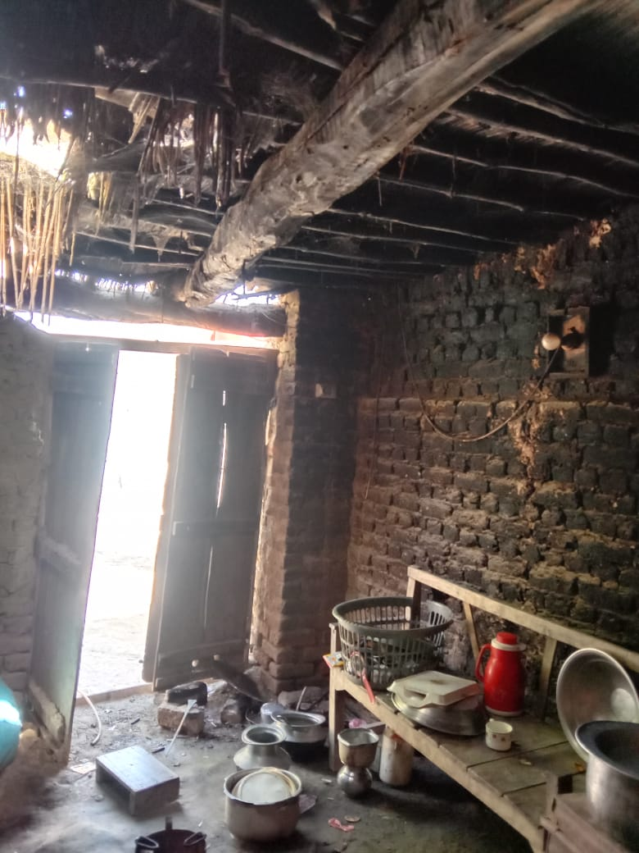
AHMAD JATOI (Orphan)
Village: Betto Jatoi -Dadu
Environmental Engineering- CGPA 3.33

Slide 28

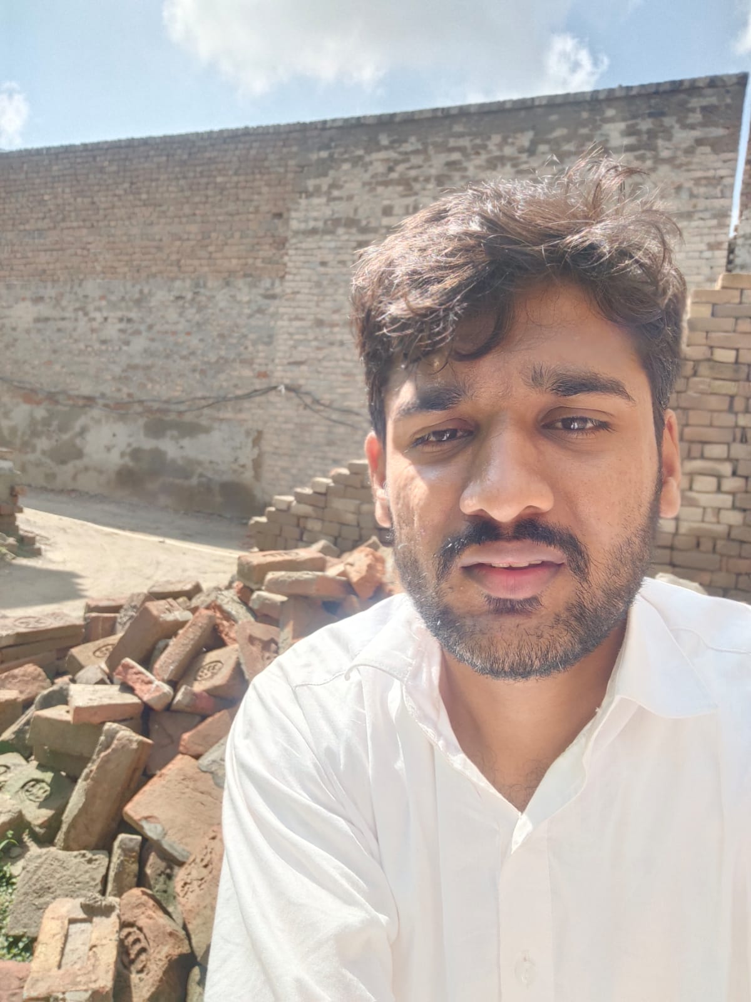
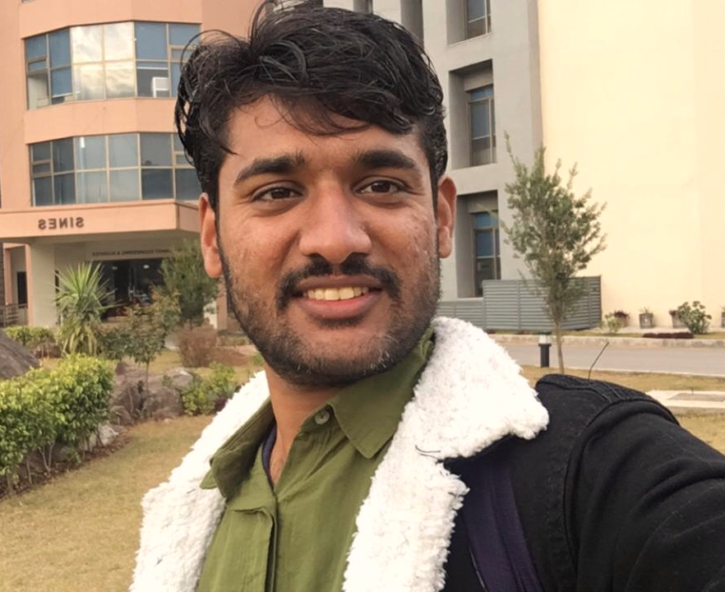
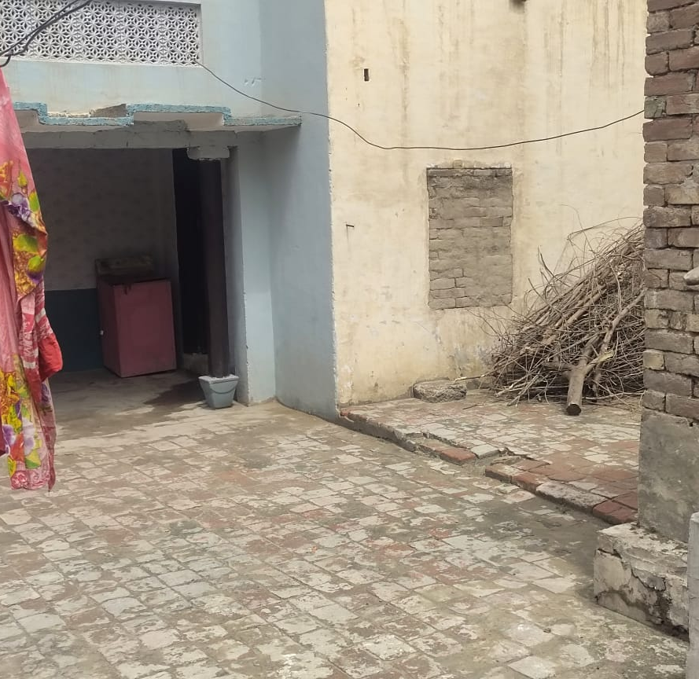
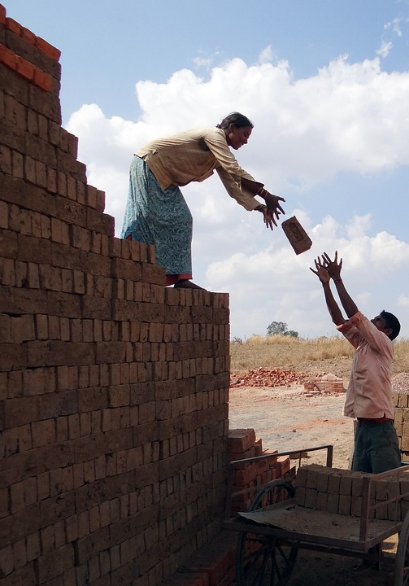
SHAHID (Kiln Worker)
Hometown: Bhakhar
MS Computational Chemistry - CGPA 3.5
Net Household Income: 15000 PKR
Already made an Impact Factor Publication
A forecasting model approach of sustainable electricity management by developing adaptive neuro-fuzzy inference system

Slide 29

Notes:
90+(104/2)+2t3
90 Low GPA
126 Open or Zakat Tagged

Slide 30
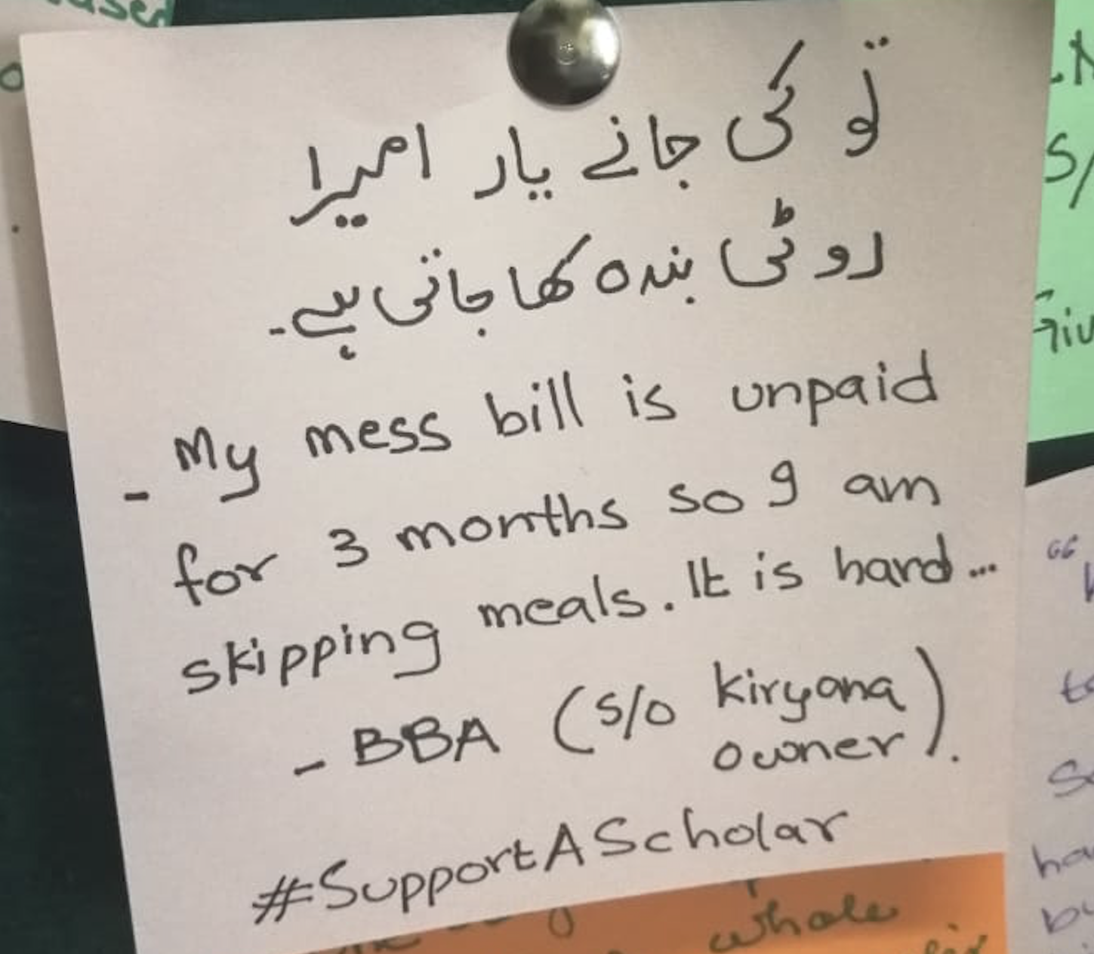
SPONSOR A SCHOLAR
ADOPT A NUSTIAN
With a contribution of PKR 1.0 M, you can cover the academic expense of a scholar at NUST for all four years of a UG program!
GIFT A DREAM
With your support, an exceptionally brilliant mind with unexceptional determination will find the roads leading to better future
Notes:
To join this initiative, potential partners may establish a circular endowment of PKR 12 million for maximum mileage. Under this sustainable model, the scholarship will be announced and allocated in each academic intake. This will be a continuous practice once every year in perpetuity. Thereby, creating more visibility for your organization each year, and mapping the financial impact on 4 students for each UG degree cycle (4 years degree).
However, to facilitate our potential donors, our programme provides flexibility by initiating the partnership with one endowment scholarship seat for only PKR 3.5 million. This one-time donation will support one undergraduate student on repeat, meaning when one beneficiary graduates, another will be allocated on the same slot.
On a parallel model, your organization can Adopt a Scholar and be part of their j0urney throughout. By contributing PKR 1 Million, one student is set free from stressing about their educational expenses. You can go the extra mile and support their hostel accommodation and messing as well (with an additional PKR 0.5 Million). However, when the student graduates, your gift graduates with them.
All donations are tax creditable and are collected by the NUST Trust Fund, which is a not-for-profit organization certified by the Pakistan Centre for Philanthropy.
A Customized Partnership exclusively for YOU!
We can design a customized programme that aligns best with the spirit of your organization; you may let us know the gender, domicile, and your preferred field of study - or you can leave it on us to pick the most deserving student that can benefit from your gift to NUST.

Slide 31
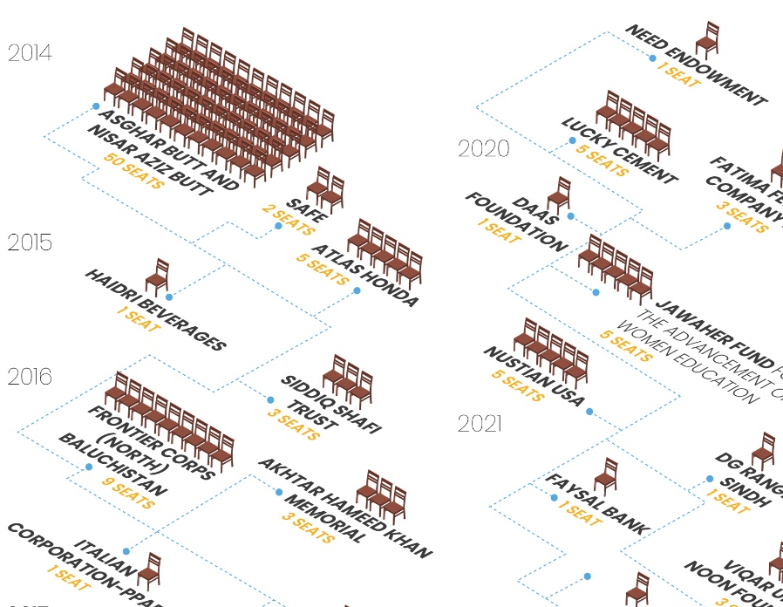
ENDOWMENT
PARTNERSHIP
SINGLE ENDOWMENT SEAT
PKR 3.5 M/seat
(Approx. 15,000 USD)
-ONE TIME CONTRIBUTION-
-LIFE-TIME IMPACT-
With intergenerational Equity and Impact, this Endowment Seat will become a Fueling Station for many Potent Dreams of Brilliant and Deserving Scholars
With each contribution, you will be helping NUST move one step forward in its journey of excellence
Notes:
To join this initiative, potential partners may establish a circular endowment of PKR 12 million for maximum mileage. Under this sustainable model, the scholarship will be announced and allocated in each academic intake. This will be a continuous practice once every year in perpetuity. Thereby, creating more visibility for your organization each year, and mapping the financial impact on 4 students for each UG degree cycle (4 years degree).
However, to facilitate our potential donors, our programme provides flexibility by initiating the partnership with one endowment scholarship seat for only PKR 3.5 million. This one-time donation will support one undergraduate student on repeat, meaning when one beneficiary graduates, another will be allocated on the same slot.
On a parallel model, your organization can Adopt a Scholar and be part of their j0urney throughout. By contributing PKR 1 Million, one student is set free from stressing about their educational expenses. You can go the extra mile and support their hostel accommodation and messing as well (with an additional PKR 0.5 Million). However, when the student graduates, your gift graduates with them.
All donations are tax creditable and are collected by the NUST Trust Fund, which is a not-for-profit organization certified by the Pakistan Centre for Philanthropy.
A Customized Partnership exclusively for YOU!
We can design a customized programme that aligns best with the spirit of your organization; you may let us know the gender, domicile, and your preferred field of study - or you can leave it on us to pick the most deserving student that can benefit from your gift to NUST.

Slide 32





NUST TRUST FUND
Zero Operational Headers
Shariah Compliant
Tax Exemption
PCP* Certified
Donor Stewardship, Reporting, & Fund Management System
Transparent
Flexible
Diverse
*Pakistan Centre for Philanthropy

Slide 33
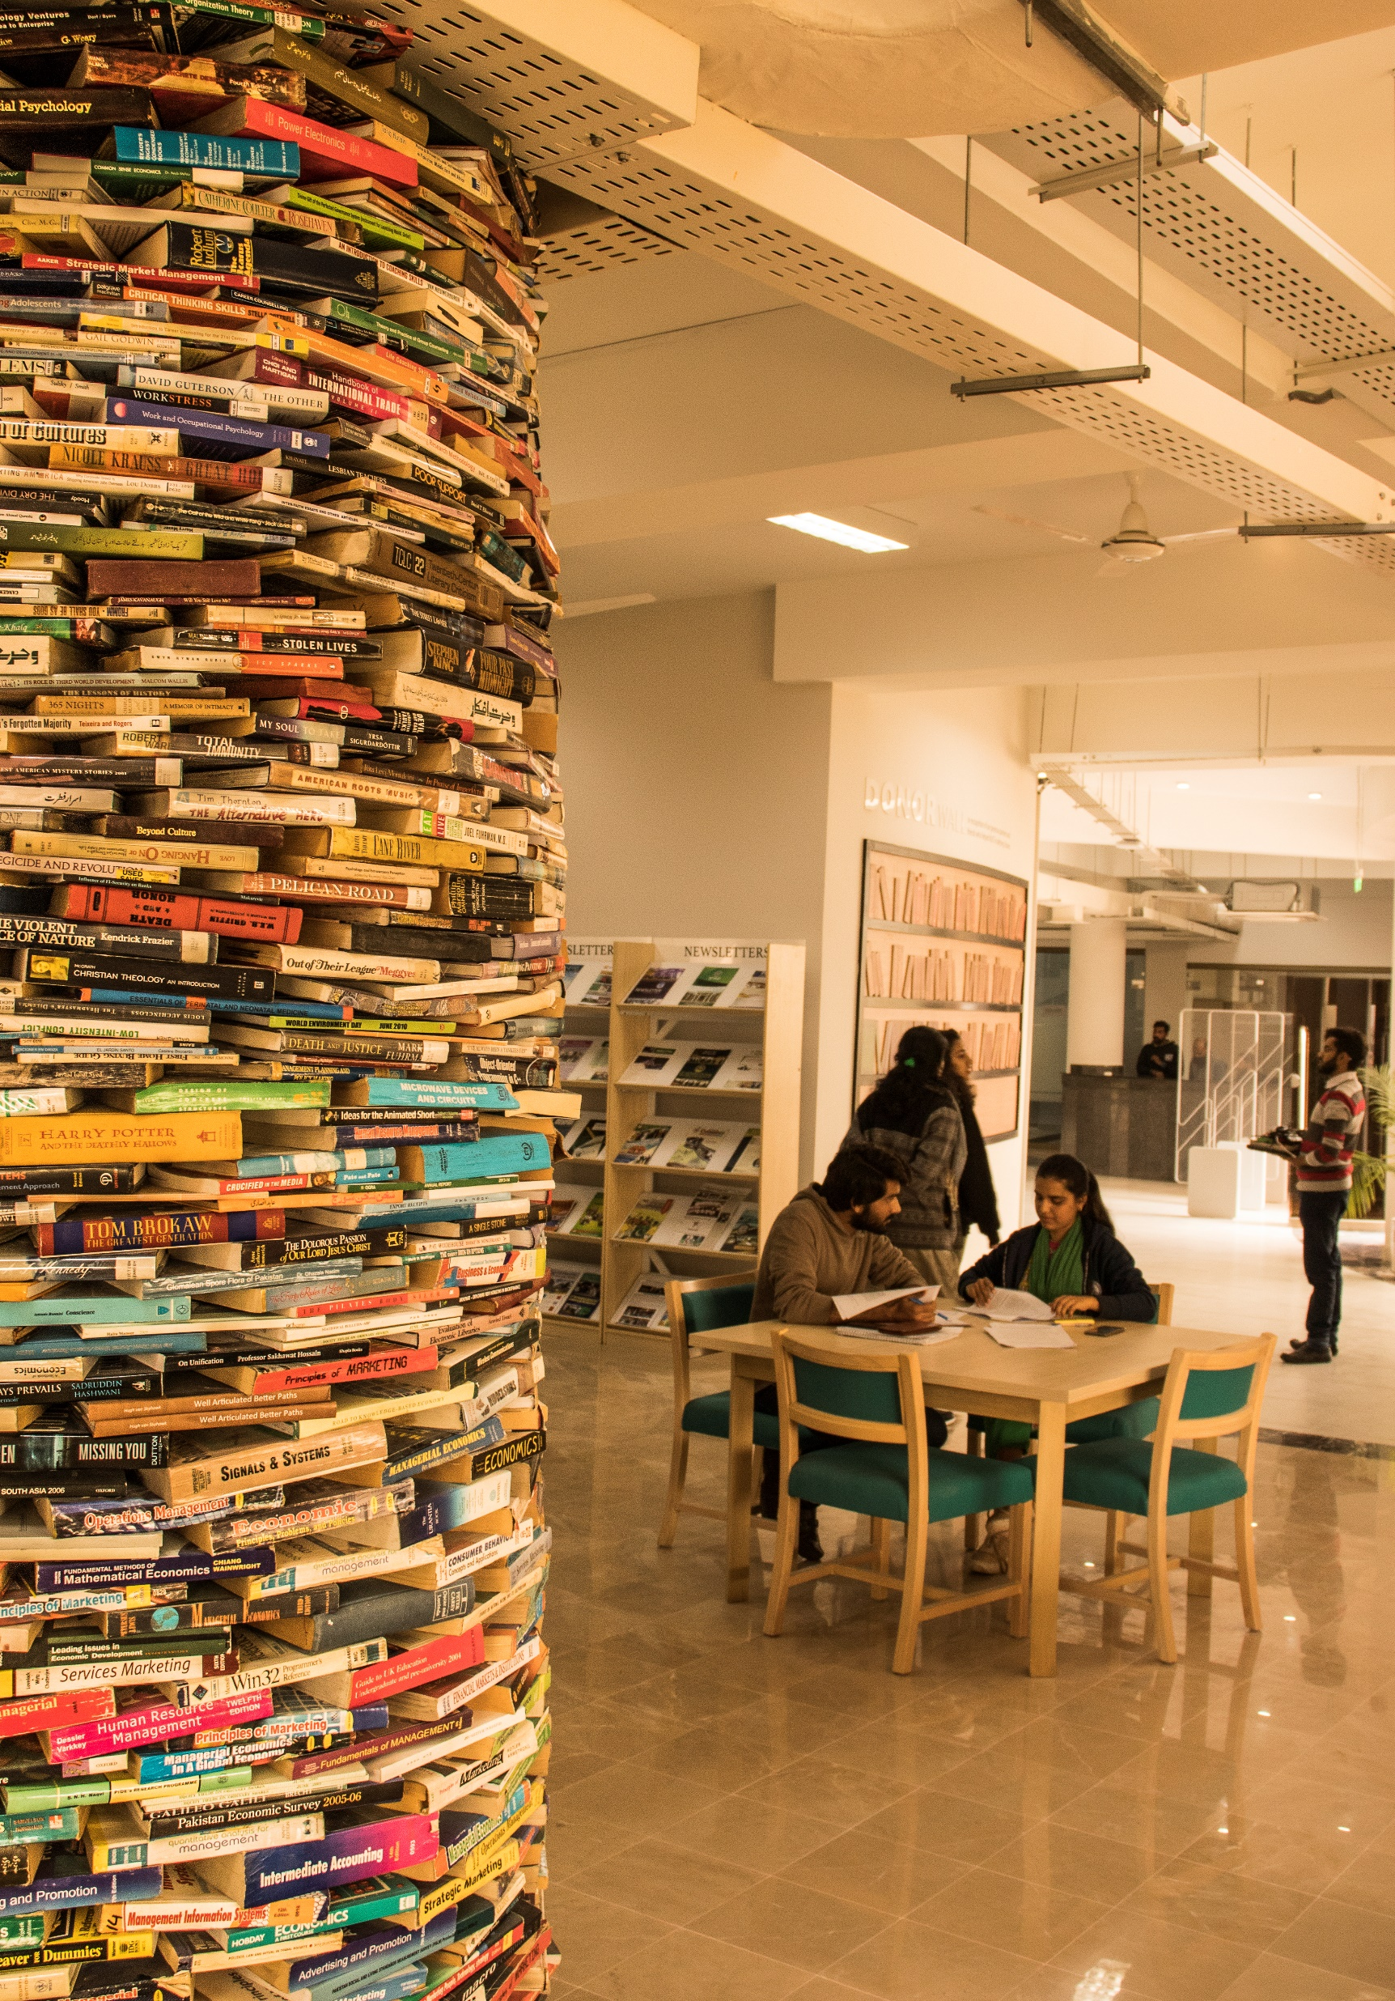
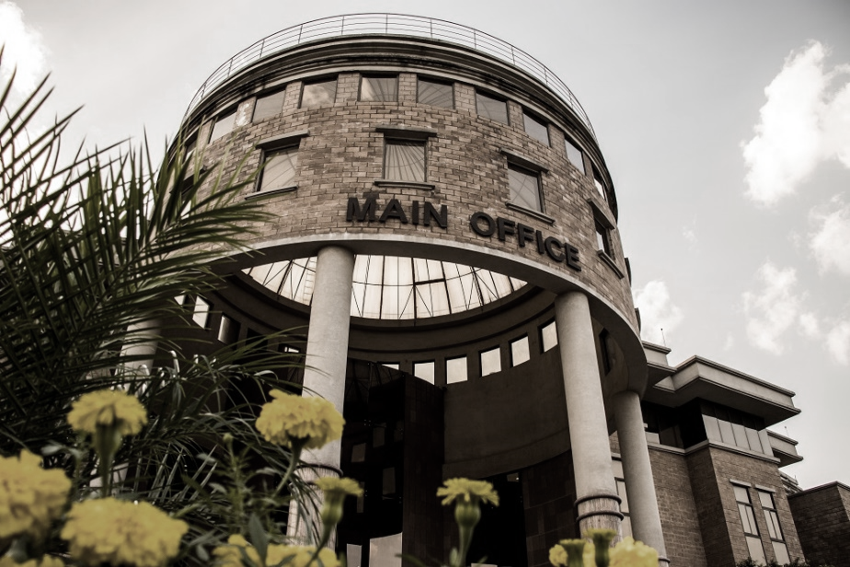

PLATTER OF PARTNERSHIPS
HIRE THE BEST HUMAN CAPITAL
INDUSTRY SPECIFIC RESEARCH PROJECTS
TRAININGS & HUMAN
RESOURCE DEVELOPMENT
GROW YOUR BUSINESS
AT NSTP
RESEARCH & INNOVATION INFRASTRUCTURE
PUBLIC PRIVATE PARTNERSHIP
CAPACITY BUILDING PROJECTS
ENDOWMENT PROGRAM

Slide 34


UNLOCK THE POWER OF JOINT COLLABORATION
Email us at dir.uao@nust.edu.pk
Call us at 051-90856821-38

Slide 35


Slide 36
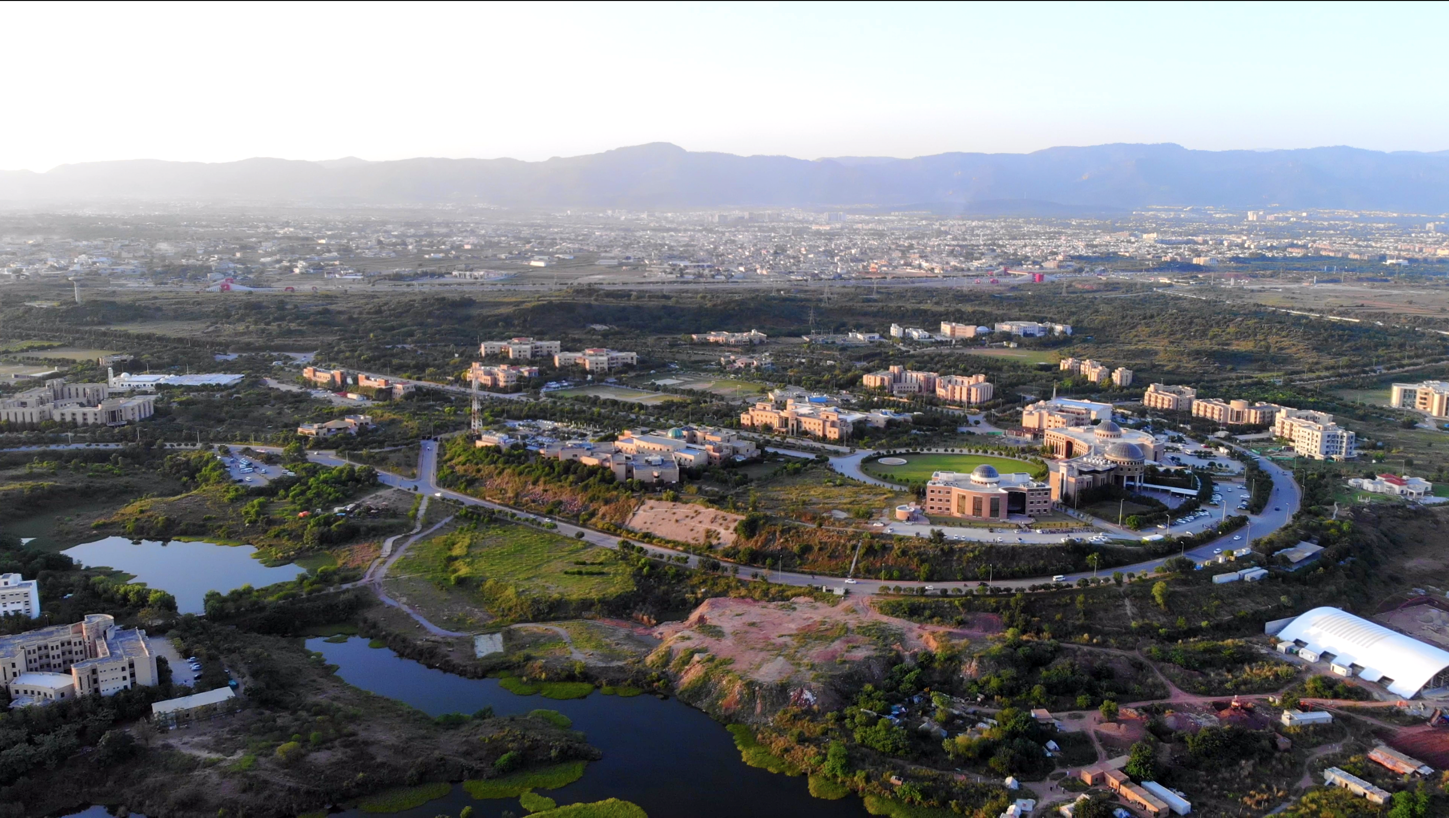

CAMPUS
LIFE
Providing one of the best university life experience in the country
Notes:
Mahtab
A sprawling Sports Complex, spread over a total area of 285,266 sq. ft., is under construction at the H-12 campus – it will provide male & female gymnasiums, a bowling alley, indoor tennis and badminton courts, a skating ring, and a swimming pool, open for use by students, faculty, staff, alumni & their families.

Slide 37
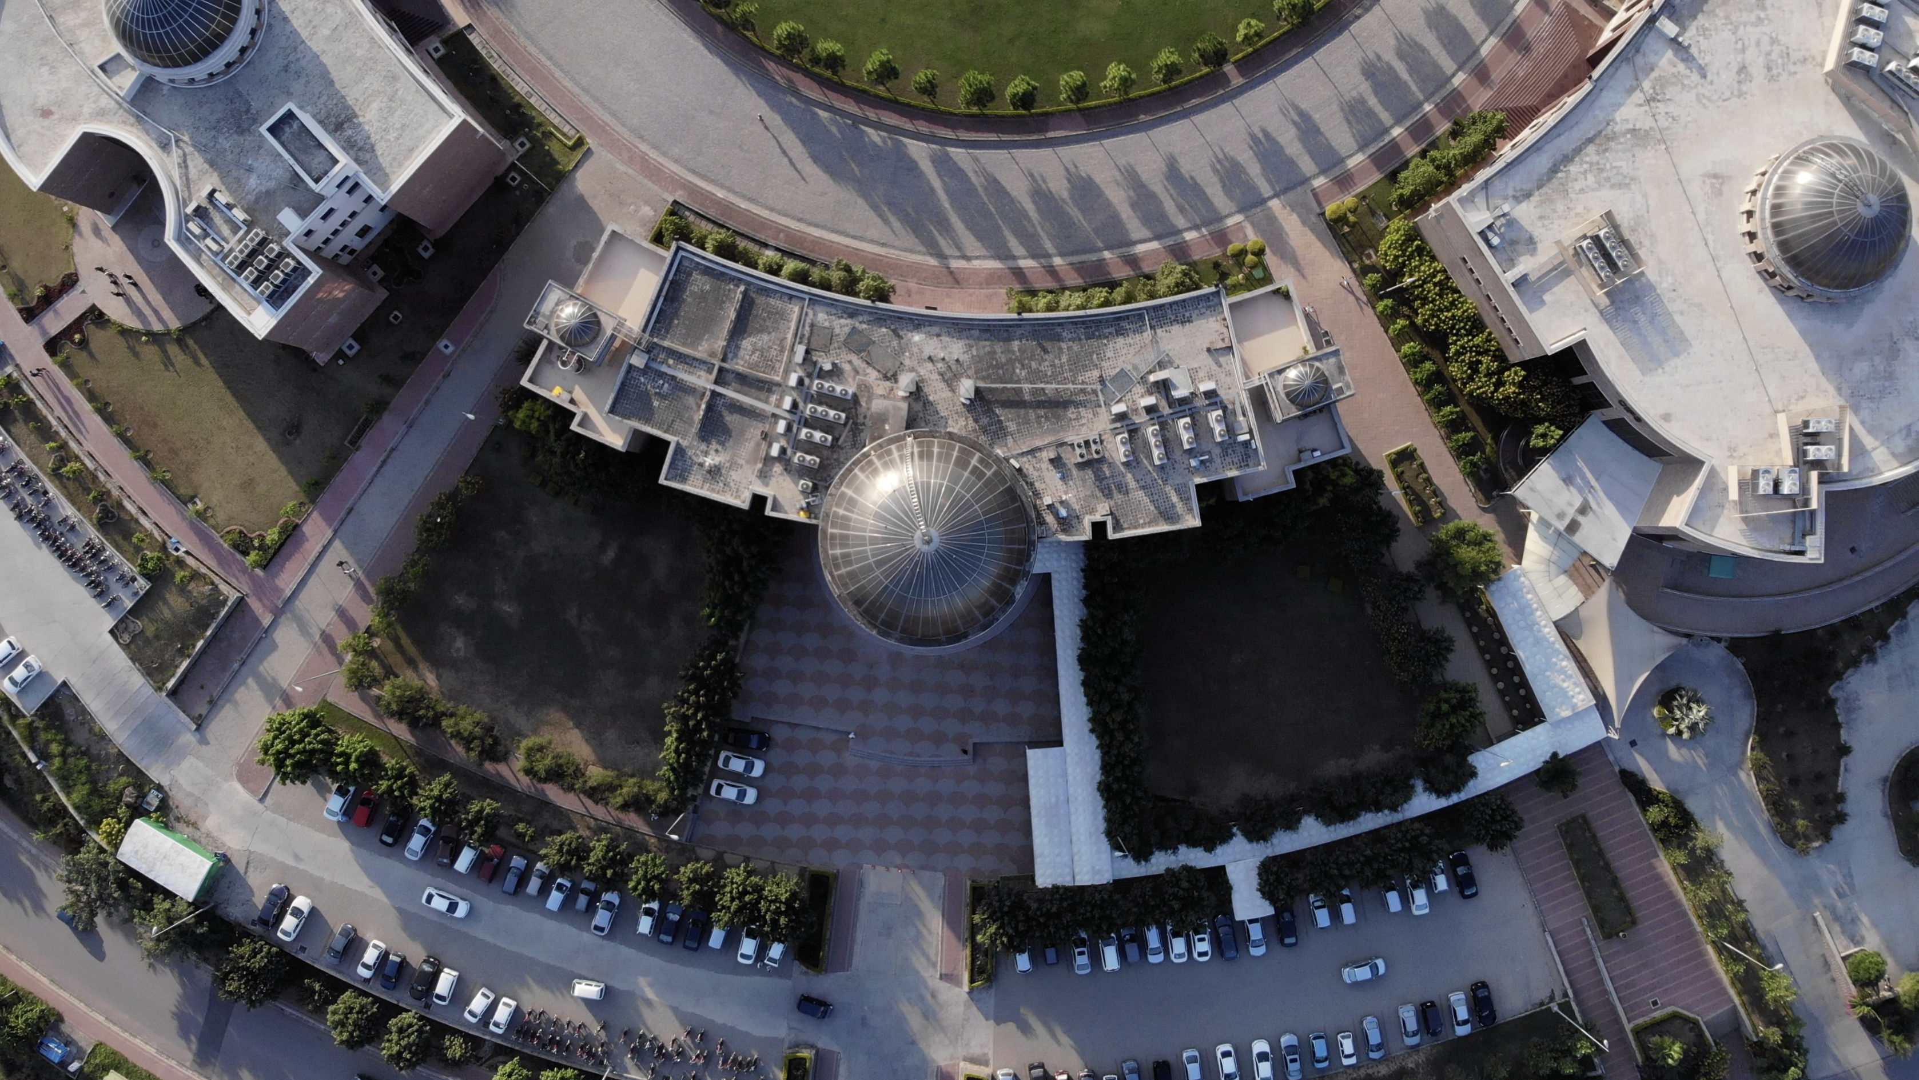

THANK YOU

