Slide 1
SBP SME Policy & Refinance/
Risk Coverage Schemes
May 30, 2021
at
The Gujranwala Chamber of
Commerce and Industries Gujranwala

Slide 2
Outline
SME Definition under Prudential Regulations
Key Challenges to SME Financing
SBP SME Policy
SME Refinance/Risk Coverage Schemes
Suggestions for improving utilization under SME Refinance Schemes

Slide 3
SMEs’ Contribution in Pakistan Economy
Estimated Share in total businesses (5.2 million)
Estimated Contribution to GDP
Workers employed in non-agricultural workforce
Source: SMEDA
Notes:
https://smeda.org/index.php?option=com_content&view=article&id=7:state-of-smes-in-pakistan&catid=15

Slide 4
SBP Definition for SE & ME-SME
Enterprises | No. of Employees* | Annual Sales Turnover | Financing Limit**
Small Enterprises | upto 50 | Upto 150 million | Upto Rs. 25 million
Medium Enterprises | 51-250 (Mfg. & Service) 51-100 (Trading) | Above Rs 150 million & up to Rs 800 million | Upto Rs. 200 million
*Including contract employees
**From a single Bank/DFI or from all banks/DFIs

Slide 5
Issues & Challenges
Demand side
Supply side
Low financial literacy
Quick and easy access to informal finance
Reluctance to tax filing
Complicated loan procedure
Lack of awareness on SME financing products
Lack of collateral and documentation
High risk perception
Asymmetric information
Lack of collateral
High administrative cost
Corporate mindset (compromised marketing)
Limited expertise w.r.t SME finance (products, cash flows, credit scoring, credit rating)
Heavy investments in govt. papers
Unavailability of assessment of demand of SME financing

Slide 6
Obstacles to SME Financing
SME financing considered riskier and costlier by banks;
Lower regulatory credit limit for SEs;
Lack of credit risk-sharing facility for low-end MEs;
Cumbersome loan processing procedures at banks;
Lack of program-based lending and value-chain financing;
Scarcity of trained SME banking officers in banks;
Lack of formal structures for awareness creation for SMEs;
Limited use of technology for SME financing;
SMEs concern on taxation and documentation issues.

Slide 7
Pillar 1: Improving Regulatory Framework
Introduction of Indicative Targets
Introduction of Refinance Facility
Province-wise targets assigned to banks/DFIs from January 2018;
Gender-based targets to be assigned from January, 2019;
Targets stratified along multiple dimensions (level, growth, number of borrowers etc).
New refinance facility for Working Capital loans for priority sub-sectors;
The priority sub-sectors are: IT, Furniture, Surgical Goods, Gems & jewelry, Leather industry, Fruits, Printing & packaging, Dates, Processing, vegetables & food processing and packaging;
The rate for end user will be 6% and SBP Refinance rate will be 2%

Slide 8
Obstacle # 2: Lower regulatory credit limit for SEs
Pillar # 2: Up-scaling Microfinance Banks
Graduate eligible MFBs into MSE Banks;
Financing limit of eligible MFBs increased to Rs 3 million;
Prescribed regulatory limits and caps to manage risks.

Slide 9
Obstacle # 3: Lack of credit risk-sharing facility for low-end MEs
Pillar 3: Risk Mitigation
Low-end medium enterprises covered in Credit Guarantee Scheme;
A new Credit Guarantee Company to be established;
Partnerships with provincial governments in risk sharing schemes starting with GoPb & GoS;
Establishment of Secured transaction e-registry for un-incorporated entities.

Slide 10
Obstacle # 4 Cumbersome loan processing procedures at banks
Pillar 4: Simplified Procedures
Loan Application Forms (LAF) for SE & ME simplified;
Borrower’s Basic Fact Sheet made part of LAF;
Turn-around Time for SE loans reduced from 30 to 15 working days;
Turn-around Time for ME loans prescribed at 25 working days;

Slide 11
Obstacle # 5: Lack of program-based lending and value-chain financing
Pillar 5: Value-Chain and Program-Based Lending
Targets to be assigned for Value-Chain Financing;
Banks asked to adopt program-based lending;
Program-based lending to expedite credit decision-making for SME Financing.

Slide 12
Obstacle # 6 Scarcity of trained SME banking officers in banks
Pillar 6: Capacity Building & Awareness Creation
Training programs by NIBAF for capacity building of bankers (100 programs per annum);
Awareness programs by SBP BSC and SMEDA (150 programs per annum);
Centre of Excellence to be established to undertake R&D.

Slide 13
Obstacle # 7 Lack of formal structures for awareness creation for SMEs
Pillar 7: Handholding of SMEs- Non-Financial Advisory Services (NFAS)
Banks to provide NFAS to develop the capacity of SMEs;
Focus on improving the management and organization practices of SMEs;
3S forum (SBP, SMEDA & SECP) to facilitate and steer this effort.

Slide 14
Obstacle # 8 Limited use of technology for SME financing
Pillar 8: Leveraging Technology & Innovation Challenge
Use of Information Technology to support growth in SME Finance
Development of a web-based marketplace for e-Commerce;
Launch an innovation challenge fund to promote SME financing through technology.

Slide 15
Obstacle # 9 SMEs concern on taxation and documentation issues
Pillar 9: Simplifying Taxation Regime
Tax rate reduction on banks’ income derived from SME financing;
Tax holiday on income of eligible start-ups and women SE borrowers;
Reduction in sales tax on services sector SEs & MEs (provincial governments).

Slide 16
SBP Refinance Schemes

Slide 17
SBP Refinance Schemes for SMEs
SME Asaan Finance (SAAF) Scheme
Prime Minister Kamyab Jawan –Youth Entrepreneurship Scheme
Export Finance Scheme
Long Term Financing Facility (LTFF)
Refinance Facility for Modernization of SMEs
Mark-up Subsidy & Guarantee Facility for Rice Husking Mills in Sindh
Refinance & Credit Guarantee Scheme for Women Entrepreneurs

Slide 18
SBP Refinance Schemes for SMEs
Refinance Scheme for Working Capital Financing of Small Enterprises and Low-End Medium Enterprises
Financing Facility for Storage of Agricultural Produce
Financing Scheme for Renewable Energy
Refinance Scheme for Working Capital Financing of SEs & Low-end MEs
Credit Guarantee Scheme (CGS) for Small and Rural Enterprises
Small Enterprise (SE) Financing and Credit Guarantee Scheme for Special Persons

Slide 19
SME Asaan Finance (SAAF) Scheme
Collateral Free Lending for SMEs

Slide 20
SME Asaan Finance (SAAF) Scheme
Objective:
To enable some proactive banks to develop a lending technology that overcomes the inherent structural deficiencies in SMEs lending like asymmetry of information, high credit risk, lack of collateral, high delivery costs, etc.
Eligible borrowers:
All SMEs (new as well as operative businesses)
Loan features:
Loan size will be capped at Rs. 10 million
All types of loans – term loans as well as working capital/running finance loans
Either unsecured or secured against PGs or charge on moveable assets

Slide 21
SME Asaan Finance (SAAF) Scheme
Tenor of refinance facility: 3 years. However, after three years, banks will return refinance amount to SBP in ten equal yearly installments.
Refinance rate: 1%
End user rate: 9%
Risk Sharing: First loss portfolio level credit risk guarantee providing coverage of 40% to 60%
60% for small loans (up to Rs 4 million)
50% for midsize loans (above Rs 4 million and up to Rs 7 million)
40% for relatively large loans (above Rs 7 million and up to Rs 10 million)
The risk sharing will be applicable on loans disbursed during the first three years.

Slide 22
Prime Minister’s Kamyab Jawan Youth Entrepreneurship Scheme (YES)
Purpose | To provide self-employment opportunities to unemployed youth, Govt. of Pakistan launched Prime Minister’s Kamyab Jawan Youth Entrepreneurship Scheme (YES) across the country.
Eligibility Criteria | All citizen of Pakistan holding CNIC, aged between 21 and 45 years with entrepreneurial potential are eligible. For IT/E-Commerce related businesses, the lower age limit will be 18 years. Above age limit condition is applicable on individual and sole proprietors. In case of all other forms of business including partnership and companies, only one of the owners, partners or directors must be in the age bracket prescribed above.
Loan size | Size of the loan is segregated into three tiers, as under: Tier 1 (T1) loans- Rs 100,000 to Rs. 1 million Tier 2 (T2) loans- Above Rs 1 million and upto Rs 10 million Tier 3 (T3) loans-Above Rs 10 million and upto Rs 25 million
Loan type | Long Term Loan/Working Capital Loan including Murabaha and leasing/ financing of locally manufactured vehicles for commercial use.
Loan Tenor | Upto 8 years with maximum grace period of upto one year.
Focus on Women | 25% of the loans will go to women borrowers.

Slide 23
Prime Minister’s Kamyab Jawan YES
Debt to Equity ratio | For New Businesses: Tier 1 - 90:10 Tier 2 & 3 - 80: 20 For Existing Businesses: Nil for all tiers The Borrower’s contribution of equity would be in the form of cash or immovable property and will be required after approval of loan.
Security Requirements | Security arrangement will be as under: T1 loans: Clean, however, only personal guarantee of the borrower T2 and T3 loans: As per bank’s own credit policy Vehicle financed under T1, T2 and T3 to serve as collateral.
Risk Mitigation | Government will bear credit losses (principal portion only) on the disbursed portfolio of the banks as under: T1 loans: Upto 50% T2 loans: Upto 20% T3 Loans: Upto 10%
Pricing | Pricing for Working Capital & Term Loans:

Slide 24
Prime Minister Kamyab Jawan –YES
Allocation in Budget | Finance Division shall allocate funds in each fiscal year’s budget as per estimates provided by SBP. Payment will be made on submission of consolidated claims of all banks by the SBP on quarterly basis.
Executing Agency | All Commercial and Islamic banks are advised to come on board.
Sectors and Products | All sectors and products including agriculture.
Additional Measures | Executing Agencies (EAs) under this program should ensure following additional measures: Criteria for assessing entrepreneurial potential should be developed and implemented. In case of loan for existing businesses, a robust independent verification mechanism may be introduced to ensure proper utilization of loans. Further, for new businesses, a robust mechanism for ongoing monitoring of the loans’ utilization should be developed and implemented. All loans previously disbursed or approved under this scheme will be converted into the new parameters with effect from July 01, 2020.

Slide 25
Export Refinance Scheme
A short term (180 days) financing facility for working capital of exporters
Consists of two parts:
Part-I (Transaction Based)
Part-II (Performance Based)
All sectors are eligible except those mentioned in the negative list
Prevailing rate for exporters is 7%
0.5% -1.5% performance based markup rebate under EFS Part-II
Banks’ spread is 1% higher in case of lending to SMEs under scheme
The financing facility is also available under Islamic mode

Slide 26
Export Refinance Scheme
EFS Part-I (Transaction Based)
Facility available to Direct Exporters (DE) (including commercial exporters & trading companies) & Indirect Exporters (IDE)
Coverage to the extent of 100% of export order/ LC/contract, in case of financing for 180 days and 85% for 270 days.
Facility available at both pre & post shipment stages to DEs.
Performance required against every transaction.

Slide 27
Export Finance Scheme
EFS Part – II (Performance Based)
Performance based facility – limit based on performance of the exporter
Exporters are entitled a revolving limit equivalent to 50% of their total value of export proceeds realized in the previous year.
The exporter is required to show annual export performance (realized value of export proceeds) by exporting at least twice of its borrowings on average daily product basis.
Entitlement is determined on the basis of EE-1 Statement (that includes export proceeds from exports of eligible items in previous year under both parts of EFS.)

Slide 28
Performance Based Lower Mark up Rates under Export Finance Scheme
Performance Requirement | Reimbursement Benefit in Existing Markup for Corporate Borrowers | Reimbursement Benefit in Existing Markup to SME Borrowers
2.00 to 3.00 times | NIL | NIL
3.01 to 4.00 times | 0.5% | 1%
4.01 to 5.00 times | 1% | 1.5%
Above 5.0 times | 1.5% | 2%

Slide 29
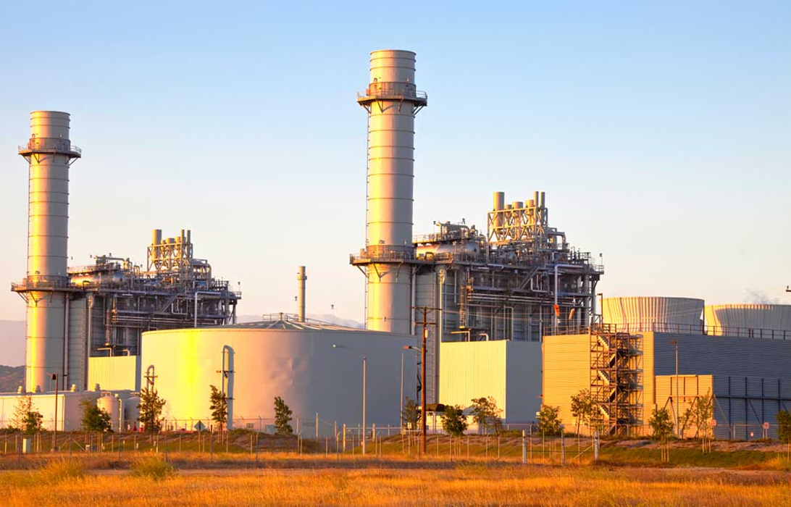
Long Term Financing Facility (LTFF)

Slide 30
LTFF-Scope and Eligibility
Purpose: Long term local currency finance for imported and locally manufactured new plant and machinery
Eligibility: Available to the export oriented projects only if their annual export is equivalent to US $5 million or at least 50% of the sales whichever is lower
PFIs: Financing shall be available through banks / DFIs approved as PFIs
Financing Limit: Maximum borrowing limit for a single export oriented unit is Rs 1.5 billion
Tenor: Financing shall be available for a maximum period of 10 years including a maximum grace period of 2 years.

Slide 31
LTFF-Rates of Service Charges
Period of financing | Rate of Refinance | PFI Spread | End User’s rate
Up‐to 3 years | 4.50% | 1.50 % | 6.00%
3‐5 Years | 3.50% | 2.50 % | 6.00%
5‐10 Years | 3.00% | 3.00 % | 6.00%

Slide 32
Eligible For Financing Under LTFF Scheme
Core Categories
Textile & Garments
Rice Processing
Leather & Leather products
Sports goods
Carpets & Wools
Surgical Instruments
Developmental Categories
Fisheries
Poultry & Meat
Fruits/Vegetable & Processing, Cereals
I.T. – Software & Services
Marble & Granite
Gems & Jewelry
Engineering Goods
Generators / Captive Power Plants
Ethanol
Furniture and Pharmaceutical
Regeneration of Textile Waste
Glass Sector
Dairy Sector
Soda Ash
Fabrics
Spinning & Ginning
Garments
Towels
Made up
Art silk & synthetic textile

Slide 33
LTFF-Terms & Conditions
The cost of insurance, transit insurance, erection and commissioning charges and other incidentals (including transportation charges, in case of locally manufactured machinery) etc.; shall not be financed under the facility.
PFIs may also consider financing requests of new projects and expansion of existing projects on the basis of projected exports, keeping in view the provisions of SMEFD Circular Letter No. 05 of 2010 & SMEFD Circular Letter No. 05 of 2011 respectively”
Export oriented SME borrowers may purchase imported machinery from the commercial importers or authorized dealers of the foreign manufacturers in Pakistan and authorized suppliers in case of locally manufactured machinery and plant
Financing is available against Letter of Credit only, to the extent of the C&F value of imported machinery and ex-factory / showroom price of locally manufactured machinery

Slide 34
Islamic LTFF-Scope and Eligibility
Scope: Mudarabah based Islamic Long Term Financing Facility (ILTFF) for plant and machinery through Islamic banking institutions (IBIs). SBP shall make Mudarabah investment in general pool of IBIs participating in the scheme.
Eligibility: Exporters (including SMEs) can avail long term local currency financing for purchase of imported or locally manufactured new plant and machinery for eligible sectors.
Available to the export oriented projects only if their annual export is equivalent to US $5 million or at least 50% of the sales whichever is lower
PFIs: Funding from SBP shall be available to IBIs which are approved by SBP as Participating Islamic Banking Institutions (PIBIs) under ILTFF.
Financing Limit: Maximum borrowing limit for a single export oriented unit is Rs 1.5 billion
Tenor: Financing shall be available for a maximum period of 10 years including a maximum grace period of 2 years.

Slide 35
Refinance Facility for Modernization of SMEs

Slide 36
Refinance Facility for Modernization of SMEs
Brief Description | For purchase of new local/ imported plant and machinery for the BMR of existing SMEs or for setting up new SME units and for the purchase of new generators of up-to 500 KVA
Features | 1) Financing available only against LC in case of purchase of imported plant and machinery 2) Financing available to the extent of C&F value of imported new plant and machinery and ex-factory/ show room price of local plant and machinery 3) Financing is also available for carrying out civil works upto 20 percent of total project cost for conversion of conventional brick kiln and upto 50 percent of total project cost for new zigzag technology based brick kiln 4) Disbursements by banks/DFIs should not be made to the borrower directly; instead payments shall be made to the manufacturers / suppliers of the machinery 5) Financing shall not be available for the purpose of acquisition of land, construction of building etc.

Slide 37
Refinance Facility for Modernization of SMEs
Rate of Mark up | End user rate is 6% out of which 4% is bank’s share
Financing tenor | Maximum financing tenor is 10 years with maximum grace period of six months.

Slide 38
Refinance Facility for Modernization of SMEs
Rice Husking,
Cotton Ginning,
Power Looms,
Dairy & Livestock,
Cutlery & Stainless Utensils,
Surgical Instruments,
Marble & Granite,
Engineering Goods, (Electronic),
Fisheries,
Packaging / Processing of Fruits / Vegetables,
Furniture,
Gems & Jewellery,
Sports Goods,
Agro‐based Industry
Please keep in mind that this is an illustrative list. Other SME sectors are also eligible.

Slide 39
Mark-up Subsidy & Guarantee Facility for Rice Husking Mills in Sindh

Slide 40
Mark-up Subsidy & Guarantee Facility for Rice Husking Mills in Sindh
Brief Description | Launched in 2013, in collaboration with Sindh Enterprise Development Fund (SEDF) to facilitate rice mills of Sindh in establishment and BMR of rice husking mills. Also available for installing mechanized dryers.
Rate of Mark up | End user rate is 2%. Banks’ spread is 4.75% out of which 2.75% is borne by SEDF. SBP’s refinance rate of 2% is also borne by SEDF.
Risk Coverage | 30% risk coverage against outstanding principal
Maximum Financing Amount | Maximum Rs 10 million. However, the rice husking mills that want to install mechanized dryers can avail financing upto Rs 16 million.
Financing tenor | Maximum financing tenor is 5 years.

Slide 41
Refinance & Credit Guarantee for Women Entrepreneurs

Slide 42
Refinance & Credit Guarantee Scheme for Women Entrepreneurs
Brief Description | For women entrepreneurs in the country’s for setting up of new businesses or expansion of existing ones.
Rate of Mark up | End user rate is 5% that entirely goes to banks. SBP refinance rate is 0%.
Maximum Financing Amount | Rs 5 million
Financing tenor | Maximum financing tenor is 5 years with maximum grace period of 6 months
Risk Coverage | 60% of outstanding principal
Quota | 20% for Baluchistan

Slide 43
Financing Facility for Storage of Agricultural Produce
Brief Description | For establishment, expansion and BMR of steel/ metal/ concrete silos, warehouses & cold storage facilities. For purchase of new imported/ local plant & machinery/ equipments/ accessories to be used in silos, warehouses and cold storage facilities. Generators with maximum capacity not in excess of in-house energy requirements can be financed under the scheme. Financing available up to 65% cost of civil works.
Rate of Mark up | For SMEs end user rate is 6% out which bank’s share is 4%.
Maximum Financing Amount | Maximum for single project is Rs 500 million.
Financing tenor | Maximum tenor for SMEs is 10 years.

Slide 44
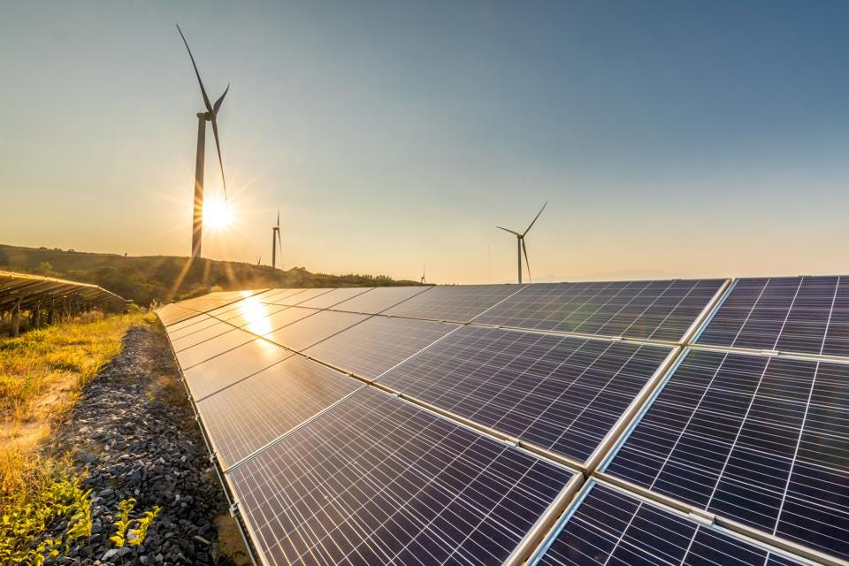
SBP Financing Scheme for Renewable Energy

Slide 45
SBP Financing Scheme for Renewable Energy
For power generated by using alternative/ renewable energy sources like solar, wind, hydro, biogas, bio-fuels, biogas cogeneration, and geothermal as fuel.
 | Category I | Category II | Category III
Brief Description | Prospective sponsors, desirous of setting up renewable energy power projects with a capacity ranging from more than 1 MW and up-to 50 MW for their own use, selling of electricity to the national grid (including distribution companies) or combination of both. | Prospective sponsors, desirous of installing renewable energy source based projects/ solutions for generation of electricity up-to 1 MW. | Vendors/ suppliers/ energy sale companies installing wind and solar systems of up-to 5 MW including selling of RE equipment on lease/ rental/ deferred payment basis or selling of electricity to ultimate owners / users.
Fin. limit | Rs 6 billion for single project | Rs 400 M for single borrower | Rs 2 billion for single vendor / supplier/Energy Sale Company

Slide 46
Financing Scheme for Renewable Energy
For power generated by using alternative/ renewable energy sources like solar, wind, hydro, biogas, bio-fuels, bagasse cogeneration, and geothermal as fuel.
 | Category I | Category II | Category III
SBP Refinance | SBP Refinance shall be up-to100% of total financing (debt) of an eligible RE project of upto 20 MW and up-to 50% of financing (debt)of an eligible RE Project of more than 20 MW. | SBP Refinance shall be up-to 100%of financing to the eligible borrowers. | SBP Refinance shall be up-to 100% of financing to the eligible borrowers.
Fin Tenor | Max 12 Yr--2 Yr. GP | Max 10 Yr--3 Mon GP | Max 10 Yr – 06 Month Grace Period
Mark up | 3% SBP + 3% Bank=6% p.a. | 2% SBP + 4% Bank=6% p.a. | 3% SBP + 3% Bank=6% p.a.

Slide 47
Refinance Scheme for Working Capital Financing of SEs & Low-end MEs
Brief Description | Financing is initially available to meet the working capital requirements of below mentioned sectors:
Rate of Mark up | End user rate is 6% with banks’ spread of 4% and SBP refinance rate is 2%
Eligible Enterprises | All small enterprises (SEs) as per SBP’s PRs Medium enterprises (MEs) with annual sales of Rs 300 million
Financing Amount | Upto Rs 25 million for SEs Upto Rs 50 million for Mes
Financing Tenor | Maximum financing tenor is 1 year
Information Technology (IT) | Gems and jewelry
Furniture | Leather industry
Surgical goods | Fruits, vegetables and food processing & packaging
Dates processing | Printing & packaging

Slide 48
Credit Guarantee Scheme (CGS) for Small and Rural Enterprises
SBP launched Credit Guarantee Scheme (CGS) for Small and Rural Enterprises in March 2010 in collaboration with UK’s Department for International Development (DFID).
Under this scheme, risk coverage of upto 60% is provided against credit losses of participating financial institutions on their lending to small, micro and rural enterprises.
The extent of risk coverage is linked with the level of loan collateralization. The lower the loan collateralization, the higher is the risk coverage extended under the scheme
Risk coverage of 60% is provided against all loans extended to women borrowers, start-up businesses and small, rural and micro enterprises operating in the underserved areas of the country

Slide 49
Small Enterprise (SE) Financing & Credit Guarantee Scheme for Special Persons

Slide 50
Small Enterprise (SE) Financing & Credit Guarantee Scheme for Special Persons
Brief Description | Special persons holding CNIC with disability logo/symbol will be provided finance for setting up of new business enterprises or for expansion of existing ones
Rate of Mark up | End user rate is 5% that entirely goes to banks. SBP refinance rate is 0%.
Maximum Financing Amount | Rs 1.5 million
Financing tenor | Maximum financing tenor is 5 years with maximum grace period of 6 months
Risk Coverage | 60% of outstanding principal

Slide 51
Scheme | Financing Limit | Mark-Up (%) | Max Tenor (Years)
SAAF | Up to Rs. 4 Million Upto Rs. 7 Million Upto Rs 10 Million | 9% | 10
PM Kamab Jawan Program- YES | Tier 1 (T1) loans- Rs. 100,000 to Rs. 1 m Tier 2 (T2) loans- Above Rs. 1 upto Rs 10 m Tier 3 (T3) loans-Above Rs. 10 upto Rs 25 | 3% 4% 5% | 8
Export Refinance Scheme | Part-I 100% of Ex O etc. 85% for 270 days Part-II 50% of previous year exports | 7% | 180 days
LTFF | Upto Rs. 1.5 billion. | 6% | 10
Refinance for Modernization of SMEs | Up to Rs. 25 Million for SEs Up to Rs. 200 Million for MEs | 6% | 10
Mark up and Credit Guarantee for Rice Husking Mills in Sindh | Upto Rs 2 million. | 2% | 5

Slide 52
Scheme | Financing Limit | Mark-Up (%) | Max Tenor (Years)
Refinance and Credit Guarantee Scheme for Women Entrepreneurs | Up to Rs. 5 Million | 5% | 5
Refinance Scheme Working Capital for SMEs | Up to Rs. 25 Million for SEs Up to Rs. 50 Million for MEs | 6% | 1
FFSAP | Upto Rs. 500 Million | 4% | 10
Financing Scheme for Renewable Energy | Category I: Rs. 6,000 Million Category II: Rs. 400 Million Category III: Rs. 2,000 Million | 6% | 12 10 10
CGS for Small and Rural Enterprises | Upto
Refinance and Credit Guarantee Scheme for Special Persons. | Up to Rs. 1.5 Million | 5% | 5

Slide 53
Thank you

