Slide 1

BASICS OF HSE COURSE
National Business Development Program for SMEs (NBDP)

Slide 2



SMALL & MEDIUM ENTERPRISES
DEVELOPMENT AUTHORITY (SMEDA)
Small & Medium Enterprises Development Authority (SMEDA) is a Federal organization created to assist SME business growth by creating conducive policies and provision of Business Development Services.
National Business Development Program for SMEs (NBDP) is a project of SMEDA, established to expand SMEDA’s outreach and to provide an effective handholding to SMEs across Pakistan through provisioning of Demand Based Training Programs along with PKR 6,000 Subsidy for each participant
www.smeda.org.pk www.nbdp.org.pk

Slide 3
PITAC INTRODUCTION
ABOUT US
The Government of Pakistan established Pakistan Industrial Technical Assistance Centre (PITAC) in 1962 with the merger of Industrial Research and Development Centre (IRDC) and Industrial Productivity Centre(IPC) under the administrative control of Ministry of Industries, Government of Pakistan.
WHAT WE PROVIDE
PITAC today is providing a service to Pakistan which can only be measured in the number of Engineers/Students and Projects that go through our hands, who then go and provide a service to Pakistan in their respective fields, a figure which cannot be quantified in figures but by the quality of training and service we provide.

Slide 4
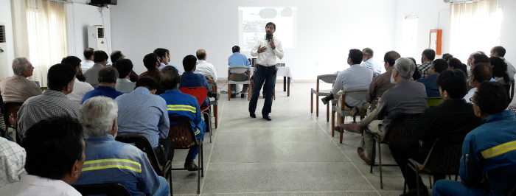
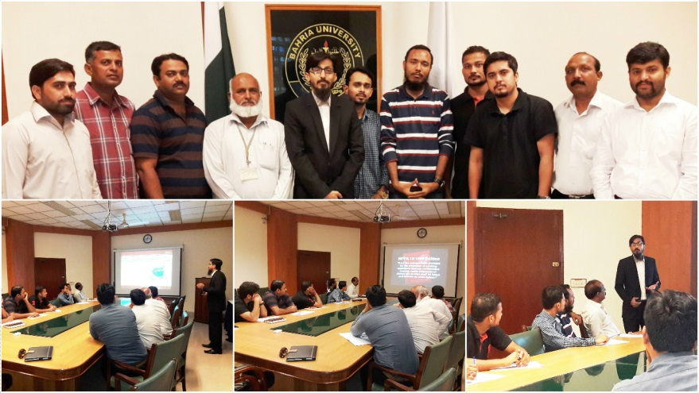
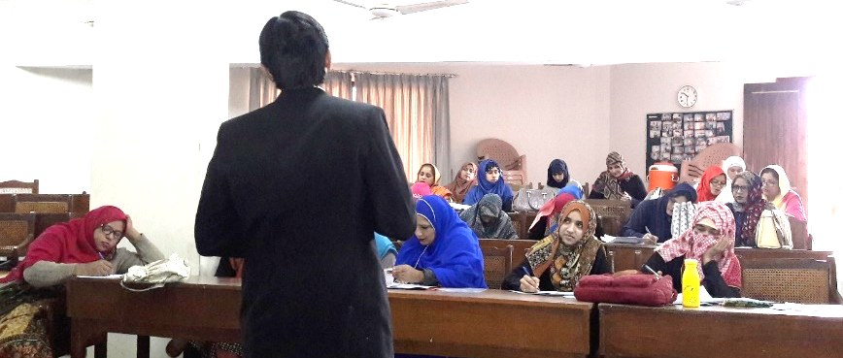
Syed Owais Mukhtar
BE (NED University)
MBA
Masters Quality – NED
IDSE
Grad IOSH
TSP
IOSH MS
HABC Fire Safety
ISO 9001:2015 LA
ISO 14001:2015 LA
ISO 45001:2018 LA
Manager HSE
QHSE Professional
Trainer
Writer / Blogger / Author
Online Course Creator

Slide 5
Syed Owais Mukhtar - Grad IOSH - is a Trainer / Consultant and is certified in International Diploma in Safety Engineering (Level 6) – by NCFE, UK – Accredited for GRAD IOSH , Certified IOSH Managing Safely – by IOSH, UK, HABC Fire Safety Certified – by HABC, UK, ISO 9001:2015 and ISO 45001:2018 Lead Auditor Certified – by IRCA, UK and many more, he has done training session on topics like ISO 45001, ISO 9001, ISO 14001, ISO 27001, OHSAS 18001, Behavior Based Safety, Leadership, Career Counseling, Managing Emotions & Attitude at Workplace, Interview Skills & Resume Writing, HSE, Fire Safety, 5-s, Risk Assessment (HIRA + TRA), Basic Warehouse Safety, he has trained staff and management of some high level organizations like Hilong (PPL Contractor), Three Gorges Wind Mill Farm, Hascol, SBEPL, NILAT, United King, Agility & Tristar, Super Tech Autoparts (Pvt) Ltd., NED University, Dawood University, SMIU, IIUI, Sybrid (Lakson Group), Bahria University, Karachi, Aga Khan Schooling System, NGOs like Youth Intelligentsia, The Citizen Foundation, Society for Education & Welfare, Society for International Educaiton, Evolution a US Consulate Project for education.

Slide 6
BASICS OF HEALTH, SAFETY & ENVIRONMENT
Notes:
Hello and welcome to the online course, BASICS OF HEALTH, SAFETY & ENVIRONMENT.

Slide 7
CONTENT LIST
1. What Is Meant By Health, Safety And Environment?
Basic concepts overview, need of HSE, definition of health safety and environment.
2. Hazard Identification And Risk Assessment
Learn what is risk assessment and how to carry out a risk assessment
3. Fire Safety And Fire Prevention Techniques
Info about fire safety, what is fire, its chemistry, types and how it is extinguished
4. Basics Of Behavior Based Safety
What it is, what is behavior observation and reinforcement technique.
5. Information About IOSH, OSHA, ISO 45001 & 14001, NEBOSH & NFPA
Informaiton about the international bodies running the health safety regulations and laws
6. FAQs
Some frequently asked questions about health safety and environment
Notes:
Here is the list of what you are going to study today, this course is divided into 6 sections, all covering the basics of health safety and environment.
In chapter 1. we will discuss - What Is Meant By Health, Safety And Environment? In which we will cover Basic concepts overview, the need of HSE, definitions of health safety and environment.
In chapter 2. we will discuss Hazard Identification And Risk Assessment - in which we will learn how to carry out hazard identification and risk assessment, and what is the hierarchy of risk control
Chapter 3. will cover the Fire Safety And Fire Prevention Techniques – in which basic information about fire safety is covered like, what is fire, its chemistry, types of fire and how they are extinguished
In chapter 4. we will study Basics Of Behavior Based Safety - we will discuss: What is Behavior, what is behavior observation and its reinforcement techniques
In Chapter 5. we will discuss Information About IOSH, OSHA, ISO 45001 & 14001 - Information about the international bodies running the health safety regulations and laws
And finally in the last chapter we will cover some frequently asked questions about health safety and environment

Slide 8
1.
WHAT IS MEANT BY HEALTH, SAFETY AND ENVIRONMENT?
Let us find out the meaning and basic concepts of HSE
Notes:
So lets begin with chapter number one which is WHAT IS MEANT BY HEALTH, SAFETY AND ENVIRONMENT? – in this lecture we will find out the meaning and basic concepts of HSE

Slide 9
2.78 million
374 million
And billions
deaths a year as a result of occupational accidents or work-related disease
non-fatal injuries and illnesses
In overhead cost due to deaths and injuries, penalties, loss in asset.
Notes:
Before moving forwards here are some of the stats which shows the criticality of the situation which give rise to the need of HSE management systems and the thought to companies to focus more on the health safety and environment. The world came across about 2.78 million deaths a year as a result of occupational accidents or work-related disease, 374 million non-fatal injuries and illnesses and billions of dollars in overhead cost due to deaths and injuries, penalties, loss in asset, etc.

Slide 10
The Need
What employees want
What employers want
Safe workplace
Accident free
No pain
Minimize cost
Positivity
Minimize loss time injury
Care
Proactive, legal
Notes:
Employees and employers are the two major stakeholders of any firm. A firm works when both of them are in peaceful agreement with each other which increases the productivity, however the productivity is affected when any one of the stakeholder is not satisfied.
Employees want a safe workplace, a place where they will not counter any pain, the environment is encouraging and positive and care should be observed from both sides. On the other hand, employers want a workplace which is accident free, they want to minimize the cost along with a decreased in loss time injury, they also want to be proactive in legal compliance to avoid any lawsuits etc.
Thus these two sides and the requirements will give rise in need of a health, safety and environment management system

Slide 11
Why Firms Adopt HSE?
Moral
Society as a whole demands that people are safe whilst at work. It is a moral obligation of a firm.
Legal
Governments are now active to play their part in HSE. Laws are been made and updated timely, for firms to obey
Economic
Minimize amount of Direct & Indirect cost associated with an accident or ill-health case.
Commercial
Clients are getting more awareness than ever, now before doing contract they see HSE scores.
Notes:
The reason why firms adopt HSE is for below four major reasons.
Moral - Society as a whole demands that people are safe whilst at work. It is a moral obligation of a firm to take measures for human safety at work.
Legal - Governments are now active to play their part in HSE. Laws are been made and updated timely, for firms to obey. Firms can get into law suits and penalties for not following the legal requirements.
Economic – Firms want to minimize amount of direct & Indirect cost associated with an accident or ill-health case. And it will only be possible if an effective HSE management system is implemented and ensured!
Commercial - Clients are getting more awareness than ever, now before doing contract they see HSE scores. In order to maintain their goodwill now they prefer to work with those companies who are more compliant to HSE standards.

Slide 12
Definition of Health, Safety & Environment
The concept of “health” focuses on the prevention of human life from sickness and illness,
Safety is the condition of human life being protected from injuries, near misses and accidents, it also addresses the property and assets safety,
And when we talk about environment, we ensure that any working done by any organization will not harm the air, land, water, trees, habitat, etc.
Environment
Health
Safety
Notes:
The concept of “health” focuses on the prevention of human life from sickness and illness,
Safety is the condition of human life being protected from injuries, near misses and accidents, it also addresses the property and assets safety,
And when we talk about environment, we ensure that any working done by any organization will not harm the environment.

Slide 13
International Laws
Government Laws
Local Authorities
Company’s HSE Dept
Who Controls HSE?
Notes:
There might be a question in your mind that who is managing HSE, well there are different authorities managing the health, safety and environment on different levels.
If you are working in a company, firm, industry or office, most organizations have a health, safety and environment department i.e. HSE department, the job of this department is to make policies and procedures and take measures to implement them in order to comply with the guidelines of the local authorities, government and international laws
The local authorities are usually the organization which are working on the industrial level, for example the administration of an industrial zone, the NGOs dealing with specific group of companies like Committee of Textile Factories, or Board of Automotive Parts Manufacturers, these local authorities make policies which are aligned with the government and international laws which are then followed by the firms.
Government make laws. Usually, parliament, intellectual groups and individuals are give the responsibility by the government to draft out laws related to health and safety, they make it fulfilling the international laws and then circulate it in the groups below which include local authorities and firms for implementation.
International laws and regulations are made by those organization which are formed by group of countries coming together and agreeing on areas need to be addressed, organization like UN, WHO, line out guidelines which are then followed by countries - a common example is UN SDG Sustainable Development Goals which are outlines by UN and is accepted and implemented by member countries of UN, countries define their plans, which are later adopted by the local authorities, and then local firms follow it.

Slide 14
Group Discussion No. 01
In the next 4 slides, we will divide the class in 04 groups, and after 15 minutes of discussion, each group will come and discuss the slide they are assigned.

Slide 15
Some basics requirements of HSE
Part 01
Cleanliness.
Disposal of wastes and effluents.
Ventilation and temperature.
Dust and fume.
Artificial humidification.
Overcrowding.
Lighting.
Notes:
Before moving forwards lets pick a pen and paper, you have to submit answer after four slides for this quiz / assignment. So, here are some of the basic actions organization takes while going to implement health safety and environment management system, while some might be not applicable for your firm, kindly take a pen and paper and list down all those which are applicable to your working environment, after four slides you will be asked to write and submit those requirements which are applicable on the firm you are working. If you are not working or not associated with any firm, then write the same statement in the assignment.
Lets start with first and the most common requirement:
Cleanliness. A clean environment is a safe environment, a workshop with tools and products spread on the floor is more likely to have incidents then a workshop in which system of housekeeping is implemented and ensured.
Disposal of wastes and effluents. This falls under the category of environment, it is the responsibility of the firm to ensure that wastes and effluents are been disposed in the most appropriate manner which will not further harm the environment. Life cycle studies can also be done in order to ensure appropriate disposals.
Ventilation and temperature. The work environment is dependent on how ventilated it is and the temperature is maintained in order for the easiness of the workers and to save them from illness and sickness.
Dust and fume. Dust and fumes must be channelized and exhausted from the work environment to ensure the health of the worker. Dust is also a fire hazard and fumes can caused respiratory issues if not exited properly.
Artificial humidification. Artificial humidification must be provided in the environment which are prone to dry conditions.
Overcrowding. For people to work in a safe manner overcrowding must be avoided. There is a law for minimum number of people per sq. feet, you have to see the local regulations for this. If not complied this can cause more injuries and fatalities during evacuation in case of fire and other emergencies requiring evacuation.
Lighting. Lighting must be appropriate, if too low it can cause incidents like slip, trips and falls, etc. and if too high they can affect the eye sight, the standard lighting (calculated in lux) is different for different areas and is usually mentioned in local laws.

Slide 16
Some basics requirements of HSE
Part 02
Drinking water.
Latrines and urinals.
Spittoons.
Precautions against contagious or infectious disease.
Compulsory vaccination and inoculation.
Power to make rules for the provision of canteens.
Precautions in case of fire.
Notes:
Drinking water. Workers must be provided clean and healthy drinking water to stay hydrated. Especially in the hot weathers. It is the responsibility of company to ensure it.
Spittoons, Latrines and urinals. Provision of latrines and urinals in hygienic condition is another responsibility of the firm. The cleanliness must be ensured for a healthy environment.
Precautions against contagious or infectious disease. Firm has to take actions and precautions against the contagious and infectious diseases, it depends on the weather and the overall area dynamics. As per this law the food preparation workers are specifically focused because of their access to various team members, moreover the overall covid19 has started a new debate in this area as well so that must also be considered as well.
Compulsory vaccination and inoculation. There are some compulsory vaccinations which must be provided to all team members, the details can be checked from local laws as every state and country has its own compulsory vaccinations.
Power to make rules for the provision of canteens.
Precautions in case of fire. Every firm must take precautions to prevent fire, for this they must carry out fire risk assessment, also in case of fire they must have all the equipment ready for extinguishing the fire, the team members must be trained on the risks assessment and the procedure of fire fighting.

Slide 17
Some basics requirements of HSE
Part 03
Fencing of machinery.
Work on or near machinery in motion.
Striking gear and devices for cutting off power.
Cranes and other lifting machinery.
Hoists and lifts.
Revolving machinery.
Pressure plant.
Notes:
Fencing of machinery. Access must be restricted to dangerous machines, only the authorized and trained team members must access and operate, this can include but not limited to high risk areas, flammable liquids and material, moving parts, robotic arms, big cutters and in some cases x-rays machines also fall in this category due to the hazards associated with it.
Care should be done in cases where work has to be performed on or near the machinery which is in motion.
Striking gear and devices for cutting off power. Emergency shut off button must be provided with machines so that in case of any incident the machines can be shut off easily and immediately.
Cranes and other lifting machinery. Hoists and lifts. The safe working load must be defined for all type of lifting equipment and workers are required to comply with them. No machine must be used beyond the load bearing capacity to avoid any malfunction or incident. This is for the workers working on that particular machine and overall team safety. Actions must be taken if lifting equipment are misused, like lifters been used as man lift, or any kind of horseplay.
Revolving machinery. Due to increased incidents related to revolving machineries and relevant parts ultimate care must be taken while operating and when working nearby such machines, guarding must be done as far as reasonably practicable.
Pressure plant. Usually inspections and testing are carried out related to pressure plants.

Slide 18
Some basics requirements of HSE
Part 04
Floors, stairs and means of access.
Pits, sumps, opening in floors, etc.
Excessive weights.
Protection of eyes.
Safety of building, machinery and manufacturing process.
Precautions against dangerous fumes.
Explosive or inflammable dust, gas, etc.
Notes:
Floors, stairs and means of access. Every country has its own laws and regulations for it. As a general thumb rule the way of access must be wide enough to cater standing of four persons at a time. This is also done in order to make the evacuation quicker and easier.
Pits, sumps, opening in floors, etc. Must be covered appropriately keeping in view the population and equipment passing over them. They must be strengthen if they are in the way of passage of heavy equipment and machinery.
Excessive weights. If manually lifted there is a maximum limit defined, moreover ergonomic factor must also be considered while designing such jobs.
Protection of eyes. Personal protective equipment must be provided in order to protect the workers working on machineries which produce impactful parts, welding sparks, splashes of hazardous and bio-hazardous liquids, eye protection like glasses, goggles, face shields must be used depending on the relevant hazard..
Safety of building, machinery and manufacturing process. Overall building structural stability must be ensured, similarly machine maintenance and overall manufacturing process must be designed keeping in mind the safety rules and regulations.
Precautions against dangerous fumes. Risk assessment must be done and if required PPEs must be used. Individual exposures must be controlled.
Explosive or inflammable dust, gas, etc. Risk assessment must be done to identify the risk of dust or gas been emitted, leaked from the procedure, controls must be defined in order to avoid those leakages.

Slide 19
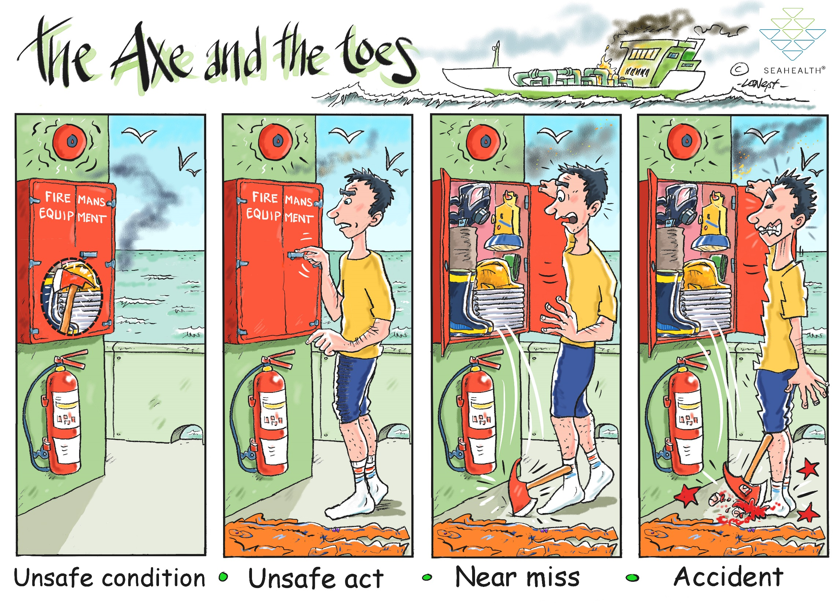
19
Unsafe
Condition
Unsafe
Act
Near-miss
Accident
Notes:
Further in order to understand the concept of safety and health you have to understand some terms. These terms are
1. unsafe condition, as you can see in the picture there is an unfixed axe which is placed inside the fire equipment box and can fall on the ground if the box is opened, this is called an unsafe a condition, a condition which is not safe, and is against the health and safety policies and procedures.
2. Unsafe act, in the second picture we can see a person is approaching the box without safety shoes, this is an unsafe act, if he has been deployed to carry the job of fire fighter he must wear protective clothing as well, but in the picture we can see he is not wearing shoes, moreover, coverall is also on the floor.
3. Near miss – As soon as the person opened the box the axe (which was not placed properly in the box) fell on the ground, which means an unsafe act is now transformed into a near miss. But due to the favorable conditions and by-chance, no incident happened.
4. Accident – In the final picture we can see that the axe fell off on the feet due to which his feet is injured, this is an accident. When we ignore and don’t take actions on the unsafe conditions, unsafe acts, and near misses, they will result in accidents.

Slide 20
A greater part of the work related to health and safety will be done if the mentioned basic requirements are fulfilled, rest of the requirements can be identified through risk assessment which we are going to study in the next section.
Notes:
A greater part of the work related to health and safety will be done if the mentioned basic requirements are fulfilled, rest of the requirements can be identified through risk assessment which we are going to study in the next section.

Slide 21
“An incident is just the tip of the iceberg, a sign of a much larger problem below the surface.” – Don Brown
Notes:
“An incident is just the tip of the iceberg, a sign of a much larger problem below the surface.” – Don Brown

Slide 22
2.
HAZARD IDENTIFICATION AND RISK ASSESSMENT
Identification of risk and then its mitigation and control techniques
Notes:
Welcome to chapter number two, HAZARD IDENTIFICATION AND RISK ASSESSMENT
In this chapter we will study Identification of risk and then its mitigation and control techniques

Slide 23
Risk Assessment
Risk
Assessment
A risk assessment is simply a careful examination of what, in your work, could cause harm to people, so that you can weigh up whether you have taken enough precautions or should do more to prevent harm.
To examine
Notes:
Risk Assessment - A risk assessment is simply a careful examination of what, in your work, could cause harm to people, so that you can weigh up whether you have taken enough precautions or should do more to prevent harm.

Slide 24
FEW DEFINITIONS YOU MUST KNOW
Hazard is anything that has a potential to harm!
Risk is the likelihood of harm that can happen from the hazard
Likelihood is how often that hazard has affected someone.
Severity is the amount of damage or harm a hazard could create.
Notes:
Before moving forward in the chapter of risk assessment, first let us understand some basic definitions related to the subject, this will help us in understanding rest of the chapter
Hazard is anything that has a potential to harm! It can be anything varying from a pen, a thumb pin, any machinery, chemicals, or vehicle, etc, every object has some hazards, something that has a potential to harm, however the risk level of that hazard differs from situation to situation.
Now what is risk? Risk is the likelihood of harm that can happen from the hazard. A machine which is operated by multiple workers might have high likelihood of harm than a machine operated by a single worker, a pot-hole near the boundary wall might have lower likelihood of harm than a pot-hole on the walk way.
Likelihood is how often that hazard has affected someone. During risk assessment we have to give likelihood a number, varying from rare to very often.
Severity is the amount of damage or harm a hazard could create. Just like likelihood we also have to give a number to severity ranging from insignificant harm to very severe!

Slide 25
Hazard Sources
Motion
extreme temperatures
Types of chemical exposures
Sources of harmful dusts
Sources of light radiation
Sources of falling objects
Or Potential for dropping objects
Sources of sharp objects
Any electrical hazards
Sources of rolling or pinching objects
Layout of workplace and location of co workers

Slide 26
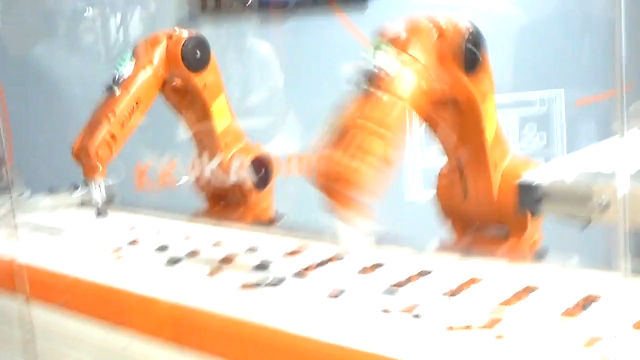
Motion

Slide 27
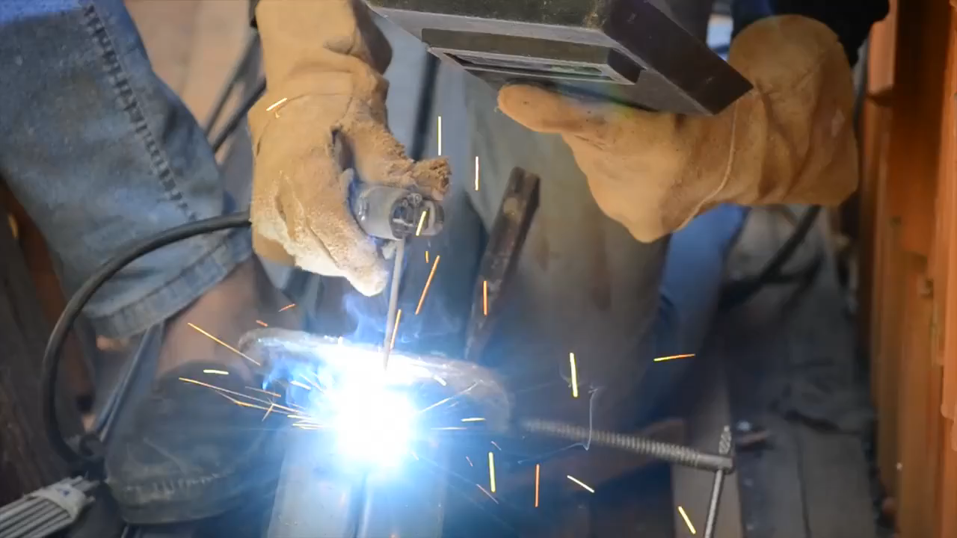
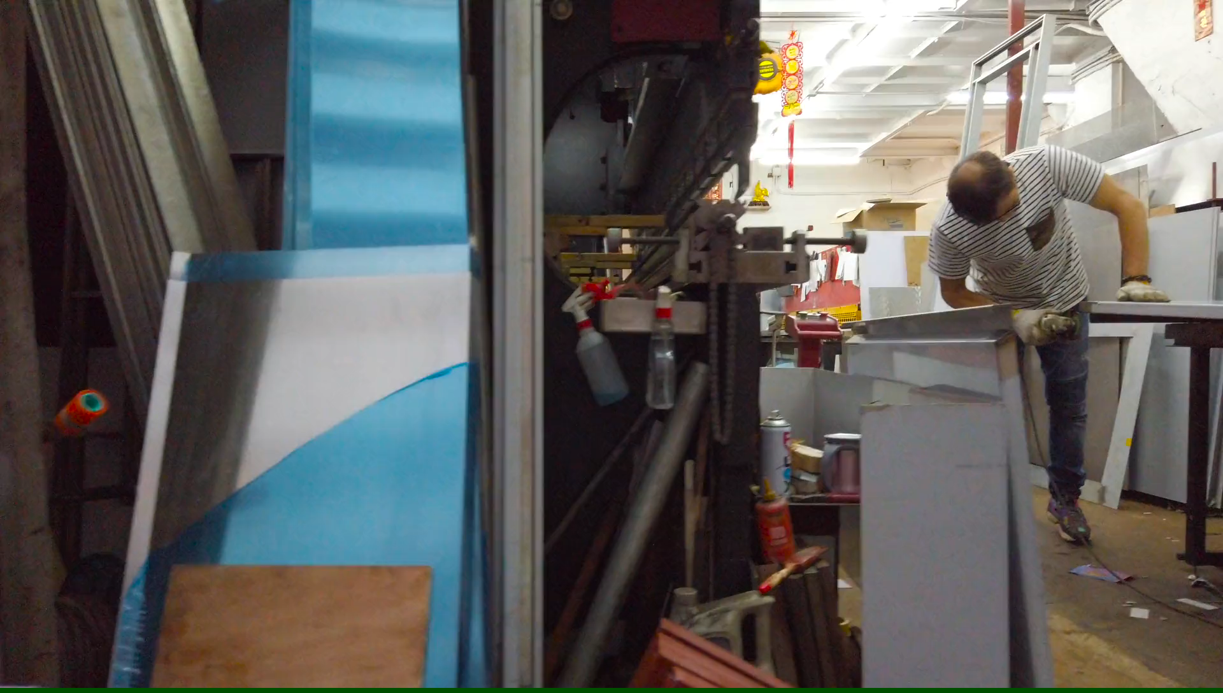
Temperature

Slide 28
Temperature

Slide 29
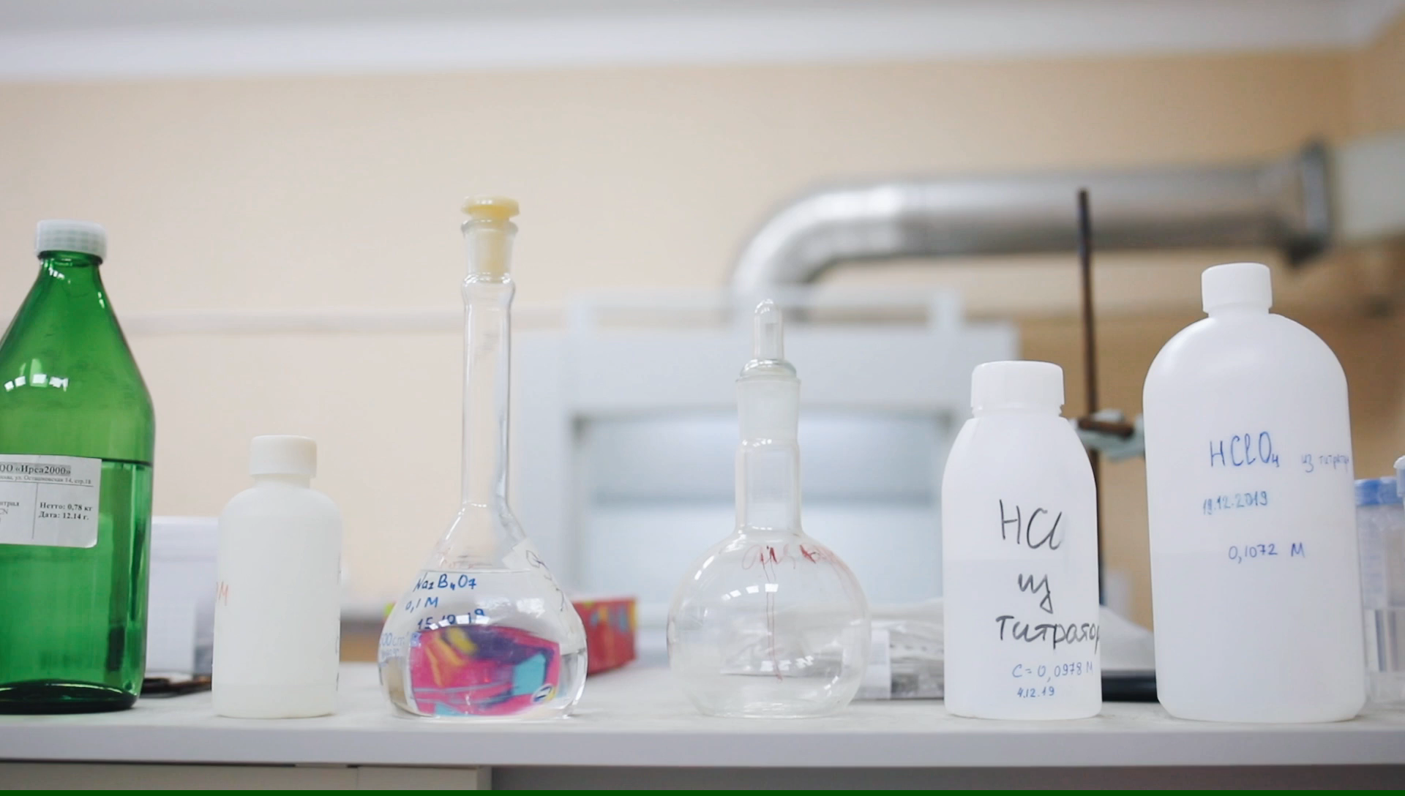
Chemical Exposure

Slide 30

Chemical Exposure

Slide 31
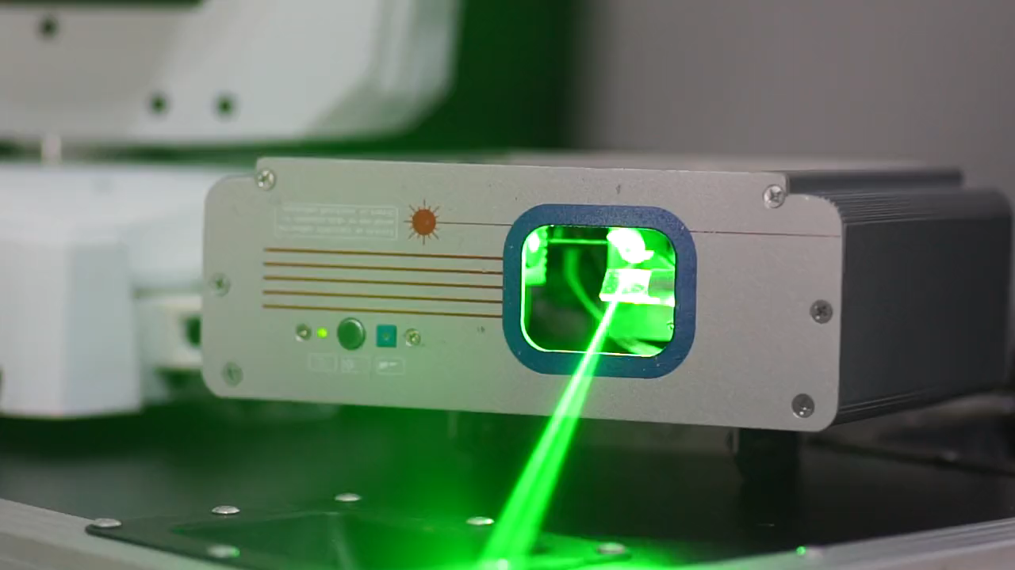
Radiation

Slide 32
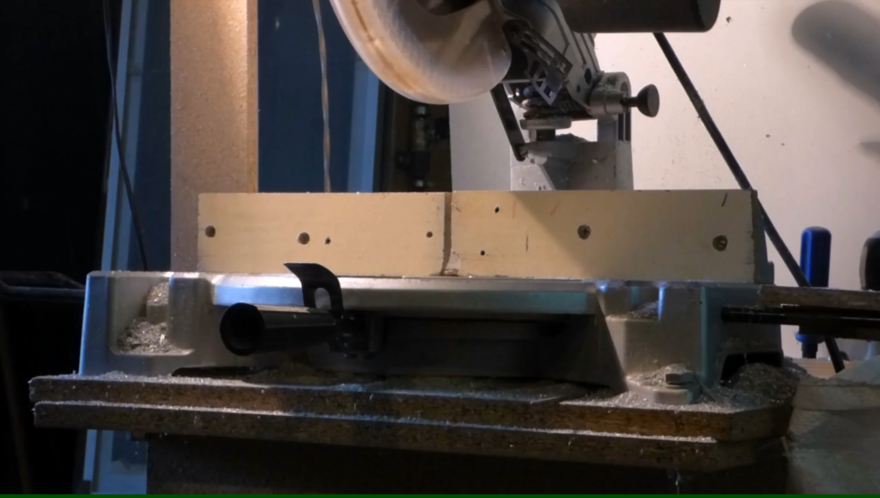
Sharp Objects / Tools

Slide 33
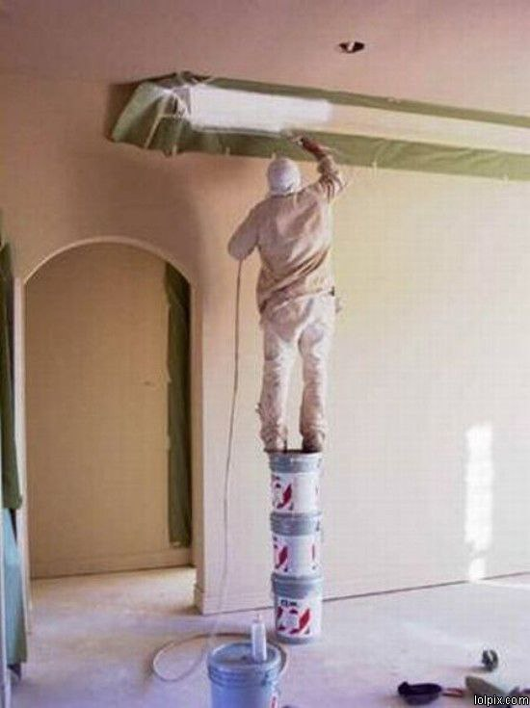

Slide 34
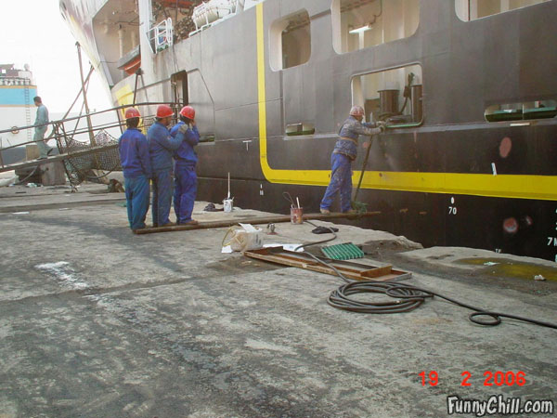

Slide 35
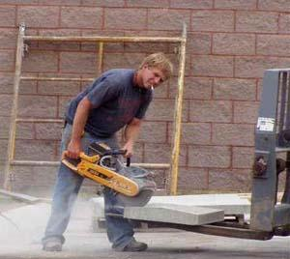

Slide 36
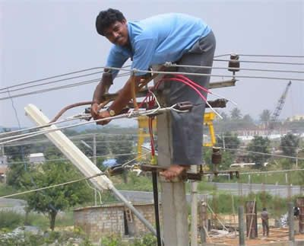

Slide 37
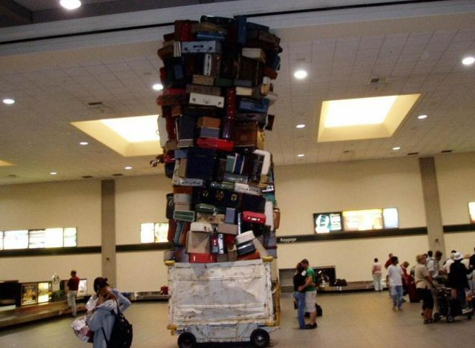

Slide 38
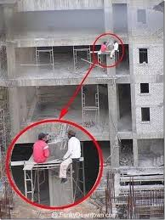

Slide 39
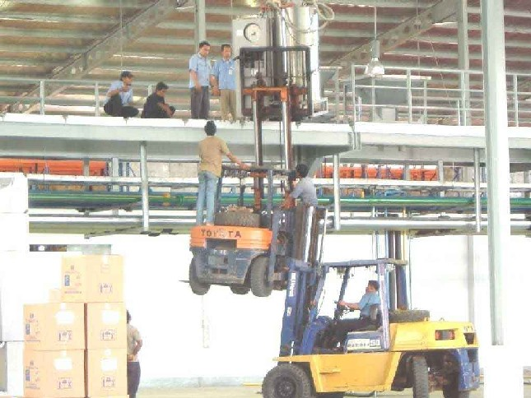

Slide 40
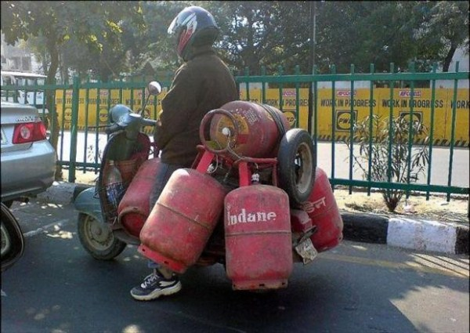

Slide 41
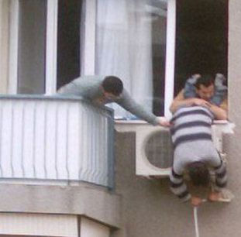

Slide 42
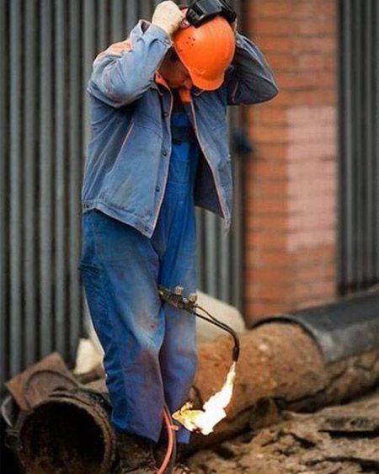

Slide 43
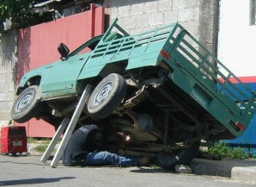

Slide 44
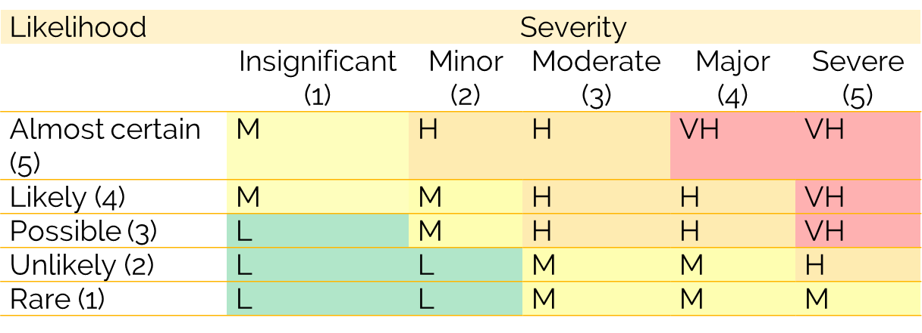
How to calculate risk?
Risk is the product of severity and likelihood!
Risk = Likelihood x Severity
12
3
4
Notes:
How to calculate risk?
As we all know that risk is quantifiable, it can be defined in numbers form and can answer the question “how much”
Risk is the product of severity and likelihood! Which means Risk = Severity x Likelihood
This is called the risk matrix, from the quantifiable values of likelihood and the severity we can identify if the risk is low, medium, high or very high
This is not a hard and fast rule, firms can design their own risk matrix according to complexity of their procedures.
So as per the matrix, if for a particular hazard, the severity is 3 and the likelihood is 4, the risk level will be 12 which falls in the high risk category.

Slide 45
Risk = Severity x Likelihood
12
3
4
25
5
5
08
2
4
02
1
2
Notes:
Lets do few more calculations
if the severity is 5 and the likelihood is 5, the risk level will be 24 which falls in the very high risk category
if the severity is 2 and the likelihood is 4, the risk level will be 08 which falls in the moderate risk category
And if the severity is 1 and the likelihood is 2, the risk level will be 02 which falls in the low risk category
Here I have to explain one more concept which is called acceptable risk, firms have to decide below which risk level is the acceptable risk, not all risks have to be addressed organizations have to take care of the feasibility and cost factor as well, an acceptable risk is that risk level on which organization does not take any action to mitigate or control because the risk is too negligible to be concerned of.

Slide 46
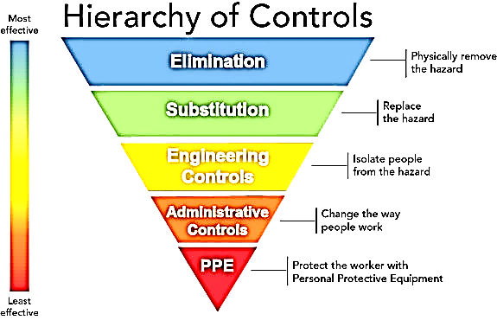
Hierarchy Of Controls
Elimination
.
.
.
.
.
Substitution
Engineering Controls
Admin Controls
PPEs
Notes:
Let’s talk about the hierarchy of controls, when there is a hazard which has risk level above the acceptable risk, then the organization has to take some countermeasures, there are 5 controls that can be applied which are elimination, substitution, engineering controls, administrative controls, and PPEs.
Let’s discuss every control one by one, elimination means physical removal of the hazard, ask yourself and your team “Can I eliminate this?” and you will surely reach a conclusion where you will be having a lot of ideas, they can include the elimination as well as also give you new insights about the substitution. Mostly elimination is easier in the design or planning phase, but once the manufacturing has started it is rather difficult to eliminate a process or equipment from the whole cycle. However, this can always be brainstormed.
Substitution - The goal of substitution is to replace a hazardous product or process with a safer one. Examples include using non-toxic or less toxic chemicals and upgrading aging machinery with newer equipment.
Engineering controls is the idea of controlling the hazards by engineering modification of the process as well as equipment to make the overall cycle safer. Using sound insulation in the equipment to lower down the noise level for the workers' safety OR using guard rails to prevent a person from falling - Barriers, guards, Physical isolation are the examples of engineering controls
Administrative controls means creation of safe working procedures for workers safety which include limiting exposure of workers with the hazard, displaying signs and speed limits, making policies, SOPs, and SWPs to lower down the risk to an acceptable level. Safe Work Procedures/ Operational Control - Standard Operating Procedures (SOPs) - Reduced Exposure times – Training all comes under the administrative controls
PPEs are the last resort in controlling any hazard. It is the last line of defense against workers' injuries. Numerous types of PPE are available, depending on work conditions and the part of the body that might be susceptible to a hazard. However before applying any PPEs first all of the above-mentioned control methods must be followed i.e. elimination, substitution, engineering controls, administrative controls and if none of them work, or is unable to lower the risk to acceptable, then PPEs must be used to further lower it down to acceptable level. They can include but not limited to High Visibility Vest - Safety shoes – Helmets, etc

Slide 47
alarp
Legislation (in every country) requires employers to reduce risks to a level that is as low as is reasonably practicable (abbreviated as ALARP)
To carry out a duty so far as is reasonably practicable means that the degree of risk in a particular activity or environment can be balanced against the time, trouble, cost and physical difficulty of taking measures to avoid the risk
Industry guidelines, code of practices and previous incidents/ accidents will provide guidance on what is reasonably practicable
Notes:
Legislation (in every country) requires employers to reduce risks to a level that is as low as is reasonably practicable (abbreviated as ALARP)
To carry out a duty so far as is reasonably practicable means that the degree of risk in a particular activity or environment can be balanced against the time, trouble, cost and physical difficulty of taking measures to avoid the risk
Industry guidelines, code of practices and previous incidents/ accidents will provide guidance on what is reasonably practicable

Slide 48
LET’S REVIEW SOME CONCEPTS
Hazard
A hazard is something that can cause harm, e.g. electricity, chemicals, working up a ladder, noise, a keyboard, a bully at work, stress, etc.
Risk
A risk is the chance, high or low, that any hazard will actually cause somebody harm.
Risk Assessment
A risk assessment is nothing more than a careful examination of what, in your work, could cause harm to people.
Alarp
The concept of “ALARP”; this involves weighing a risk against the trouble, time and money needed to control it.
Severity
Severity is the amount of damage or harm a hazard could create.
Acceptable risk
We cannot expect to achieve a risk level equal to zero. Thus we have to define which level of risk we consider as acceptable.
Notes:
Hazard
A hazard is something that can cause harm, e.g. electricity, chemicals, working up a ladder, noise, a keyboard, a bully at work, stress, etc.
Risk
A risk is the chance, high or low, that any hazard will actually cause somebody harm.
Risk Assessment
A risk assessment is nothing more than a careful examination of what, in your work, could cause harm to people.
Alarp
The concept of “ALARP”; this involves weighing a risk against the trouble, time and money needed to control it.
Severity
Severity is the amount of damage or harm a hazard could create.
Acceptable risk
We cannot expect to achieve a risk level equal to zero. Thus we have to define which level of risk we consider as acceptable.

Slide 49
HIRA Tips and Recommendations
Risk assessment is a live document, whenever a new risk is identified or a process is changed the risk assessment must be reviewed to include those new risk or changes.
Risk assessment must be documented and the record must be retained for future use and reference.
Experts recommend doing risk assessment by cross functional teams, when more brains are involved the risk assessment will become more detailed, a detailed risk assessment ensures that maximum number of risks are addressed.
Training is mandatory, after the completion of risk assessment, team members must be trained on the document to make them aware of all the hazards related to the job they are performing.
Risk assessment can be used as a tool while performing gap analysis of any area, process or firm.
While defining the controls, please note that not all controls falls in the category of PPEs or training, these two controls might seem to fit on almost all hazards, realistic and appropriate controls must be selected.
Notes:
Risk assessment is a live document, whenever a new risk is identified or a process is changed the risk assessment must be reviewed to include those new risk or changes.
Risk assessment must be documented and the record must be retained for future use and reference.
Experts recommend doing risk assessment by cross functional teams, when more brains are involved the risk assessment will become more detailed, a detailed risk assessment ensures that maximum number of risks are addressed.
Training is mandatory, after the completion of risk assessment, team members must be trained on the document to make them aware of all the hazards related to the job they are performing.
Risk assessment can be used as a tool while performing gap analysis of any area, process or firm.
While defining the controls, please note that not all controls falls in the category of PPEs or training, these two controls might seem to fit on almost all hazards, realistic and appropriate controls must be selected.

Slide 50
“Opportunity and risk come in pairs” Bangambiki Habyarimana
Notes:
“Opportunity and risk come in pairs” Bangambiki Habyarimana

Slide 51
3.
FIRE SAFETY AND FIRE PREVENTION TECHNIQUES
What is fire, formation, hazards and how it is extinguished
Notes:
The 3rd chapter is FIRE SAFETY AND FIRE PREVENTION TECHNIQUES
In which we will study about basics of fire safety, what is fire, how it is formed, what are the hazards, types of fire and how it is extinguished.

Slide 52
Risk Assessment
History of
Fire Safety
The field of health and safety is initiated from fire safety and then reached the level of maturation which we can see now in our curriculums. So in order to make a strong base in HSE education you must understand fire safety completely.
To examine
Notes:
History of Fire Safety - The field of health and safety is initiated from fire safety and then reached the level of maturation which we can see now in our curriculums. So in order to make a strong base in HSE education you must understand fire safety completely.

Slide 53
1,319,500
Fires responded to in 2017
Notes:
Do you know that in year 2017 more than 1300,000 fires are responded in US.

Slide 54
499,000
Structure fires in 2017
3,400
Civilians deaths in fires
Notes:
Do you know that there are about 499,000 structure fires in US in 2017
Which have caused 3400 civilian deaths in totality
This shows that learning about fire safety is important.

Slide 55
02
Fuel
Oxygen
Fire
01
03
Source of ignition
Notes:
A fire is formed when these three are available, number one is fuel, number two oxygen and number three is source of ignition.
When all of the three combines a fire is formed.
The fuel can be in any form, it can be solid like wood and paper, can be liquid like gasoline and diesel and can be in gaseous form like natural gas methane or hydrogen.
The oxygen is usually available in the environment, the other source of oxygen can be any oxygenating agent which act as the supply line of oxygen
Finally a source of ignition, which act as the starter of fire in the presence of fuel and oxygen. A fire is formed when all these mentioned favorable conditions are available.
But, if any one of them is removed or decreased, the triangle will collapse and this will put out the fire. This concept is mandatory to understand in order to learn fire safety.

Slide 56
Why fire is dangerous?
High temperature can cause burns
Smoke can cause respiratory issues
Lack of visibility can cause hindrance in evacuation
Building collapse
These are the common hazards of fire
Notes:
Fire is basically a beneficial thing, humans are using it from thousands of years, we cook food on fire, we use fire in industries to melt metal and form alloys which is later used to make various equipment, we use fire in our homes to cook food and to keep ourselves warm in extreme weathers.
However, there are some hazards of fire due to which we have to learn fire safety, fire possess high temperature and it can burn and this burns if get severe can cause injuries and in some extreme cases fatalities. Smoke is the by product of fire, in fire incidents many people die due to suffocation by smoke, also smoke lowers down the visibility and this can cause injuries and even deaths.
In some extreme cases due to high temperatures building structure can collapse which can result in massive amount of deaths.
This is why fire safety must be learned so that we are able to save ourselves and others from fire incidents

Slide 57
Direct use of fire
Steel industry, in furnaces
Textile Industry
Kitchens
And various other departments
Notes:
Fire is directly used in
Hotels, every restaurant and hotel have a kitchen and in kitchen there is a direct use of fire.
Using of high temperatures and molten metal is common in steel industry, large capacity furnaces are used.
In Textile fire is closely used in process called flame bonding, in which direct fire is used in order to laminate the textiles.
These are some of the processes in which direct fire is used so arrangements and cautiousness is required in order to keep everyone safe.

Slide 58
Assignment 01
Where direct fire is used in industry
Give examples

Slide 59
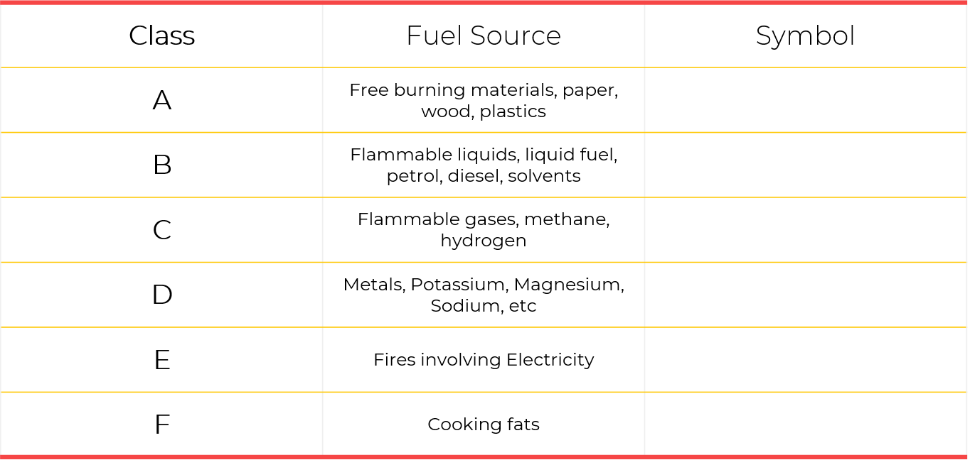






Classification of fire based on fuel sources
Notes:
Fire developed from different sources of fuel is classified differently. The extinguishing technique of one class differs from others therefore understanding of classification is necessary in order to understand the extinguishing phenomena
Number one is class A, the source of fuel in this type of fire burning is free materials, paper, wood, plastic etc – the symbol for this class of fire shows a fire burning in wood along with alphabet A
Number 2 is class B, the source of fuel in this type of class is flammable liquids, and liquids fuels like petrol, gasoline, diesel and other solvents. The symbol shows a fuel can in flames alongwith letter B
Number 3 is class C, the source of fuel in this class of fire is flammable gases, for example natural gas, methane, hydrogen, etc – the symbol is lamp with a flame along with letter C
Number 4 is class D, the source of fuel in this class of fire is metals, metals like potassium, megnesium and sodium – the symbile is the word METAL written along with a D in the box
Number 5 is class E, the fires involving electricity, the symbol is a electrical current
Number 6 is class F, which involves cooking fats. The symbol is a frying pan in fire along with letter F

Slide 60
British & US Classification of Fire
UK | US
Class A fires –solids like paper, wood, etc Class B fires –flammable liquids Class C fires –flammable gasses Class D fires –burning metals (eg aluminium swarf) Electrical fires (the letter E is not used. Instead the symbol of an electric spark is displayed) – are fires caused by electrical equipment Class F fires –fats such as used in deep fat fryers Reference https://www.firesafe.org.uk/portable-fire-extinguisher-general/ | Class A - combustibles like wood, cloth, and paper. Class B - Flammable liquids Class C - Energized electrical equipment, including wiring, fuse boxes, circuit breakers, machinery and appliances. Class D - Combustible metals such as magnesium or sodium. Reference http://www.americanfireandlifesafety.com/classes-of-fires.html
Notes:
There is a difference between the British and the US classification of Fire. The British system classification of Fire contain 6 classes from letter A to letter F, on the other hand US classification of Fire contain only four classes from letter A to letter D. In which there isn't any separate classification of flammable of gases.

Slide 61






How a fire is extinguished? Methods.
This process extinguishes the fire by lowering down its temperature.
Oxygen supply is decreased or cut down in this process.
This process chemically reacts with fire and then extinguishes it.
By removing the fuel burning in the fire.
Cooling
Cooling
Smothering
Smothering
Chemical Reaction
Chemical Reaction
Starvation
Cooling
Smothering
Chemical Reaction
Starvation
Starvation
Water
Foam
1
2
3
4
Powder/DCP
CO₂
Wet Chemical
Fire Blanket
Notes:
In general there are four methods of putting out a fire, cooling, smothering, by chemical reaction and starvation.
Water is used for cooling purposes, water has the tendency to increase its own temperature by absorbibg temperature of anthing it is in touch, we also know that heat travels from hotter substances to colder ones, thus heat transfers from fire to the water constituents
Foam, CO2, wet chemical and fire blanket, all of them act as a barrier between the oxygen supply and fire.
DCP extinguishes by performing chemical reaction with the fire
And by putting less material, less stock, gap between stocks we can extinguish fire through starvation.

Slide 62
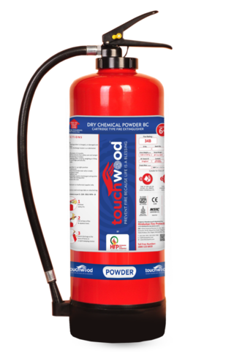





DCP – The Universal Fire Extinguisher
DCP stands for Dry Chemical Powder
Can be used in all types of fires
Extinguishers by chemically reacting with the combustion
Identification is blue color
Notes:
DCP (Dry chemical poweder) also called as ABC Fire Extinguisher is the most widely used fire extinguisher. This F/E can be used in class A, B, C, D and fires involving electricity
Extinguishers by chemically reacting with the combustion
Identification is blue color
Must not be used in confined space, as this can cause suffocation in a close room due to inhaling powder.

Slide 63
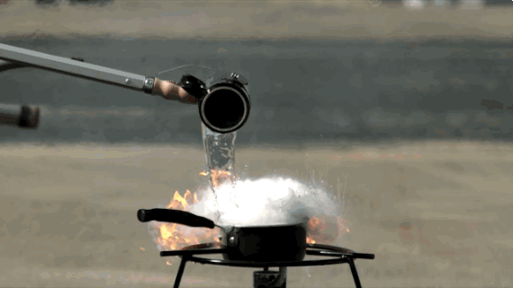
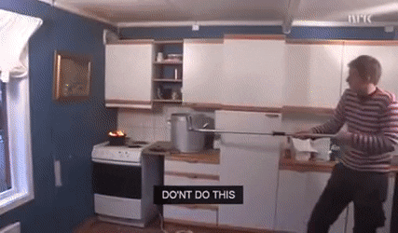
Why water is not used on liquid fuels?

Slide 64
CO2 – Fire Extinguisher
Extinguishers by removing oxygen and lowering temp
Best for class – B – liquid fuels
Safe to use in electricity related fires
Must not be used in confined areas
Notes:
Co2 is the second widely used fire extinguisher
It extinguishes by cooling as well as displacing oxygen from the environment
It is best to use on liquid fuels fire
Must not be used in confined spaces as it can cause suffocation
Best to use on Class B, Class C and Fires involving electricity

Slide 65
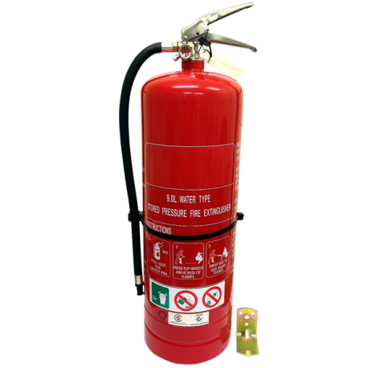
Water – Fire Extinguisher
Extinguishers by cooling – lowering temp
Best for class – A fires
Must not be used in electricity related fires & liquid fuel or cooking fats
Identification is red color
Notes:
Fire extinguishers that contain water are best for extinguishing class A fire.
They must not be used in fire involving electricity and those with liquid fuels.
We know that water in some conditions can conduct electricity this is the reason water extinguisher can not be used on electricity related fires.
Moreover, water must also not be used on liquid fueld and most importantly on cooking oil fire, because it can expand the fire and can harm more
In the next slides you can see the reason why water must not be used on cooking oils

Slide 66
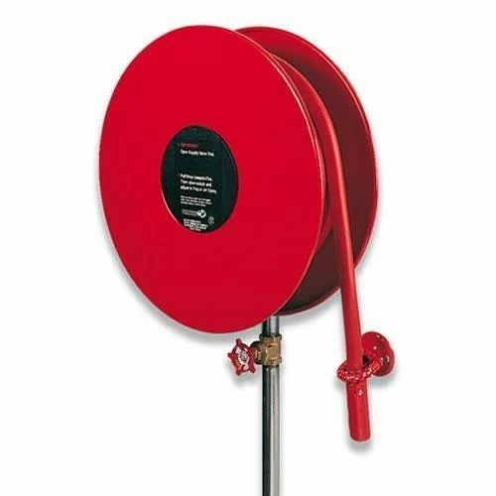
Fire Hose Reel System
The hose system is a firefighting appliance consisting essentially of cabinet, hose support, manual stop valve, lay flat hose with couplings, shut-off nozzle.
Water is been pressurized and circulated companywide through development of pressure from a fire hydrant
Notes:
Fire extinguishers that contain water are best for extinguishing class A fire.
They must not be used in fire involving electricity and those with liquid fuels.
We know that water in some conditions can conduct electricity this is the reason water extinguisher can not be used on electricity related fires.
Moreover, water must also not be used on liquid fueld and most importantly on cooking oil fire, because it can expand the fire and can harm more
In the next slides you can see the reason why water must not be used on cooking oils

Slide 67
Fire Hose Reel System
Fire hydrant system is powered by
  Electrical power – normal operations
  Diesel power in case of power cut off due to electrical fire
Notes:
Fire extinguishers that contain water are best for extinguishing class A fire.
They must not be used in fire involving electricity and those with liquid fuels.
We know that water in some conditions can conduct electricity this is the reason water extinguisher can not be used on electricity related fires.
Moreover, water must also not be used on liquid fueld and most importantly on cooking oil fire, because it can expand the fire and can harm more
In the next slides you can see the reason why water must not be used on cooking oils

Slide 68
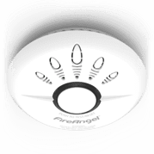
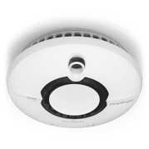
Different Types of
Fire Detector Heads (Sensors)
Smoke Detectors
Ionisation Smoke Alarms
Photoelectric (Optical) Alarms
Heat Detectors
Fixed temperature
Ionisation/Photoelectric (Multi-sensor) Alarms
Rate of temperature rise
Carbon Monoxide Detectors
For detection of CO
Notes:
The four types of fire detectors are heat, optical (ionisation), photoelectric, and ionisation/photoelectric. The differences in each of these are how they detect fires, heat being from temperature, and the other three being from smoke
Smoke Detectors
The three most common smoke detectors are ionisation, photoelectric, and combination ionisation/photoelectric. All smoke detectors sound an alarm, when they identify smoke, to notify a building’s occupants. What differentiates these detectors from one another is the way that they detect smoke.
Ionisation Smoke Alarms
These detectors are excellent at detecting fast-burning fires. These are the cheapest and cost very little to purchase. They are very sensitive to small particles of smoke produced by fast flaming fires, such as paper and wood, and will detect this type of fire before the smoke gets too thick.
Photoelectric (Optical) Alarms
These detectors are effective at detecting larger particles of smoke from slow-burning, ‘smouldering’ fires. They’re extremely reliable and produce few false alarms. These are more expensive but more effective at detecting larger particles of smoke produced by slow-burning fires than an ionisation smoke detector.
Ionisation/Photoelectric (Multi-sensor) Alarms
They are designed to be sensitive to a wide range of fires and provide a faster reaction to both fast-flaming and slow smouldering fires. As a result, BS 5839-6:2019+A1:2020 recommends the use of multi-sensor technology in all rooms except the kitchen. As the unit monitors for two different by-products of fires (smoke and temperature), its response to all types of fire is vastly improved over traditional single-sensor alarms. They are also less prone to false alarms associated with ionisation and optical type alarms.
Heat Detectors
These can detect an increase in temperature and are insensitive to smoke. Heat detectors detect the presence of heat and an increase in air temperature. These detectors have few false alarms but, they take longer to identify a fire than a smoke detector. They are ideal in situations where smoke detectors may cause false alarms such as steamy, humid, or dusty environments and therefore best suited for kitchens, garages, and lofts.
Heat sensitive point detectors
Fixed temperature – which will operate when it is exposed to a pre-determined temperature. Normally fixed temperature detectors employ a fusible alloy element that must be replaced after the detector has operated. Different temperature-rated elements are available to take into account varying ambient air temperatures.
The second type operates on the rate of temperature rise. The rate of rise temperature detector may also include a fusible element for fixed temperature operation.
Carbon Monoxide Detectors

Slide 69
“Don’t let your dreams go up in the smoke, practice fire safety!
Notes:
“Don’t let your dreams go up in the smoke, practice fire safety!

Slide 70
4.
BASICS OF BEHAVIOUR BASED SAFETY
What is behavior, behavioral assessment, observation and reinforcement!
Notes:
In chapter 4 we will study about BASICS OF BEHAVIOUR BASED SAFETY- we will mainly cover What is behavior, behavioral assessment, observation and reinforcement!

Slide 71
Risk Assessment
Behavior
Based
Safety
In the 1930’s, Heinrich reported that about 90% of all accidents involving fatalities, major and minor injuries were caused by “unsafe behavior” by workers. Behavior Based Safety was developed in the 1970s.
To examine
Notes:
Behavior Based Safety
In the 1930’s, Heinrich reported that about 90% of all accidents involving fatalities, major and minor injuries were caused by “unsafe behavior” by workers. Behavior Based Safety was developed in the 1970s.

Slide 72
Some definitions!
Behavior is what a person does or says
And our behavior is shaped by attitude and circumstances.
Behavior based safety
Is a safety management program and it specifies exactly what behaviors are required from everyone in order to have a safe work environment
Monitoring
The system must have controls in place to monitor whether or not these behaviors are being practiced routinely within the working environment
Notes:
Behavior is what a person does or says
And our behavior is shaped by attitude and circumstances.
Behavior based safety
Is a safety management program and it specifies exactly what behaviors are required from everyone in order to have a safe work environment
Monitoring
The system must have controls in place to monitor whether or not these behaviors are being practiced routinely within the working environment

Slide 73

Why BBS Program?
A good BBS program will help you in:
Reduce incidents (i.e. nearmisses, accidents, injuries, property damages)
Improve quality
Reduce absenteeism
Maintain a healthier workforce
Improve workers feeling about their work
Reduce workers compensation costs
Elevate safety benchmark
Notes:
A good BBS program will help you in:
Reduce incidents (i.e. nearmisses, accidents, injuries, property damages)
Improve quality
Reduce absenteeism
Maintain a healthier workforce
Improve workers feeling about their work
Reduce workers compensation costs
Elevate safety benchmark

Slide 74
Behavior Based Safety Program
Lack of training
Negative Behavior
Find Motives
Address it
Poor health condition
Observe Behavior
Money
Personal problems
Positive Behavior
Reinforce it
Training
Participation
Notes:
So this is how a Behavior Based Safety Program works
After defining the leadership commitment, job roles and responsibilities, safe work practices,
Behavior observation is done, this can be done through any development of checklist in which all the safe behaviors will be listed which must be done while performing the job – make sure that the team members must know that they are been observed
During the observation you will came across two types of behavior, it can be either negative or positive,
In case of identification of negative behavior you have to adderss it, do the root cause analysis and find the cause and take action accordingly,
Common root causes in this manner might be lack of training, poor health condition or personal problem, even if the personal proble is beyond office life you msut truy to address it as much as been allowed in office policies
In case of positive behavior, you msut reinforce it, reinforcement increases the likelihood of the safe act, you can reinfore it by three common mechanism,
Monetory compensation, award them financially, this will not also motivate him but also cause him to repeat those actions
Training, provision of traiing is also a reinforcement technique
And participation, which is also a appreaciation mechanism
Regarding punishment, punishment is counter effective and will likely to increase unsafe acts and is been proven in research

Slide 75

Behavior must be observed so that you can understand it and can develop the list of safe (acceptable) behavior.
Observing Behavior
Observe to reinforce
Notes:
Observing Behavior - Observe to reinforce
Behavior must be observed so that you can understand it and can develop the list of safe (acceptable) behavior.
Remember: Determining safe behaviours will vary by job or department and will change as work conditions or equipment change. Make sure your team members understand this.

Slide 76
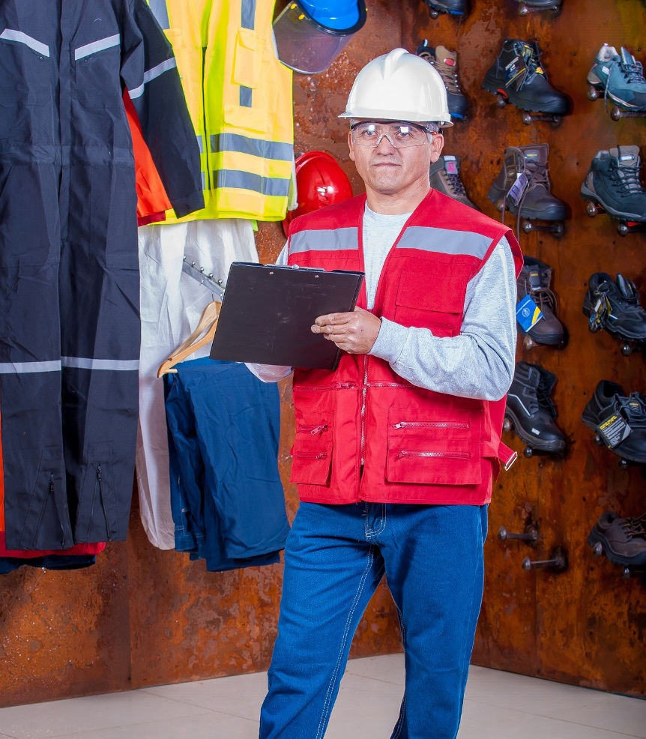
Observation Guideline
Things to remember when you are observing behaviors
Establish criteria for observation, effective planning required.
Observe frequently and at different times
Ensure that your teams know that they are been observed
Define the safe behavior that you are looking for
Develop a checklist to help you
Make notes and compile a detailed report afterwards
Notes:
Things to remember when you are observing behaviors
Establish criteria for observation, effective planning required.
Observe frequently and at different times
Ensure that your teams know that they are been observed
Define the safe behavior that you are looking for
Develop a checklist to help you
Make notes and compile a detailed report afterwards

Slide 77

The positive feedback which increases the likelihood of acceptable (safe) behaviors.
Reinforcement
The fuel to good behaviour
Notes:
Reinforcement
The fuel to good behaviour
The positive feedback which increases the likelihood of acceptable (safe) behaviors.
Remember: Determining safe behaviours will vary by job or department and will change as work conditions or equipment change. Make sure your team members understand this.

Slide 78


Reinforcement guidelines
Reinforce immediately – during act
Do it frequently
Reinforce safe behavior ONLY
Be specific about the behavior you are enforcing
Use positive body language, smiles
Use positive language
Notes:
Reinforcement guidelines
Reinforce immediately – during act
Do it frequently
Reinforce safe behavior ONLY
Be specific about the behavior you are enforcing
Use positive body language, smiles
Use positive language

Slide 79



Motivation
Motivation Changes Attitude & Attitude Drives Behavior
Money, is a technique of motivation, which include cash reward, salary increase, overtime, bonus system, safe behavior points in the appraisal system.
Positive Reinforcement, i.e. positive feedback upon safe behavior, this can also include training and re-training.
Employee Participation, people are motivated when they are involved and consulted. This is why it is also added in
ISO 45001:2018.
Notes:
When all other reasons for unacceptable behaviour have been removed, what is left is usually attitudinal.
Motivation Changes Attitude & Attitude Drives Behavior
There are three motivation techniques that can change attitude
Number 01 is Money, money is a technique of motivation, which include cash reward, salary increase, overtime, bonus system, safe behavior points in the appraisal system.
Number 02 is Positive Reinforcement, i.e. positive feedback upon safe behavior, this can also include training and re-training. Research has defined that positive reinforcement causes to increase the number of repetitions of safe acts
Number 03 is Employee Participation, people are motivated when they are involved and consulted. This is why participation clause it is also added in the new version of ISO 45001:2018

Slide 80
5.
INFORMATION ABOUT IOSH, OSHA, ISO 45001 & 14001, NEBOSH & NFPA
How these organizations can help us in HSE
Notes:
In chapter 5 we will study about some of the organization which makes standards, laws, guidelines related to health safety and environment, we will study how these organizations work and can help us in getting knowledge and guidance in implementation of health safety and environment

Slide 81

IOSH stands for Institution of Occupational Safety and Health
A global organization for health and safety professionals, based in UK
Provides support, advise, advocacy and training to health and safety professionals
IOSH provides memberships which are accepted globally
Notes:
IOSH stands for Institution of Occupational Safety and Health
A global organization for health and safety professionals, based in UK
Provides support, advise, advocacy and training to health and safety professionals
IOSH provides memberships which are accepted globally

Slide 82
IOSH Membership
Any HSE professional can get their membership – they have various levels of memberships offered:
  Student Member
  Affiliate Member
  Associate Member (AIOSH)
  Technical Member (TechIOSH)
  Graduate Member (GradIOSH)
  Chartered Member (CMIOSH)
The instructor providing you this training is GradIOSH, which is the second most senior IOSH membership
Notes:
Any HSE professional can get their membership – they have various levels of memberships offered:
Student Member
Affiliate Member
Associate Member (AIOSH)
Technical Member (TechIOSH)
Graduate Member (GradIOSH)
Chartered Member (CMIOSH)
The instructor providing you this training is GradIOSH, which is the second most senior IOSH membership

Slide 83
IOSH Membership Benefit
Every level has different benefits, but common ones are
World wide recognition, IOSH certificates are accepted and recognized anywhere in the world
A wide range of online learning content and business skills resources
Career guidance, CV building, interview preparation through IOSH Career Hub
Notes:
IOSH Membership Benefit
Every level has different benefits, but common ones are
World wide recognition, IOSH certificates are accepted and recognized anywhere in the world, if you are an IOSH graduate you can get admission in the upper level degree programs worldwide
A wide range of online learning content and business skills resources which can be easily available for downloading and can be used for implementation and training purposes
Career guidance, CV building, interview preparation through IOSH Career Hub which can support a HSE professional in development of his career path, provide guidance on how to prepare for interviews, apply and get a relevant job

Slide 84

Stands for Occupational Safety and Health Administration
Section of USA Department of Labor
Provides laws and regulations available for almost all areas of health and safety
Tons of trainings and already prepared ppts are available so you can easily understand and deliver
Notes:
OSHA stands for Occupational Safety and Health Administration
It is a section of USA Department of Labor
It provides laws and regulations available for almost all areas of health and safety, which can be used as reference in implementation of health and safety management systems in organizations
The website contain tons of trainings and already prepared ppts which you can easily access, understand and deliver

Slide 85

ISO STANDARDS
ISO
Is the abbreviation of International Organization of Standardization. It’s a NGO which is established in Geneva in 1947
Has a membership of more than 160 national standards institutes from countries in all region of the world.
There are more than 18000 standards which are developed by the ISO
More than one million certificates issued to companies worldwide
Notes:
ISO is the abbreviation of International Organization of Standardization. It’s a NGO which is established in Geneva in 1947
Has a membership of more than 160 national standards institutes from countries in all region of the world.
There are more than 18000 standards which are developed by the ISO which are related to health and safety, quality, environment, information security, anti bribing, lab accreditations etc
More than one million certificates issued to companies worldwide every year

Slide 86
ISO 45001
ISO 45001:2018 is the Occupational Safety & Health Management System Standard
It replaces previous standard of OHSAS 18001:2007
Its is based on PDCA cycle
Notes:
ISO 45001:2018 is the Occupational Safety & Health Management System Standard
It replaces previous standard of OHSAS 18001:2007
Its is based on PDCA cycle

Slide 87
ISO 14001
ISO 14001:2015 is the latest version of the Environment Management System (EMS)
ISO 14001 provides requirements with guidance for use that relate to environmental systems.
Focus on life-cycle thinking
Notes:
ISO 14001:2015 is the latest version of the Environment Management System (EMS)
ISO 14001 provides requirements with guidance for use that relate to environmental systems.
Focus on life-cycle thinking – which means that every resource which is consumed by the organization is chased till the maximum extent in order to see if the remains of that are harming the environment or not, in case they are harming then efforts must be done in order to decrease those harmful effects

Slide 88
National Examination Board in Occupational Safety and Health
NEBOSH
UK-based examination board
Offering qualifications and courses in health, safety, environment and well-being management
Founded in 1979
Awards, Certificates, Diplomas & Masters

Slide 89
NEBOSH
AWARD: provide a general understanding of health and safety principles and practices
CERTIFICATE: provide an excellent foundation in health and safety for managers, supervisors

Slide 90
NEBOSH
DIPLOMAS: NEBOSH's Diplomas are professional qualifications for health, safety and environmental practitioners.
MASTERS: Learning at Masters-level in partnership with the University of Hull. For Diploma Holders

Slide 91
National Fire Protection Association
NFPA
International nonprofit organization devoted to eliminating death, injury, property and economic loss due to fire, electrical and related hazards
NFPA publishes more than 300 consensus codes

Slide 92
National Fire Protection Association
NFPA
NFPA 1 Fire Code
NFPA 2 Hydrogen Technologies Code
NFPA 10 Standard for Portable Fire Extinguishers
NFPA 30B Code for the Manufacture and Storage of Aerosol Products

Slide 93
National Fire Protection Association
NFPA
NFPA 70E® Standard for Electrical Safety in the Workplace®
NFPA 72® National Fire Alarm and Signaling Code®
NFPA 86 Standard for Ovens and Furnaces

Slide 94
300,000
171
More than 300,000 companies are certified for ISO 14001
Companies certified in 171 countries
Notes:
More than 300,000 companies are certified for ISO 14001
Companies are certified in 171 countries on ISO 14001

Slide 95
6. FREQUENTLY ASKED QUESTIONS (FAQs)
Some FAQs
Notes:
Chapter number 6. FREQUENTLY ASKED QUESTIONS (FAQs) –

Slide 96

Is it necessary to comply to HSE requirements?
Yes, legally in most of the countries of the world, health, safety and environment regulations are part of the law. If you or your firm are not following it then it can result in warnings, penalities and in some cases law suits and jailtime as well.
Also, it is also your moral duty. Apart from factories and indutries even if you are deploying someone in your home for maitnenance work, you should provide him with all safety precautions as well.
Notes:
Is it necessary to comply to HSE requirements?
Yes, legally in most of the countries of the world, health, safety and environment regulations are part of the law. If you or your firm are not folowing it then it can result in warnings, penalities and in some cases law suits and jailtime as well.
Also, it is also your moral duty. Apart from factories and indutries even if you are deploying someone in your home for maitnenance work, you should provide him with all safety precautions as well.

Slide 97

Do we need to apply for ISO certifications?
Not really, it is a volunteer choice. You can follow the standard and not opt for certification. Its up to the decision of firm according to their feasibility.
Notes:
Do we need to apply for ISO certifications?
Not really, it is a volunteer choice. You can follow the standard and not opt for certification. Its up to the decision of firm according to their feasibility.

Slide 98

It is necessary to provide the helmet, safety shoes and safety vest to all of my team members?
This is not a thumb rule! PPEs are the last resort in the risk control techniques.
Also the provision of PPEs is dependent on the risk associated, for e.g. a safety shoes will not be necessary if there isn’t any risk associated with it.
Moreover, it is the duty of the employer to provide PPEs
Notes:
It is necessary to provide the helmet, safety shoes and safety vest to all of my team members?
This is not a thumb rule! PPEs are the last resort in the risk control techniques.
Also the provision of PPEs is dependent on the risk associated, for e.g. a safety shoes will not be necessary if there isn’t any risk associated with it.
Moreover, it is the duty of the employer to provide PPEs

Slide 99
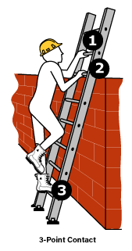
What is work at height?
If you are working above the ground level and if falling from that height can cause a personal injury, this is called working at height.
Slips or trips are risks that are additional to this riks, work at height will be considered and taken as a separate risk in any risk assessment.
Notes:
What is work at height?
If you are working above the ground level and if falling from that height can cause a personal injury, this is called working at height.
Slips or trips are risks that are additional to this riks, work at height will be considered and taken as a separate risk in any risk assessment.

Slide 100
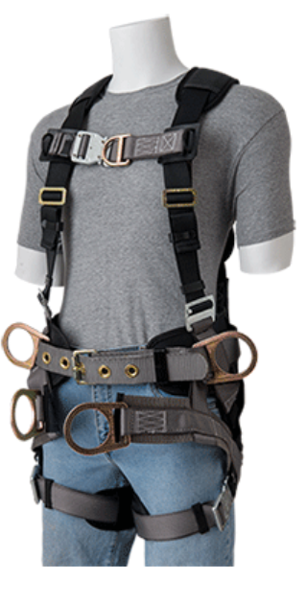
Do you always require safety harness when working at height?
It depends on situation to situation. Before carrying out any work at height activity first of all plan and organize it, ensure those who are working are competent, risk assessment must be done! The equipment used for work at height is properly inspected and maintained.
In many situations safety harness might not be a need.
Notes:
Do you always requre safety harness when working at height?
It depends on situation to situation. Before carrying out any work at height activity first of all plan and organize it, ensure those who are working are competent, risk assessment must be done! The equipment used for work at height is properly inspected and maintained.
In many situations safety harness might not be a need.

Slide 101
Is psychological safety is part of health and safety at work?
Indeed yes! Psychological risks must be considered while performing risk assessment of any firm. Employers must take steps to manage these to minimize psychological risks.
Also as an employee, you are responsible to look after your own health and to keep yourself fit for work. In case of any ambiguity, must discuss this with your employer.
Notes:
Is psychological safety is part of health and safety at work?
Indeed yes! Psychological risks must be considered while performing risk assessment of any firm. Employers must take steps to manage these to minimize psychological risks.
Also as an employee, you have you are responsible to look after your own health and to keep yourself fit for work. In case of any ambiguity, must discuss this with your employer.

Slide 102
Can a first aider administer painkillers/headache tablets?
First aid does not cover the administration of drugs or medications.
Moreover, drugs and medications should not be kept in the workplace first aid box or kit.
Notes:
Can a first aider administer painkillers/headache tablets?
First aid does not cover the administration of drugs or medications.
Moreover, drugs and medications should not be kept in the workplace first aid box or kit.

Slide 103
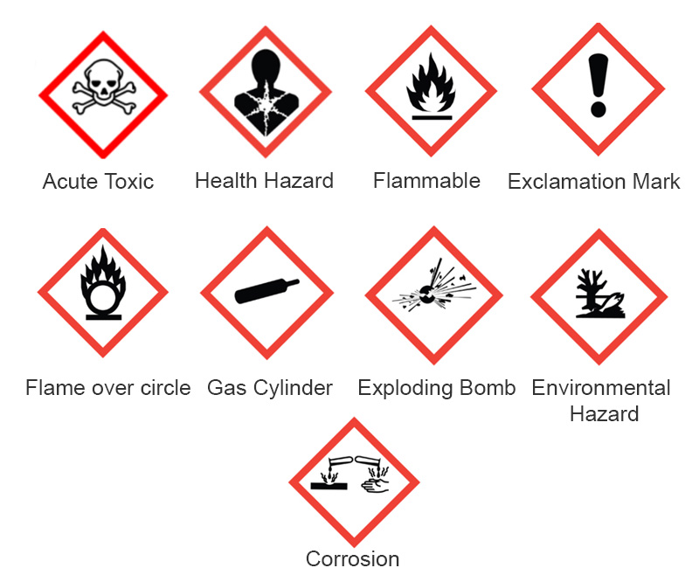
How to handle chemicals safely?
Every chemical comes with a Material Safety Data Sheet (MSDS) or Safety Data Sheet (SDS), which details about how to handle that specific chemical.
Notes:
Every chemical comes with a Material Safety Data Sheet (MSDS) or Safety Data Sheet (SDS), which details about how to handle that specific chemical.
In order to handle that specific chemicals the details are mentioned in MSDS. Safety precautions are part of MSDS.

Slide 104
In metal fires, what is the metal?
Because of its flash point is low in air.
Notes:
Can a first aider administer painkillers/headache tablets?
First aid does not cover the administration of drugs or medications.
Moreover, drugs and medications should not be kept in the workplace first aid box or kit.

Slide 105
PTW?
Doest work permit include assessment
Because of its flash point is low in air.
Notes:
Can a first aider administer painkillers/headache tablets?
First aid does not cover the administration of drugs or medications.
Moreover, drugs and medications should not be kept in the workplace first aid box or kit.

Slide 106
How to handle chemicals safely?
In order to handle that specific chemicals the details are mentioned in MSDS. Safety precautions are part of MSDS.
Notes:
Every chemical comes with a Material Safety Data Sheet (MSDS) or Safety Data Sheet (SDS), which details about how to handle that specific chemical.
In order to handle that specific chemicals the details are mentioned in MSDS. Safety precautions are part of MSDS.

Slide 107



