Slide 1
SBP Refinance Schemes
Development Finance Support Department
SBP-Banking Services Corporation

Slide 2
SBP’s Refinance Schemes
Financing Scheme for Renewable Energy
Export Finance Scheme
Long Term Financing Facility
Refinance Facility for Modernization of SMEs
Refinance Scheme for Working Capital Financing of Small Enterprises and Low-End Medium Enterprises
Small Enterprise (SE) Financing and Credit Guarantee Scheme for Special Persons
Financing Facility for Storage of Agriculture Produce

Slide 3
Definition of SEs and MEs
Small Enterprise (SE):
Medium Enterprise (ME):
Number of Employees* | Up to 50
Annual Sales Turnover | Up to Rs. 150 million
Number of Employees | 51-250 (Manufacturing & Service) 51-100 (Trading)
Annual Sales Turnover | Above Rs. 150 million and up to Rs. 800 million (All types of MEs)
An entity has to fulfill both the criteria of number of employees and sales turnover for categorization as small or medium enterprise

Slide 4
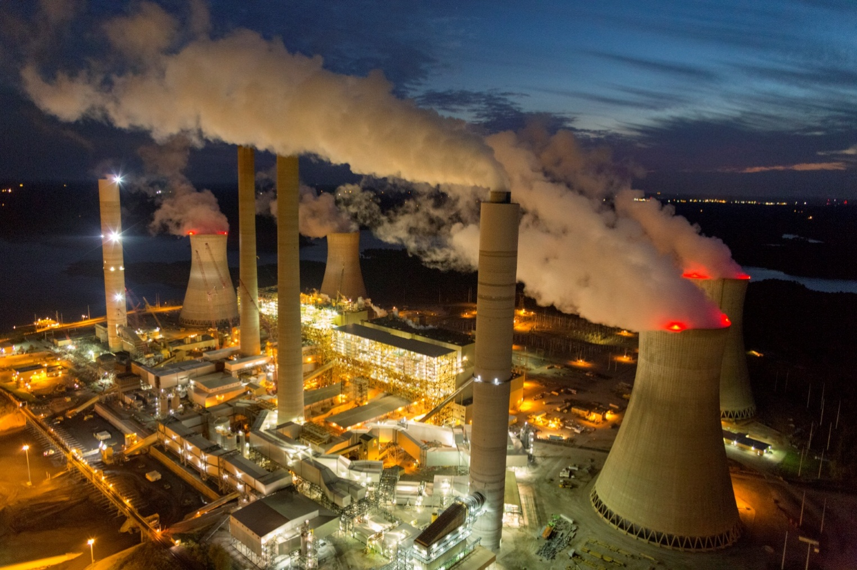
FINANCING scheme for RENEWABLE ENERGY

Slide 5
SBP Financing Scheme for Renewable Energy Eligibility Criteria
Category I | Prospective sponsors, desirous of setting up renewable energy power projects with a capacity ranging from more than 1 MW and up-to 50 MW for their own use, selling of electricity to the national grid (including distribution companies) or combination of both.
Category II | Prospective sponsors, desirous of installing renewable energy source based projects/ solutions for generation of electricity up-to 1 MW.
Category III | Vendors/ suppliers/ energy sale company desirous of installing wind and/or solar projects/ solutions of up-to 5 MW on lease, sale (including deferred payment sale), rent basis or selling of electricity to ultimate owners/ users. Vendors/ suppliers are required to be certified under AEDB Certification Regulations. In case of energy sale, vendors/suppliers/EPC contractors of an energy sale company are required to be AEDB certified.
Shariah compliant alternate of this scheme is also available.

Slide 6
SBP Financing Scheme for Renewable Energy Financing Limit and SBP Refinance
Financing Limit
Category I | Rs 06 billion for a single project
Category II | Rs 400 million for a single borrower
Category III | Rs 02 billion for a single vendor/ supplier/ energy sale company
SBP Refinance
Category I | SBP Refinance shall be up-to 100% of total financing (debt) of an eligible RE project of upto 20 MW and up-to 50% of financing (debt) of an eligible RE Project of more than 20 MW.
Category II | SBP Refinance shall be up-to 100% of financing to the eligible borrowers.
Category III | SBP Refinance shall be up-to 100% of financing to the eligible borrowers.

Slide 7
SBP Financing Scheme for Renewable Energy Service Charges and Rates for End Users
 | SBP Service Charges/ Refinance Rate | Maximum bank/ DFI’s Spread | Maximum End User Rate
Category I | 3% | 3% | 6%
Category II | 2% | 4% | 6%
Category III | 3% | 3% | 6%

Slide 8
SBP Financing Scheme for Renewable Energy Period and Repayment of Financing
 | Period of Financing | Repayment
Category I | Maximum twelve (12) years, including maximum grace period of two (02) years | Principal repayable in quarterly or half yearly installments Mark-up repayable on quarterly basis.
Category II | Maximum ten (10) years, including maximum grace period of three (03) months. | Principal repayable in monthly, quarterly or half yearly installments. Mark-up repayable on monthly or quarterly basis.
Category III | Maximum ten (10) years including maximum grace period of six (06) months | Principal repayable in monthly, quarterly or half yearly installments. Mark-up repayable on monthly or quarterly basis.

Slide 9
Export Finance Scheme (efs)
Courtesy: Dawn, Pakistan

Slide 10
Export Finance Scheme
A short term (180 days) financing facility for export of value added items
Consists of two parts:
Part-I (Transaction Based)
Part-II (Performance Based)
All commodities are eligible except those mentioned in the negative list
Prevailing rate for exporters is 3% (Bank’s spread for SME 2% & Corporates 1%)
0.5% - 1.5% performance based markup rebate under EFS Part-II
The financing facility is also available under Islamic mode

Slide 11
Export Finance Scheme
EFS Part-I
(Transaction Based)
Facility available to Direct Exporters (DE) (including commercial exporters & trading companies) & Indirect Exporters (IDE)
EFS Part – II
(Performance Based)
Performance based facility – limit based on performance of the exporter
Coverage to the extent of 100% of export order/ LC/contract, in case of financing for 180 days.
Performance required against every transaction.
Exporters are entitled a revolving limit equivalent to 50% of their total value of export proceeds realized in the previous year.
The exporter is required to show annual export performance (realized value of export proceeds) by exporting at least twice of its borrowings on average daily product basis. For FY 2019-20 and FY 2020-21 the export performance requirement has been reduced from 2 time to 1.5 times due to COVID-19.
Entitlement is determined on the basis of EE-1 Statement (that includes export proceeds from exports of eligible items in previous year under both parts of EFS).
0.5% - 2% performance based markup rebate under EFS Part-II
Facility available at both pre & post shipment stages to DEs.

Slide 12
Performance Based Lower Mark up Rates under Export Finance Scheme
Performance Requirement | Reimbursement Benefit in Existing Markup for Corporate Borrowers | Reimbursement Benefit in Existing Markup to SME Borrowers
2.00 to 3.00 times | NIL | NIL
3.01 to 4.00 times | 0.5% | 1%
4.01 to 5.00 times | 1% | 1%*
Above 5.0 times | 1.5% | 1%*
*In no case, SBP refinance rate shall fall below 0%

Slide 13
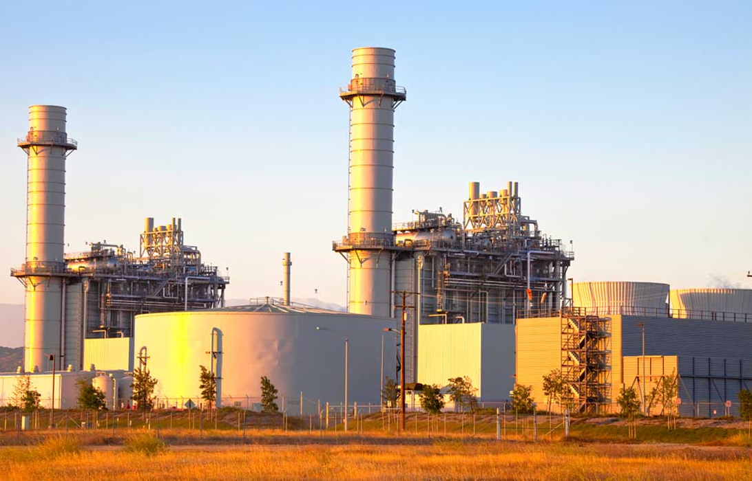
Long Term Financing Facility (LTFF)

Slide 14
LTFF-Scope & Eligibility
Purpose: Long term local currency finance for imported and locally manufactured new plant and machinery
Eligibility: Available to the export-oriented projects only if their annual export is equivalent to US $5 million or at least 50% of the sales whichever is lower
PFIs: Financing is available through banks/ DFIs approved as PFIs
Financing Limit: Maximum borrowing limit for a single export oriented unit is Rs.5 billion for New projects; and BMR/ upgradation of those projects.
Tenor: Financing shall be available for a maximum period of 10 years including a maximum grace period of 2 years.
Scope of LTFF/ILTFF has been extended to all sectors, which are allowed as per Export Policy Order issued by Ministry of Commerce from time to time.
Shariah compliant alternate of this product is available.
Notes:
i). Scope and Eligibility
Under this facility, Participating Financial Institutions (PFIs) can provide long term local currency finance for imported and locally manufactured new plant and machinery to be used by the export oriented projects (see list of sectors eligible for financing under this facility).
The facility shall be available to the export oriented projects only if their annual export is equivalent to US $5 million or at least 50% of the sales whichever is lower.
Financing shall be available through banks / DFIs approved as PFIs; list of which is given in Annexure‐I. Other banks/ DFIs can also lodge their requests to I.H. & SME Finance Department of SBP for seeking the status of a PFI which shall be processed as per SBP’s criteria. Further, for the provision of facility through Islamic Banks SBP will issue separate instructions regarding Shariah Compliant Product of LTFF.
Maximum borrowing limit for a single export oriented unit is Rs 1.5 billion under LTFF.
Financing shall be available for a maximum period of 10 years including a maximum grace period of 2 years.

Slide 15
LTFF Rates of Service Charges
Period of financing | Rate of Refinance | PFI Spread | End User’s rate
Up‐to 3 years | 3.50% | 1.50 % | 5.00%
3‐5 Years | 2.50% | 2.50 % | 5.00%
5‐10 Years | 2.00% | 3.00 % | 5.00%
Notes:
ii) Rates of Service Charges
The rate of service charge at which SBP will provide refinance to the banks/DFIs shall be determined on the basis of/ reference to the average of weighted average yields of last two auctions of 3, 5 and 10 years PIBs subject to the following;
The rate of service charges once fixed shall remain locked‐in for the entire duration of the loan, provided the borrowers continue to repay all scheduled installments at the respective due dates.
In cases where the loan amount has not been disbursed in full during the validity of an applicable rate, the un‐disbursed amount shall attract the new rate of finance/refinance applicable on the date of its disbursement by the bank/DFI.

Slide 16
LTFF Terms & Conditions
The cost of insurance, transit insurance, erection and commissioning charges and other incidentals (including transportation charges, in case of locally manufactured machinery) etc.; shall not be financed under the facility.
PFIs may also consider financing requests of new projects and expansion of existing projects on the basis of projected exports as under:
Export-oriented SME borrowers may purchase imported machinery from the commercial importers or authorized dealers of the foreign manufacturers in Pakistan and authorized suppliers in case of locally manufactured machinery and plant.
Financing is available against Letter of Credit only, to the extent of the C&F value of imported machinery and ex-factory / showroom price of locally manufactured machinery.
Exports in First Two Years | US$ 2 million or 20% of total sales of the project, whichever is lower.
Exports in Third Year | US$ 3 million or 30% of sales, whichever is lower.
Exports in Fourth Year | US$ 5 million or 50% of sales, whichever is lower.
Notes:
iv). Terms & Conditions:
The cost of insurance, transit insurance, erection and commissioning charges and other incidentals (including transportation charges, in case of locally manufactured machinery) etc; shall not be financed under the facility.
The PFIs can also consider the requests of new export oriented projects on the basis of projected exports. A criterion in this regard is given in SMEFD Circular Letter No 05 dated February 14, 2011 read with SMEFD Circular Letter No 05 dated April 22, 2010.
Further, in case of new projects, sponsor will be required to contribute their equity share in an escrow account maintained with the PFI. The proceeds in the said account shall be used by the sponsors only for the purpose of setting up of the project/payment to the supplier etc; representing his equity share in the project. However, where sponsor(s) of the project have already invested their entire share of equity in the project in the form of land, construction of building etc., the same shall be treated as ‘equity’ of the sponsor and the condition of maintaining an escrow account may not be required provided overall debt/equity ratio is met. The lending PFI should place a certificate on record in this regard in the relevant credit file for subsequent inspection by our BID.
Export oriented SME borrowers (as defined in Prudential Regulations for SMEs), may purchase imported machinery from the commercial importers or authorized dealers of the foreign manufacturers in Pakistan and authorized suppliers in case of locally manufactured machinery and plant.

Slide 17
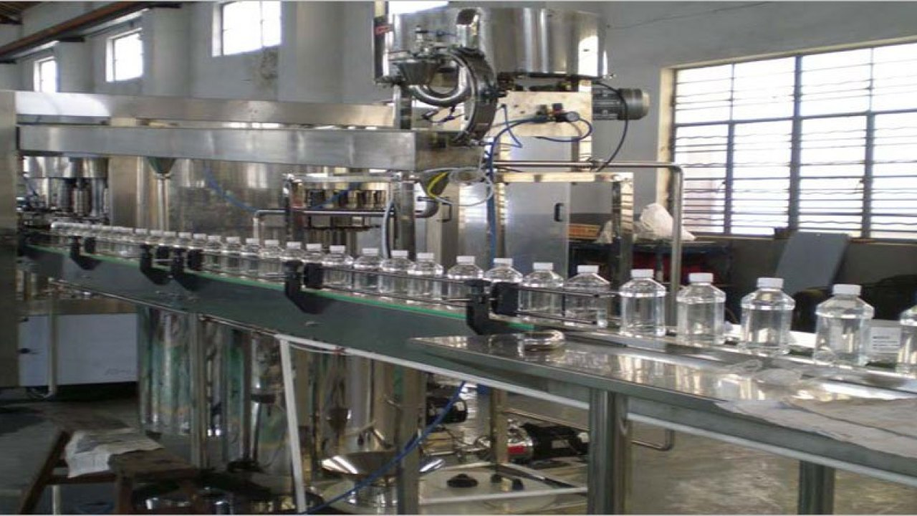
REFINANCE FACILITY FOR MODERNIZATION OF SMEs

Slide 18
Refinance Facility for Modernization of SMEs Scope and Eligibility
Target Segment: Financing is available to wide range of SME Clusters/ Sectors
Eligibility: Only SME borrowers, as defined in Prudential Regulations for SMEs, are eligible to avail financing facilities under the Scheme.
Purpose: Financing is available for:
purchase of new imported/ local plant & machinery for BMR of existing units and setting up of new SME units
import/ local purchase of new generators up‐to a maximum capacity of 500 KVA.
carrying out civil works up-to 20% of total project cost for conversion of conventional brick kiln and up-to 50% of total project cost for establishment of a new zigzag technology based brick kiln
Participating Financial Institutions: All commercial banks and Development Finance Institutions (DFIs)
Tenor: Maximum period 10 years including a maximum grace period of 6 months
The rate of service charges is 6% p.a.
Shariah compliant alternate of this product is also available.
Notes:
i). Scope and Eligibility
Financing shall be available to wide range of SME Clusters / Sectors.
Only SME borrowers, as defined in Prudential Regulations for SMEs, shall be eligible to avail financing facilities under the Scheme.
Financing shall be available for purchase of new imported/local plant & machinery for BMR of existing units and setting up of new SME units.
Financing shall also be available for import/ local purchase of new generators up‐to a maximum capacity of 500 KVA under the Scheme. The capacity of generator shall, however, not be in excess of SME Unit’s in‐house energy requirements or up‐to 500 KVA, whichever is less.
Financing facilities shall be available through all commercial banks and Development Finance Institutions (DFIs).
Financing shall be available for a maximum period of ten years including a maximum grace period of six months.
Financing under the Facility will be available till further instructions.

Slide 19
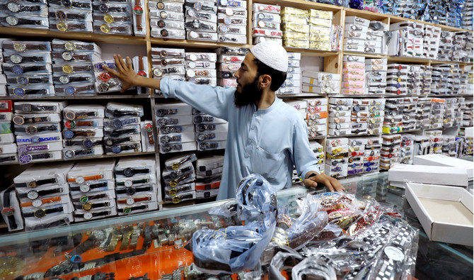
Refinance Scheme for Working Capital Financing of Small Enterprises and Low-End Medium Enterprises
Courtesy: Arab new pk

Slide 20
Refinance Scheme for Working Capital Financing of Small Enterprises and Low-End Medium Enterprises
Brief Description | Financing is initially available to meet working capital requirements of below mentioned sectors: 1- Information Technology 2- Gems & Jewelry 3- Furniture 4- Leather Industry 5- Surgical Goods 6- Fruits, vegetables, food processing & packaging 7- Date Processing 8- Printing & Packaging
Rate of Mark up | End user rate 6% with banks’ spread of 4% SBP rate is 2%
Eligible Enterprises | All small enterprises (SEs)as per SBP’s PRs Medium enterprises (MEs) with annual sales of Rs 300 million
Financing Amount | Upto Rs 25 million for SEs and Upto Rs 50 million for MEs
Financing Tenor | Maximum financing tenor is 1 year
Shariah compliant alternate of this product is available.

Slide 21
Small Enterprise (SE) Financing and Credit Guarantee Scheme for Special Persons

Slide 22
Small Enterprise (SE) Financing and Credit Guarantee Scheme for Special Persons
Scope | Special persons holding CNIC with disability logo/ symbol will be provided finance for setting up of new business enterprises or for expansion of existing ones
Financing Limit | Up to Rs 1.5 million
Refinance | Up to 100% by SBP. SBP will provide refinance to Participating Financial Institutions at 0%.
Risk Coverage | 60% of outstanding loan (principal portion only)
Tenor | Up to 5 years with grace period of up to 6 months
Mark up Rate | End user rate will be up to 5% per annum (p.a.)
PFIs | All Banks/ DFIs

Slide 23
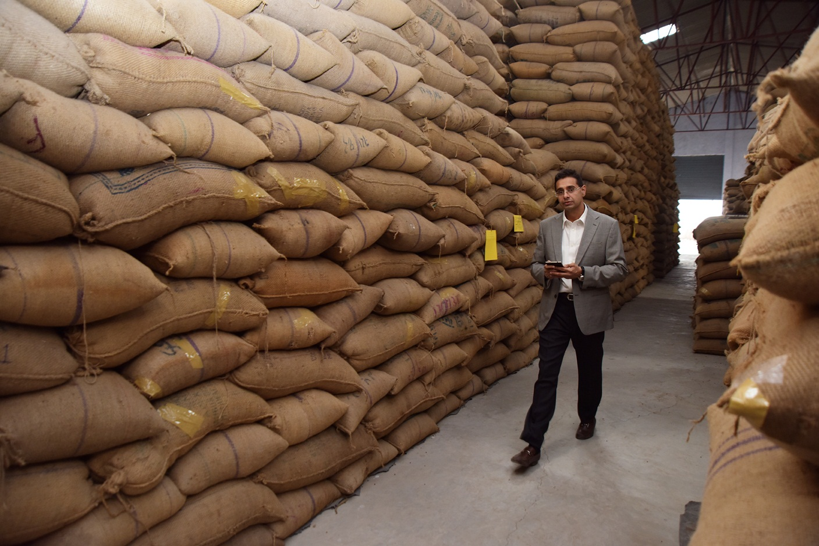
FINANCING FACILITY FOR STORAGE OF AGRICULTURAL PRODUCE (FFSAP)

Slide 24
FFSAP - Scope and Eligibility
Purpose: To encourage private sector to establish Silos, Warehouses & Cold Storages
Target Segment: Financing is available for establishment/ expansion/ BMR of Silos, Warehouses & Cold Storages facilities for storing agricultural produce. Financing for local purchase/ import of new machinery, equipment accessories, generators (the capacity of generator shall, however, not be in excess of in-house energy requirements) thereof used in steel/ metal/ concrete silos, warehouses and cold storages. Further, up to 65% cost of civil works is also eligible under the Scheme.
Financing Amount: Maximum financing to a single commercial project is Rs 500 million under the Facility.
Maximum financing to a single SME project is Rs 200 million under the Facility.
Participating Financial Institutions: Available through all commercial banks and DFIs
Tenor: Maximum period of 7 years including a maximum grace period of 6 months. Maximum tenor of loan for SMEs is 10 years with 6 months grace period.
Other Terms: Against LCs in case of financing against imported plant & machinery / raw material to be used for construction of the Silos/ Cold Storage
Shariah compliant alternate of this facility is also available.

Slide 25
FFSAP Rates of Service Charges
For SMEs
Tenor | Rate of Refinance | Banks’/DFIs’ Spread | End Users’ Rate
Up‐to 10 years | 2.0% | 4.0% | 6.0%
For Non SMEs
Tenor | Rate of Refinance | Banks’/DFIs’ Spread | End Users’ Rate
Up‐to 3 years | 3.50% | 2.50% | 6.0%
3 to 5 years | 3.25% | 2.75%
5 to 7 years | 2.50% | 3.50%

Slide 26
Thank You

