Slide 1
Promoting Made in Pakistan in South America
Dr. Muhammad Khalid Ejaz
The Ambassador of Pakistan to Argentina

Slide 2
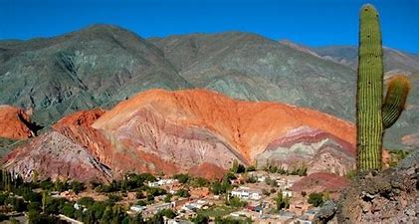
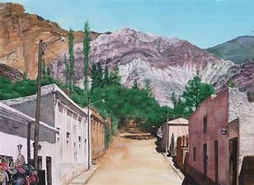
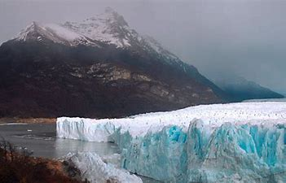
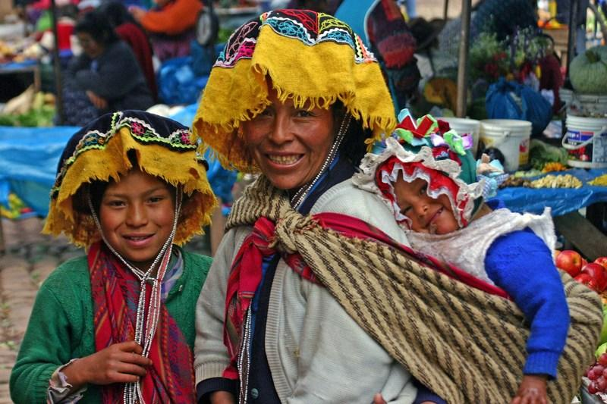
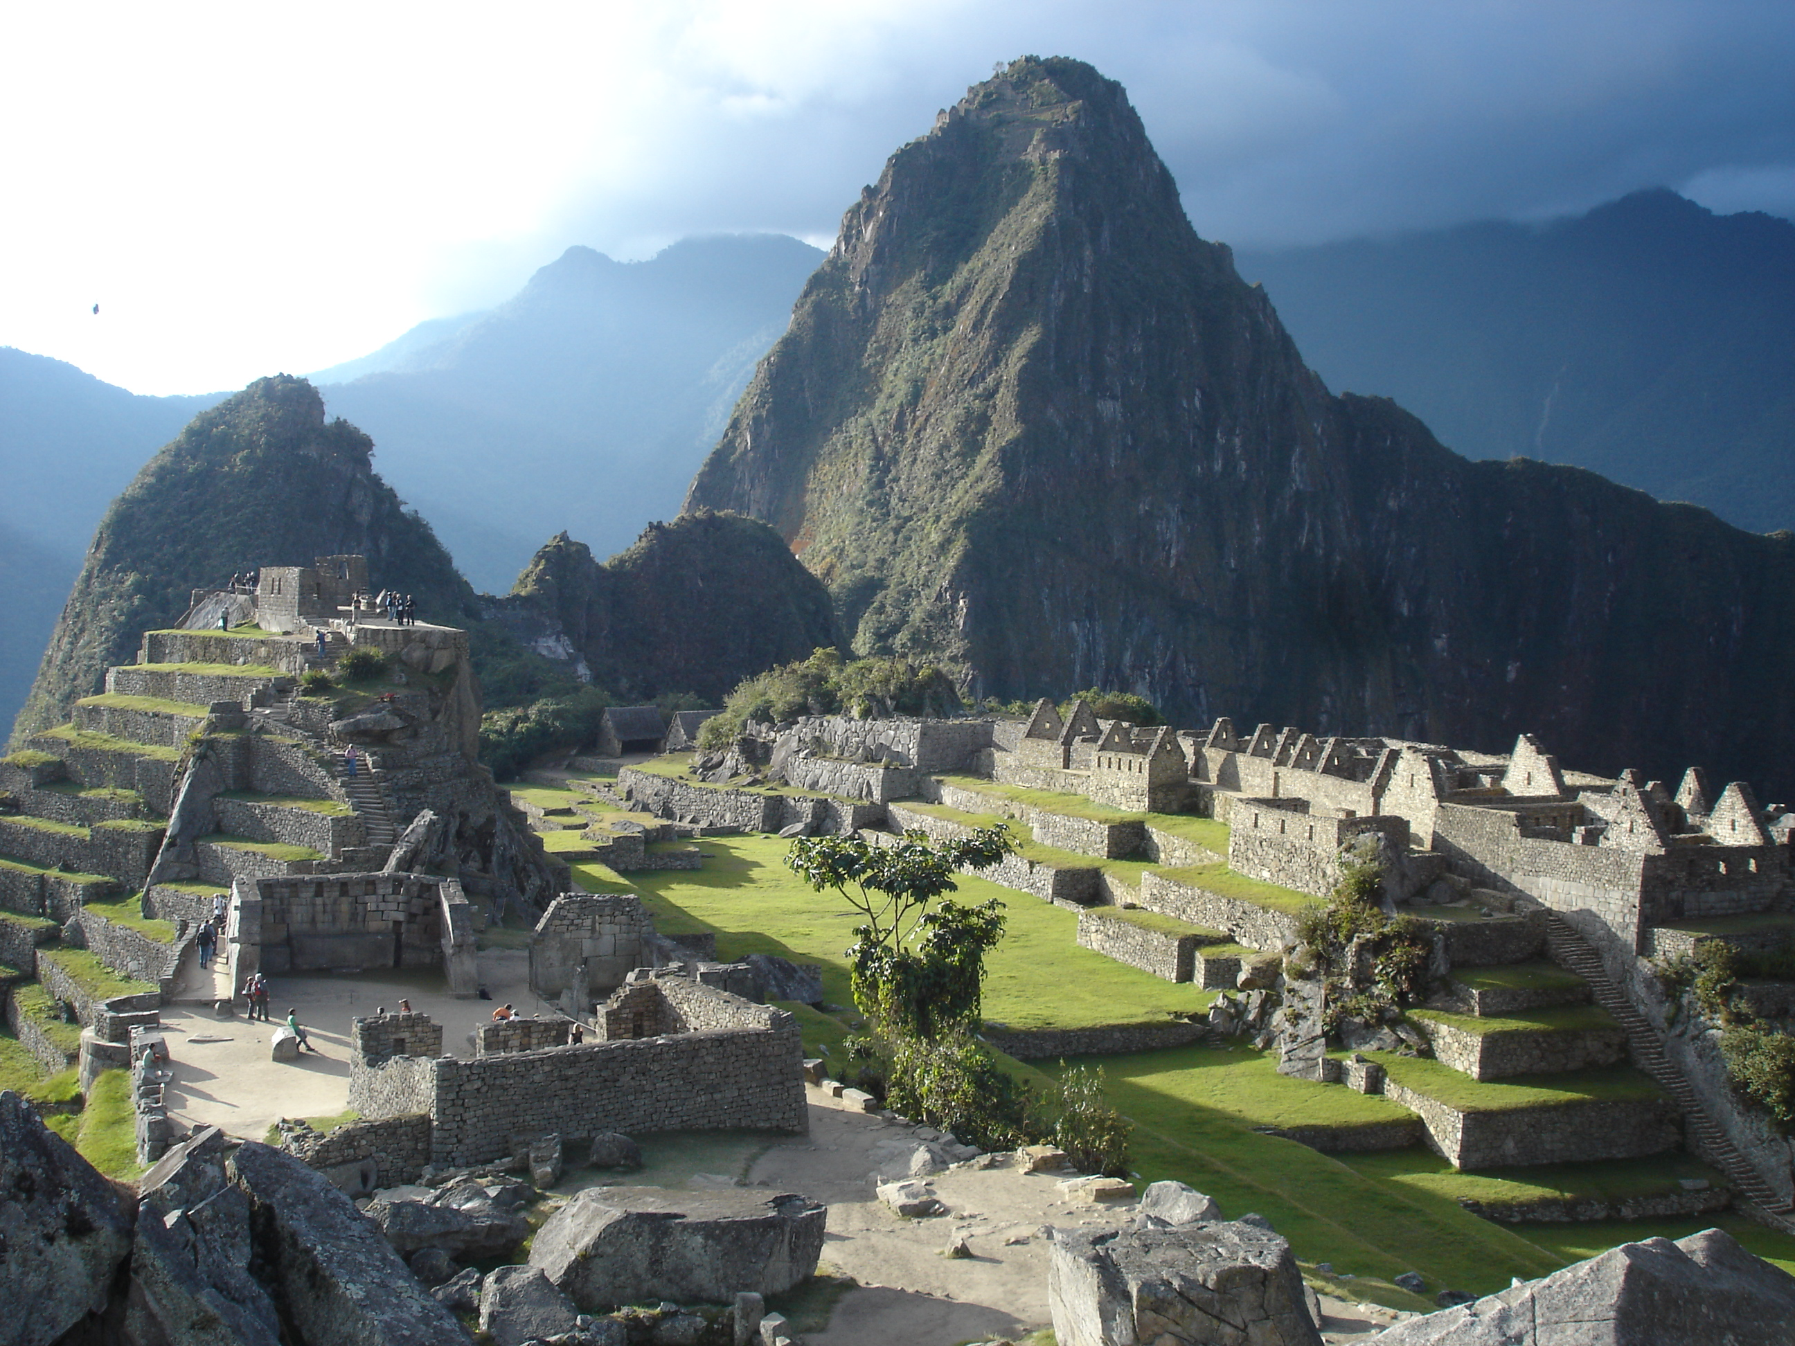
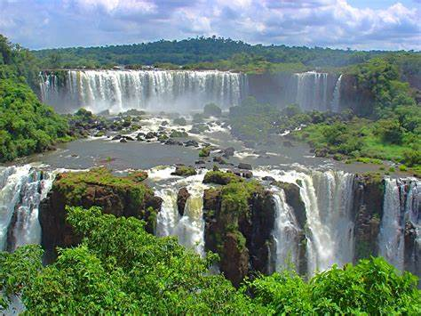
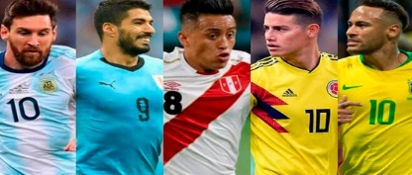
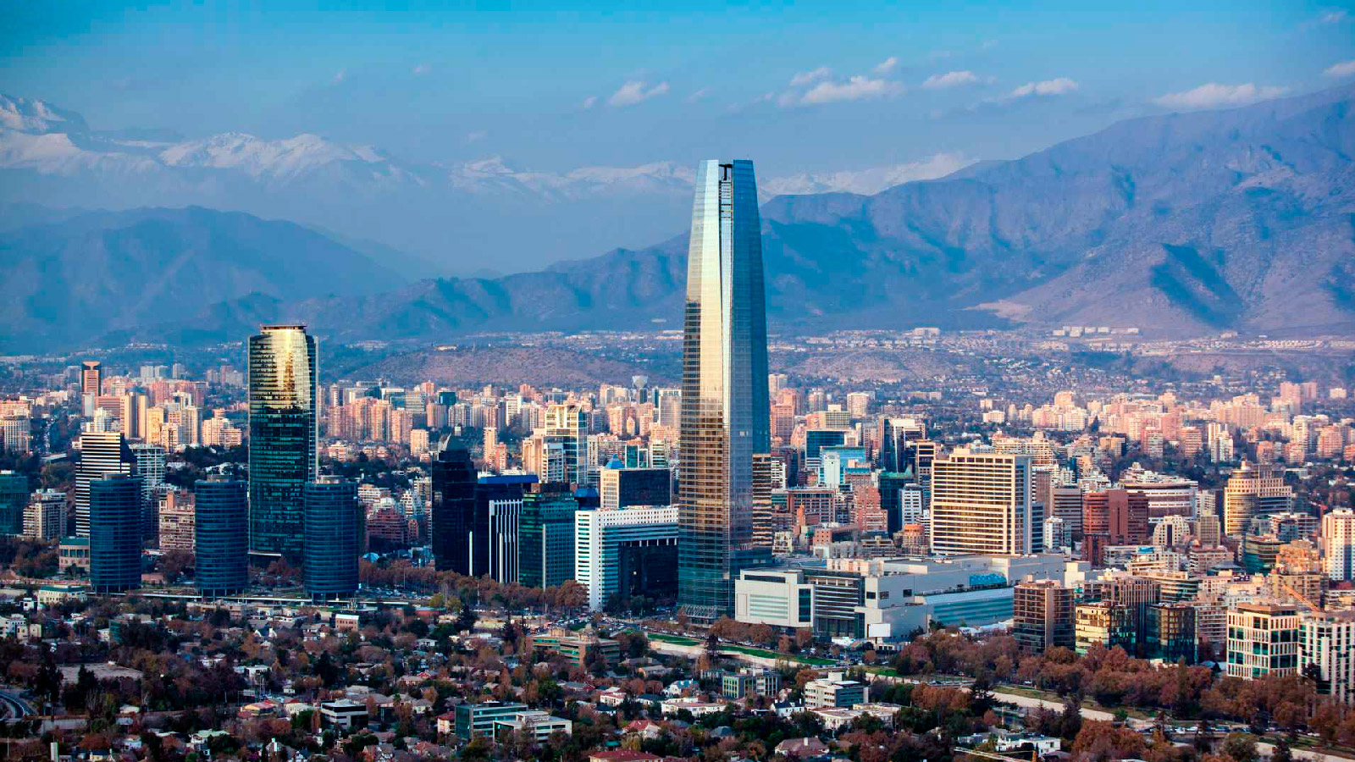
Sights of South America

Slide 3
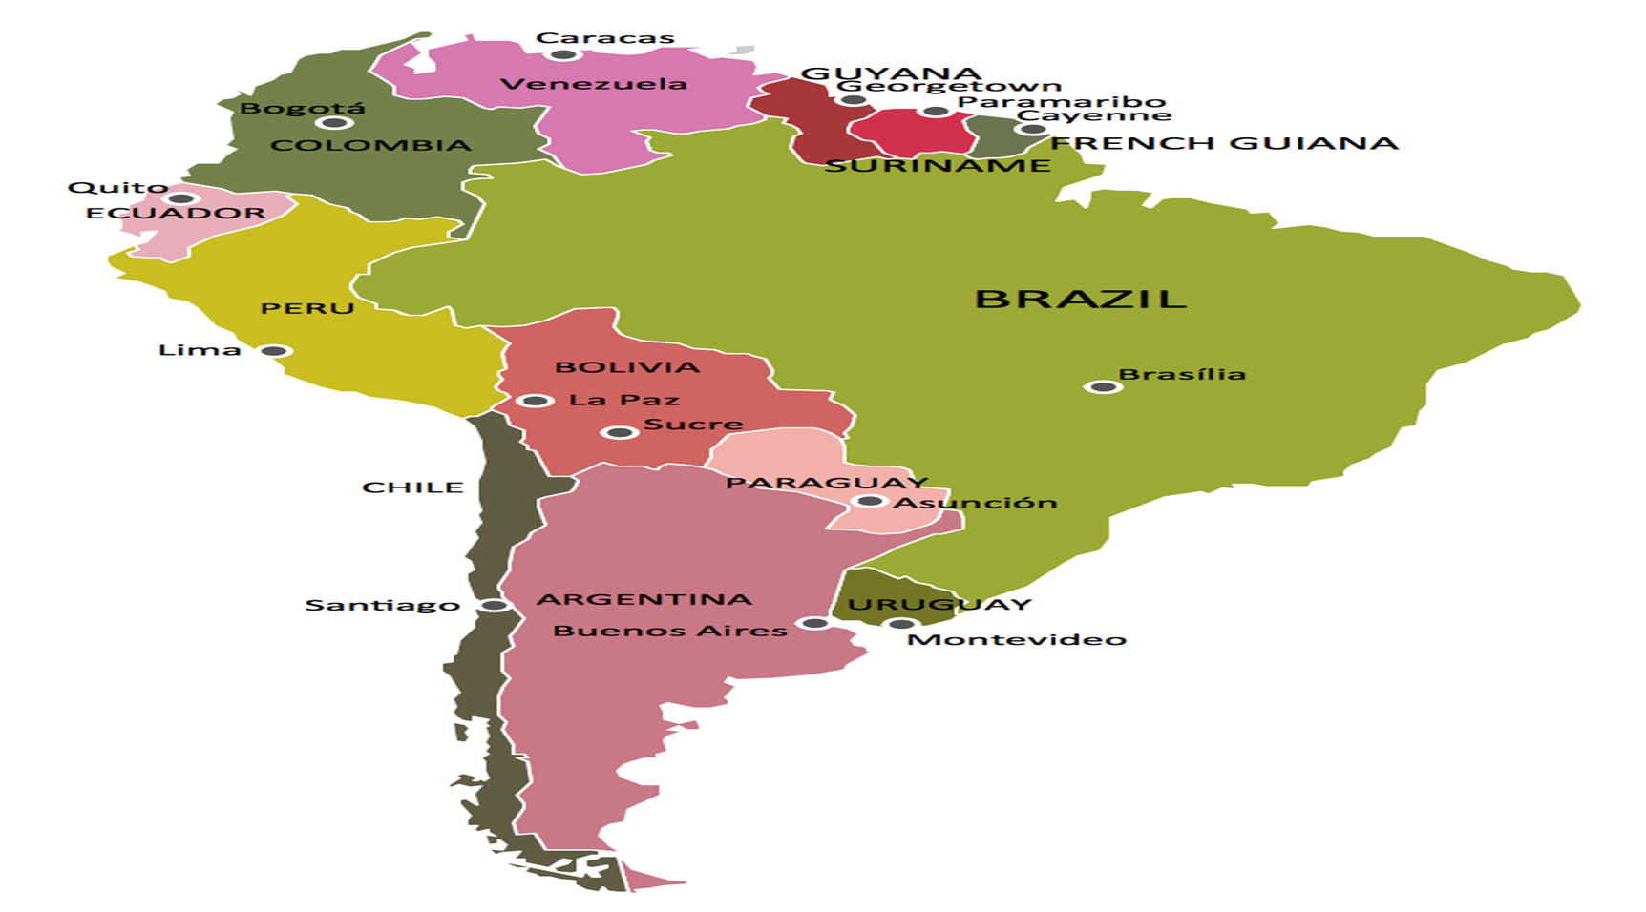
Area of Responbility
Accredited Jurisdiction
Argentina
Chile
Peru
Ecuador
Paraguay
Uruguay

Slide 4
At a Glance

Slide 5
South America: Economic Freedom

Slide 6
Argentina-Fact Sheet
Total Area | 2780400 SqKm
Population | 45.376 Million (Est. 2020) Population Growth 0.86% (2020 est.)
Natural Resources | Fertile plains of the pampas, lead, zinc, tin, copper, iron ore, manganese, petroleum, uranium, arable land
Urbanization | 92.1% of total population (2020) rate of urbanization
GDP | US $ 449 (2019)
GDP per capita | US $ 9,80,90
Merchandise exports | US $ 65 Billion (2019)
Merchandise imports | US $ 49 Billion (2019)
Major Export Destinations | Brazil, European Union, China, US, Chile, Other
Major Imports Origin | Brazil: China, European Union, United States of America, Paraguay, Other
No of FTAs/RTAs in Force | 08

Slide 7
Argentina-Major Trading Partners-2019

Slide 8
Major Trading Partners & Trade Balance During First Six Months of 2020
Source: Indec, Argentina

Slide 9
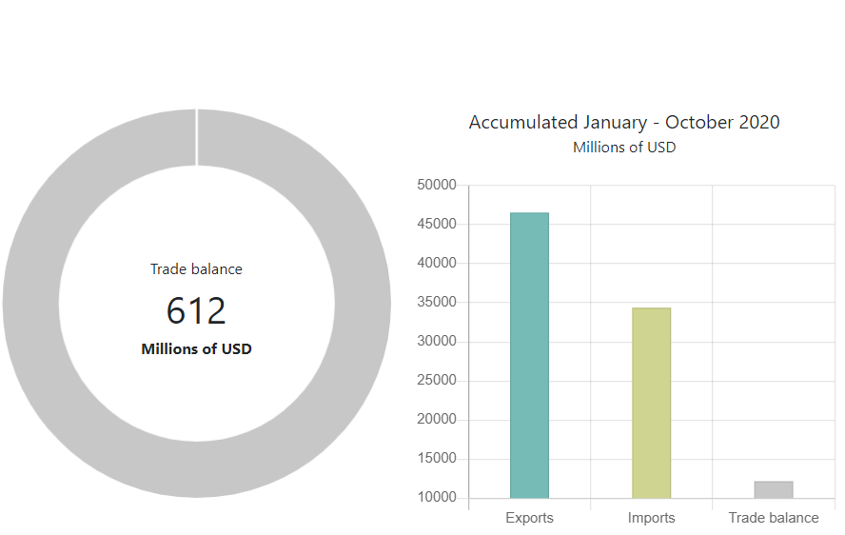
Argentina: Trade Balance during Covid Times

Slide 10
Pak-Argentina Bilateral Trade Over the Years

Slide 11
Pak Argentina Import Commodity Basket

Slide 12
Argentina’s Major Exports to Pakistan-2019

Slide 13
Pak-Argentine Export Commodity Basket-2019

Slide 15
Pak-Argentina Import Commodity Basket-2019

Slide 16
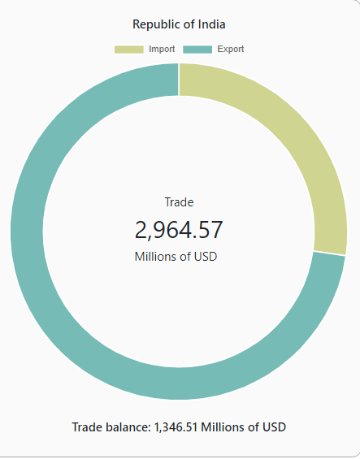
Argentina Trade with Pakistan vs India
35.44
809.03
101.91
2155
2019

Slide 17
Arg Import Tariff on Products of Pak Export Interest
Product Group | Ad Valorem tariff
Cotton yarn | 26%
Cotton fabric | 26%
Manmade fabric | 26%
Beauty products (pedicure/manicure) | 18%
Medical & dental equipment | 16%
Articles of leather | 20%
Home textile | 35%
Product Group | Ad Valorem tariff
Salt lamps | 4%
Footwear | 35%
Rice | 10%
Sports goods | 35%
Footballs | 35%
Ready made garments | 35%
*Para tariffs & non-tariff measures are additional barriers to trade

Slide 18
Pak-Argentina bilateral Trade-Embassy’s Endeavors
Identification of potential export products
Virtual meetings with Chambers
Virtual Exhibitions
JTC meeting scheduled after 11 years
Engagement with ANMAT for registration of Pakistan’s drugs/medical instruments in Argentina
Parleys with SENASA
Attestation of trade documents
Efforts to resolve visa issues
Creating a soft image of Pakistan-Plasma Therapy Open Forum

Slide 19
Chile Fact Sheet
Population | 18.2 Million (2020 est)
Area | 756,102 sq Km
GDP | US $ 283 billion
Per Capita Income | US$ 25,915 (2019)
Composition of GDP | Services: 53.1 %, Industry: 41.8 %, Agriculture: 5.1 %
Major agriculture products | grapes, apples, pears, onions, wheat, corn, oats, peaches, garlic, beans; beef, poultry, wool; fish; timber
Major industries | copper, lithium, other minerals, foodstuffs, fish processing, iron and steel, wood & wood products, transport equipment, cement, textiles
Total merchandise trade (2019) | US $139,691 Million
Merchandise exports | US $ 69,889 millions (FOB)
Merchandise Imports | US $ 69.801 million
Chile’s major exports (commodity GroupWise in 2018) | agricultural products 32%, fuels and mining products 54%, manufacturing 13.1 & others 0.9%,
Chile’s major imports (Commodity Group wise in 2019) | manufactured goods 71.2%, fuels and mining products 17.6%, agriculture products 10.1%.

Slide 20
Chile-Major Export Commodities
Commodity Group | 2016 | 2017 | 2018 | 2019
Minerals | 30,089 | 36,681 | 40,171 | 36,221
Fruits & berries | 5,944 | 5,680 | 6,484 | 6,670
Forestry & its derivatives | 5,161 | 5,407 | 6,812 | 5,526
Fisheries products | 5,167 | 6,038 | 6,758 | 6,496
Other food products | 2,135 | 2,115 | 2,387 | 2,463
Wines | 1,856 | 2,025 | 2,005 | 1,934
Services exports | 981 | 1,017 | 1,190 | 1,258
Other products | 687 | 583 | 572 | 447
Ships and ranches | 434 | 529 | 636 | 638
Other than mining | 9,392 | 8,078 | 9,148 | 9,472
US $ in Million

Slide 21
Chile Major Commodity Group-Imports
Major Commodity Group | 2016 | 2017 | 2018 | 2019
Mineral fuels and lubricants | 7,385.66 | 9,460.68 | 11,961.90 | 10,823.71
Means of transport and their parts | 6,969.22 | 8,498.24 | 9,984.59 | 8,246.31
Foods | 3,203.68 | 3,852.17 | 4,241.89 | 4,240.23
Clothing and accessories, and footwear | 3,081.85 | 3,473.23 | 3,688.27 | 3,350.89
Technology | 2,937.79 | 3,058.17 | 3,218.32 | 2,830.57
Other relevant products | 1,821.68 | 1,957.20 | 2,274.40 | 2,217.13
US $ in Million

Slide 22
Major Commodity wise breakup of imports-Chile

Slide 23
Chile major trading partners-Export

Slide 24
Chile major trading partners-import
US $ billion

Slide 25
Chile Trading Regime
The overall tariff on imports into Chile since 2003 is 6%
Chile's twenty-nine trade agreements to date have established a substantial tariff reduction framework.
Of Chile’s total imports of US $ 64 Bn, $50 Bn (78%) enjoyed preferential treatment at effective rate of duty of 0.79% against the MFN rate of 6% in 2019
By the end of 2019, the average effective Advalorem tariff reached 0.79%.

Slide 26
Pakistan-Chile Bilateral Trade
US $ in Million

Slide 27
Pak-Chile Major Export Items-2019

Slide 28
Pak Chile-Untapped Potential
Source: ITC

Slide 29
Potential Items of Exports to Chile
US $ in Million
HS Code | Description | Pakistan’s export to Chile | Pakistan’s Export to the World | Chile’s import from the World
63 | Other made-up textile articles; sets; worn clothing and worn textile articles; rags | 21.976 | 4070.644 | 358.375
61 | Articles of apparel and clothing accessories, knitted or crocheted | 7.699 | 3028.781 | 1169.386
'52 | Cotton and Cotton fabric | 6.575 | 3252.069 | 41.316
'10 | Cereals (Rice) | 1.471 | 2375.641 | 858.878
'62 | Articles of apparel and clothing accessories, not knitted or crocheted | 3.892 | 2814.503 | 1156.492
Source: ITC, year 2019

Slide 30
Potential Items of Exports to Chile
HS Code | Description | Pakistan’s export to Chile | Pakistan Export to the World | Chile import from the World
'42 | Articles of leather; saddlery and harness; travel goods, handbags and similar containers; articles ... | 1.413 | 634.279 | 254.836
'90 (Surgical goods) | Optical, photographic, cinematographic, measuring, checking, precision, medical or surgical ... | 1.762 | 454.177 | 1350.665
'95 (Soccer balls) | Toys, games and sports requisites; parts and accessories thereof | 3.832 | 225.019 | 528.971
'57 | Carpets and other textile floor coverings | 0.612 | 67.152 | 54.972
30 | Pharmaceuticals | 0.014 | 217 | 1642
Source: ITC, year 2019

Slide 31
Pak-Chile Renewed Engagement
Re-starting the process of FTA negotiation stalled since 2010
Expression of interest to join Pacific Alliance
Proposal to open a trade mission in Santiago
High level consultations with Chilean authorities to promote trade

Slide 32
Peru-Fact Sheet
Population | 32.510
Area | 1285220 (2019)
GDP | US $ 226.85 billion (2019)
Per Capita Income | US$ 13,500 (2019)
Composition of GDP | Agriculture: 7.6% (2017 est.) Industry: 32.7% (2017 est.) Services: 59.9% (2017 est.)
Major agriculture products | Avocados, coffee, cocoa, cotton, sugarcane, rice, potatoes, corn, grapes, oranges, pineapples, guavas, bananas, barley, medicinal plants, quinoa, palm oil, marigolds, onions, wheat, poultry, beef dairy products; fish
Major industries | Mining and refining of minerals; steel, metal fabrication; petroleum extraction and refining, natural gas and natural textiles, clothing, food processing, beer, soft drinks, rubber, machinery, electrical machinery, chemicals, furniture
Total merchandise trade (2019) | US $ 89,95 Million
Merchandise exports | US $ 47,690 millions
Merchandise Imports | US $ 42,265 million
Major exports (commodity GroupWise in 2019) | Agricultural products 20.8%, fuels and mining products 53.3 %, manufacturing 9.2% and others 16.8 %,
Major imports(Commodity Group wise in 2019) | manufactured good 69.8%, fuels & mining products constituting 17.1% and agriculture products 12.7%.

Slide 33
Peru-Major Trading Partners-Exports

Slide 34
Peru-Major Trading Partners-Imports

Slide 35
Pakistan-Peru Bilateral Trade
US $ in Million

Slide 36
Pak-Peru bilateral trade

Slide 37
Pakistan’s major Exports to Peru-2019
US $ in Million

Slide 38
Pak-Peru major commodities import
US $ in Million

Slide 39
Pakistan-Peru Export Potential Map
Source: ITC

Slide 40
Anti-dumping duties on Pak Fabric-Peru
Anti-dumping duties on Poplin fabric from Pakistan since 2004
Initially, @ US $ 1.13/kg, however, were revised to US $ 0.47/kg in November, 2004.
These anti-dumping measures have to be reviewed after every five years.
Last review concluded just in October, 2020
Anti dumping Commission of Peru, INDECOPI maintained the duties for a further period of 5 years.

Slide 41
Paraguay-Fact Sheet
Population | 7,191,685 (July 2020 est.)
Area | 406,752 sq km
GDP | US $ 40 billion (2018)
Per Capita Income | US$ 13,500 (2019)
Composition of GDP | agriculture: 17.9% (2017 est.) industry: 27.7% (2017 est.) services: 54.5% (2017 est.)
Major agriculture products | Cotton, sugarcane, soybeans, corn, wheat, tobacco, cassava (manioc, tapioca), fruits, vegetables; beef, pork, eggs, milk; timber
Major industries | Sugar processing, cement, textiles, beverages, wood products, steel, base metals, electric power
Total merchandise trade (2019) | US $ 20196 Million
Merchandise exports | US $ 7652 millions
Merchandise Imports | US $ 12544 million

Slide 42
Paraguay major trade partners-imports

Slide 43
Paraguay-Major Export Commodities
Soybeans
Livestock feed
Cotton
Meat
Edible oils
Leather
Wood

Slide 44
Paraguay-Major Import Commodities
Vehicle parts
Consumer goods
Tobacco
Road vehicles
Petroleum products
Tractors
Chemicals,

Slide 45
Pakistan-Paraguay bilateral trade
US $ million

Slide 46
Pakistan’s major Exports to Paraguay-2019

Slide 47
Pakistan’s major imports from Paraguay-2019

Slide 48
Pakistan-Paraguay Export Potential Map
Source: ITC

Slide 49
Uruguay-Fact Sheet
Population | 7,191,685 (July 2020 est.)
Area | 406,752 sq km
GDP | US $ 40 billion (2018)
Per Capita Income | US$ 13,500 (2019)
Composition of GDP | Agriculture: 17.9% (2017 est.) Industry: 27.7% (2017 est.) services: 54.5% (2017 est.)
Major agriculture products | cotton, sugarcane, soybeans, corn, wheat, tobacco, cassava (manioc, tapioca), fruits, vegetables; beef, pork, eggs, milk; timber
Major industries | sugar processing, cement, textiles, beverages, wood products, steel, base metals, electric power
Total merchandise trade (2019) | US $ 20196 Million
Merchandise exports | US $ 7652 millions
Merchandise Imports | US $ 12544 million

Slide 50
Pak-Uruguay bilateral trade
US $ in million

Slide 51
Pak-Uruguay major export items-2019
US $ million
US $ in million

Slide 52
Pak-Uruguay major import items-2019
US $ in million

Slide 53
Pak-Uruguay Trade potential
Uruguay Import |  |  |  | Pakistan's export to the World
Chapter | Description | Value | Chapter | Description | Value
'30 | Pharmaceutical products | 255.511 | '30 | Pharmaceutical products | 217.587
'02 | Meat and edible meat offal | 240.667 | '02 | Meat and edible meat offal | 295.61
'61 | Articles of apparel and clothing accessories, knitted or crocheted | 136.541 | '61 | Articles of apparel and clothing accessories, knitted or crocheted | 3028.781
'62 | Articles of apparel and clothing accessories, not knitted or crocheted | 117.509 | '62 | Articles of apparel and clothing accessories, not knitted or crocheted | 2814.503
'64 | Footwear, gaiters and the like; parts of such articles | 88.159 | '64 | Footwear, gaiters and the like; parts of such articles | 135.313
'10 | Cereals | 80.692 | '10 | Cereals | 2375.641
'95 | Toys, games and sports requisites; parts and accessories thereof | 58.69 | '95 | Toys, games and sports requisites; parts and accessories thereof | 225.019

Slide 54
Pak-Uruguay Trade potential
US $ in Million
Uruguay Import |  |  |  | Pakistan's export to the World
Chapter | Description | Value | Chapter | Description | Value
'08 | Edible fruit and nuts; peel of citrus fruit or melons | 50.611 | '08 | Edible fruit and nuts; peel of citrus fruit or melons | 398.771
'63 | Other made-up textile articles; sets; worn clothing and worn textile articles; rags | 37.018 | 63 | Other made-up textile articles; sets; worn clothing and worn textile articles; rags | 4070.644
'82 | Tools, implements, cutlery, spoons and forks, of base metal; parts thereof of base metal | 34.583 | '82 | Tools, implements, cutlery, spoons and forks, of base metal; parts thereof of base metal | 113.8
'41 | Raw hides and skins (other than furskins) and leather | 50.215 | '41 | Raw hides and skins (other than furskins) and leather | 228.614

Slide 55
Pak-Uruguay Trade potential
US $ in Million
Uruguay Import |  | Value |  | Pakistan's export to the World
'52 | Cotton | 9.064 | '52 | Cotton | 3252.069
'57 | Carpets and other textile floor coverings | 5.061 | '57 | Carpets and other textile floor coverings | 67.152
'90 | Optical, photographic, cinematographic, measuring, checking, precision, medical or surgical ... | 172.51 | '90 | Optical, photographic, cinematographic, measuring, checking, precision, medical or surgical ... | 454.177
'41 | Raw hides and skins (other than furskins) and leather | 50.215 | '41 | Raw hides and skins (other than fur skins) and leather | 228.614

Slide 56
Ecuador Fact Sheet
Population | 16,904,867
Area | 283,600 Sq Km
GDP | US $ 104.3 billion (2017)
GDP Per Capita | US $ 11,500 (PPP) (2017)
GDP Composition | 6.7% (2017 est.) industry: 32.9% (2017 est.) services: 60.4% (2017 est.)
Agricultural products | bananas, coffee, cocoa, rice, potatoes, cassava (manioc, tapioca), plantains, sugarcane; cattle, sheep, pigs, beef, pork, dairy products; fish, shrimp; balsa wood
Industries | petroleum, food processing, textiles, wood products, chemicals

Slide 57
Pak-Ecuador Bilateral Trade

Slide 58
Pak-Ecuador Major Items of Exports

Slide 59
Pak-Ecuador Major Items of Import
Total Imports from Ecuador to Pakistan below US $ 1 million per year.
Major imports are Ferrous/Iron waste and scrap.

Slide 60
Issues & Challenges in Trade with Latin America
High Tariff on Pakistan’s exports-NO FTA/PTA
Non-Tariff Barriers
Protectionist Economies (Chile is an exception)
Geographically remote
Language barrier
No significant Pakistani diaspora
Complicated banking and foreign exchange regulations
Uncertainty and bureaucratic red tapism
Covid and economic recession

Slide 61
Way Forward
Focus on preferential trading arrangements
Visits of High level delegations
Pro-active diplomacy
Re-invigorating Pak-Chile FTA negotiations
Re-engaging with Mercosur
Pacific Alliance
Product focused studies
Exploring the IT and Services Sectors
Removal of non-tariff barriers
Efforts to resolve visa issues
Frequent Visits/virtual meetings with trade bodies and importers/exporters in Latin America
Continuous engagements with Governments, Regulatory Bodies and Chambers

Slide 62
References
Ministry of Commerce
Argentina Ministry of Trade
Peru Customs
Chile Customs
Uruguay Customs
Paraguay Customs
CIA Country Fact Book
WTO

