Slide 1
Product certification & Registration Importance & Process

Slide 2
Hello!
I am Shahzad Shoukat
working in the field of training & certification of different standards and regulations (ISO 9001:2015, ISO 14001:2015, ISO 13485:2016, ISO 45001:2018 SEDEX, SA 8000, BSCI) since 25years.
You can Find me at:
Tel: +92 323 9614339
Email: s.shoukat44@yahoo.com

Slide 3
Presentation Contents
Introduction of Generic Standard
Introduction of ISO 9001:2015 & ISO 14001:2015
Social Standards
CE Mark Regulation & Requirements
Implementation & Benefit of Management System

Slide 4
Introduction of Generic Standard
1
ISO 9001:2015 & ISO 14001:2015

Slide 5
“Generic content is unspecific content. It is independent of organization's scope of activity”

Slide 6
Introduction of Generic standards
if it wants to establish a quality management system, ISO 9001 gives the essential features
or if it wants to establish an environmental management system, ISO 14001 gives the essential features.

Slide 7
Management System
ISO 9001:2015 (Quality Management System)
ISO 14001:2015 (Environmental Management System)

Slide 8
Management System
QMS
ISO 9001 gives the requirements for what the organization must do to manage processes affecting quality of its products and services.
EMS
ISO 14001 gives the requirements for what the organization must do to manage processes affecting the impact of its activities on the environment.

Slide 9
Quality management
Quality refers to all those features of a product (or service) which are required by the customer. Quality management also means what the organization does to
enhance customer satisfaction, and
achieve continual improvement of its performance.
.

Slide 10
Environmental management
ISO 14001 is for environmental management. This means what the organization does to:
minimize harmful effects on the environment caused by its activities,
to conform to applicable regulatory requirements, and to
achieve continual improvement of its environmental performance.
.

Slide 11
Processes, not products
Both ISO 9001 and ISO 14001 concern the way an organization goes about its work.
They are not product standards.
They are not service standards.
They are process standards.
They can be used by product manufacturers and service providers.

Slide 12
Certification and registration
Certification is known in some countries as registration.
It means that an independent, external body has audited an organization's management system and verified that it conforms to the requirements specified in the standard (ISO 9001 or ISO 14001).
ISO does not carry out certification and does not issue or approve certificates.

Slide 13
YEAR 1 (INITIAL CERTIFICATION)
1
2
3
4
Pre- Audit
Audit Plan
Audit (Stage 1 & 2)
Initial Certification
This is Optional, and it
must be done well in advance of Stage 1 Audit
Plan for audit has
to be mutually
Agreed upon
Non-conformities must
be closed before Stage 2 Audit & stage 2 Non-Conformities to be closed before Final certification Decision
Certificate will be issued within 1 week after successful
NC closure
Certification Process

Slide 14
YEAR 2 (1st SURVEILLANCE AUDIT)
1
2
Pre- Audit
Audit Surveillance 1
1
2
YEAR 2 (2nd SURVEILLANCE AUDIT)
Pre- Audit
Audit Surveillance 2
RE-CERTIFICATION AUDIT:
Within two months before the triennial certiﬁcate expiration

Slide 15
Accreditation
Accreditation is like certification of the certification body.
It means the formal approval by a specialized body - an accreditation body - that a certification body is competent to carry out ISO 9001:2015 or ISO 14001:2015 certification in specified business sectors.
Certificates issued by accredited certification bodies - and known as accredited certificates - may be perceived on the market as having increased credibility.

Slide 16
Certification is a business decision
Certification is a decision to be taken for business reasons:
if it is a contractual, regulatory, or market requirement,
If it meets customer preferences
it is part of a risk management programme, or
if it will motivate staff by setting a clear goal.

Slide 17
Benefits of ISO 9001 and ISO 14001
International, expert consensus on state-of-the-art practices for quality and environmental management.
Common language for dealing with customers and suppliers worldwide in B2B.
Increase efficiency and effectiveness.
Model for continual improvement.
Model for satisfying customers and other stakeholders.
Build quality into products and services from design onwards.

Slide 18
Social Standards
2
SA 8000, SEDEX & BSCI

Slide 19
Social Standards
A consensus standard which encourages organizations to develop, maintain and apply socially acceptable workplace practices in those areas that they can control or influence.

Slide 20
Social Standards
Based on:
Universal declaration of Human Rights
UN Convention on the Rights of the Child
Conventions of the International Labour Organization ( ILO )

Slide 21
Social Standards
Ensures ethical sourcing of goods and services
Improve working conditions globally
Provide universal standard in all business and country sectors
Work in parallel with human rights and labor organizations worldwide

Slide 22
Social Standards
Child Labor
Forced Labor
Health & Safety
Freedom of Association
Discrimination
Disciplinary Practices
Working Hours
Compensation
Management System

Slide 23
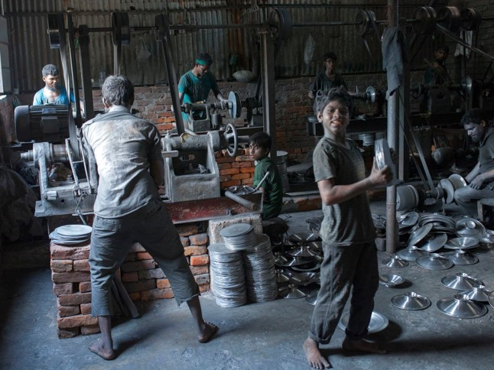
Child Labor
Minimum work age of 15 unless local minimum age law stipulates a higher age
Minimum work age of 14 if the law follows ILO Convention 138
Children or young workers put in safe and health workplace
Provision of the Policies and Procedure for remediation of Children
.

Slide 24
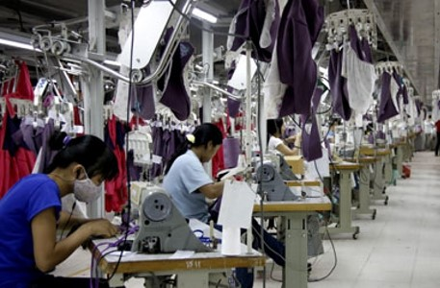
Forced Labor
No forced or indentured labor
No deposits or lodge of identity documents

Slide 25
Health & safety
Ensure a safe and healthy working environment
A senior management staff appointed for health & safety Issues
Adequate safety training provided for staff

Slide 26
Health & safety
A system to detect, avoid or respond to safety threats
Clean bathrooms & potable water & food storage facility
Dormitories meet basic needs of workers

Slide 27
Freedom of Association
Respect trade unions & right of workers to bargain collectively
If legally restricted , there shall be parallel means of free association
No discrimination against union reps and members

Slide 28
Discrimination
Not engage in or support discrimination
No interference with individual rights to observe tenets or practices
No form of worker harassment allowed

Slide 29
Disciplinary Practices
Not engage in or support the use of corporal punishment , mental or physical coercion & verbal abuse.

Slide 30
Working Hours
Not exceed 48 hrs per week for normal working hrs
At least one day off in every seven days
Overtime not more than 12 hrs per week
Overtime paid at a premium rate

Slide 31
Compensation
Wages meet legal requirement and sufficient to meet “ Basic Needs”
Wages not withheld for Discipline
Wages presented as understood by workers
Wages paid in Cash or Check form
No false apprentice scheme

Slide 32
Management System
Policy
Management Review
Company Representatives
Planning and Implementation
Control of Suppliers

Slide 33
Certification Process

Slide 34
Value
Marketing advantage of a selling point
Improvement of the relationship with the public, governments and NGO’s
Better position in the labour market
Enhancing organisation’s productivity through Risk Management

Slide 35
Governments, shareholders, customers, and other interested parties expect to purchase from socially responsible organizations. ➢ ➢ ➢ Do The Right Things Right

Slide 36
CE Mark
3
European Regulation for Products

Slide 37
CE Mark
CE marking indicates that a product has been assessed by the manufacturer and deemed to meet EU safety, health and environmental protection requirements.

Slide 38
When is CE marking mandatory?
Some products are subject to several EU requirements at the same time. You must make sure that your product complies with all the relevant requirements before affixing the CE marking to it.

Slide 39
How to obtain CE marking?
As the product's manufacturer, you bear sole responsibility for declaring conformity with all requirements. You don't need a license to affix the CE marking to your product, however, before doing so, you must:
ensure conformity with all relevant EU-wide requirements

Slide 40
How to obtain CE marking?
determine whether you can assess your product by yourself or if you have to involve a notified body
put together a technical dossier documenting conformity: find out about technical documentation
draft and sign an EU declaration of conformity

Slide 41
Technical documentation
The technical documentation should include at least:
your name and address, or those of any authorised representatives
a brief description of the product
identification of the product, for example, the product's serial number
the name(s) and address(es) of the facilities involved in the design and manufacture of the product
the name and address of any notified body involved in assessing the conformity of the product

Slide 42
Technical documentation
a statement of the conformity assessment procedure that has been followed
the EU declaration of conformity
label and instructions of use
a statement of relevant regulations to which the product complies
identification of technical standards with which compliance is claimed
list of parts
test results

Slide 43
Risk assessment
As a manufacturer, you are responsible for identifying all the possible risks your product could pose and determine the applicable essential requirements. This analysis must be included in the technical documentation. In addition, you will need to explain the ways in which you have addressed the risks identified to ensure that your product complies with the applicable requirements, for example, by applying harmonised standards.

Slide 44
EU declaration of conformity
An EU declaration of conformity (DoC) is a mandatory document that you as a manufacturer or your authorised representative need to sign to declare that your products comply with the EU requirements. By signing the DoC you take full responsibility for your product's compliance with the applicable EU law.

Slide 45
EU declaration of conformity
Must ensure that the product is accompanied by the DOC and must keep a copy of it for 10 years after the product has been placed on the market.
You must translate the EU declaration of conformity into the language or languages required by the EU country in which your product is sold.

Slide 46
How do you affix the CE marking?
The CE marking must be visible, legible and indelible.
The CE marking must consist of the initials "CE", both letters should have the same vertical dimension and be no smaller than 5mm (unless specified differently in the relevant product requirements).
If you wish to reduce or enlarge the CE marking on your product, you should respect the proportions of the two letters. As long as the initials remain visible, the CE marking can take different forms (for example colour, solid or hollow).

Slide 47
How do you affix the CE marking?
If the CE marking cannot be affixed to the product itself, you can affix it to the packaging if there is any, or to any accompanying documents. If your product is subject to several EU directives/regulations which require a CE marking to be affixed, the accompanying documents must indicate that your product conforms to all applicable EU directives/regulations.

Slide 48
Directives & Regulations for Some Products
Electrical and electronic appliances
Directive 2014/30/EU
Medical Devices
MDR 2017/ 745
Personal Protective Equipment
2016/425 (EU)
Pressure Equipment
Directive 2014/68/EU
Safety of Toys
Directive (2009/48/EC)

Slide 49
CE Mark Benefits
There are two main benefits CE marking brings to businesses and consumers within the EEA:
Businesses know that products bearing the CE marking can be traded in the EEA without restrictions.
Consumers enjoy the same level of health, safety, and environmental protection throughout the entire EEA.

Slide 50
Thanks!
Any questions?
You can Find me at:
Tel: +92 323 9614339
Email: s.shoukat44@yahoo.com

Slide 51
Credits
NBDP-SMEDA

