Slide 2
TEVTA PUNJAB CAREERS DIVISION

Slide 3
Careers Division
Interventions
Reforms
Achievements
Stats run-through

Slide 5
Entrepreneurship
Applications in Other Banks
APPROVED
29 cases
27.58M
Allied Bank 02
Askari Bank 01
Bank Alfallah 02
Bank of Khyber 01
Faysal Bank 02
Habib Bank 03
JS Bank 02
Meezan Bank 01
National Bank 03
United Bank 03
Rejected
166 cases
142M
Other Bank
20
Applic
In Process
93 cases
86.25M

Slide 6
Careers Division Center
Careers Division providing career related services to TEVTA Trainees and Alumni including:
Activities for Trainees
Career Counseling
Guest Speaker Lectures
Industrial Floor Visit
On job Trainings
Activities for Alumni
Job Fairs
On Campus Recruitment Drives
Job Placement
Financial Support for Entrepreneurship
Kamyab Jawan Program
Punjab Rozgar
Aakhuwat
Lectures

Slide 7
Career Counseling Lectures
How To write CV / Resume
Job hunting for Foreign Jobs
Interview Preparation & Dress Code
Interview Preparation & Common Interview Questions
Interview Preparation & Common Interview Mistakes
Interview Preparation & Mock Interview
Personality Grooming
Personality Grooming through Soft Skills
Personality Grooming & Communication Skills
Personality Grooming through Social Skills
Personality Grooming through Team Work & Work ethics
CV Making on Career Job portal
NVC Awareness Session
How To write Job Application / Cover Letter
CV making using other online platforms
Job hunting on Print Media
Job hunting on Digital Media
Job hunting through Websites that club jobs of print media
Job hunting through Platform that connects Jobseeker & Employers
Job hunting through Employers official websites

Slide 8
Reforms
Development of SOP
(Uniform Execution of Placement Activities )
Structured Roles
Communication Link Process Embedded
(Inclusion of social media contacts in student profile)
Identification
of Placement activities for Trainees & Graduates
Standardization & Facilitation for field
Capacity Building

Slide 9
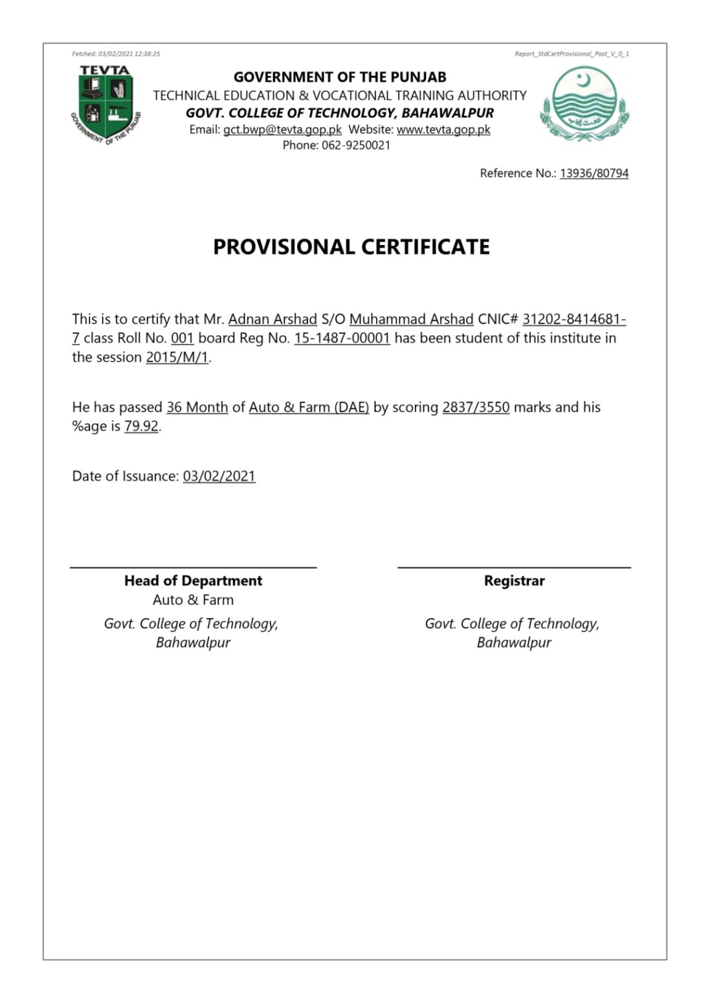
Reforms

Slide 10
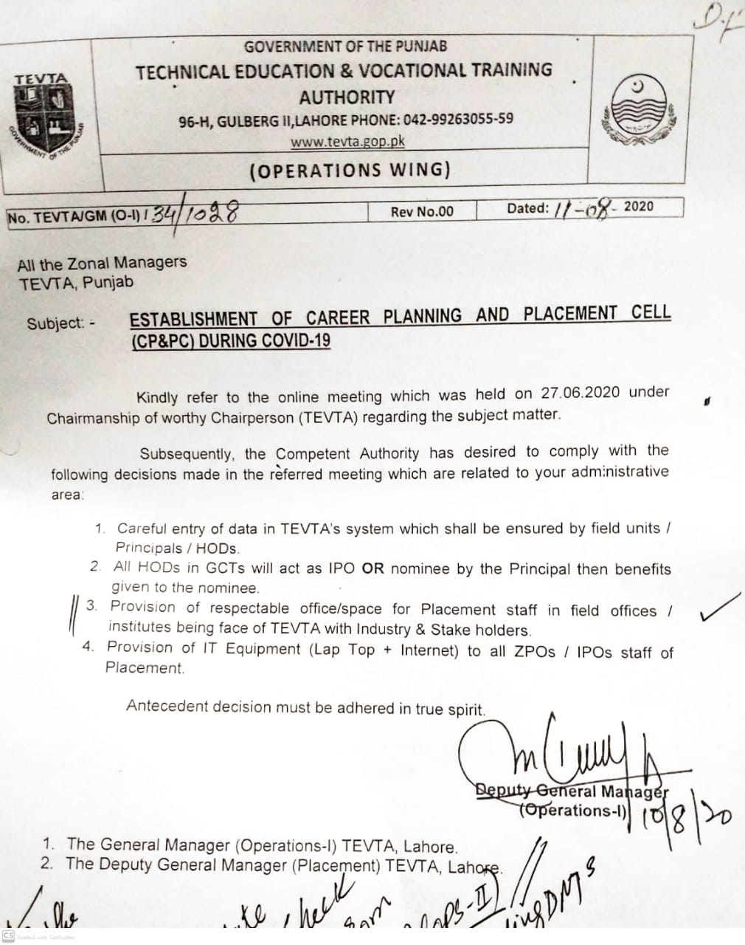
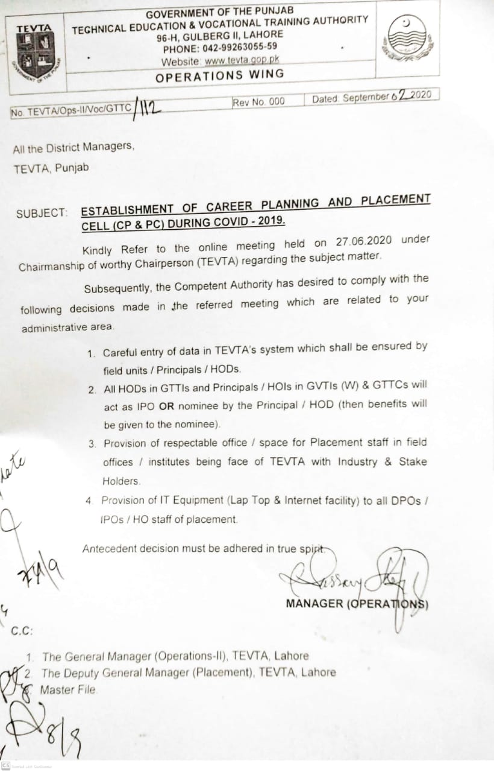
Structured Roles
OPS-I
Establishment of CP & PC
Career Division

Slide 11
INTERVENTIONS
01 – SIE Survey
ISIC Card - 07
01
100% Survey Study of Sundar Industrial Estate
International Student Identity Card (ISIC)
07
02
02 – Survey Studies
Online Dashboard - 05
Female Empowerment,
LTV Driving,
P&G
Data capturing of Placement Activity
06
03
03 – Student E-Life Cycle
Financial Assistance- 05
05
04
Digitization of student process
Prime Minister’s Kamyab Jawan – Youth Entrepreneurship Scheme (YES) for TEVTA trainees & Pass out
04 - Enterprenureship
Akhuwat Micro-financing
2000 trainees training on Hi-Tech courses

Slide 12
468
310
256
54
116
16157
5300
Industry
Response
Owned
Rented
HSE
HR Strength
Annual HR Demand
Survey
Summary
500-KW Power Consumption
87%
Chemical
Petro-Chemical
Pharmaceutical sector
Infrastructure
HR Strength
HR Demand
Demanding Trades
01
501-1000KW
11%
Textile
Garments
2%
1001-2000 KW
03
1%
Mechanical
Manufacturing
2000+ KW
04
05
Wood Working
Furniture Making
Institute
Institute
Institute
Institute
LHR
KSR
SIE
06
Institute
Hospitality
Services
Institute
Institute
Institute
Institute

Slide 13
Purpose of Course
Kind of Job Interested
Survey Results
Business Setup Training
13
Students Joined Style Textile
Financial Assistance Required
Further Studies
Job Location
Own
Interest
30k - 40K Avg
Salary Demand
Career Division

Slide 14
Survey Results
Purpose of Course
To Enhance Driving Skills
30
For Family Support
19
Get Driving License
Job Requirement
17
To Get Driving License
17
7
Preferred Online App
start own business
Own a Vehicle
30k - 40K Avg
Salary Demand
Career Division

Slide 15
Applicants vs Rejection
P & G Feedback
Total Applicants
748
Rejection Reasons
Applicants vs Rejection
Communication Skills
Standby
(Review Clearance)
Tech Evaluation
Invalid Data
Career Division

Slide 16
Digitization of Student Life Cycle
Alumni
Admission
5
Online Admission
Careers Dashboard
CV Builder
Employer Registration
Character Certificate
Integration with OEC
1
Registration
4
Integration with PBTE
Integration with TTB
Result Declaration
2
Integration with Qualification Awarding Bodies
Result Integrations
Detail Result Provisioning
Academic Activities
3
Online Attendance
Sendup Tests

Slide 17
Entrepreneurship
1991
TEVTA
1893
Employer
Enablers
Pass outs
43
PTDI
DBOM
16
IAC
Able Tech
14
BF Tech
13
Data Wiz
12

Slide 18
Entrepreneurship
Applications in Other Banks
APPROVED
29 cases
27.58M
Allied Bank 02
Askari Bank 01
Bank Alfallah 02
Bank of Khyber 01
Faysal Bank 02
Habib Bank 03
JS Bank 02
Meezan Bank 01
National Bank 03
United Bank 03
Rejected
166 cases
142M
Other Bank
20
Applic
In Process
93 cases
86.25M

Slide 19
Micro-financing for Entrepreneurs
28%
(Female)
2.48 Billion
Rupees disbursed
72%
(Male)
44,000 Beneficiaries
District Wise Beneficiaries
Business Sectors

Slide 20
Online Dashboard (Roles and Functions)
District Placement Officer
Administrator
01
Activity Submission
Guest Speaker Registration
Employer Validation
Job Seeker Validation
Overall Maintenance of System
Development of new modules
Support Provisioning to User
User control
07
02
Regional Head
Monitoring
Audit of submitted Activities
Monitoring of Regional Proformance
Super Audit of Submissions
Monitoring Employer Profiles
Monitoring Jobseeker Profiles
Reporting
Job Seeker
06
03
Registration
Profile Building
CV generation
Online Job Application
Reporting
Employer
Extraction of reports
Activity based
Employer based
User based
05
04
Registartion
Job Posting
Events Participation
(Campus Recruitment , Job Fair)
CV Bank
http://careers.tevta.gop.pk

Slide 21
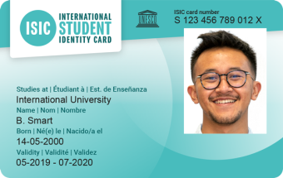
International Student Identity Card (ISIC)
Virtual Assistant
AI, SEO,
Digital
Marketing,
E-Commerce
Employer
Pass outs
200
71
DBOM
124
5
E-Rozgar Creative Designing & Web Development
IAC
Applicants
13 Card Delivered

Slide 22
ACHIEVEMENTS
Recruitment Drives 191
Atlas Honda LTD Sheikhupura
Service Industries Limited Gujrat
Honda Atlas Car Pvt. Ltd.
Nishat Hyundai
Vivo Mobile
Engro Foods
Jobfairs
Campus Recruitment Drives
Economic Opportunities
Economic Opportunities
MOU with Employers
Uber 3500 opportunities
Food panda 1000
Chezmall 1000
OEC 1200
Industrial survey Drive 5300
Integration with OEC 1200
NVC Contest
Online Careers Dashboard

Slide 23
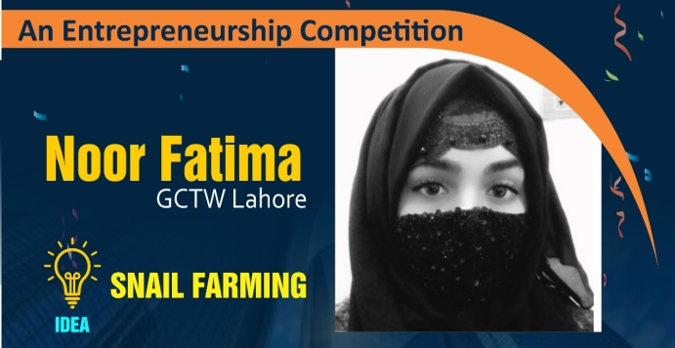
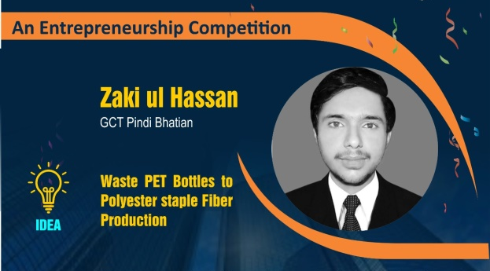
6 TEVTA Graduates Entrepreneur Ideas shortlisted
Career Division

Slide 24
3rd Position
$2,000
Career Division

Slide 25
Career Division
Career Counseling
7737
Activities
2712 Sessions
46191 Participants
96246
Participants
Guest Lecture
1171 Sessions
25066 Participants
5265
Job Placements
Recruitment Drives
Entrepreneur Startups (419)
191 Drives
115 Industries
7137 Participants
2192
Employers
Job Fairs
1096
Guest Speakers
06 Events
123 Industries
2934 Participants
Gender Wise Placement

Slide 26
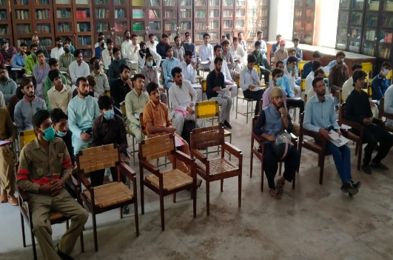
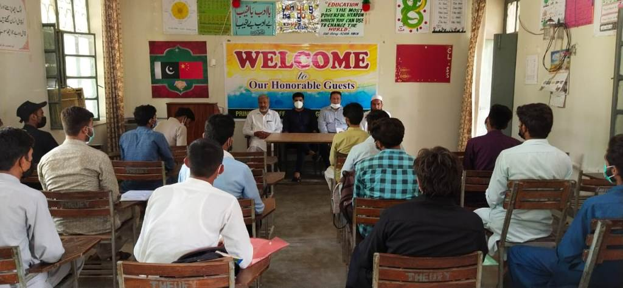
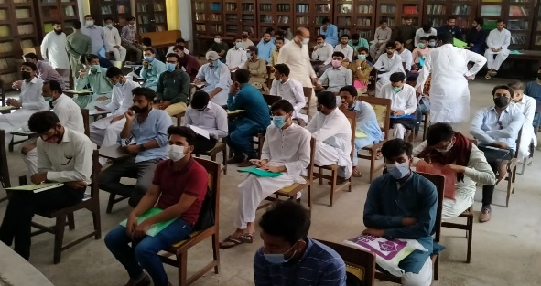
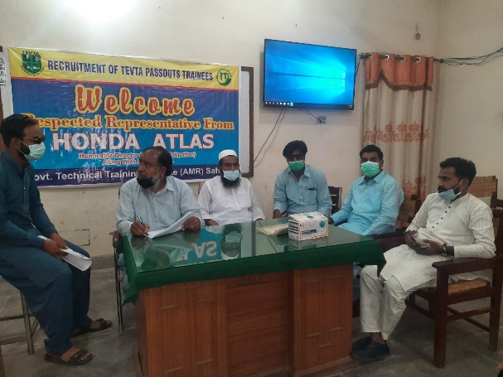
On Campus Recruitment Drives
191 Drives
115 Employers
7137 Participants
65 Institutes
788 Placements

Slide 27
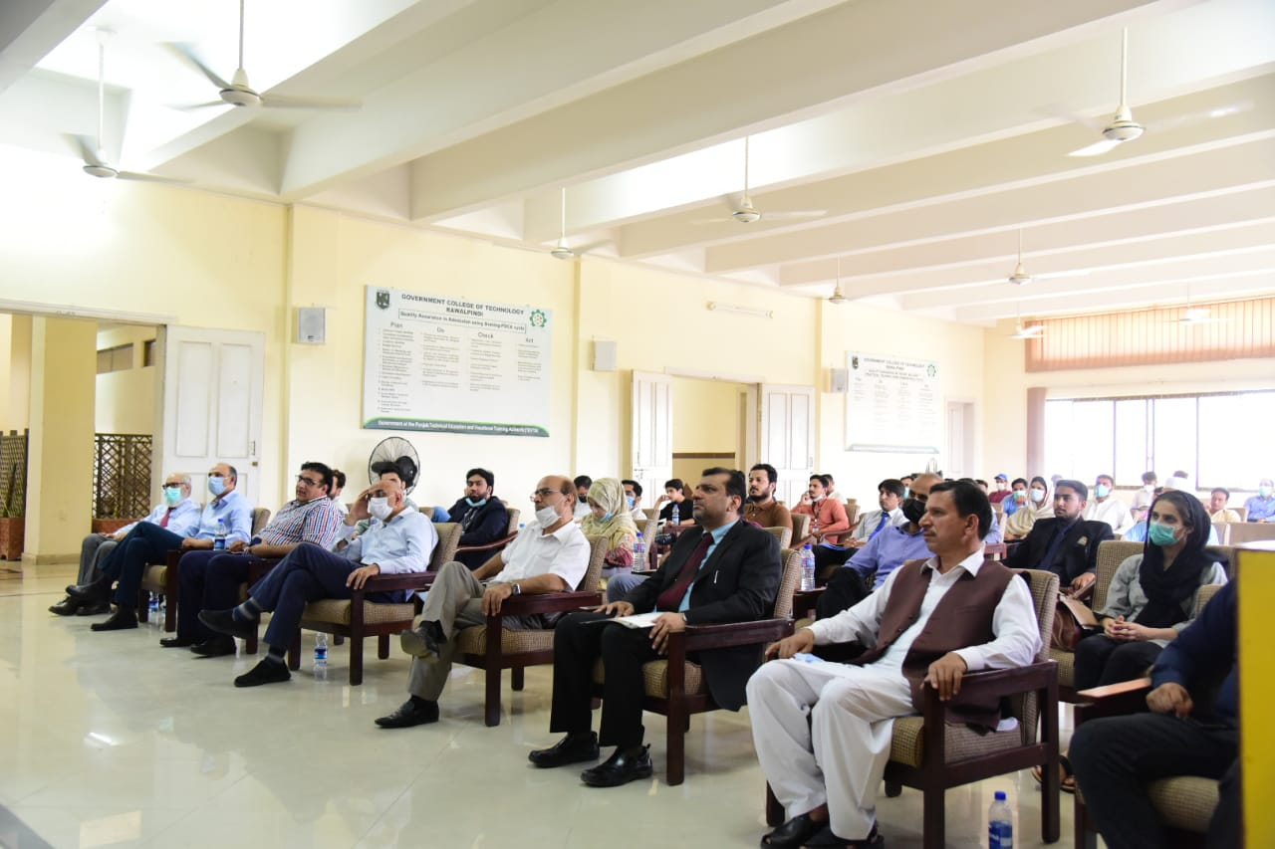
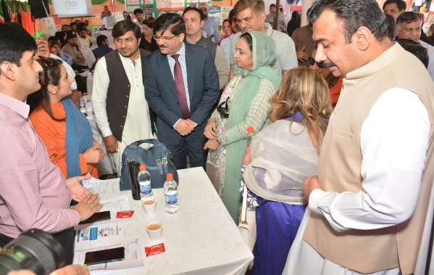
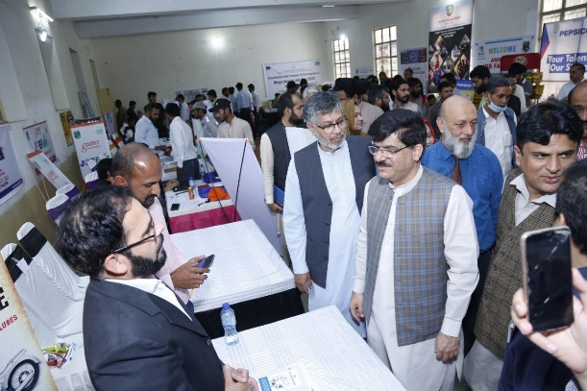
Job Fairs
Lahore Chamber of Commerce & Industry
Multan Chamber of Commerce & Industry
Faisalabad Chamber of Commerce & Industry
Rawalpindi Chamber of Commerce & Industry
6 Events
123 Employers
2934 Participants
Rawalpindi
Faisalabad
60 Institutes
Lahore
Venues
228 Placements
Multan

Slide 28
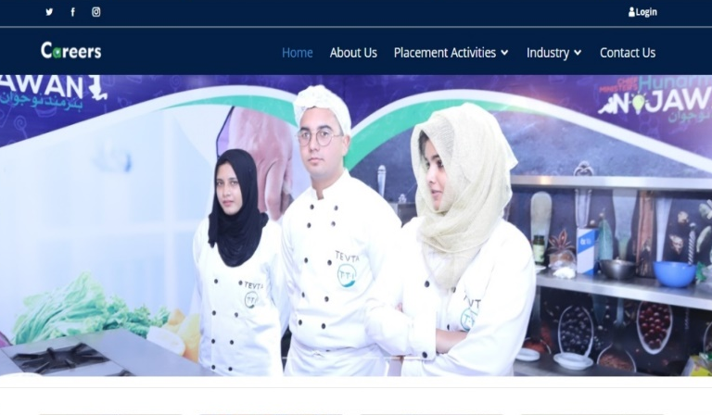
Online Placement Dashboard
Online Placement Dashboard for Each Tire.
Data Recording of Career Counseling Activities
Jobseeker Registration
Employer Registration
Jobs
Industrial Estates
News & Updates
SMS Alerts
Contact Center

Slide 29
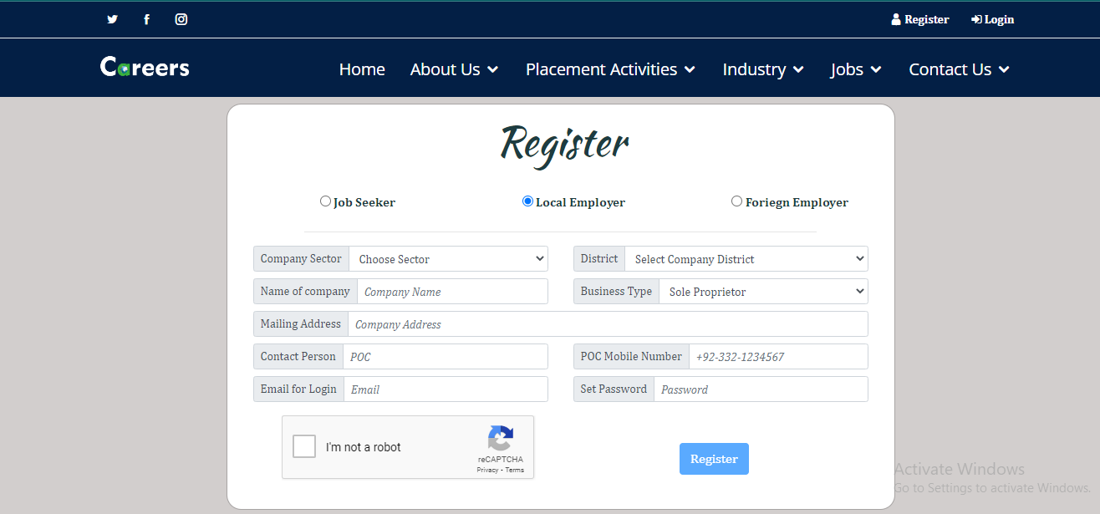
Employer Registration

Slide 30
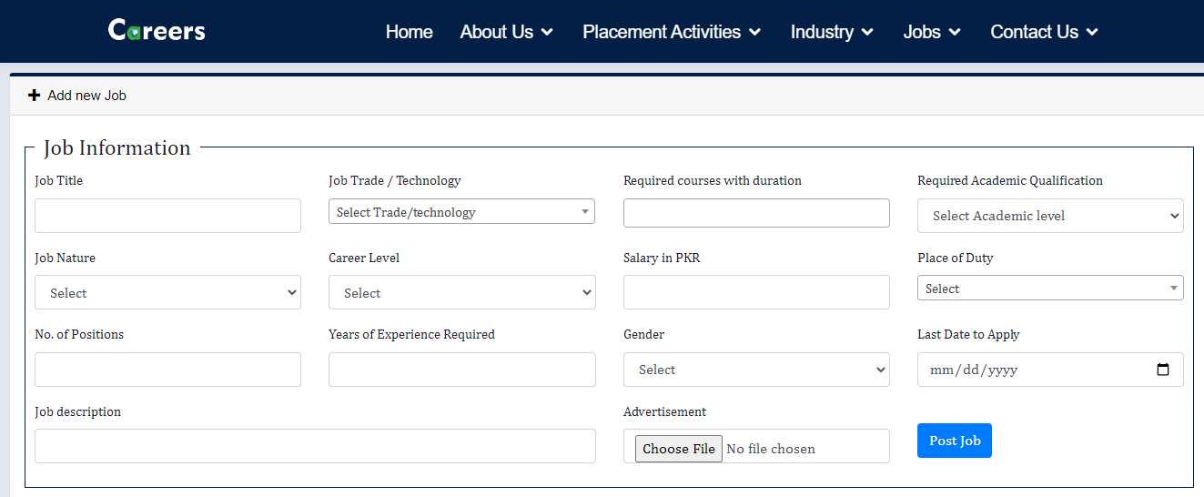
Jobs Posting

Slide 32
PITB Calling Activity
Answered
Higher Studies
Own Business
On Job
Jobseeker
6354
1070
481
1232
3571
Traceability Status

