Slide 1
1

Slide 2
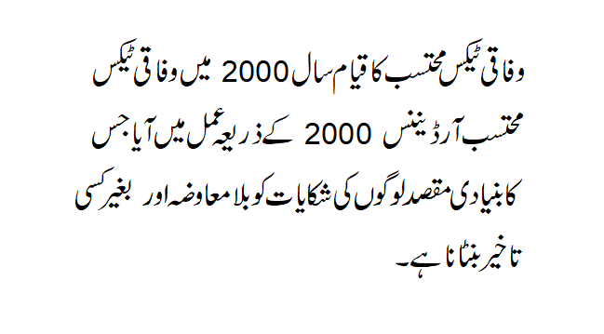
2

Slide 3
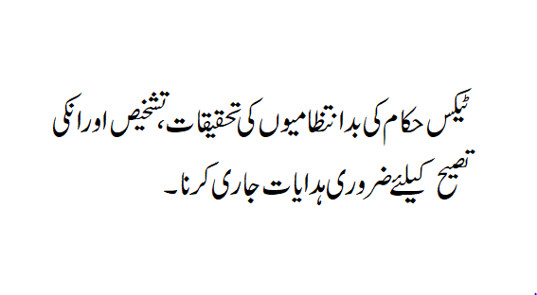
3

Slide 4
4

Slide 5
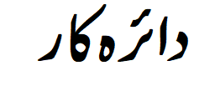
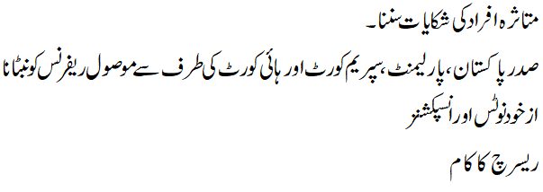
5

Slide 6
6

Slide 7
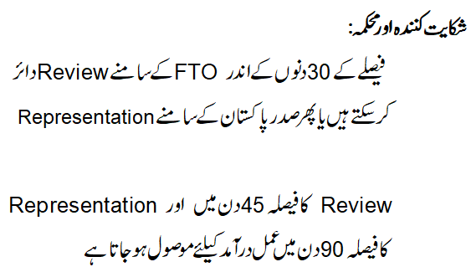
7

Slide 8
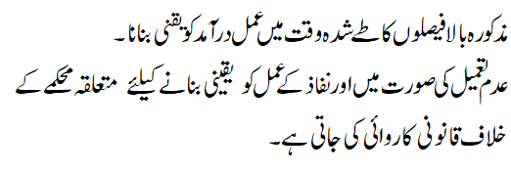
8

Slide 9
9

Slide 10
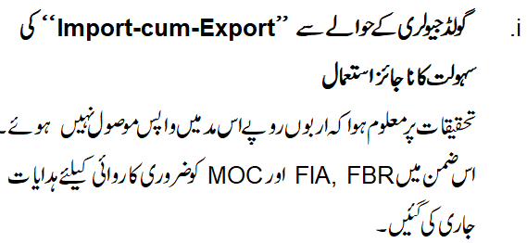
10

Slide 11
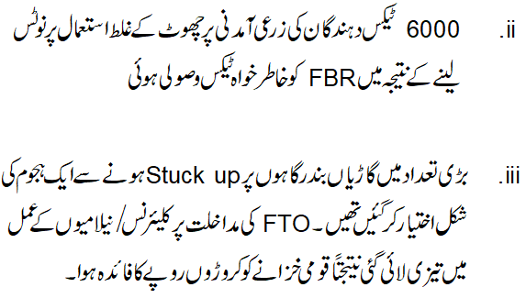

Slide 12
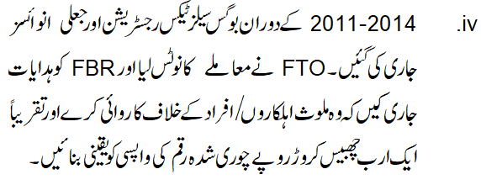

Slide 14
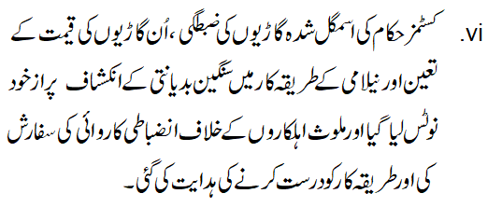

Slide 15
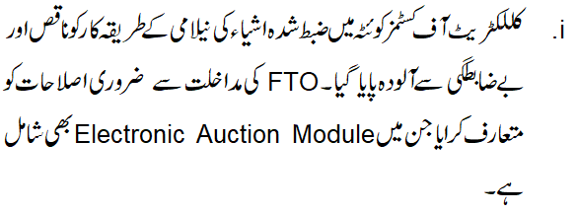

Slide 17
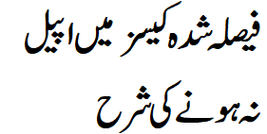
2021 | 2020 | 2019 | 2018 | 2017 | 2016
3371 | 3888 | 3171 | 2338 | 2101 | 2050
2867 | 3555 | 2633 | 1807 | 1860 | 1087
89.15% | 80.03% | 93.92% | 92.71% | 88.06% | 85.4%
10.85% | 19.9% | 6.08% | 7.29% | 11.09% | 14.6%

Slide 18
2021 Working Days | 2020 Working Days | 2019 Working Days | 2018 Working Days | 2017 Working Days | 2016 Working Days
41.6 | 48.61 | 41 | 45 | 47 | 49

Slide 19
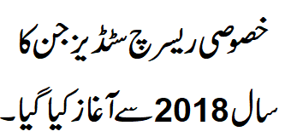
35
25
12
2018
2019
2020

Slide 20
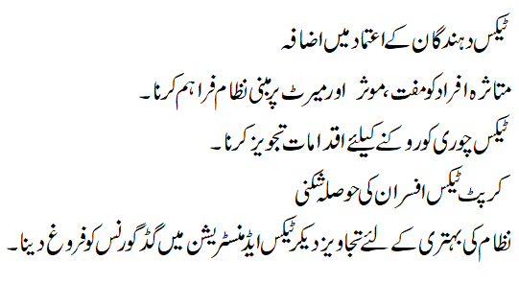
20

Slide 21
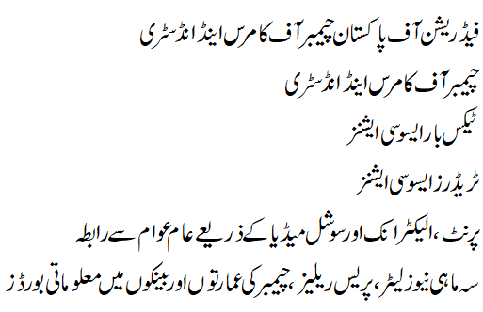

Slide 22
